Slide 1

Analysis of Trading Strategies
Zhaoyu Bai
Mar. 2025

Slide 2
Agenda
Introduction
01
Methodology
03
Results & Discussion
04
Conclusion & Future Work
05
Data Exploration
02

Slide 3
Introduction
Trading Bot Functionality:
Trading Bot functionality is now complete.
With this milestone achieved, we are ready to implement and test actual trading strategies.
MACD & Dynamic RSI Strategy Experiments:
Initiated experiments focusing on a MACD & Dynamic RSI strategy.
This detailed report covers the experiments, analysis, and insights derived from these strategies.

Slide 4
Introduction
Algorithmic Trading & Technical Indicators:
Automated trade execution using quantitative models.
MACD: Identifies trends by comparing moving averages.
RSI & Dynamic RSI: Measures momentum and adjusts thresholds based on market volatility.
Motivation & Objectives:
Optimize parameters for improved performance.
Validate strategy robustness through comprehensive backtesting.

Slide 5
Data Exploration
Data Cleaning & Checking
Feature Engineering

Slide 6
Data Cleaning & Checking Configurations
Data Cleaning Configuration (cleaner.json):
Ensures required labels (open_time, open, high, low, close, volume)
Validates data types, removes outliers (threshold = 20, adjacent_count = 7)
Applies UTC offset (3) with datetime format in milliseconds
Data Checker Configuration (checker.json):
Checks for missing data, duplicates, outliers, and logical consistency
Verifies expected data types (e.g., open_time as datetime64[ns, UTC], prices/volume as float32)

Slide 7

Data Exploration Overview
Data Source & Timeframe:
BTCUSDT data from Jan 2023 to Sep 2024 (15-minute intervals)
Feature Extraction:
Used SingleSymbolDataHandler & SingleSymbolFeatureExtractor
Key indicators: RSI, MACD (and its components), Stochastics, Bollinger Bands, ATR, VWAP, OBV, SMA, EMA, ADX, plus ‘close’ & ‘volume’

Slide 8
Derived Features & RSI Variance Analysis
RSI Variance & Range:
Calculated rolling RSI variance (window = 15)
Computed rolling RSI min & max (window = 30) to assess range
Price Volatility:
Rolling standard deviation of close prices (window = 15)
Insight:
Larger RSI variance (wider range) motivates the development of a dynamic RSI model to adapt thresholds in real-time

Slide 9
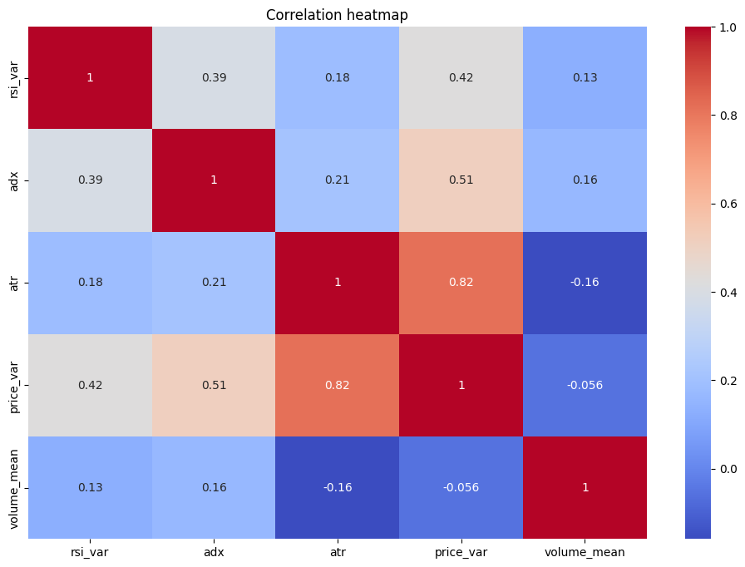
Correlation Heatmap with RSI variance
Correlation Analysis:Scaled indicators using MinMaxScaler for uniformity
Correlations observed among RSI-derived metrics (e.g., rsi_max, rsi_min, rsi_var)
Medium: price variance, adx
Small: ATR, Volume(rolling mean)

Slide 10
Implications & Dynamic RSI Model Development
Dynamic RSI Motivation:
Observed large variance in RSI supports dynamic adjustment of thresholds
Aims to adapt overbought/oversold levels based on current market volatility
Expected Benefits:
Improved signal responsiveness in sideways markets
Better risk management by reducing false signals and capturing market nuances

Slide 11
Methodology
Overall Setup & Data Configuration
Strategy Overviews
Experimental Process & Evaluation

Slide 12

Overall Setup & Data Configuration
Tools & Environment:
Python libraries (pandas, NumPy, matplotlib, scikit-learn, etc.)
Custom modules for data handling and feature extraction
Automated data cleaning via the trading bot (detailed later)

Slide 13
Overall Setup & Data Configuration
Data & Timeframe:
Symbol: BTCUSDT
Interval: 15 minutes
Example Date Ranges: 2023–2024 for initial tests; 2024–2025 for untouched data
Feature Set Parameters (from feature_set_15m.json):
RSI period: 3
MACD: short=15, long=30, signal=20
Additional indicators: Stochastics, Bollinger Bands, ATR, VWAP, OBV, SMA, EMA, ADX, etc.

Slide 14
Strategy Overviews
Strategy 1: MACD Histogram with Threshold
Compute MACD histogram (macd_diff)
Buy: When macd_diff > threshold
Sell: When macd_diff < –threshold
Full capital invested; performance metrics computed

Slide 15
Strategy Overviews
Strategy 2: MACD with Trend Confirmation
Combine MACD signals with ADX for trend validation
Buy: When macd_diff > threshold and ADX ≥ 45
Sell: When macd_diff < –threshold while ADX confirms trend

Slide 16
Strategy Overviews
Strategy 3: Dynamic RSI on Sideways Markets
Active only when market is non-trending (ADX below threshold)
Calculate dynamic RSI thresholds using rolling mean and standard deviation
Buy: When RSI falls below the dynamic lower boundary
Sell: When RSI rises above the dynamic upper boundary

Slide 17
Strategy Overviews
Strategy 4: Combined Strategy (Dynamic RSI + MACD)
Regime-based approach using ADX:
Dynamic RSI Regime: When ADX < rsi_trend_threshold (≈20–23)
MACD Regime: When ADX > adx_macd_threshold (≈45)
Undefined Region: Optionally use SSTI to trigger exits
Integrates benefits of both strategies while addressing conflicts and noise

Slide 18
Experimental Process & Evaluation
Backtesting:
Simulate trades over historical data
Track capital evolution and record trade details
Performance Metrics:
Total ROI, Max Drawdown, Sharpe/Sortino Ratios
Trade Efficiency, Win Rate, Profit Attribution, Risk Reward Ratio
Visualization:
Generate charts comparing price evolution and capital growth over time

Slide 19
Strategy Performance Overview
Overall Setup & Data Configuration
Strategy Overviews
Experimental Process & Evaluation

Slide 20
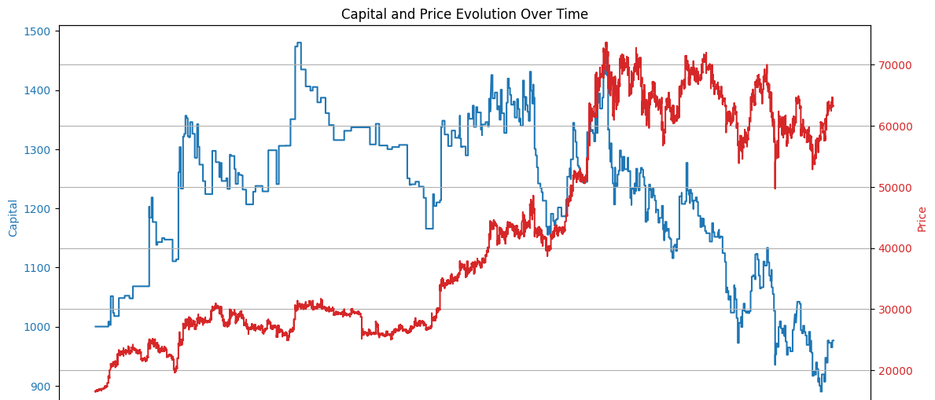
Strategy Performance
Strategy 1: MACD Histogram with Threshold
ROI: ~ -2.36%
Max Drawdown: ~39.87%
Note: Despite a high underlying asset gain (Symbol ROI ~282.88%), frequent trades and noise lead to negative overall performance.

Slide 21
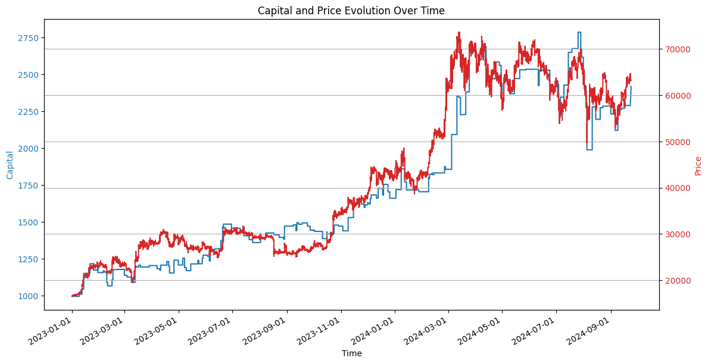
Strategy Performance
Strategy 2: MACD with Trend Confirmation
ROI: ~142%
Max Drawdown: ~28.64%
ADX filter (threshold ≥45) improved performance by excluding trades in non-trending periods.

Slide 22
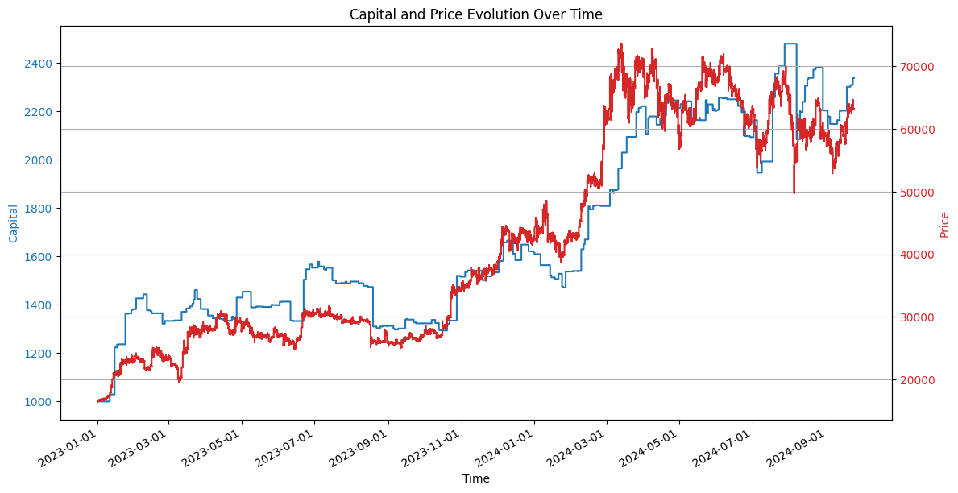
Strategy Performance
Strategy 3: Dynamic RSI on Sideways Markets
ROI: ~133.73%
Max Drawdown: ~18.04%
Higher win rate (~57%) due to adaptive RSI thresholds that adjust to market volatility.

Slide 23
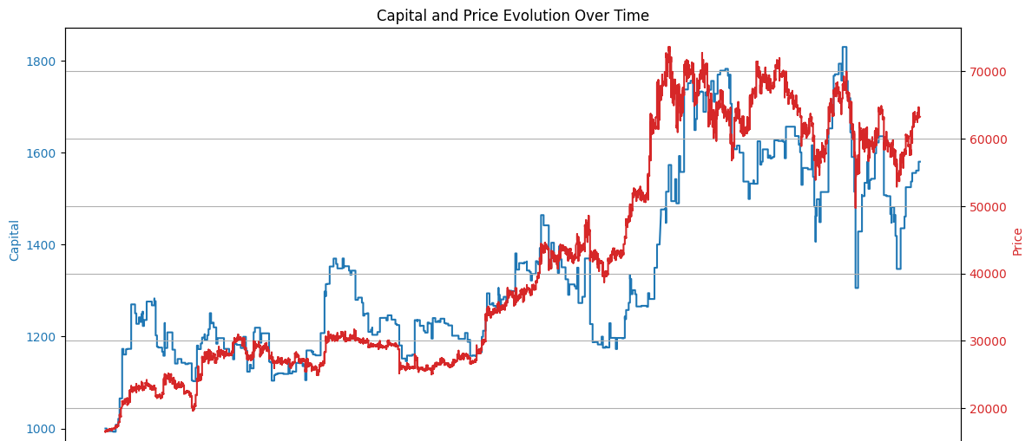
Strategy Performance
Strategy 4: Combined Strategy (Dynamic RSI + MACD)
Mixed outcomes:
Variant 1: ROI ~58%
Variant 2 (with SSTI exit): ROI ~5.29%
Complexity may cause signal conflicts and potential overfitting.

Slide 24
Comparative Analysis
Risk Profile & Volatility:
RSI strategy shows a lower maximum drawdown and higher win rate compared to MACD.
Provides more consistent, less volatile performance.
ROI & Risk-Adjusted Returns:
Both strategies deliver high ROI figures.
Low Sharpe ratios indicate that high returns might not adequately compensate for risk.

Slide 25
Comparative Analysis
Trade Efficiency & Robustness:
RSI strategy offers better trade efficiency.
RSI models are more robust under fine tuning, enhancing performance stability.
Overall Effectiveness:
Despite slightly lower ROI, the improved drawdown profile, higher win rate, and robustness make the RSI strategy potentially more attractive for risk-conscious traders.
Balancing profit capture with loss control is key to long-term trading success.

Slide 26
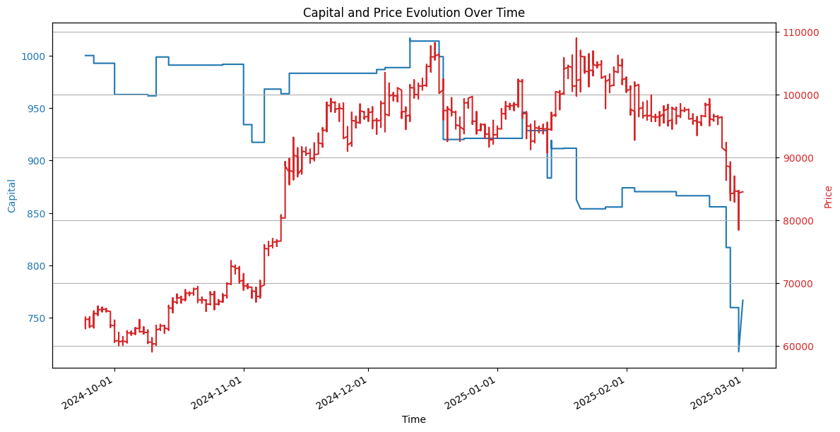
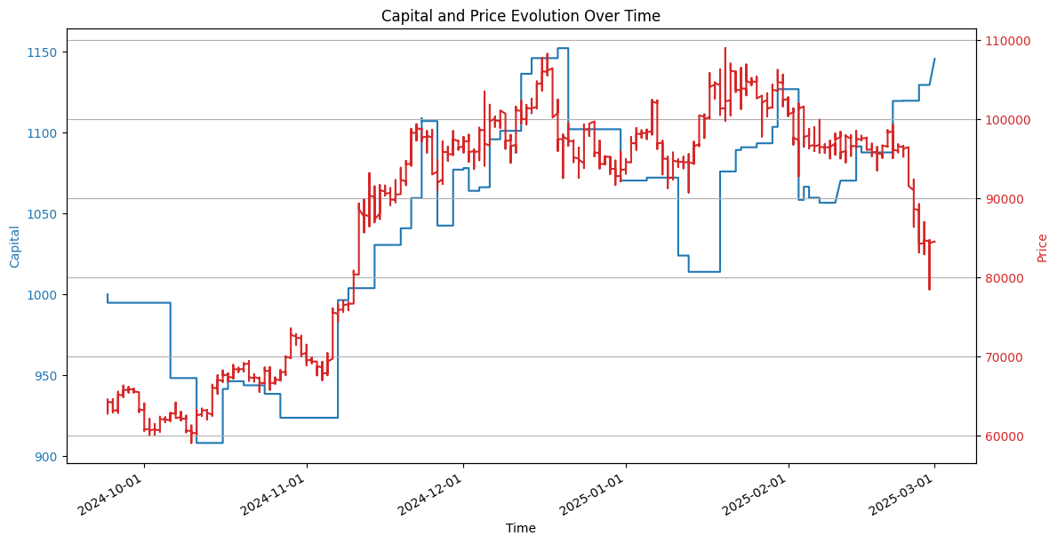
Back test on Unseen Data – Robustness
MACD + ADX confirmation
RSI + ADX confirmation

Slide 27
More Attempts on Dynamical RSI
Motivated by the discovery
Machine Learning on RSI thresholds
Alternative Dynamical Threshold model

Slide 28
Random Forest Modeling for RSI Thresholds
Target: Predict dynamic RSI max and min using features explored (price variance, adx, atr, volume mean, etc.)
Validation: TimeSeriesSplit & GridSearchCV (R² ~0.78 with MSE around 2.72)
Observation: RF predictions are similar to simple rolling window values.

Slide 29
Alternative Dynamic Threshold Methods
Median-Based Adjustment:
Use historical median with margin (mae) adjustments.
Dynamic Zone Approach:
Rolling RSI mean ± k * standard deviation (clipped within realistic RSI limits).
Volatility-Linked Model:
Adjust thresholds based on ATR and price variation.

Slide 30
Trading Strategy Performance
RF-based model: Modest ROI, inconsistent signals.
Alternative methods:
ROI improvements from ~30% to 198%.
Lower drawdowns and improved trade efficiency.
The Dynamical Zone performs the best

Slide 31
Using The Backtest Module
To mimic the real-time trading environment
Testing Robustness of strategies

Slide 32
Overview
To reflect real-world trading conditions more accurately than an idealized backtest:
Maximum Window Storage: Limits on historical data storage.
Incremental Calculation: Real-time updating of indicator values.
Rounding of Amounts: Values are rounded to three digits (an empirically chosen setting for cryptocurrency volatility) to mitigate issues caused by lag-induced price fluctuations.

Slide 33
RSI+ADX Strategy Performance Comparison
Real-Time Mimic Results
Ideal Notebook Results
ROI: 154.40%
Max Drawdown: 17.08%
Sharpe Ratio: 0.00909
Win Rate: 14.16%
Profit Factor: 1.626
Avg Trade Return: 8.99%
ROI: 133.73%
Max Drawdown: 18.04%
Sharpe Ratio: 0.00807
Win Rate: 57.29%
Trade Efficiency: 20.57%
Observations: Comparable ROI and drawdowns indicate robustness.
The discrepancy in win rate may reflect execution differences (there are small trades opened due to the rounding).

Slide 34
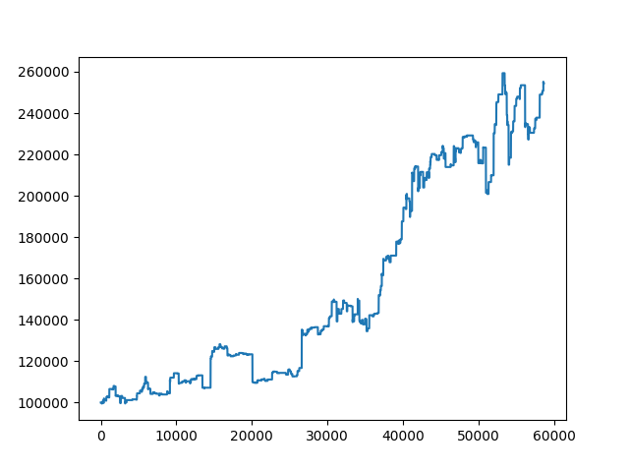
RSI+ADX Strategy Performance Comparison
Real-Time Mimic Results
Ideal Notebook Results

Slide 35
MACD+ADX Strategy Performance Comparison
Real-Time Mimic Results
Ideal Notebook Results
ROI: 81.51%
Max Drawdown: 26.20%
Sharpe Ratio: 0.00564
Win Rate: 17.26%
Profit Factor: 1.391
Avg Trade Return: 20.83%
ROI: 142.00%
Max Drawdown: 28.64%
Sharpe Ratio: 0.00817
Win Rate: 44.74%
Trade Efficiency: 15.83%
Significant performance drop in real-time mimic.
MACD+ADX appears more sensitive to incremental updates and rounding.

Slide 36
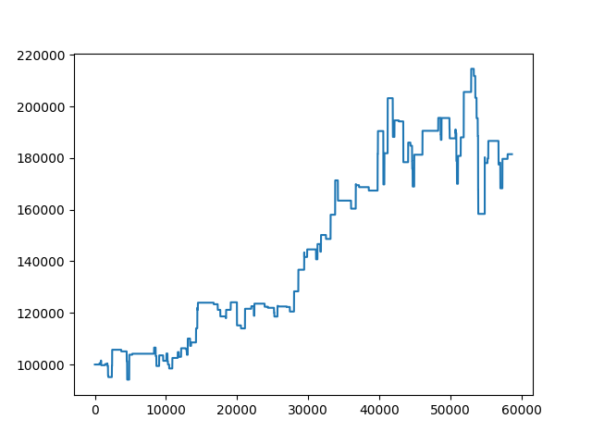
RSI+ADX Strategy Performance Comparison
Real-Time Mimic Results
Ideal Notebook Results

Slide 37
Comparative Analysis
RSI+ADX Strategy:
Robust performance across environments.
Slight differences in win rate; overall high ROI and low drawdown.
MACD+ADX Strategy:
Strong in ideal tests, but affected by real-time constraints.
Lower ROI and win rate in real-time simulation.
General Insights:
Real-time mimic simulates practical constraints (window storage, incremental calculation, rounding).
Highlights the need for strategy optimization under live conditions.

Slide 38
Conclusion & Future work
To mimic the real-time trading environment
Testing Robustness of strategies

Slide 39
Key Findings & Strategy Insights
RSI+ADX Strategy:
Robust performance across both ideal and real-time environments.
Consistent ROI with lower maximum drawdown.
Better risk management and adaptability through dynamic thresholds.
MACD+ADX Strategy:
Strong performance in ideal backtests.
Sensitive to real-time constraints (incremental updates, rounding), leading to reduced ROI and win rate.
Dynamic RSI Models:
Machine Learning (Random Forest) shows okay R² but does not work well on backtesting.
Simpler statistical methods (median-based, dynamic zones, volatility-linked) often yield competitive or superior results.

Slide 40
Implications for Live Trading
Real-Time Adaptation:
Incremental calculation and limited window storage mimic live conditions.
Rounding of trade amounts (3-digit precision) reduces execution noise.
Strategy Suitability:
RSI+ADX proves more robust and effective for live trading.
MACD+ADX may need further optimization to overcome real-time execution challenges.

Slide 41
Limitations & Future Directions
Model Sensitivity:
ML models are sensitive to small target scales; simpler methods may be more practical.
MACD+ADX strategy’s performance drops under real-time conditions.
Future Work:
Refine hyperparameters and explore ensemble methods.
Expand testing to multi-asset portfolios and varied market regimes.
Integrate with live market data for further validation.

Slide 42
Final Conclusion
Dynamic RSI models that adapt to market volatility offer improved risk management.
RSI+ADX strategy emerges as a robust candidate for real-world trading.
Testing under realistic conditions is crucial to ensure strategies perform well live.
Future research will focus on optimizing strategies and mitigating real-time execution issues.

Slide 43
Future Works
Invent Customized Indicators:
Develop bespoke indicators tailored to specific market regimes.
Combine traditional technical indicators with novel measures (e.g., sentiment, liquidity, and order flow).
Enhance Machine Learning Models:
Adapt ensemble methods (e.g., boosting, bagging) to predict dynamic RSI thresholds more robustly.
Explore deep learning architectures (e.g., LSTM networks) for capturing temporal dependencies.

Slide 44
Future Works
Expand to Multi-Asset Portfolios:
Extend dynamic RSI models to multi-asset or sector-based strategies.
Incorporate cross-market correlations to optimize risk and diversification.
Integrate Alternative Data Sources:
Include alternative data (news sentiment, social media signals, blockchain metrics) to refine indicator thresholds.
Use real-time economic and financial data feeds to adapt strategies dynamically.

Slide 45
Future Works
Robust Risk Management
Investigate adaptive stop-loss and take-profit mechanisms integrated with dynamic indicators.
Backtesting & Simulation Enhancements
Incorporate realistic transaction cost models and slippage.
Develop risk-adjusted performance metrics that account for transaction costs and slippage.
Implement simulation frameworks that allow for stress testing under extreme market conditions.

