Slide 1
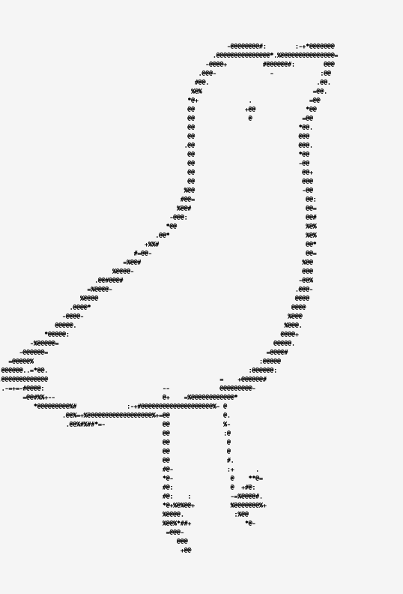
Birb
Notes:
NOTES: have window up on screen everyone can see, have 2nd window down here to type on lmao

Slide 2
Audience Volunteer
Notes:
Click on yellow file, will pull up supercollider. Have them try and get it running, let them play with it for a bit if they do

Slide 3
How did that go?
PROS:
UI intuitive
Sounds cool
CONS:
Implementation sucked
Not interactive enough
Could use more parameters
Notes:
Type audience thoughts on my side

Slide 4
My THoughts
PROS:
Simple
Accessible
UI
CONS:
Confusion/error
Reverb
Clarity
Window resize
Notes:
Pros:
Technically, it’s very simple. There’s just parentheses around everything, so you just have to put it on the server and then play it
Pretty accessible to someone who doesn’t know a lot:
don’t have to go trawling through all the synthdefs to make sure each one gets put on the server,
don’t have to make sure you’re playing each thing at the right time
Cons:
It’s confusing to have the UI show up when it isn’t actually ready to play yet — you have to cmd-enter 2x to get it to work
They had their own personal reverb in there, which I had to replace with a supercollider ugen (freeverb), which was a little confusing. But they’re very up-front about that on their github page

Slide 5
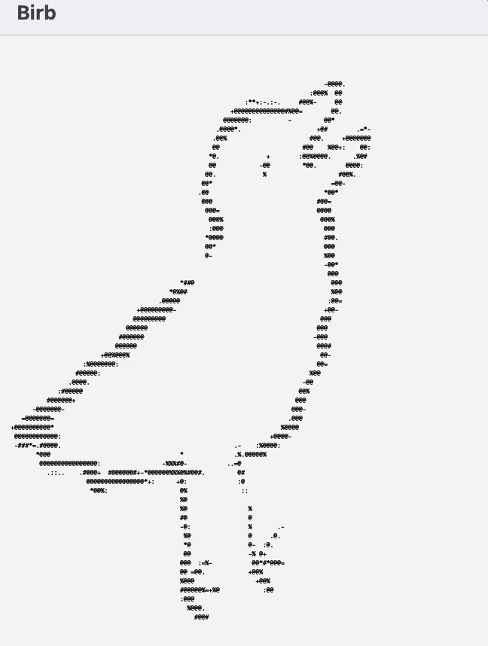
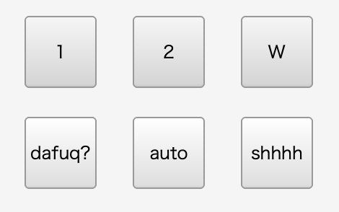
The UI
Notes:
I’m going to focus mostly on the UI bc that’s why I chose this project over the other ones I looked at. We haven’t really talked about that in class, plus it makes it WAY more accessible to someone like me who doesn’t have a lot of experience in supercollider, and I think it’s more fun to show my friends and people who really don’t know anything about tech.
The look of the UI here is great — super simple, super old-school. The bird especially works for me
Like imagine what it would look like with anything else

Slide 6
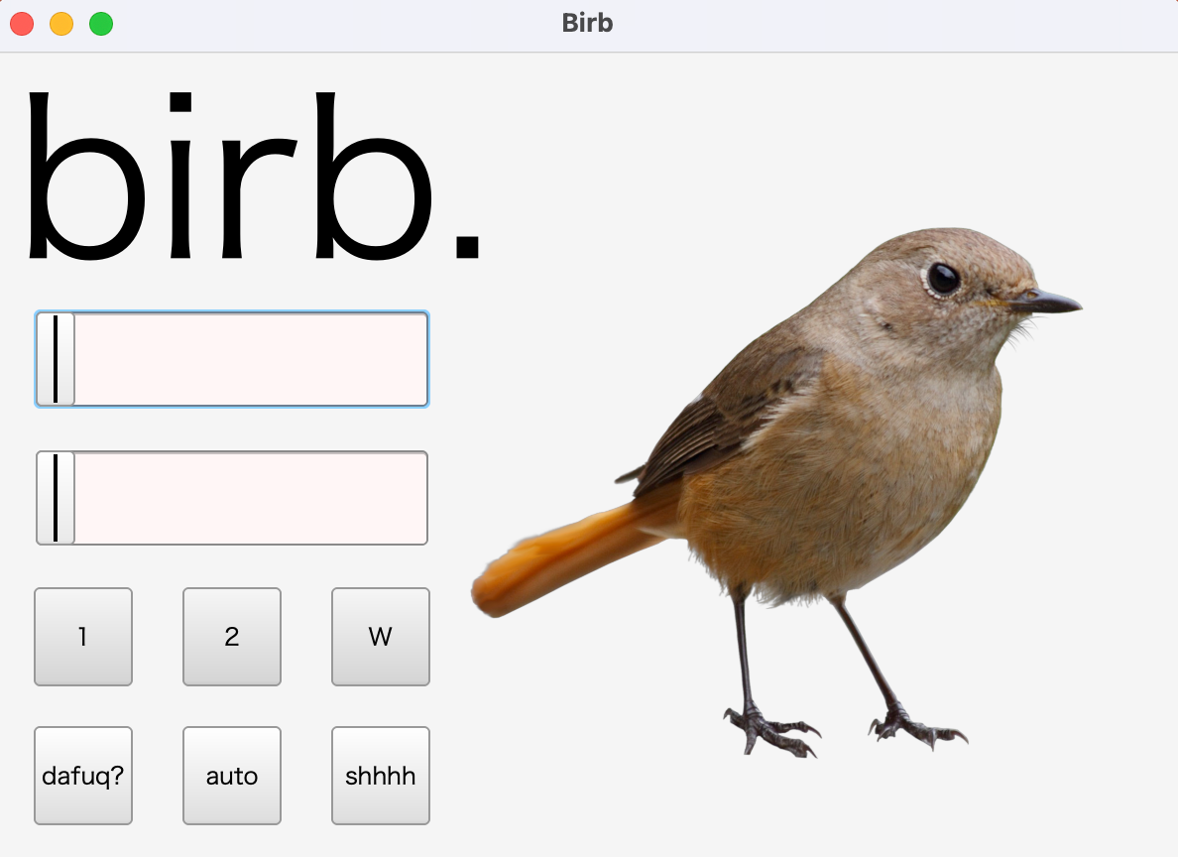

Slide 7
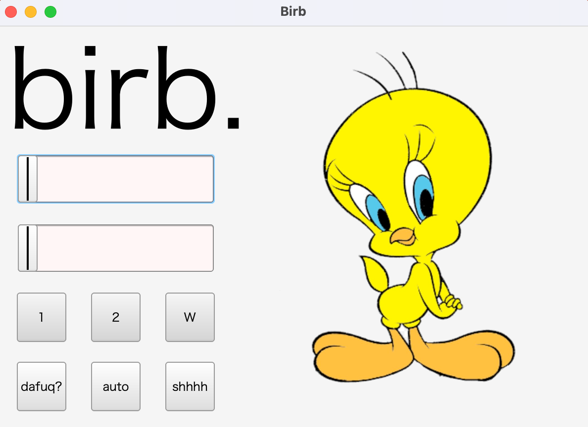

Slide 8
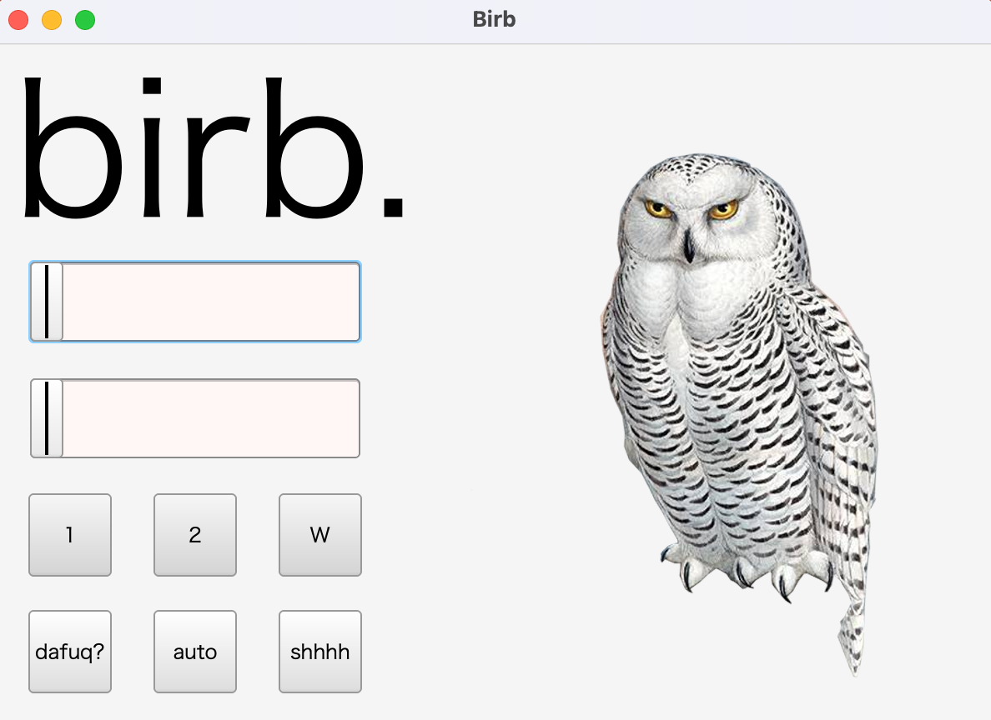

Slide 9
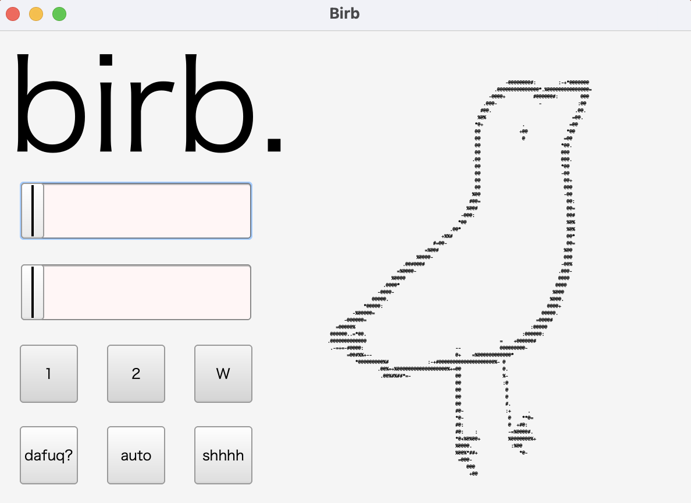

Slide 10
How?
Notes:
Open sc doc again on main screen, look at notes on mine
Well-organized
Audio at top, UI at bottom
Very linear
Ex. buttons call functions below them
Easy to read
Images
(go down to images)
Return to presentation

Slide 11
Array “birdStrings”
Func “drawBird”
Button
Notes:
Array is called by function which is called by button
One exception — the auto button, which calls separate function “rout” that repeatedly calls drawbird in a loop

Slide 12
Questions

