Slide 1
An Analysis of Depeche Mode’s Discography
By Zachary Chipman
IST652 Fall 2021

Slide 2
Introduction and Data Questions
Motivation:
Depeche Mode is one of my favorite bands of all time.
They are known for making songs with dark themes, and I wanted to see if a sentiment analysis supported that assumption.
Data Questions:
What is the overall sentiment of Depeche Mode’s discography?
How does the sentiment change from album to album?
Does the sentiment of an album reflect its popularity?
What are the most frequent words in each album and do the results reflect the sentiment of that album?

Slide 3
Data Sources
Lyrics
https://www.lyrics.com/
Scraped the original track listing from their 14 studio albums (1980-2017)
Chart Position
http://archives.depechemode.com/discography/
For each album, I scraped the album’s name as well as its top position on the UK and US album charts.
Both sources were scraped using BeautifulSoup

Slide 4
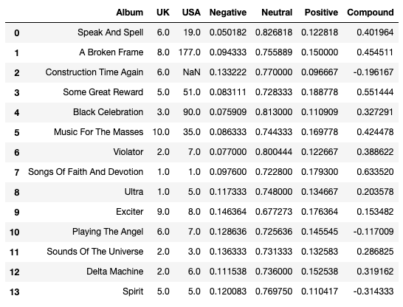
Data Preparation
Created a list for the album names and the two chart positions.
Defined each album as a list where each element was a song from that album.
Used the SentimentIntensityAnalyzer from nltk to perform a sentiment analysis on each song. From these results, I created two sets of four lists (one for each sentiment type).
The first set contained all the songs in the discography (Question 1) while the second set contained the average scores for each album (Questions 2-3).
Created a Pandas data frame to help with analysis and visualization.
To answer Question 4, I would later tokenize each album using the “genism” package.

Slide 5
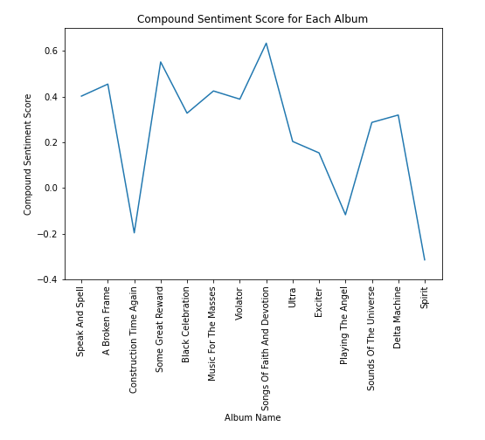
Sentiment Analysis
Overall Sentiment Scores:
Negative: 0.11 (11%)
Neutral: 0.75 (75%)
Positive: 0.14 (14%)
Compound: 0.24
The overall sentiment of Depeche Mode’s discography (and all but 3 albums) is positive.

Slide 6
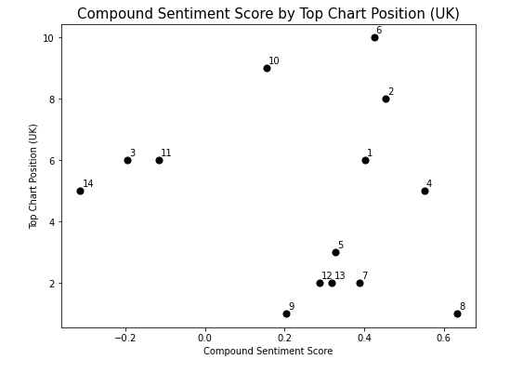
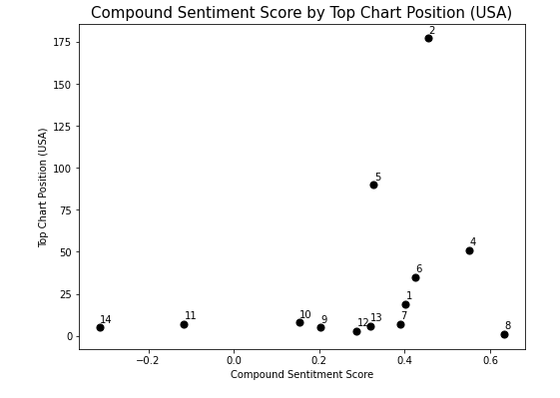
Sentiment Analysis con.

Slide 7
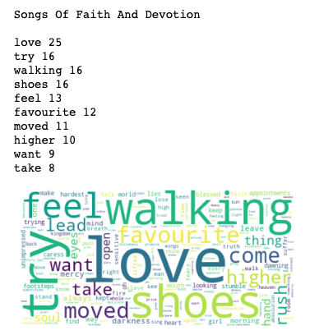
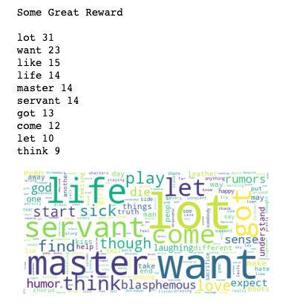
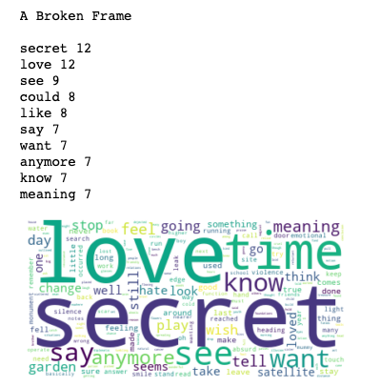
Word Frequencies (Top 3 Positive Albums)

Slide 8
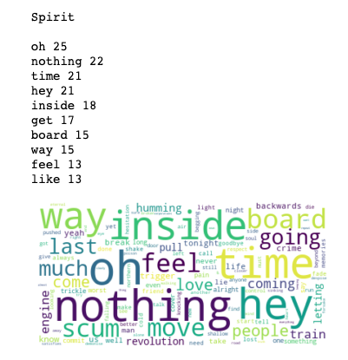
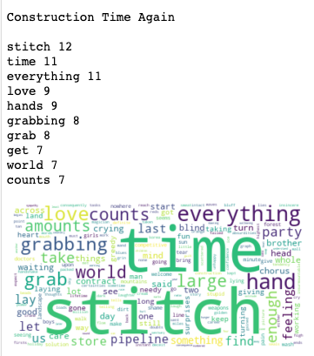
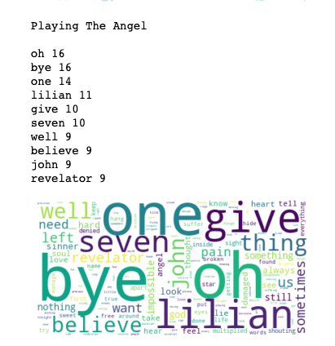
Word Frequencies (Top 3 Negative Albums)

Slide 9
Conclusions and Next Steps
Conclusions:
Since “love” is a major theme in many Depeche Mode songs, the sentiment of their discography skews positive.
The ambiguity of lyrics and the lack of music makes songs hard to analyze.
The sentiment of an album does not correlate to its popularity.
Next Steps:
Experiment with different sentiment analysis tools.
Try using n-grams.
Compare singles to non-singles.

Slide 10
Sources and References
Main sources of data:
https://www.lyrics.com/
http://archives.depechemode.com/discography/
Referenced for my sentiment analysis code and some of my plots:
https://towardsdatascience.com/how-to-analyze-emotions-and-words-of-the-lyrics-from-your-favorite-music-artist-bbca10411283
Referenced to help create the word clouds:
https://www.analyticsvidhya.com/blog/2021/05/how-to-build-word-cloud-in-python/
Helped with some of the plot features:
https://www.delftstack.com/howto/matplotlib/matplotlib-label-scatter-plot-points/
Resources for the "gensim" module:
https://radimrehurek.com/gensim/
https://towardsdatascience.com/5-simple-ways-to-tokenize-text-in-python-92c6804edfc4

Slide 11
THANK YOU!
Any Questions?

