Slide 1
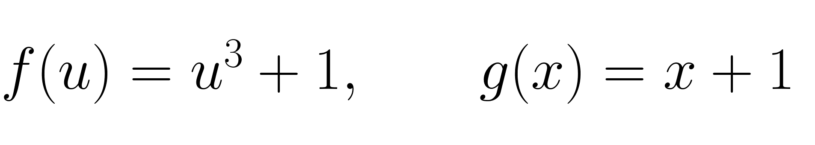

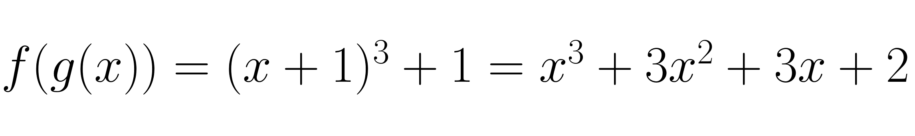
Section 0.3 Composition of functions
Board Work
Composition means: do one function, then the other.
x
g(x)
f(g(x))
Example
Find
At the board:
35

Slide 2
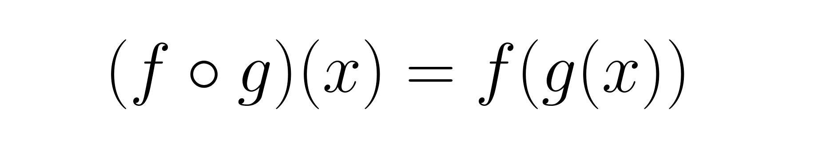
Important Theory
When is a composition defined?
Two checks:
1. x must be allowed as an input to g.
2. g(x) must be allowed as an input to f.
x
g(x)
f(g(x))
If either step fails, f ∘ g is not defined at x.
36

Slide 3





Important Theory
Inverse Functions (反函数)
An inverse function undoes the original function.
$$x$$
$$f\left(x\right)=y$$
$$f^{−1}\left(y\right)=x$$
The defining identities
Important: $f^{−1}(x)$ does NOT mean $1/f(x)$.
37

Slide 4


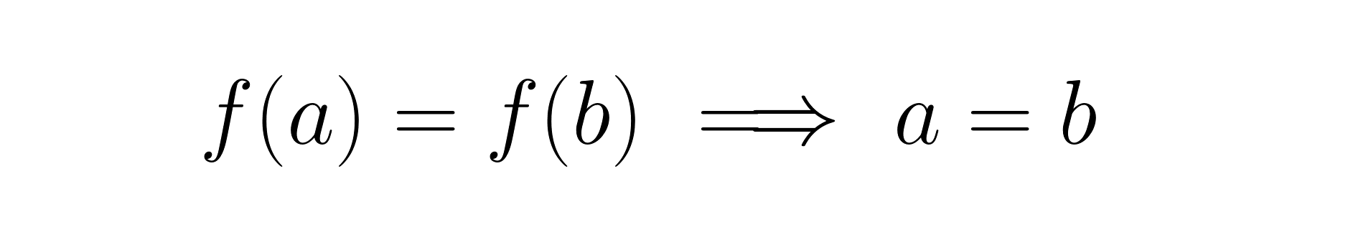
Important Theory
Why does $x^{2}$ have no inverse on all real numbers?
Two different inputs give the same output.
One-to-one
Each output comes from at most one input.
A function can have an inverse only if it is one-to-one.
38

Slide 5





Board Work
Theorem
A function has an inverse if and only if it is one-to-one.
Example 3.3 — Find an inverse
Board method:
Check:
Graph idea: $f$ and $f^{−1}$ are reflections across $y=x$.
Next slide: see the reflection.
39

Slide 6
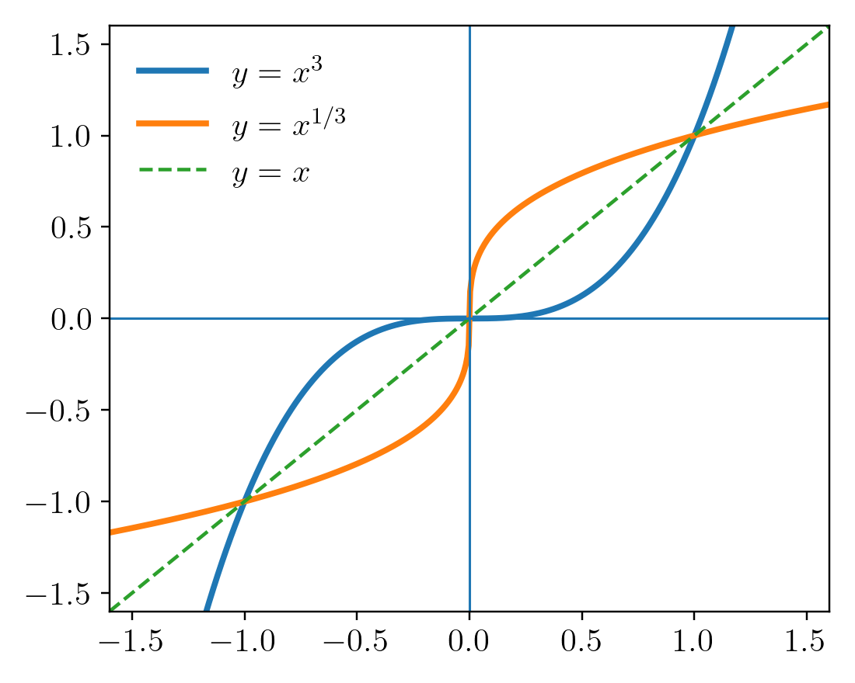

Reference
Graphs of a function and its inverse
Reflection rule
The line y=x is the mirror.
This geometric fact is often the fastest way to sketch f⁻¹.
40

Slide 7
Section 0.4 Trigonometric (三角函数) and Inverse Trigonometric Functions (反三角函数)
Reference
Why trigonometric functions?
They model repeating / oscillating behavior.
Signals
Waves
Measurements
radar • communication
sound • light
cycles • sensors
For calculus, the key ideas are periodicity, identities, and inverse trig functions.
41

Slide 8



Important Theory
Remark: When we discuss the period of a function, we most often focus on the fundamental period.
Periodic means: the pattern repeats.
The fundamental period is the smallest positive T that works.
Sine
Cosine
Fundamental period of sin and cos: 2π.
42

Slide 9






Reference
Four related trigonometric functions
The denominator tells you where the function is undefined.
43

Slide 10



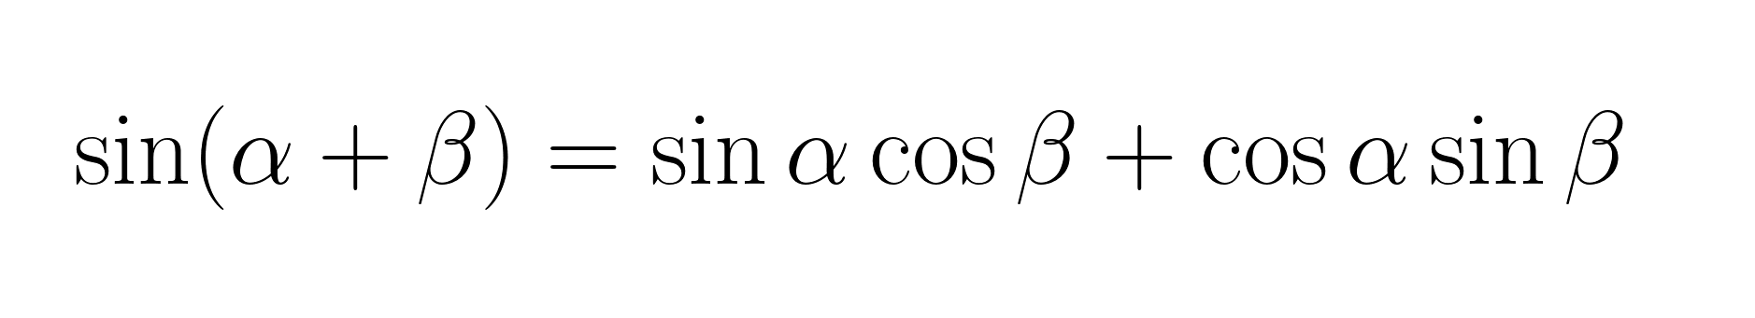
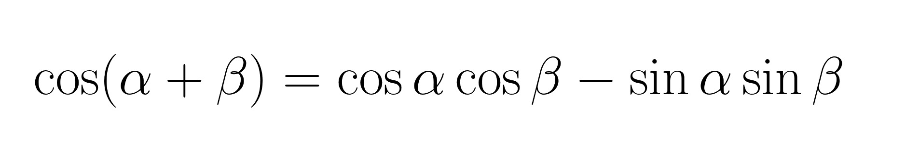


Reference
Trig identities worth recognizing
Reference slide — use identities when they simplify a later calculation.
44

Slide 11

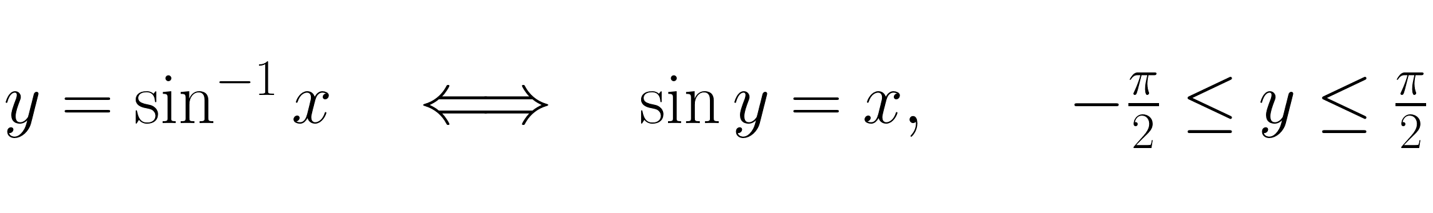
Important Theory
The Inverse Trigonometric Functions
Sine is not one-to-one on all real numbers.
Restrict its domain:
Inverse Sine Function
It is not $\frac{1}{sin x}$ — that function is $csc x$.
45

Slide 12
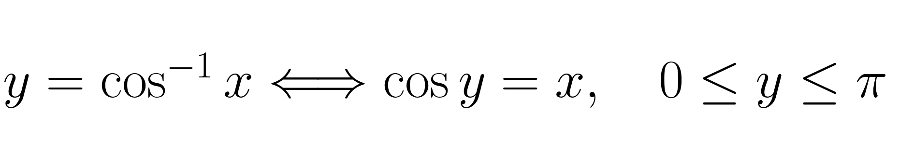
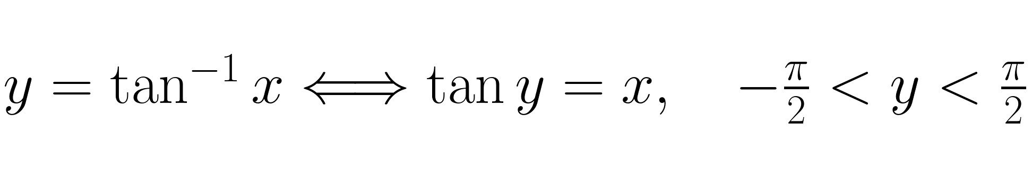





Board Work
Principal-value ranges
Example 4.10
Simplify:
Draw a right triangle with
46

Slide 13

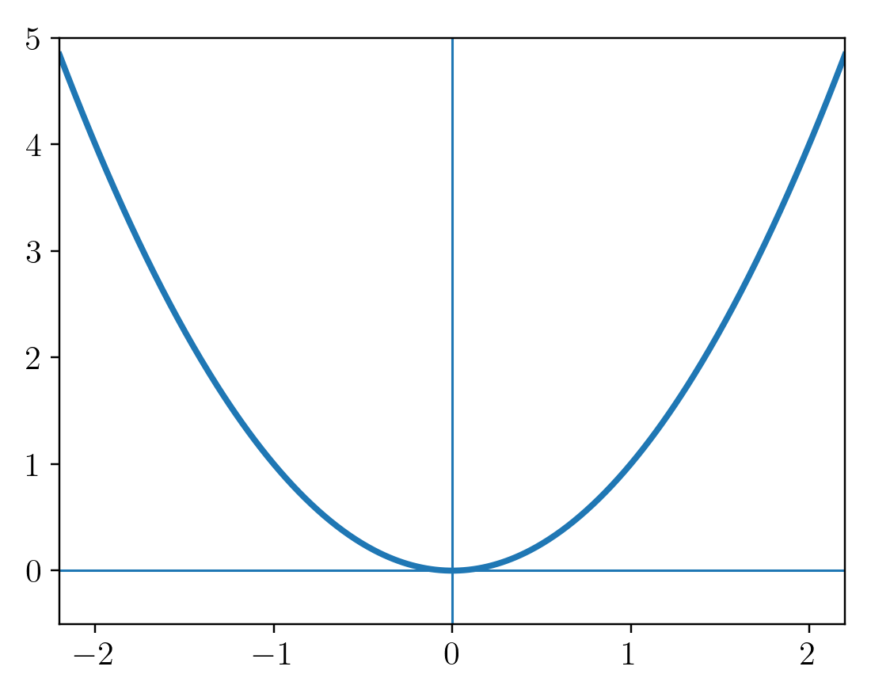

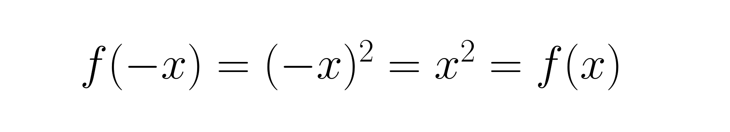
Important Theory
Section 0.5 Symmetry (Odd/Even) Functions (奇偶函数)
Even function
Geometric meaning: symmetry about the y-axis.
Example
47

Slide 14

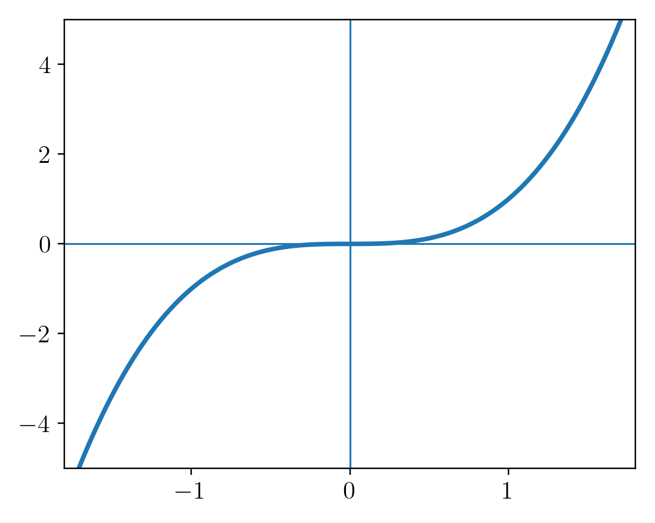

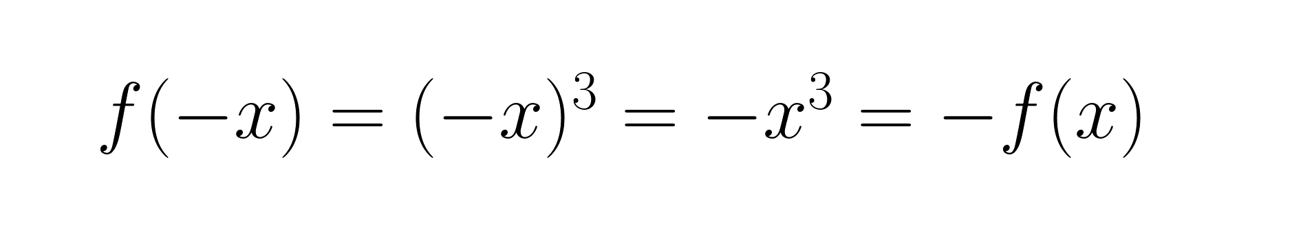
Important Theory
Odd function
Geometric meaning: 180° rotational symmetry about the origin.
Example
Rotate the right half 180° about the origin.
Even/odd classification requires a domain symmetric about 0.
48

Slide 15



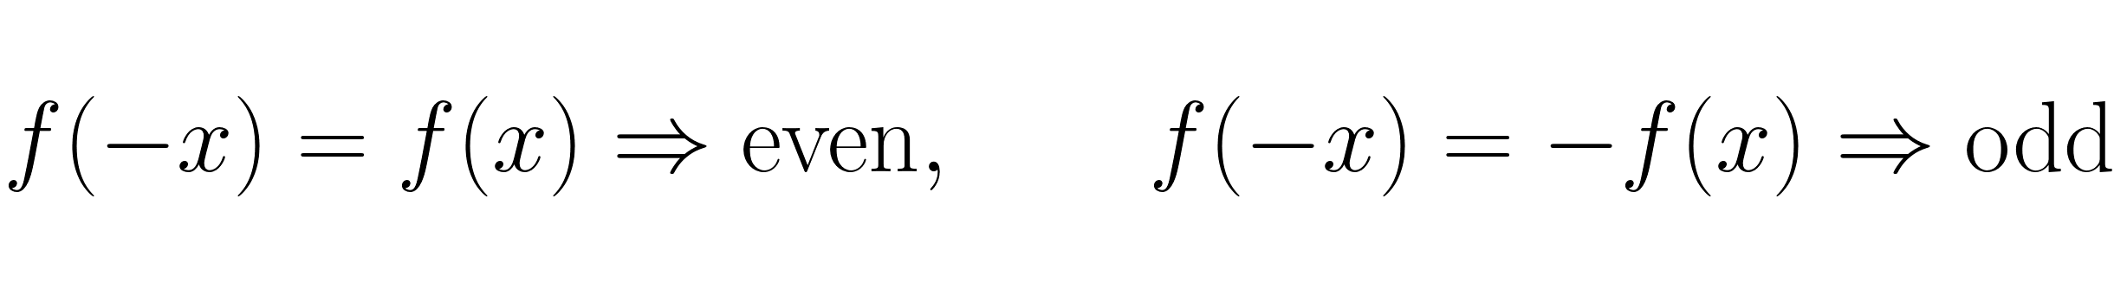
Example 5.1
Board Work
Determine whether each function is even, odd, or neither.
(a)
(b)
(c)
Test f(-x).
Test f(-x).
Test f(-x).
ODD
EVEN
NEITHER
Board rule:
If neither identity holds, the function is neither.
49

Slide 16

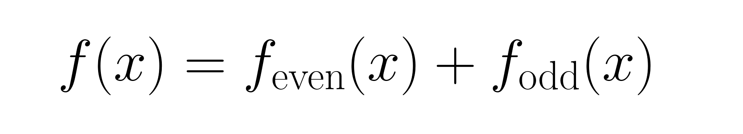


Exercise Question:
Board Work
Show that every function defined on
can be written as
Hint: try adding and subtracting f(-x).
50

