Slide 1
Reference Material
MATH1123
Calculus for Science and Engineering
Limits and Continuity
1

Slide 2
Chapter 1
Limits and Continuity (极限和连续)
Reference Material
• Limits: what happens near a point
• Continuity: no holes, no jumps
• Asymptotes: behavior near infinity or vertical barriers
2

Slide 3

Section 1.1 The Concept Of Limit
Important Theory
Plant capacity model
• x = percent of capacity used
• Policy: x approaches 80
• Direct substitution gives 0/0
• Question: what value is C(x) approaching?
3

Slide 4

Board Work
Approaching 80 from both sides
x | 79.8 | 79.99 | 79.999 | 80 | 80.0001 | 80.001 | 80.04
C(x) | 6.99782 | 6.99989 | 6.99999 | ? | 7.000001 | 7.00001 | 7.00043
The value at x=80 is not the point. The nearby behavior is the point.
4

Slide 5


Important Theory
One-sided limits
approach c from the left
approach c from the right
A two-sided limit needs both sides to agree.
5

Slide 6


Board Work
Two functions near x = 2
x | 1.9 | 1.99 | 1.999 | 1.9999
f(x) | 3.9 | 3.99 | 3.999 | 3.9999
x | 2.1 | 2.01 | 2.001 | 2.0001
f(x) | 4.1 | 4.01 | 4.001 | 4.0001
For f, both sides suggest the same number.
6

Slide 7
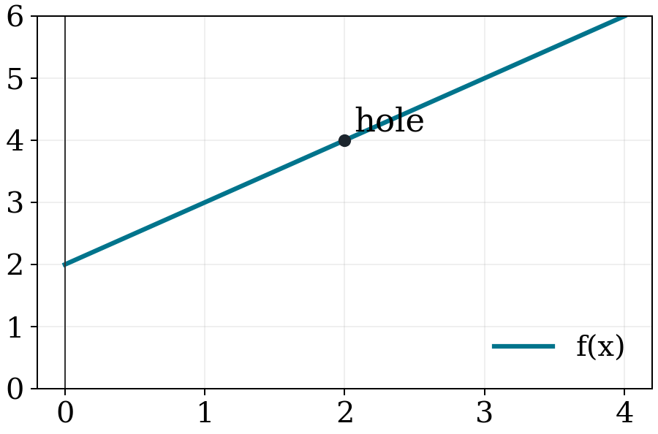

Important Theory
For f(x), the graph and table agree.
Limits describe behavior near the point — not necessarily at the point.
7

Slide 8
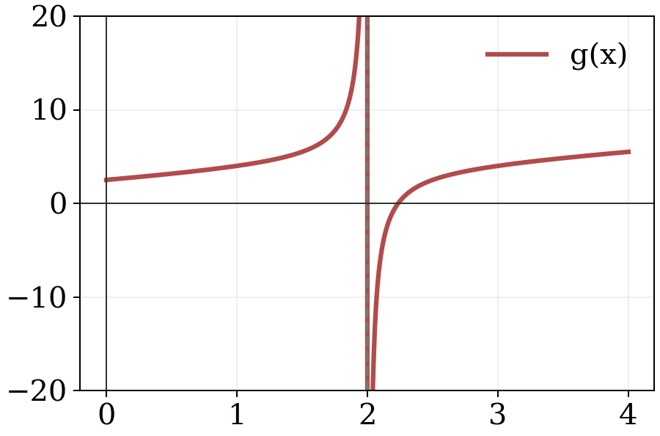


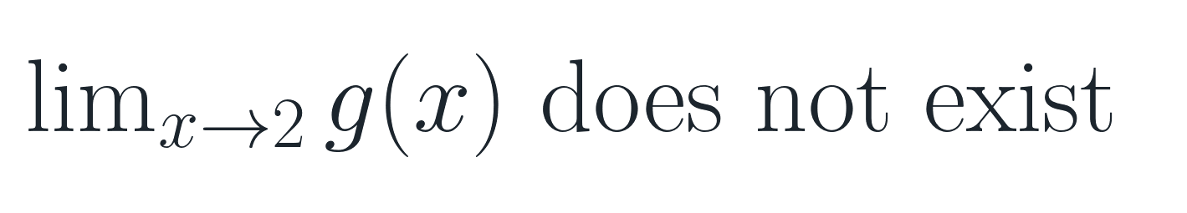
Board Work
For g(x), the two sides disagree.
8

Slide 9

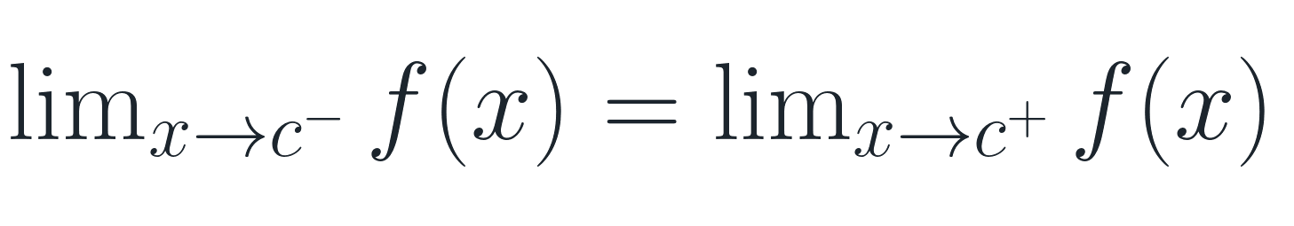
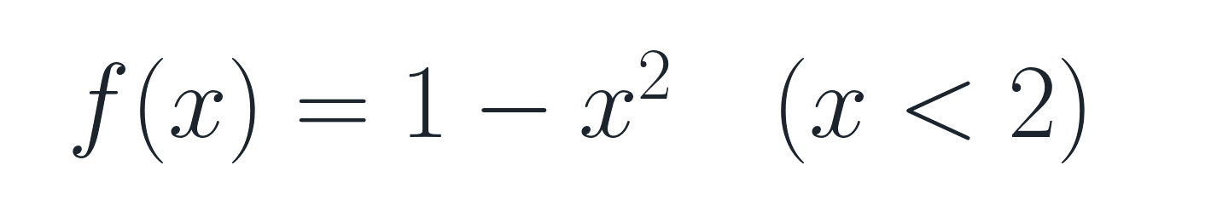
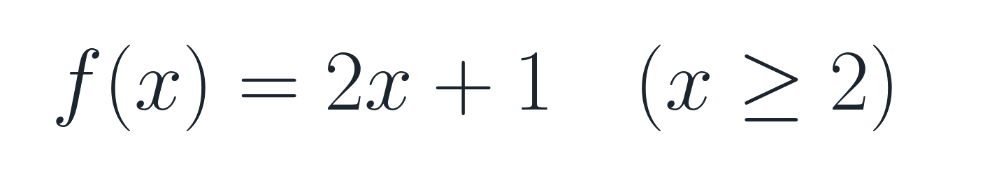
Existence of a Limit
Important Theory
if and only if
Example to test:
Board question: find the left and right limits at x=2.
9

Slide 10

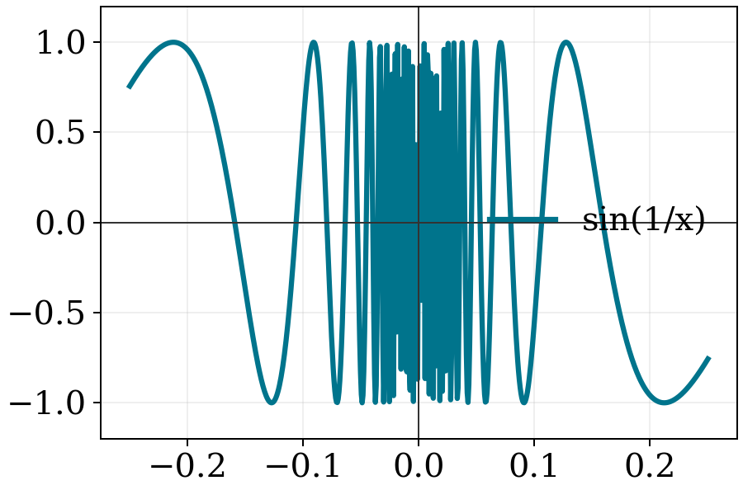
Nonexistent One-sided Limits
Reference Material
Near x=0, the function oscillates forever. It does not settle toward one number.
10

Slide 11

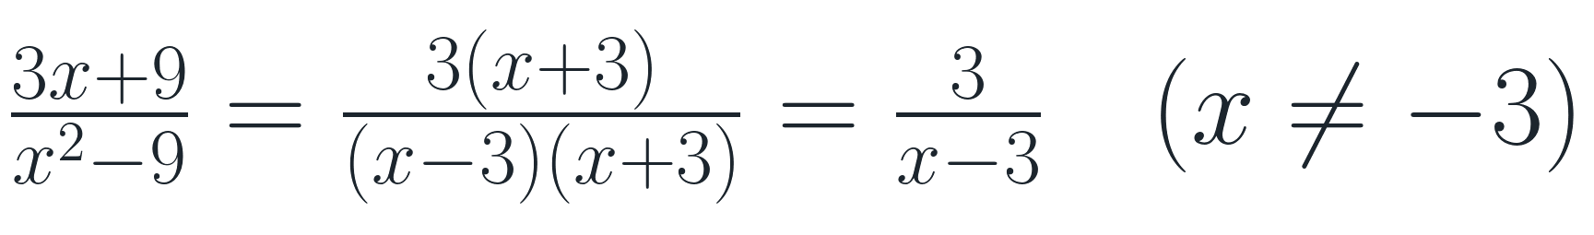

EXAMPLE 2.2 A Limit Where Two Factors Cancel
Board Work
First simplify, only then substitute the value for x
11

Slide 12


EXAMPLE 2.3 A Limit That Does Not Exist
Board Work
At x=3: denominator → 0, numerator → 18
Left limit = −1, right limit = 1
Moral: tables and graphs suggest; algebra decides.
12

Slide 13
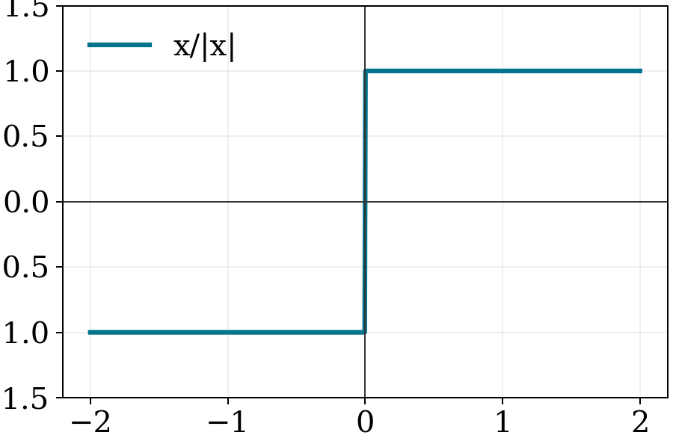



Board Work
Example 2.5: one-sided limits disagree
13

Slide 14


Section 1.2 Computation Of Limits
Important Theory
First two rules
A constant stays constant. The input x approaches c.
14

Slide 15






THEOREM 3.1
Reference Material
Limit laws: when individual limits exist
$$\lim_{x→c}{f\left(x\right)=L \lim_{x→c}{g\left(x\right)=M}}$$
15

Slide 16
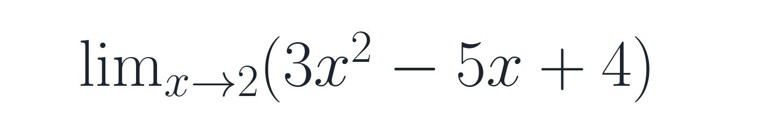
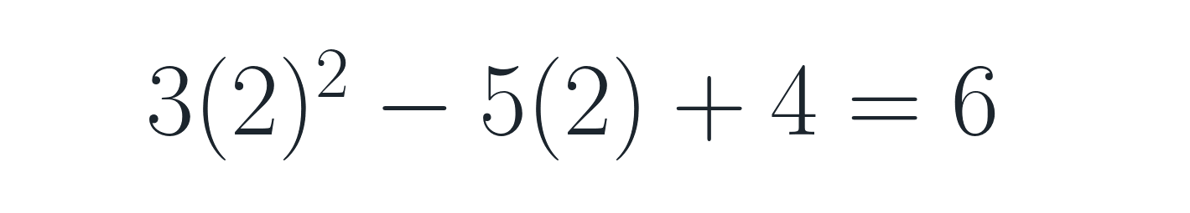
EXAMPLE 3.1 Finding the Limit of a Polynomial
Board Work
Polynomial rule: substitute x = 2.
The calculation belongs on the board; the slide gives the strategy.
16

Slide 17


EXAMPLE 3.2 Finding the Limit of a Rational Function
Board Work
Denominator at x=3 is not zero.
For rational functions, substitution works when the denominator does not vanish.
17

Slide 18

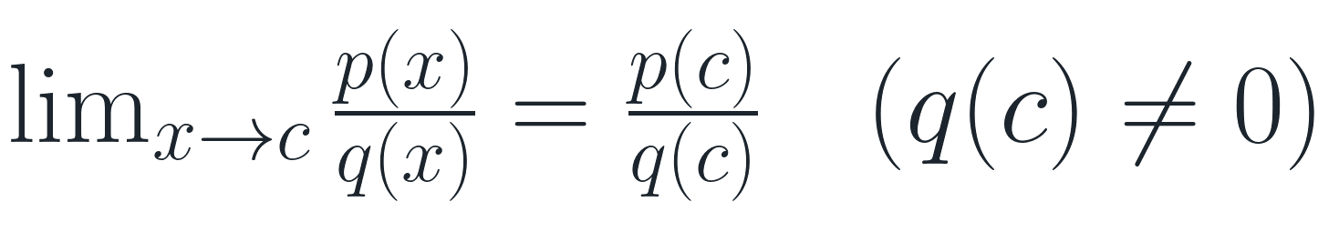
THEOREM 3.2 Limits of Polynomials and Rational Functions:
Important Theory
Substitution is legal unless the denominator becomes 0.
18

Slide 19



Indeterminate Form
Important Theory
means: do not decide yet.
Same appearance, different outcomes:
Indeterminate means: simplify first.
19

Slide 20

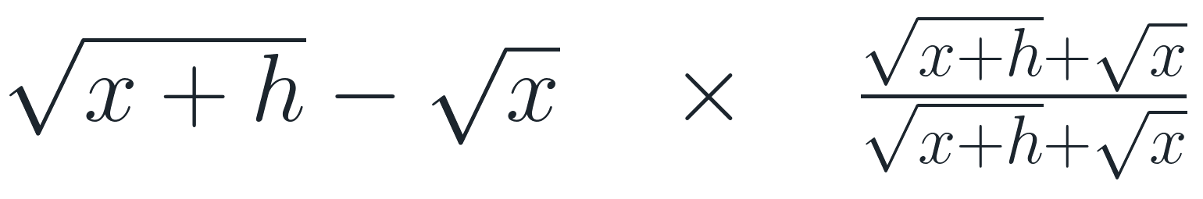
Find the Limit by Factoring and Rationalizing
Board Work
Two standard moves
Your job: remove the hidden zero factor, then substitute.
20

Slide 21
Idea:
Important Theory
A product rule cannot be used blindly.
Sometimes a wild factor is trapped by a small factor.
This is the motivation for the Squeeze Theorem.
21

Slide 22
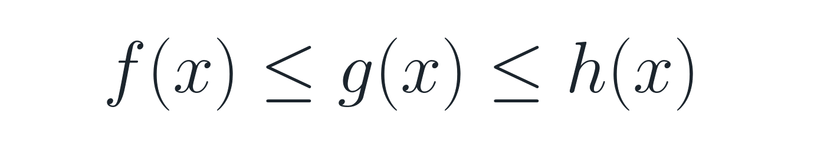
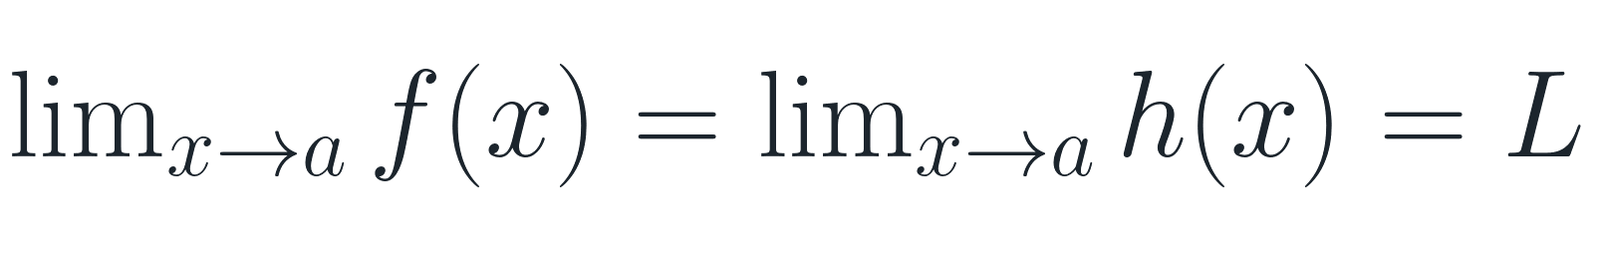
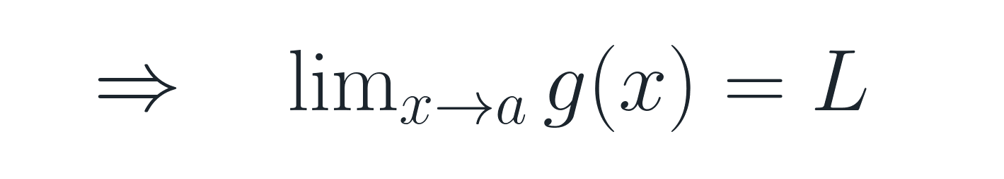
Squeeze Theorem (两面夹定理)
Important Theory
If two walls close to the same value, anything trapped between them must go there too.
22

Slide 23
Reference Material
Using the Squeeze Theorem
• Find a lower bound f(x)
• Find an upper bound h(x)
• Make sure both bounds have the same limit
• Then g(x) is forced to have that limit
The hard part is not the theorem. The hard part is finding the bounds.
23

Slide 24


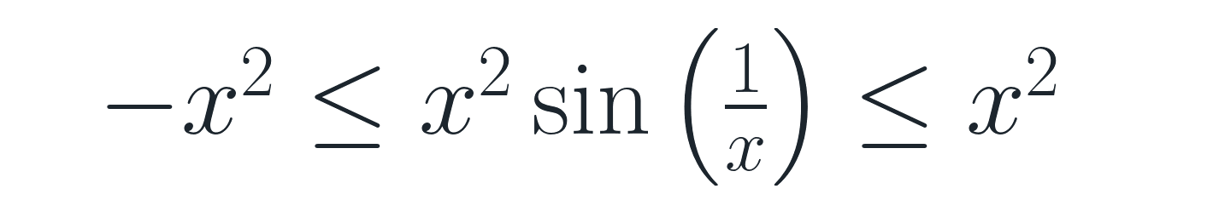
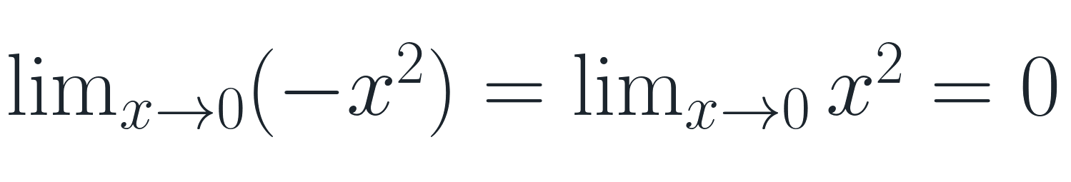
EXAMPLE 3.4 Using the Squeeze Theorem to Verify the Value of a Limit
Board Work
Therefore the middle limit is 0.
24

Slide 25
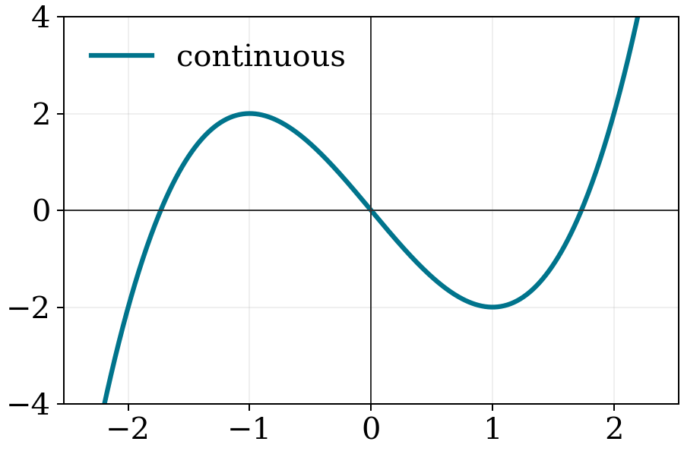
Section 1.3 Continuity and Its Consequences
Important Theory
A continuous function is one whose graph can be drawn without lifting the pen.
No holes. No jumps. No vertical blow-up.
25

Slide 26
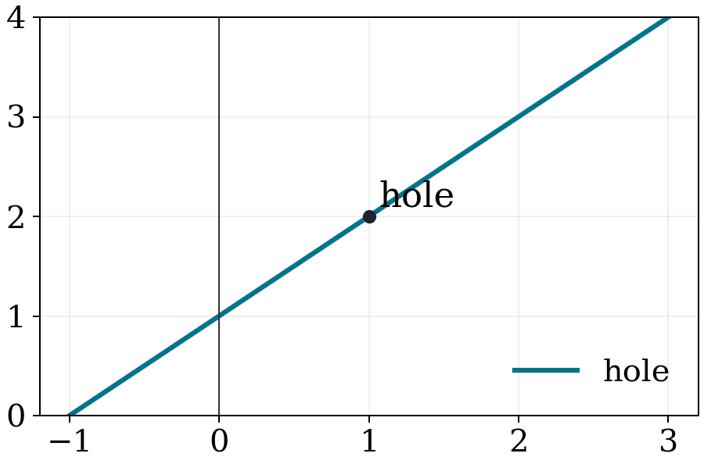
A “hole “ at x=c
Reference Material
The limit may exist even when f(c) is missing or wrong.
26

Slide 27
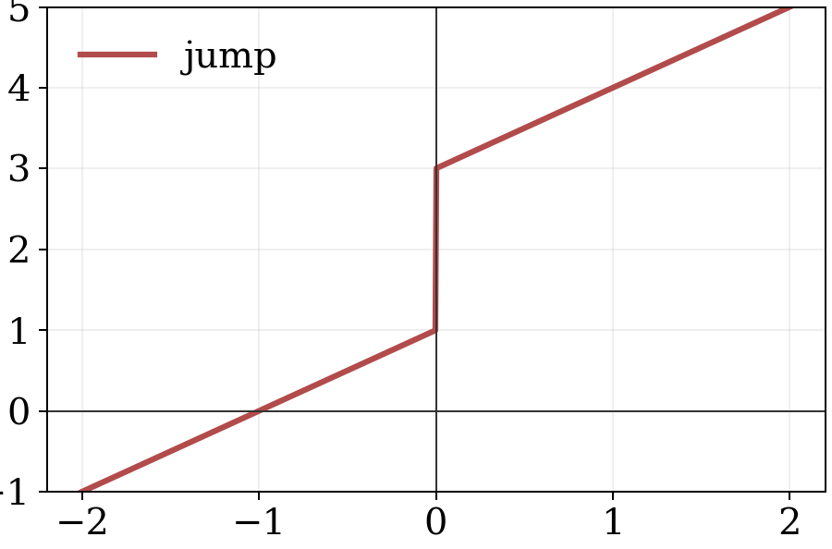
A “gap” at x=c
Reference Material
The left and right limits are different.
27

Slide 28


Definition 4.1
Important Theory
Continuity at c requires all three:
Failure of any one condition = discontinuity.
28

Slide 29

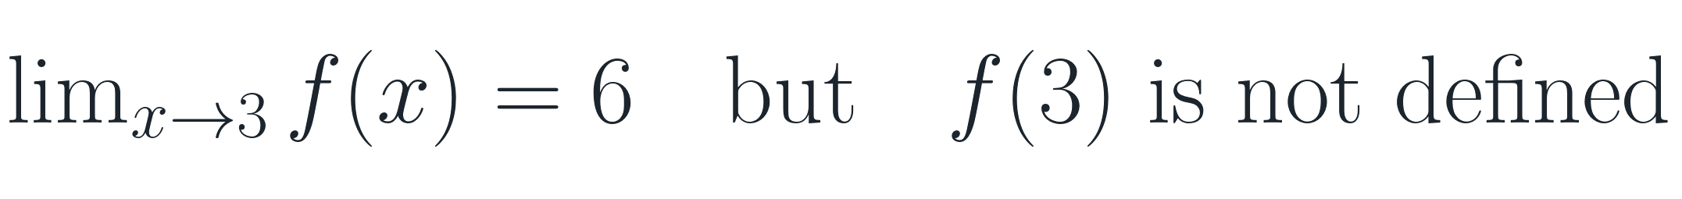
EXAMPLE 4.2 Finding Where a Rational Function Is Continuous
Board Work
Simplifies to x+3, but original is undefined at x=3.
So it is discontinuous at x = 3.
29

Slide 30

Removable Discontinuities
Important Theory
A hole is removable if we can define one missing value to repair it.
Not all discontinuities are removable: jumps and vertical asymptotes cannot be fixed by one value.
30

Slide 31
Continuity Polynomials and Rational Functions
Important Theory
Polynomials are continuous everywhere.
Rational functions are continuous wherever the denominator is not zero.
31

Slide 32





THEOREM 4.1
Reference Material
Continuity is preserved by algebraic operations.
If f and g are continuous at c, these are continuous at c too.
32

Slide 33
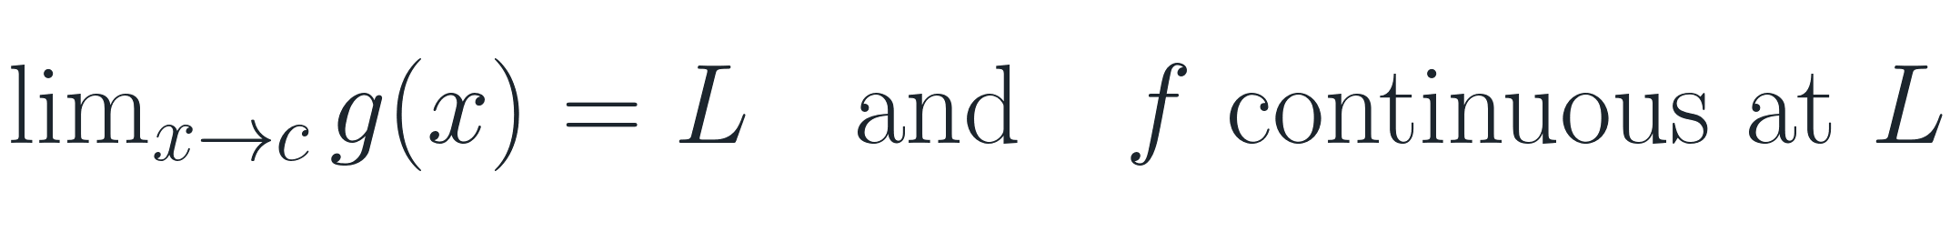
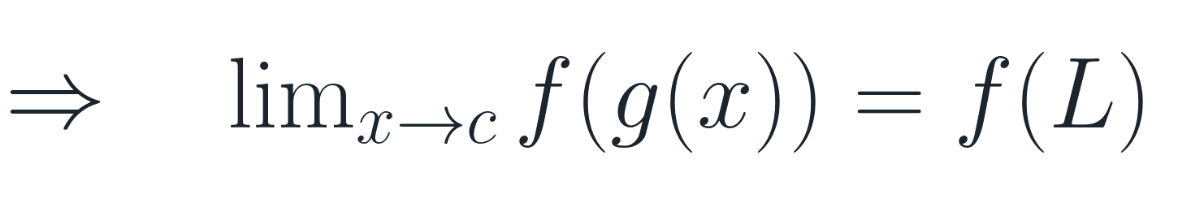
THEOREM 4.3
Reference Material
Composition preserves continuity.
Meaning: if the inside behaves well and the outside is continuous, substitute the inside limit.
33

Slide 34


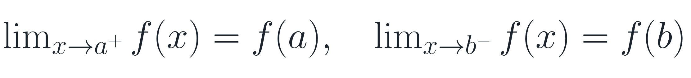
Continuity on an Interval
Important Theory
Open interval:
continuous at every interior point
Closed interval:
interior + correct one-sided behavior at endpoints
34

Slide 35
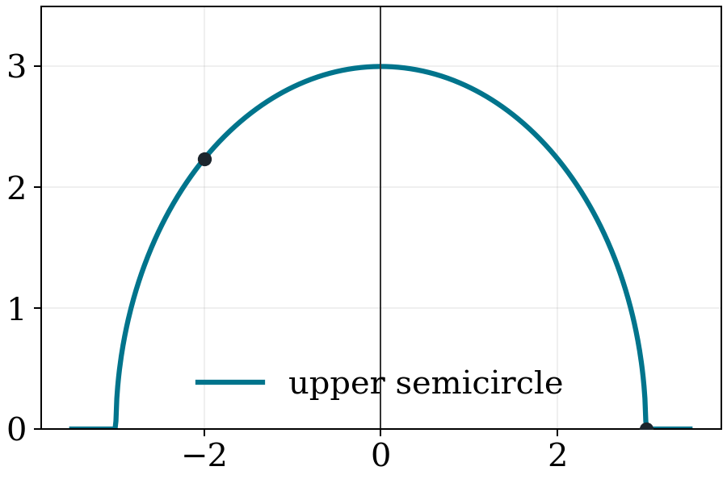
Example 4.8
Board Work
Discuss continuity on an open interval and a closed interval.
Board work: check interior points first, then endpoints.
35

Slide 36
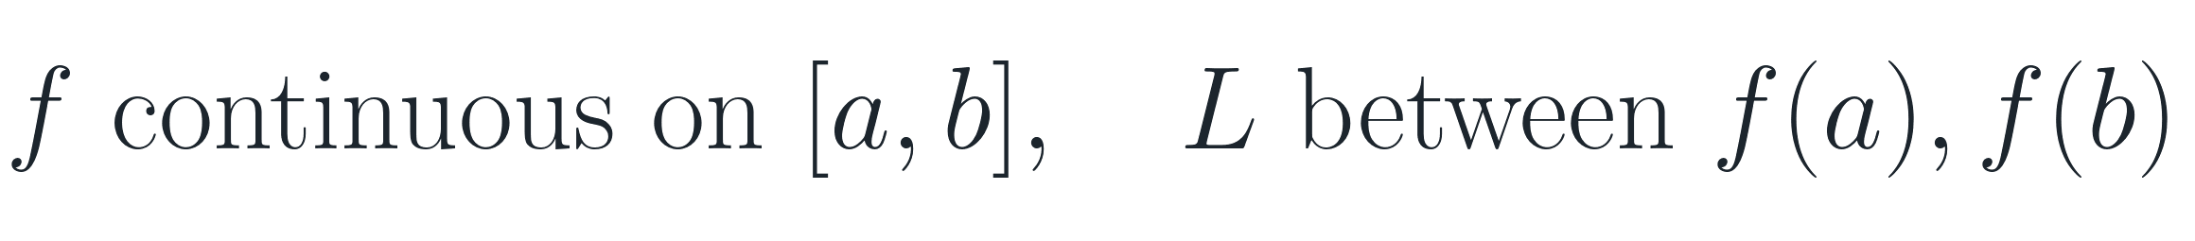

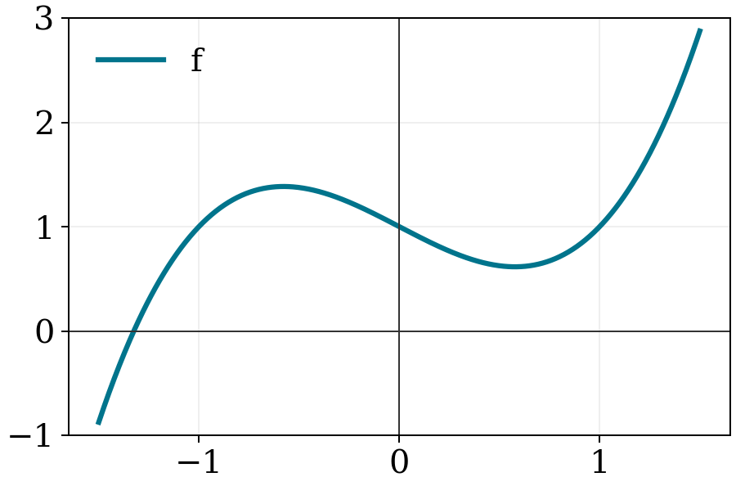
Theorem 4.4 The Intermediate Value Property
Important Theory
Continuous functions cannot jump over intermediate values.
36

Slide 37
Board Work
Why the hypotheses matter
• If the function has a jump, it may skip a value.
• If the interval is not closed, endpoint values may be missing.
• Continuity on [a,b] is the safety condition.
Can you draw a counterexample?
37

Slide 38
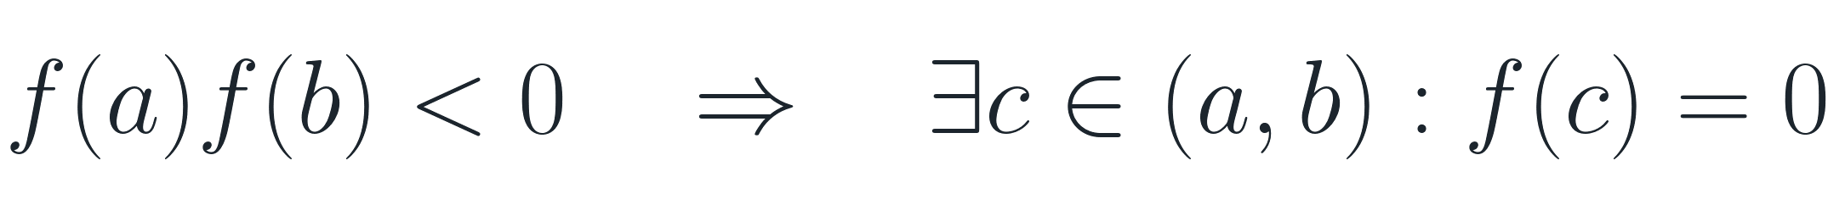
Corollary 4.2
Important Theory
Opposite signs force a zero.
This is the root-finding version of the Intermediate Value Property.
38

Slide 39
Remark:
Reference Material
Existence theorem
The theorem tells us that a number c exists.
It does not tell us the exact value of c.
Next: a method to locate it.
39

Slide 40

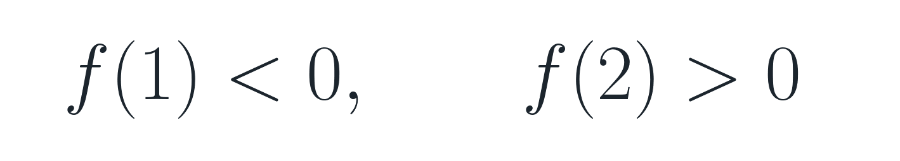
Example
Board Work
Show that the equation has a solution for 1 < x < 2.
Since f is continuous, its graph crosses the x-axis between 1 and 2.
40

Slide 41
The Method of Bisections (二分法)
Board Work
A practical way to locate a zero.
• Start with an interval [a,b] where f(a) and f(b) have opposite signs.
• Check the midpoint m.
• Keep the half-interval where the sign change remains.
• Repeat.
Step | Interval | Midpoint | Decision
1 | [1,2] | 1.5 | keep one half
2 | [...] | ... | repeat
41

Slide 42


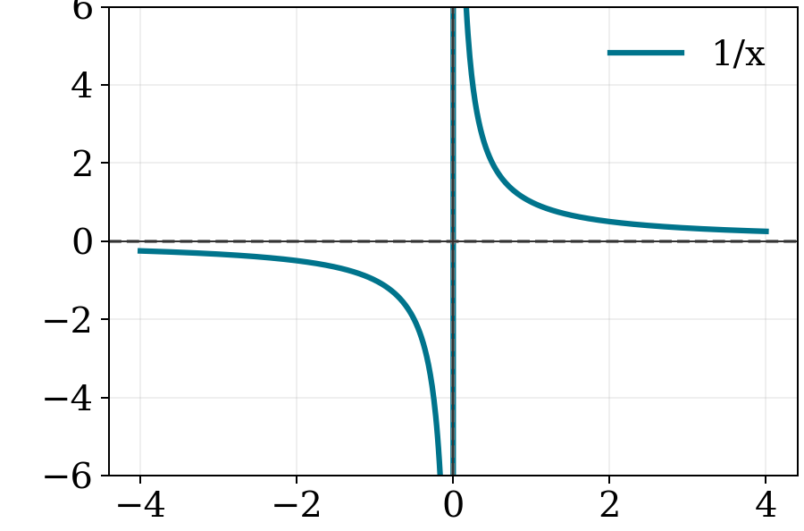
Section 1.4 Limits Involving Infinity; Asymptotes(渐近线)
Important Theory
Infinite limits describe unbounded behavior, not ordinary numbers.
42

Slide 43
REMARK 5.1
Reference Material
Writing ∞ in a limit is notation for behavior.
It does not mean that the limit is a real number.
Think: “the values grow without bound.”
43

Slide 44

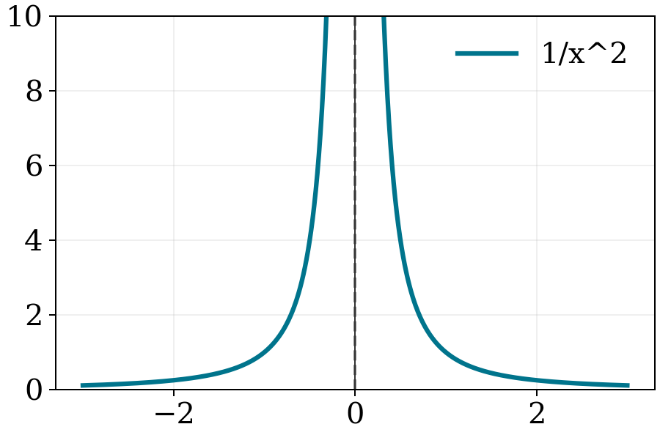
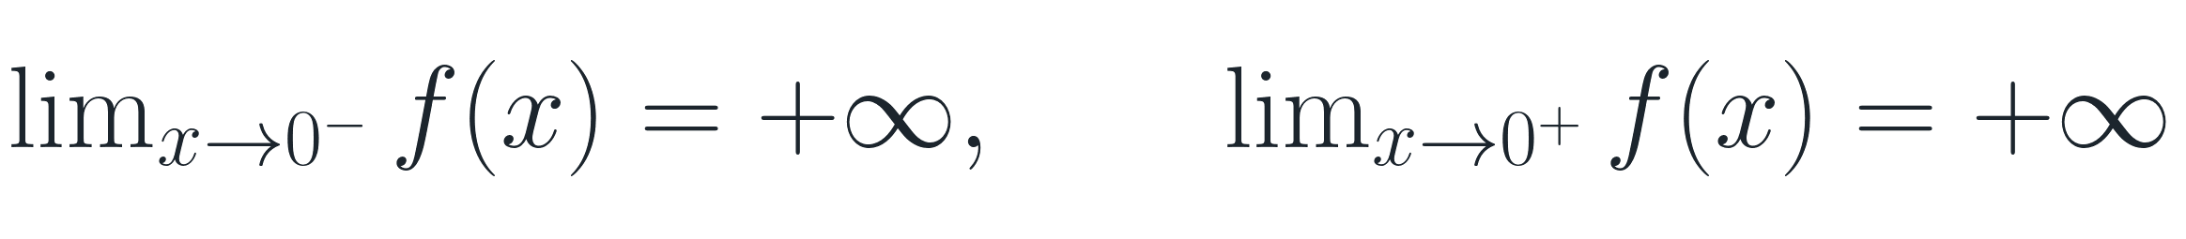
EXAMPLE 5.1 A Function Whose One-Sided Limits Are Both Infinite
Board Work
44

Slide 45
REMARK 5.2
Reference Material
Same sign or opposite signs?
Always check both one-sided limits near a vertical asymptote.
They may both be +∞, both −∞, or disagree.
45

Slide 46

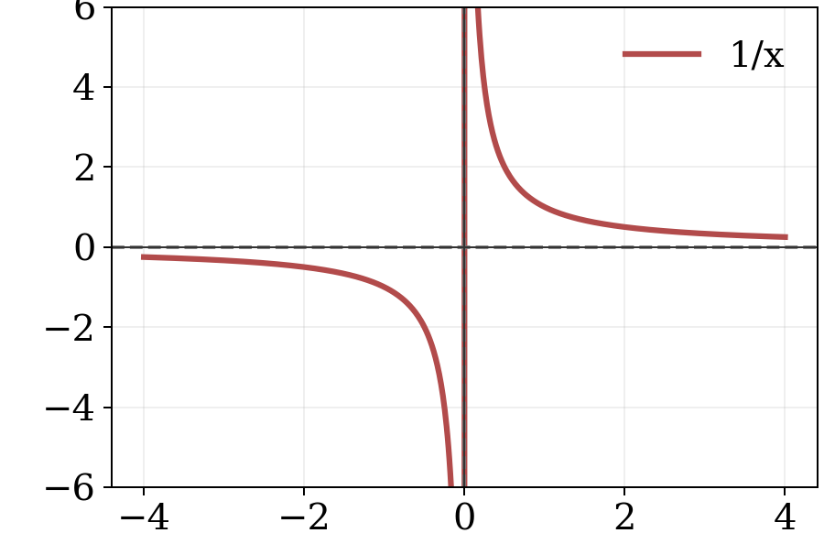
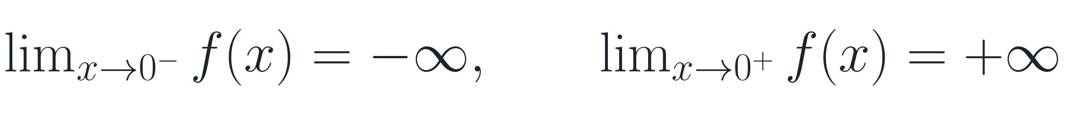
EXAMPLE 5.2 A Curve Whose Infinite One-Sided Limits Disagree
Board Work
46

Slide 47

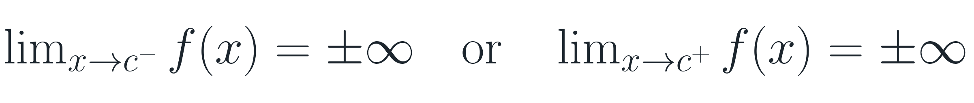
垂直渐近线
Important Theory
Vertical Asymptote
At least one one-sided limit is infinite:
47

Slide 48


Example
Board Work
Determine all vertical asymptotes of the graph of
Candidates: x=0 and x=-3.
Check whether numerator also vanishes.
48

Slide 49
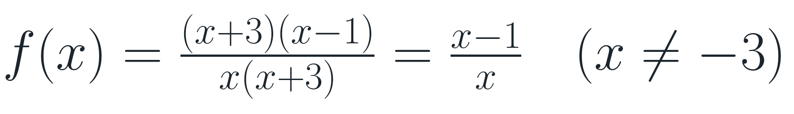
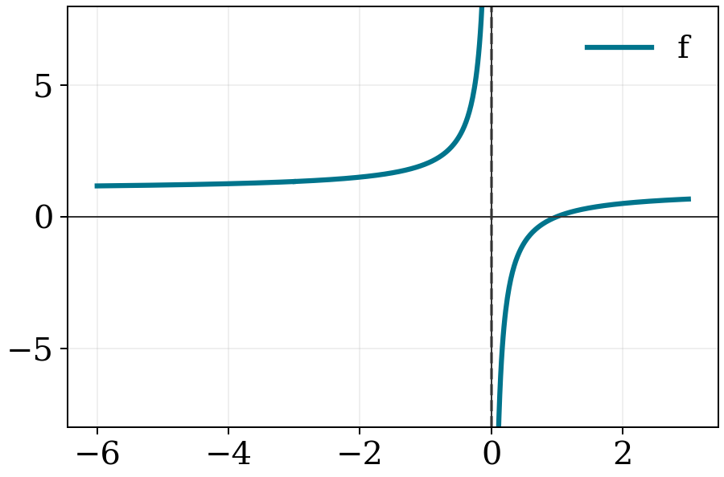
Board Work
Continuation: hole or vertical asymptote?
At x = −3: removable hole.
At x = 0: denominator zero remains → vertical asymptote.
49

Slide 50


Limits at Infinity （无穷处极限）
Important Theory
as x increases without bound
as x decreases without bound
Now the input goes far away; we ask what the output settles toward.
50

Slide 51

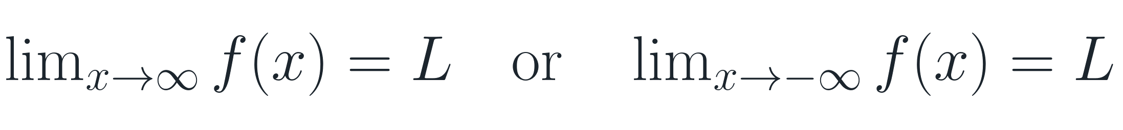
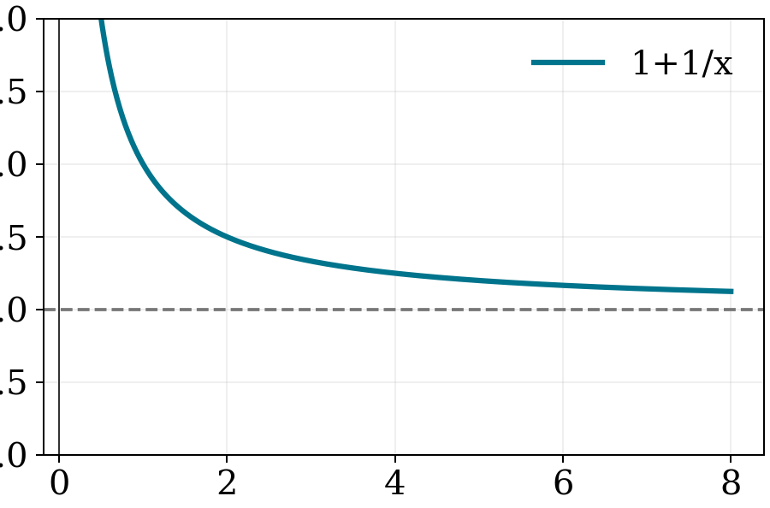
水平渐近线
Important Theory
Horizontal Asymptote
if
51

Slide 52

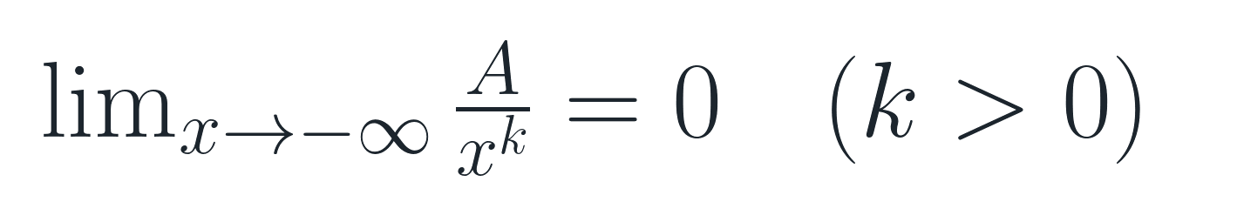
THEOREM 5.1
Reference Material
Reciprocal power rules
Terms like 1/x, 1/x², ... disappear at infinity.
52

Slide 53


Example
Board Work
Find
Divide numerator and denominator by x².
Answer: 3/2.
53

Slide 54
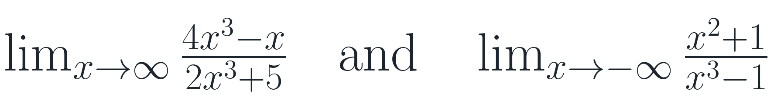
Rule of Thumb （经验法则）
Reference Material
For rational functions p(x)/q(x):
• Divide every term by the highest power of x in the denominator.
• Terms A/xᵏ go to 0 as x → ±∞.
• Then simplify what remains.
Exercise
54

Slide 55


Example
Board Work
Determine all horizontal asymptotes of the graph of
Highest power in denominator: x²
Horizontal asymptote: y = 1
55

Slide 56
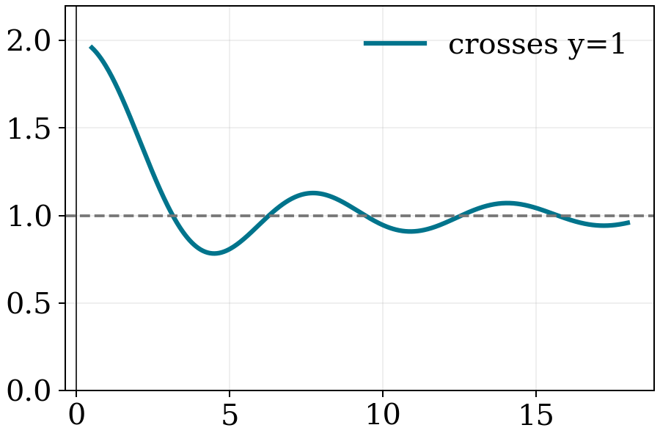
Important Theory
Vertical vs. horizontal asymptotes
• A graph cannot cross a vertical asymptote x=c.
• A graph may cross a horizontal asymptote.
• Horizontal asymptotes describe end behavior, not a wall.
End behavior is about “eventually,” not “never.”
56

Slide 57

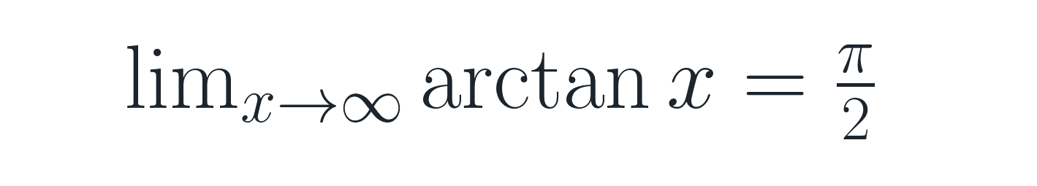
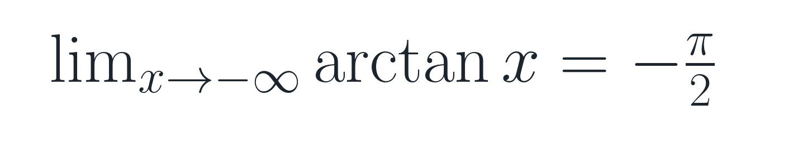
Reference Material
More examples of horizontal asymptotes
Exponential functions
Inverse trigonometric functions
These ideas return later when we study rates of change and graphs.
57

