Slide 1

Chapter 0
Preliminaries (预备知识)
In this Chapter, we will learn some important concepts. We hope to finish this preliminary
chapter in the first week.
Number systems and basic terminology
Polynomials and Rational Functions
Inverse Functions
Trigonometric and Inverse Trigonometric Functions
*

Slide 2
How to Read These Slides
The labels tell you how each slide will be used in class.
IMPORTANT THEORY
BOARD WORK
REFERENCE MATERIAL
Core ideas, definitions and results
Understand these concepts.
We stop and work through mathematics
Follow the reasoning, not just the answer.
Useful facts collected for later use
Know where to find them; we may move quickly.
Not every slide deserves the same amount of class time.

Slide 3
Section 0.1 Polynomials（多项式） and Rational Functions （有理函数）
IMPORTANT THEORY
The Real Number (实数) System
Integers (整数)：0, ±1，±2，………
Rational numbers（有理数）: A rational number is any number of the form p/q, where p and q are integers and q≠0.
Irrational numbers are those real numbers that cannot be written in the form p/q, where p and q are integers. Irrational numbers have decimal expansions that do not repeat or terminate.
*

Slide 4
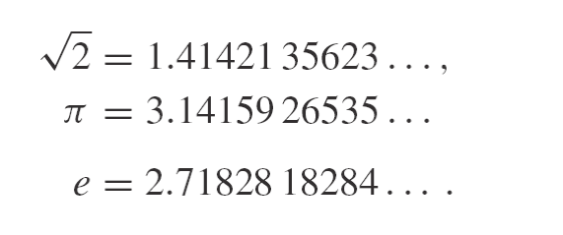

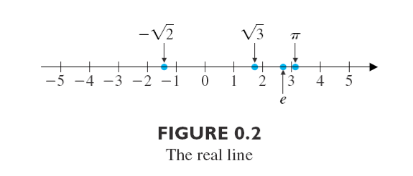
IMPORTANT THEORY
For instance, three familiar irrational numbers and their decimal expansions are
We picture the real numbers arranged along the number line displayed in Figure 0.2 (the real line). The set of real numbers is denoted by the symbol
*

Slide 5
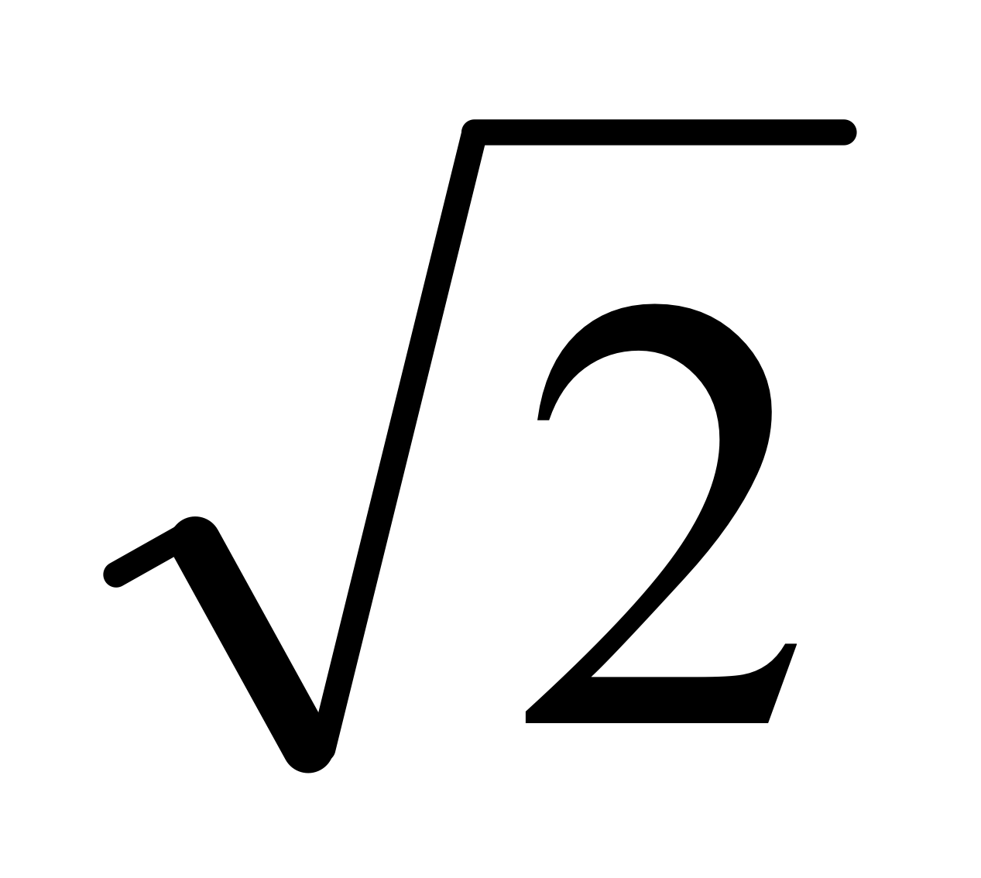
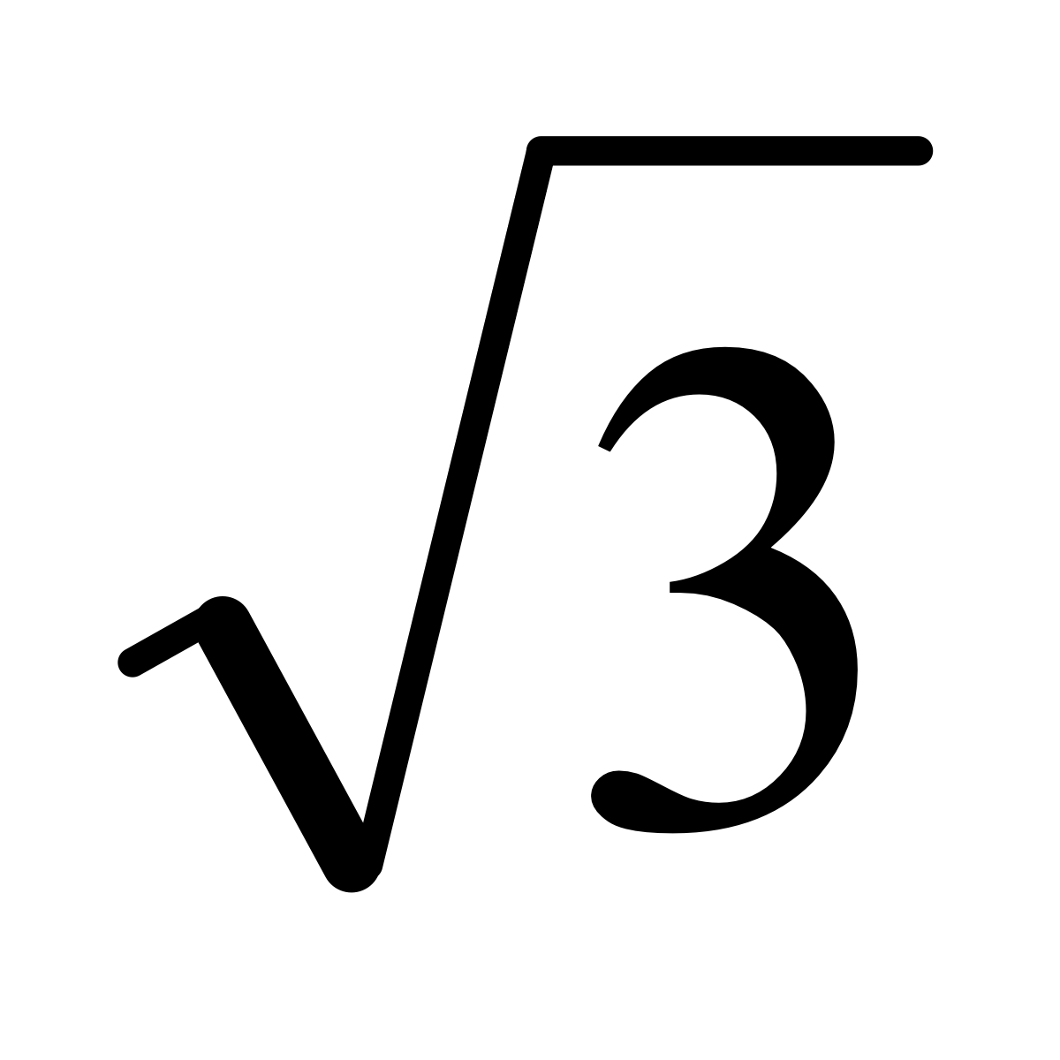
BOARD WORK
Prove that is an irrational number
If we only stay within the range of rational numbers, then it is already obvious in geometry that not all line segments can have a length. For example, the length of the diagonal of a square.
Exercises
Show that is an irrational number
*

Slide 6

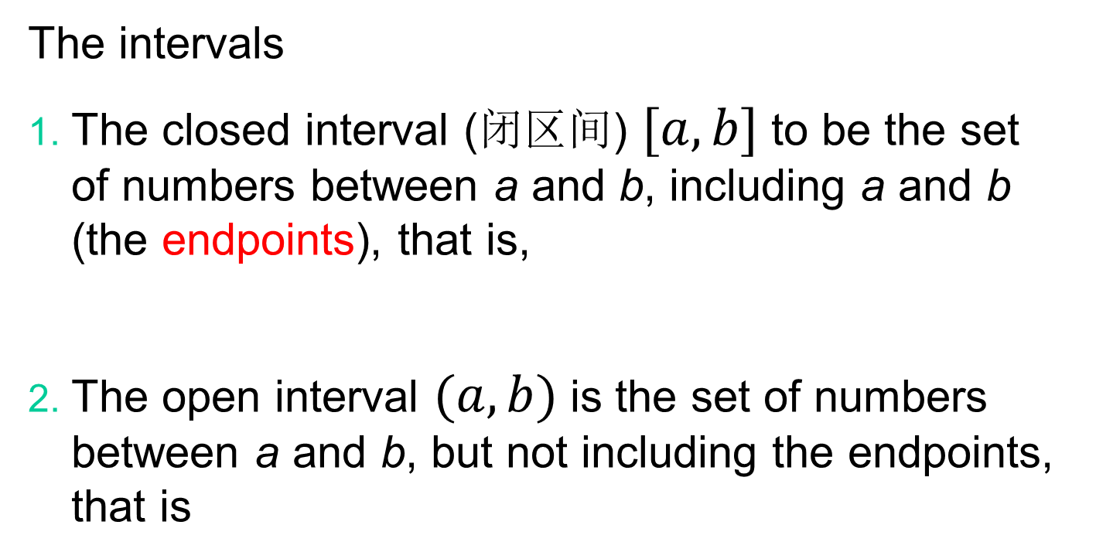
IMPORTANT THEORY
The intervals
The closed interval (闭区间) $[a,b]$ to be the set of numbers between a and b, including a and b (the endpoints), that is,
The open interval $(a,b)$ is the set of numbers between a and b, but not including the endpoints, that is
*

Slide 7
REFERENCE MATERIAL
Addition and subtraction of real numbers (实数的加法及减法)
II-1: a+b=b+a (commutative law of addition 交换律)
II-2: (a+b)+c=a+(b+c) (associative law 结合律)
II-3: a+0=a (property of zero number)
II-4: For any number a, there exists a number –a such that a+(-a)=0.
II-5: From a>b, we have a+c>b+c.
*

Slide 8
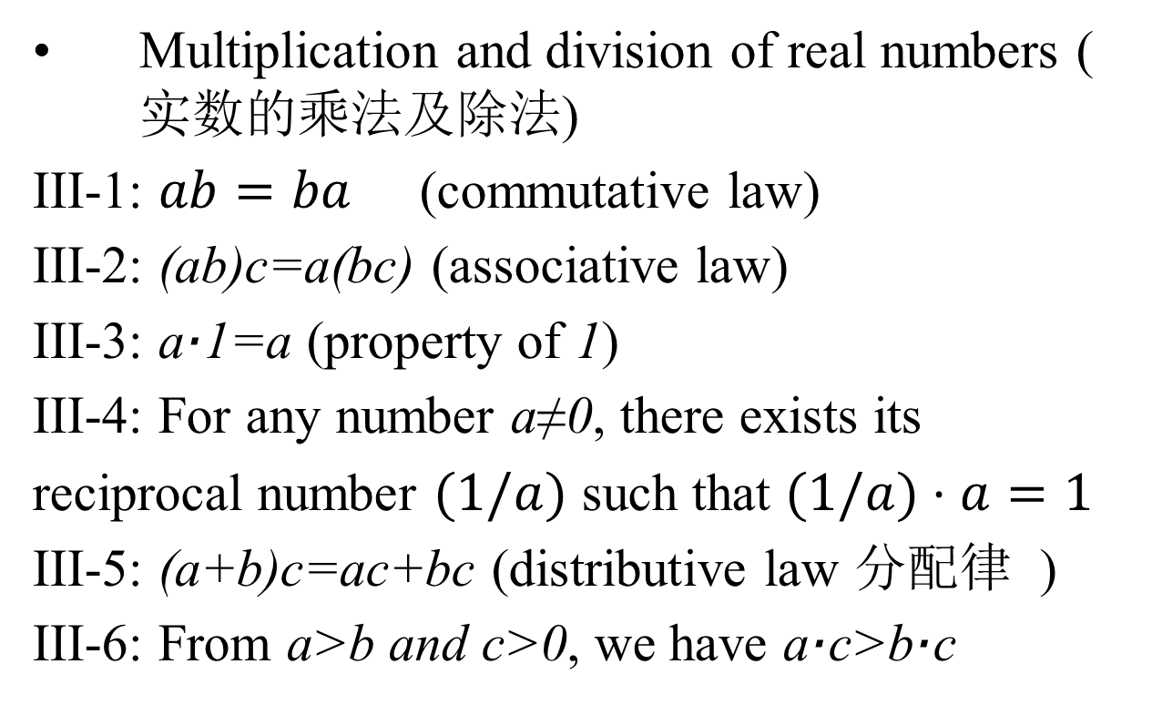
REFERENCE MATERIAL
Multiplication and division of real numbers (实数的乘法及除法)
III-1: $ab=ba$ (commutative law)
III-2: (ab)c=a(bc) (associative law)
III-3: a·1=a (property of 1)
III-4: For any number a≠0, there exists its
reciprocal number $(1/a)$ such that $(1/a)⋅a=1$
III-5: (a+b)c=ac+bc (distributive law 分配律 )
III-6: From a>b and c>0, we have a·c>b·c
*

Slide 9


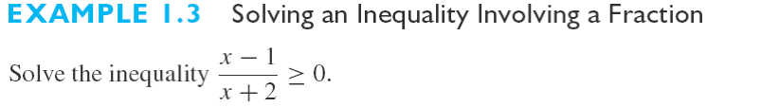
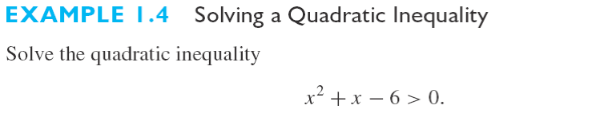
BOARD WORK
*

Slide 10

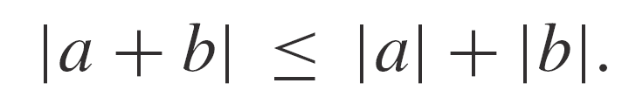
BOARD WORK
Triangle inequality (三角不等式)
*

Slide 11
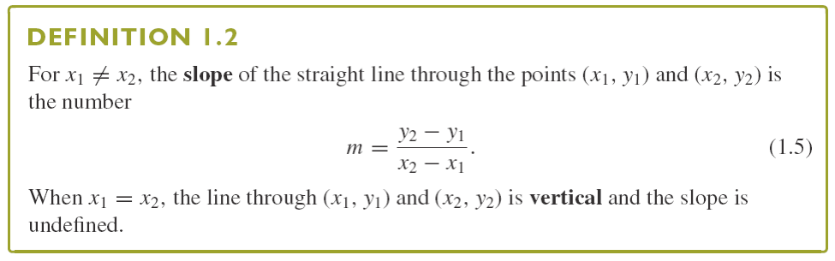
IMPORTANT THEORY
Equations of Lines (直线方程)
Notice that a line is horizontal if and only if its slope is zero.
Reading: Textbook Appendix B pages A12—A15
*

Slide 12
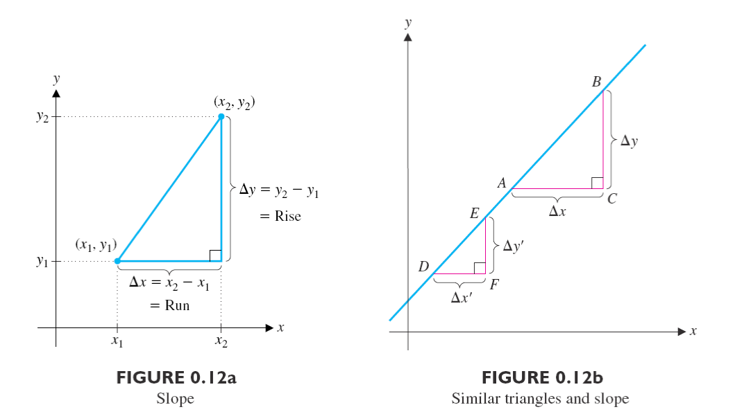
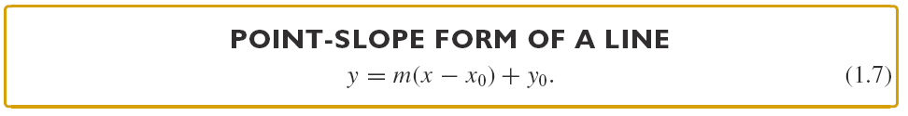
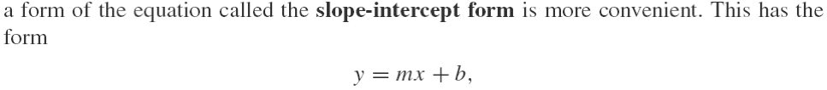
BOARD WORK
Reading: Textbook Appendix B pages A12—A15
*

Slide 13
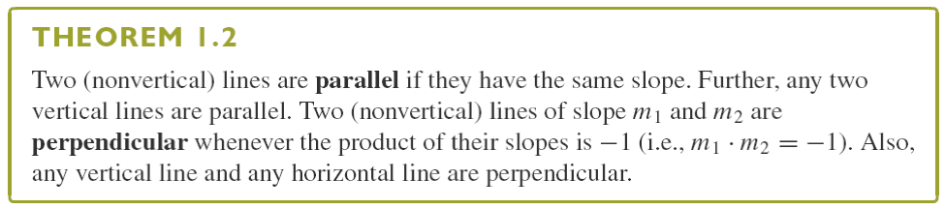
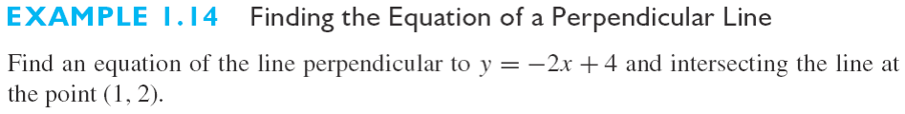
BOARD WORK
Reading: Textbook Appendix B pages A12—A15
*

Slide 14
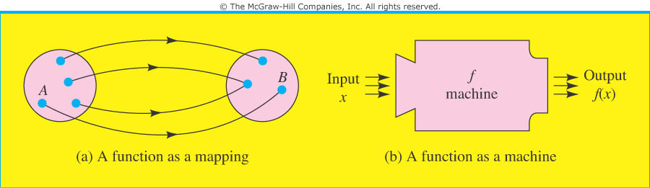
Functions（函数）
IMPORTANT THEORY
A function f is a rule that assigns to each object in a set A exactly one object in a set B. In this case, we write y=f(x).
The set A is called the domain (定义域) of the function, and the set of assigned objects in B is called the range （值域）. We refer to x as the independent variable （自变量）and to y as the dependent variable（因变量）.
*

Slide 15
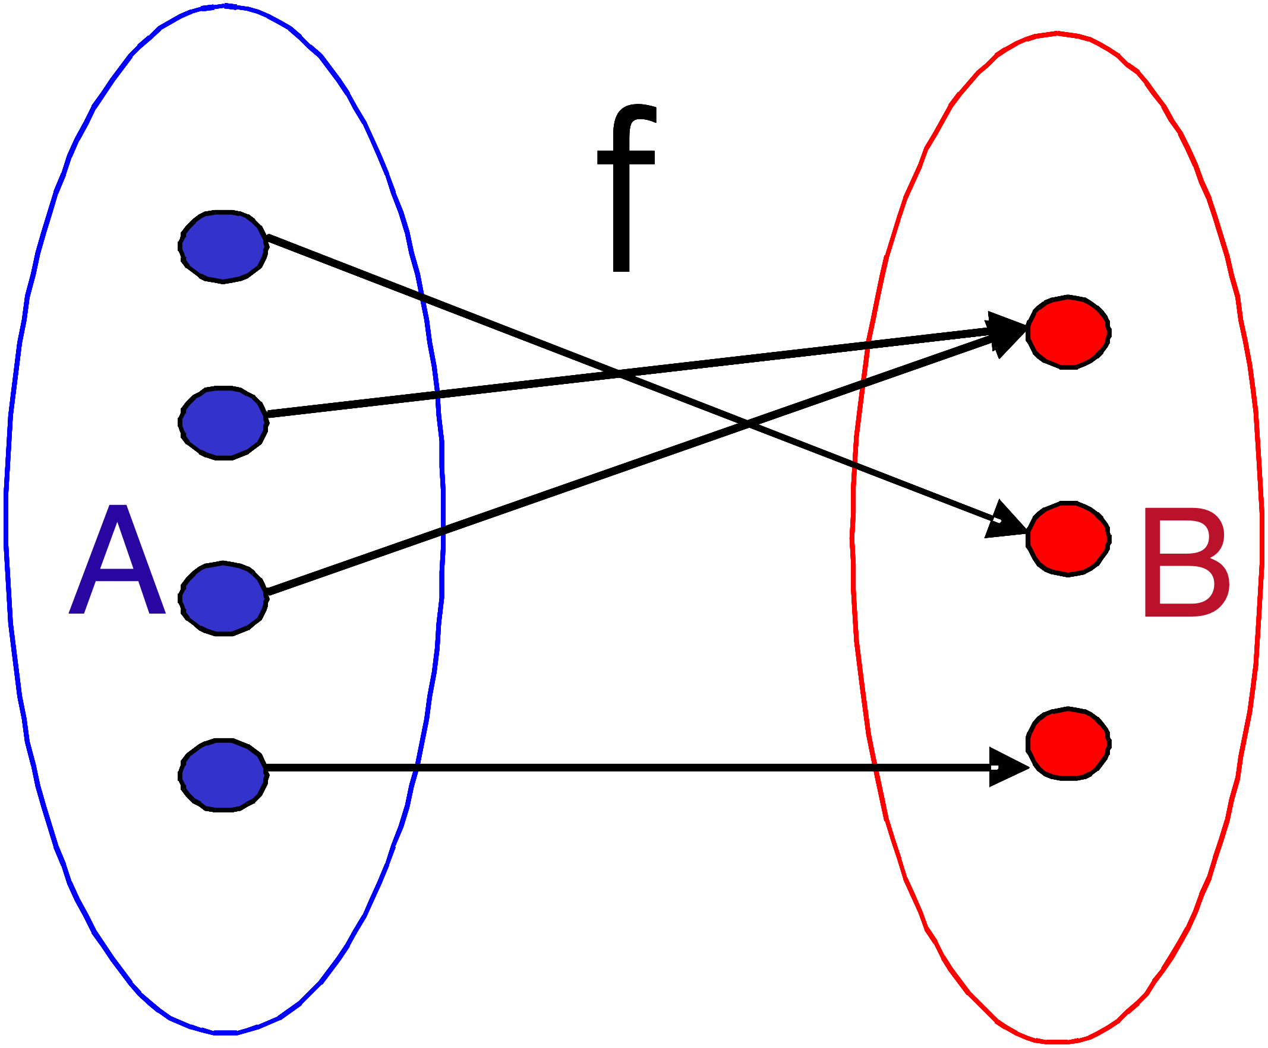
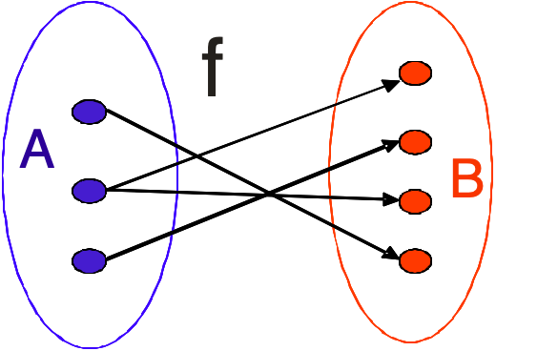
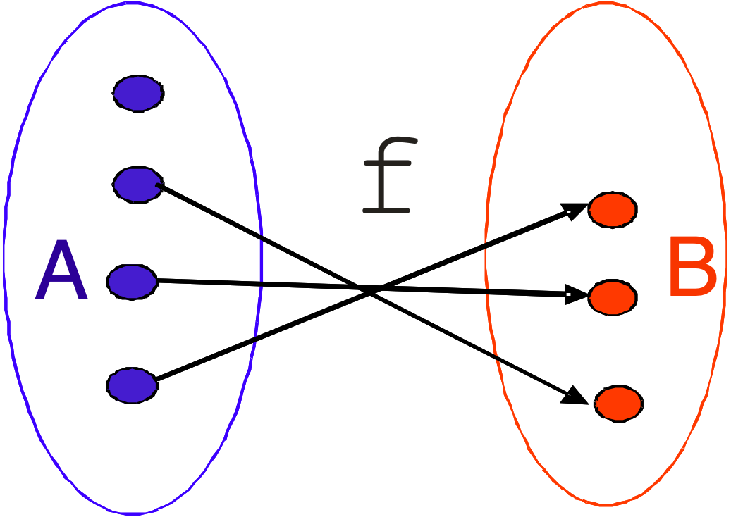
Function, or not?
IMPORTANT THEORY
YES
NO
NO
*

Slide 16
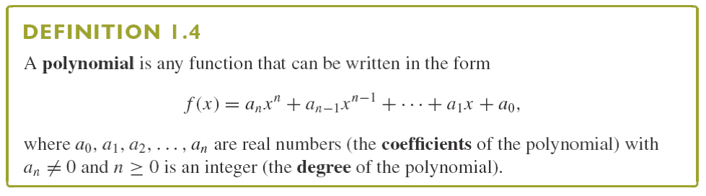
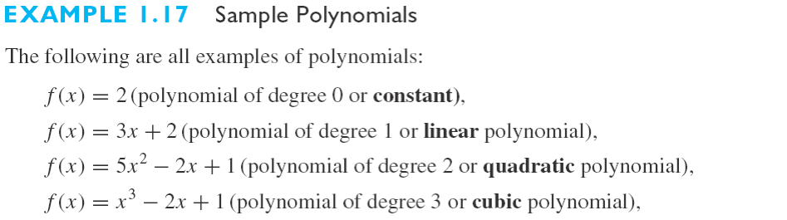
IMPORTANT THEORY
*

Slide 17
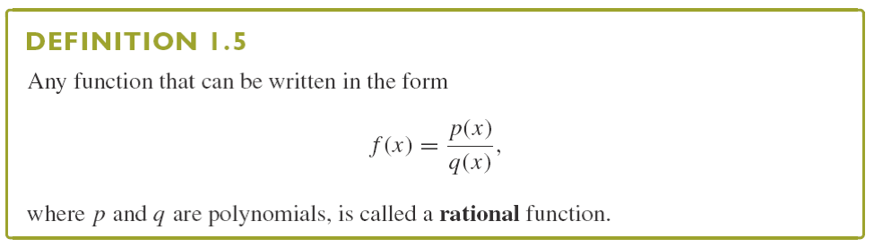
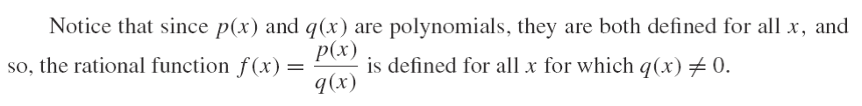
IMPORTANT THEORY
Rational Function (有理函数)
*

Slide 18
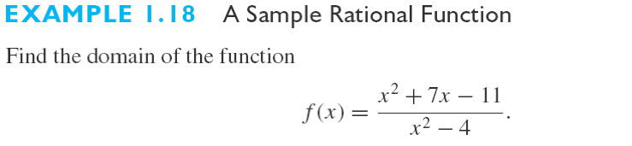
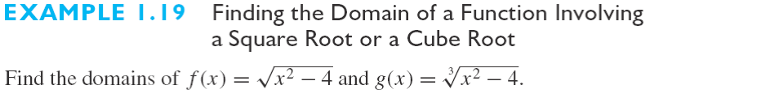
BOARD WORK
In general, there are two situations where a number
is not in the domain of a function:
1) division by 0
2) The even number root of a negative number
*

Slide 19
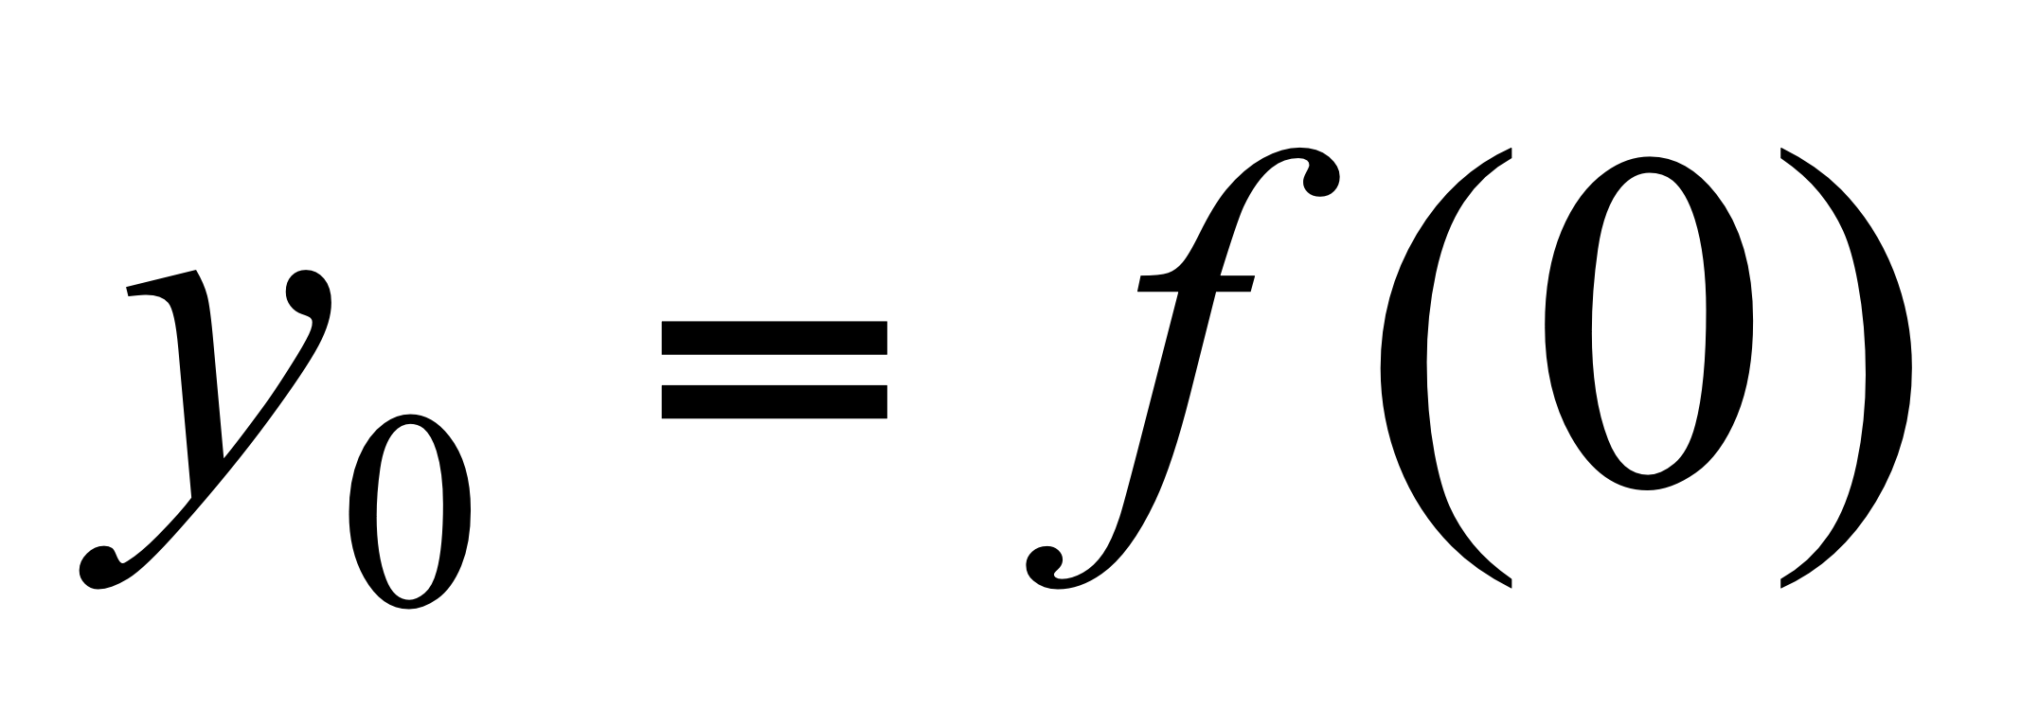
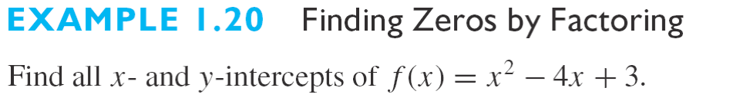
BOARD WORK
Intercepts
x intercepts: The points where a graph crosses the x axis.
A y intercept: A point where the graph crosses the y axis.
How to find the x and y intercepts: The only possible y intercept for a function is , to find any x intercept of y=f(x), set y=0 and solve for x.
Note: Sometimes finding x intercepts may be difficult.
*

Slide 20
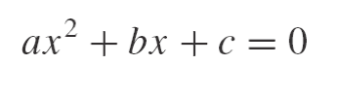
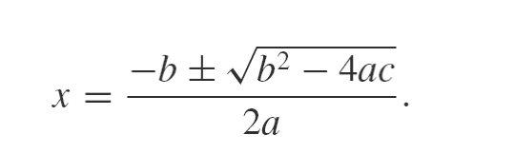
IMPORTANT THEORY
Unfortunately, factoring is not always so easy. Of course, for the quadratic equation
(for a≠0), the solutions are given by the familiar quadratic formula:
*

Slide 21
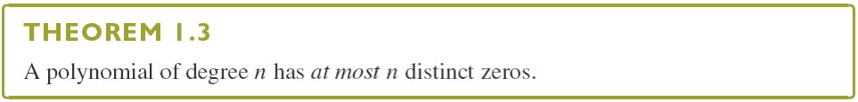

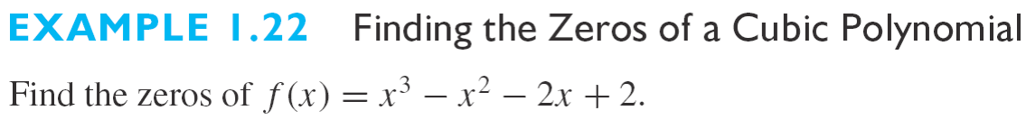
BOARD WORK
*

Slide 22
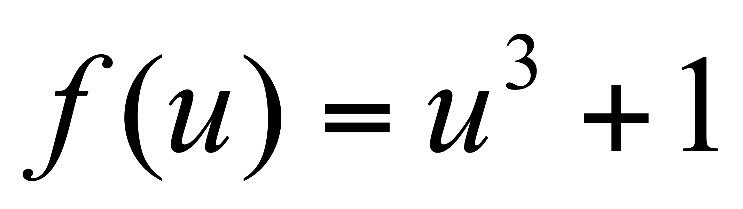
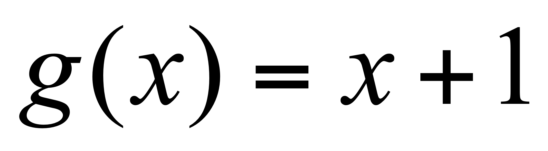
BOARD WORK
Section 0.3 Inverse Functions (反函数)
Composition of Functions（复合函数）: Given functions f(u) and g(x), the composition f(g(x)) is the function of x formed by substituting u=g(x) for u in the formula for f(u).
Example
Find the composition function f(g(x)), where and
Solution:
Replace u by x+1 in the formula for f(u) to get
Question: How about g(f(x))?
Note: In general, f(g(x)) and g(f(x)) will not be the same.
*

Slide 23
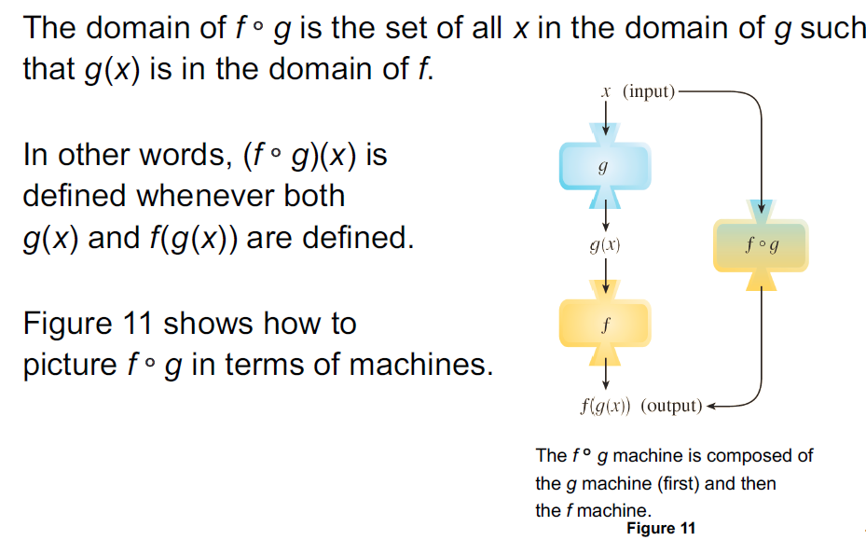
IMPORTANT THEORY
*

Slide 24
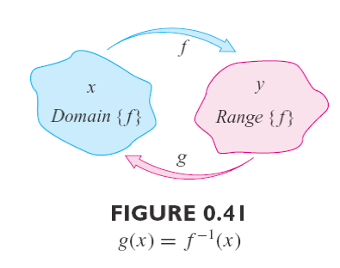
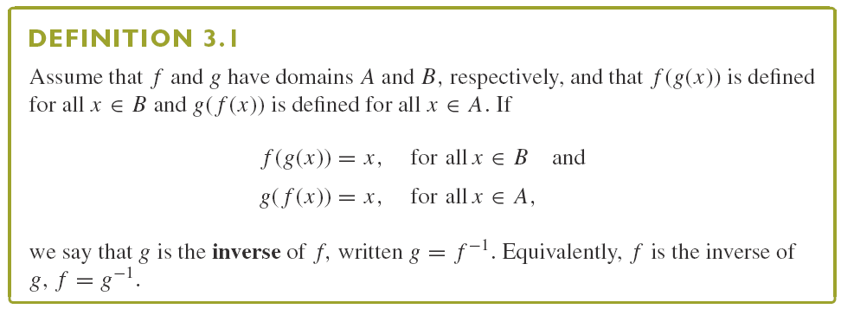
IMPORTANT THEORY
Inverse Functions
*

Slide 25

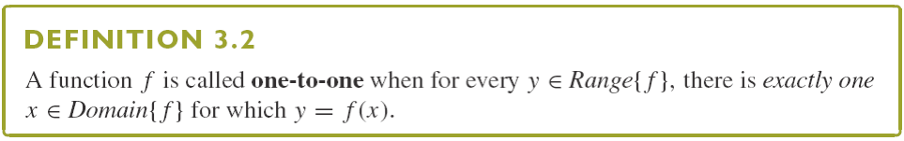
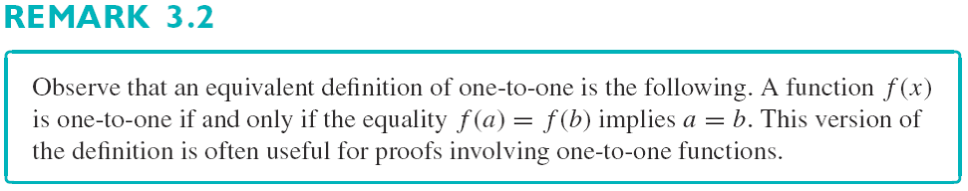
IMPORTANT THEORY
*

Slide 26
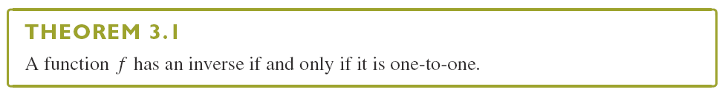


BOARD WORK
*

Slide 27
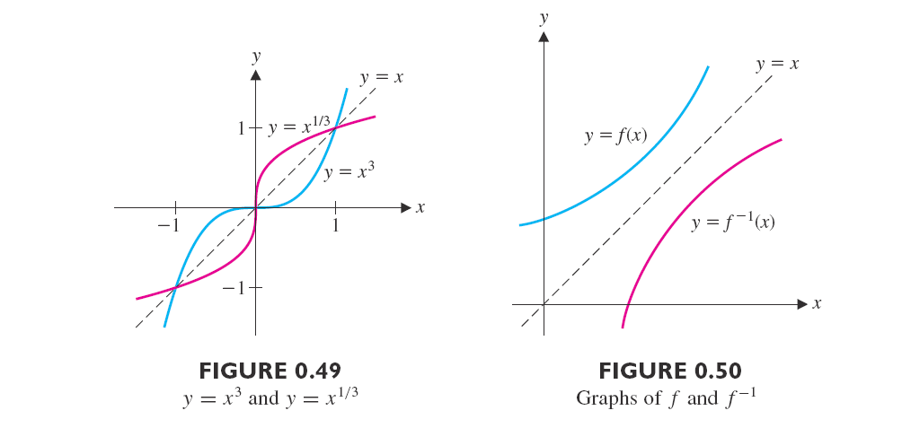
IMPORTANT THEORY
*

Slide 28
IMPORTANT THEORY
Section 0.4 Trigonometric (三角函数) and Inverse Trigonometric Functions
(反三角函数)
Many phenomena encountered in your daily life involve waves.
Radar Signals
Electromagnetic waves
Electrocardiogram
The mathematical description of such phenomena involves periodic functions, the most familiar of which are the trigonometric functions.
*

Slide 29
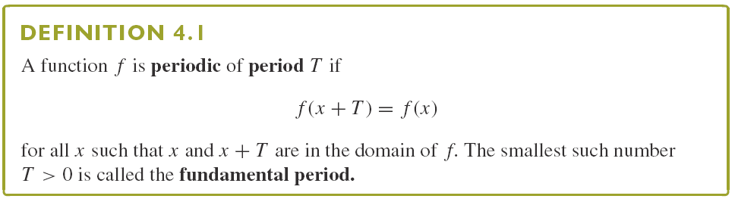

IMPORTANT THEORY
Remark: When we discuss the period of a function, we most often focus on the fundamental period.
*

Slide 30
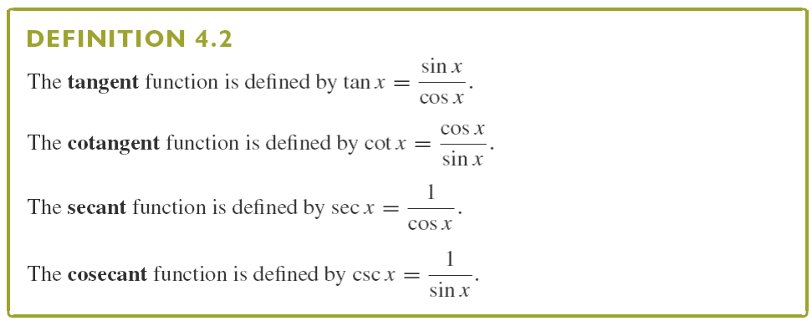
IMPORTANT THEORY
*

Slide 31
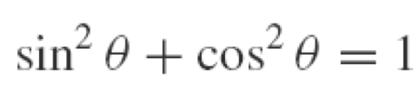
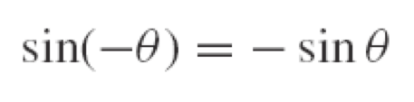
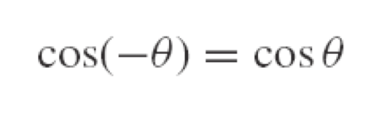
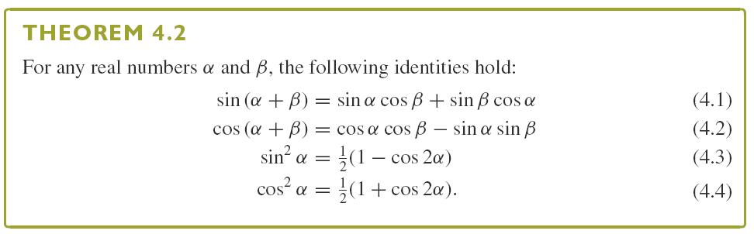
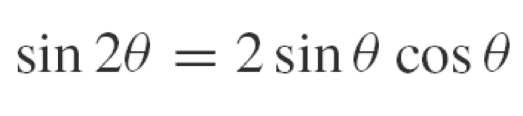

IMPORTANT THEORY
*

Slide 32
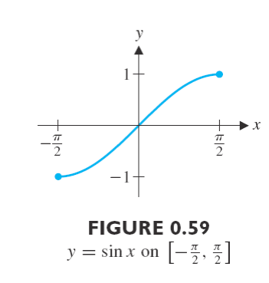

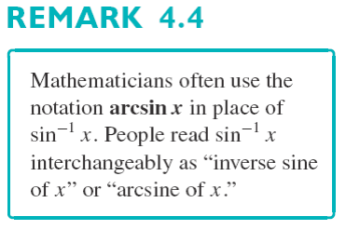
The Inverse Trigonometric Functions
IMPORTANT THEORY
*

Slide 33
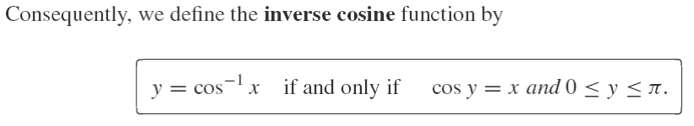



BOARD WORK
*

Slide 34

IMPORTANT THEORY
Section 0.5 Symmetry (Odd/Even) Functions (奇偶函数)
*

Slide 35


IMPORTANT THEORY
*

Slide 36


BOARD WORK
Example 5.1
*

Slide 37

BOARD WORK
Exercise Question:
Show that any function defined on can be expressed as the sum of an even function and an odd function.
*

