Slide 1
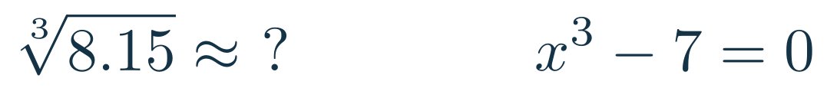
Local approximations
A difficult calculation, a simpler nearby model
Approximate a value
Approximate a root
A line or a polynomial near a known point
Repeated tangent-line estimates
Applications of differentiation
01
Notes:
2 minutes (0–2). Ask which nearby cube root is known exactly. Elicit 8 and 2. Distinguish estimating a function value from solving an equation. Today: linear approximation and differentials, Taylor polynomials, Newton’s method. Later chapter topics include L’Hôpital’s rule, monotonicity, optimization and concavity.
Source: Calculus CDS-3-1.ppt, slides 1–11. Examples and derivations adapted for this lesson.
LaTeX source:
\sqrt[3]{8.15}\approx\ ?\qquad\qquad x^3-7=0

Slide 2
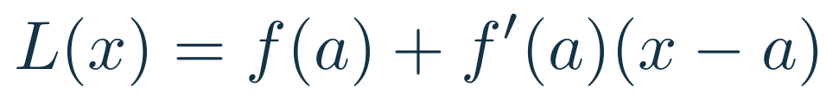
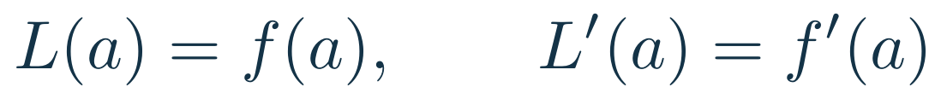
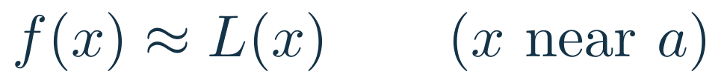
Linear approximation: the tangent line
Same value and slope at the centre
02
Notes:
4 minutes (2–6). Derive the tangent-line formula from point and slope. In the graph, a=0 and f(x)=exp(x). The curve and line agree in value and slope at 0. Compare near 0 and near 1. Approximation is local. Differentiability gives f(a+h)=f(a)+f′(a)h+o(h); no error theorem is required here.
Source: Calculus CDS-3-1.ppt, slides 1–11. Examples and derivations adapted for this lesson.
LaTeX source:
L(x)=f(a)+f^{\prime}(a)(x-a)
L(a)=f(a),\qquad L^{\prime}(a)=f^{\prime}(a)
f(x)\approx L(x)\qquad (x\text{ near }a)

Slide 3

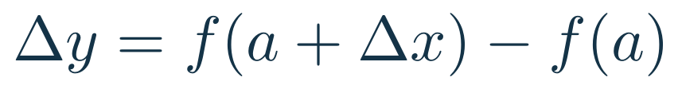
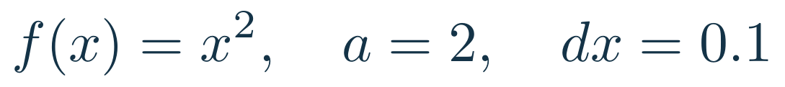
Differentials: predicted and actual change
Example
03
Notes:
3 minutes (6–9). dx is a chosen input increment, not necessarily an infinitesimal. dy is the tangent-line prediction, evaluated at a. Delta y is the actual change of the function. Compute both for x² at 2, with dx=0.1. The discrepancy 0.01 equals (dx)².
Source: Calculus CDS-3-1.ppt, slides 1–11. Examples and derivations adapted for this lesson.
LaTeX source:
dx=\Delta x=x-a
\Delta y=f(a+\Delta x)-f(a)
dy=f^{\prime}(a)\,dx\qquad\Longrightarrow\qquad\Delta y\approx dy
f(x)=x^2,\quad a=2,\quad dx=0.1
dy=0.4,\qquad\Delta y=2.1^2-2^2=0.41

Slide 4
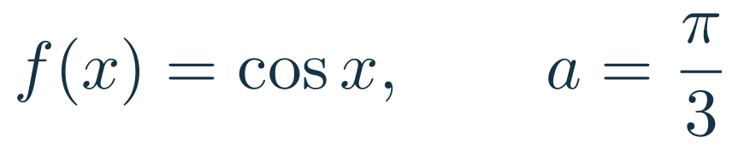
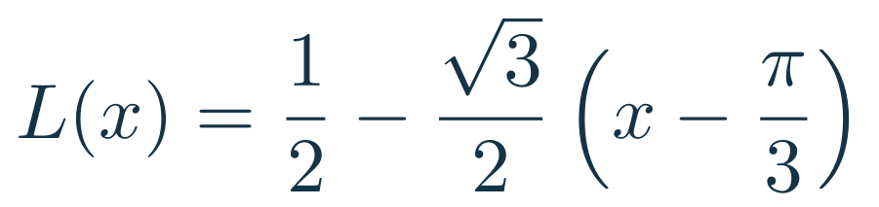

Trigonometric approximations
Your turn: the tangent line at the origin
Board work · angles in radians
04
Notes:
5 minutes (9–14). Derive the cosine line on the board from cos(pi/3)=1/2 and -sin(pi/3)=-sqrt(3)/2. Evaluate at 1 radian. Actual cos(1)=0.540302306, absolute error about 0.000573. Ask students to derive L(x)=x for sin(x) at 0. Emphasize radians and x close to 0.
Source: Calculus CDS-3-1.ppt, slides 1–11. Examples and derivations adapted for this lesson.
LaTeX source:
f(x)=\cos x,\qquad a=\frac{\pi}{3}
L(x)=\frac12-\frac{\sqrt3}{2}\left(x-\frac{\pi}{3}\right)
\cos(1)\approx L(1)\approx 0.540875
f(x)=\sin x,\quad a=0\qquad\Longrightarrow\qquad L(x)=\ ?

Slide 5
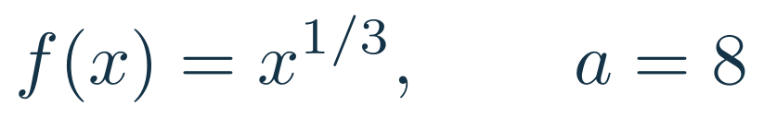
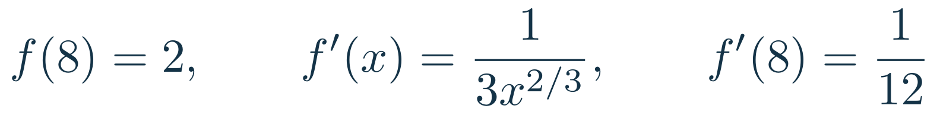
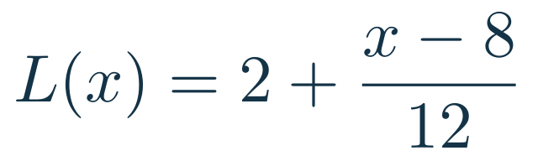
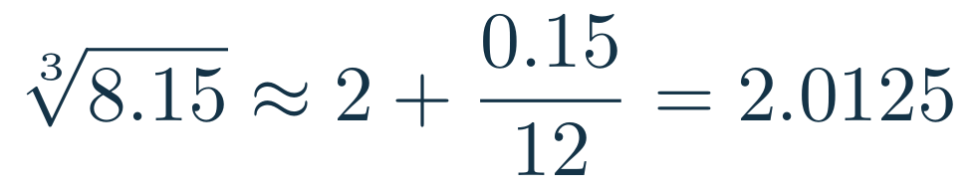
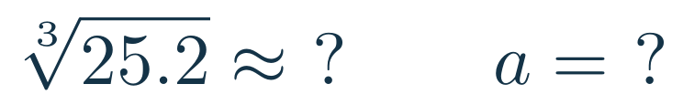
Choosing a useful centre
A nearby exact cube
Board work
05
Notes:
4 minutes (14–18). Explain why a=8 is useful for 8.15. Ask students to choose a=27 for 25.2. Then L(x)=3+(x-27)/27, so cubert(25.2)≈2.933333. Optional quick checks from the original slide: cubert(8.02)≈2.001667 and cubert(8.07)≈2.005833. Approximations are not exact.
Source: Calculus CDS-3-1.ppt, slides 1–11. Examples and derivations adapted for this lesson.
LaTeX source:
f(x)=x^{1/3},\qquad a=8
f(8)=2,\qquad f^{\prime}(x)=\frac{1}{3x^{2/3}},\qquad f^{\prime}(8)=\frac1{12}
L(x)=2+\frac{x-8}{12}
\sqrt[3]{8.15}\approx 2+\frac{0.15}{12}=2.0125
\sqrt[3]{25.2}\approx\ ?\qquad a=\ ?

Slide 6
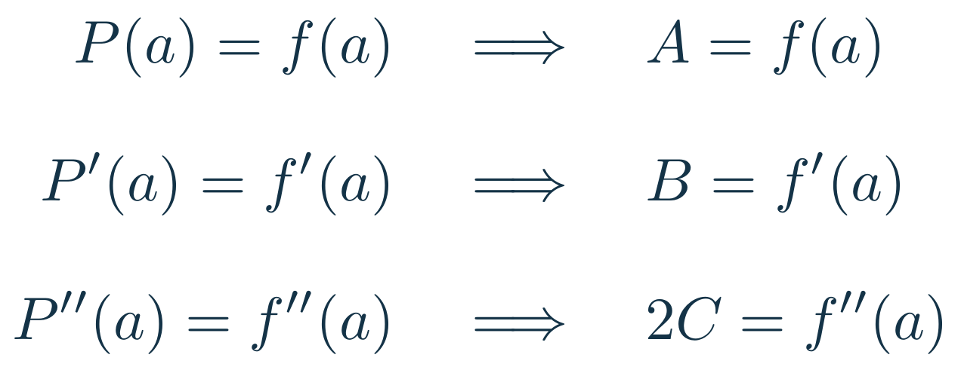
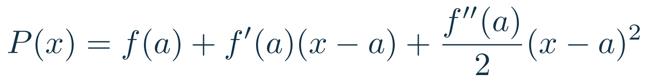
Quadratic approximation: three conditions
Match the value, first derivative and second derivative at the centre
06
Notes:
5 minutes (18–23). Assume f has a second derivative near a. Write P=A+B(x-a)+C(x-a)². Differentiate: P′=B+2C(x-a), P″=2C. Evaluate at a, then impose the three displayed conditions. These are exactly the conditions missing from the source slide. The factor 1/2 comes from differentiating the squared term twice. Matching derivatives gives the local Taylor model, not a global best-fit polynomial.
Source: Calculus CDS-3-1.ppt, slides 1–11. Examples and derivations adapted for this lesson.
LaTeX source:
P(x)=A+B(x-a)+C(x-a)^2
\begin{aligned}P(a)=f(a)&\quad\Longrightarrow\quad A=f(a)\\[8pt]P^{\prime}(a)=f^{\prime}(a)&\quad\Longrightarrow\quad B=f^{\prime}(a)\\[8pt]P^{\prime\prime}(a)=f^{\prime\prime}(a)&\quad\Longrightarrow\quad 2C=f^{\prime\prime}(a)\end{aligned}
P(x)=f(a)+f^{\prime}(a)(x-a)+\frac{f^{\prime\prime}(a)}{2}(x-a)^2

Slide 7
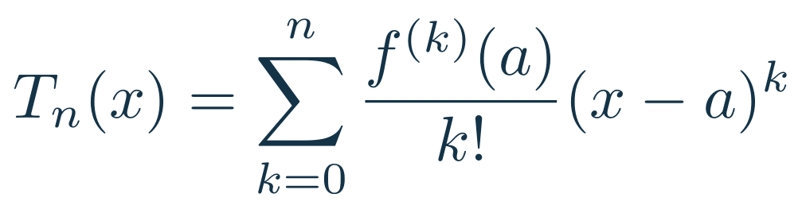
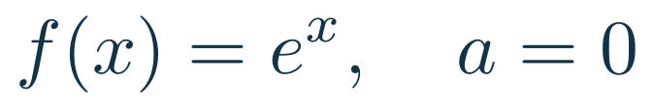
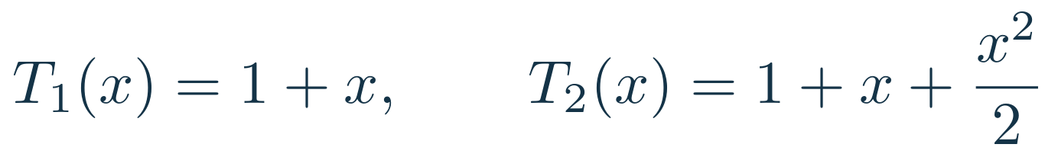
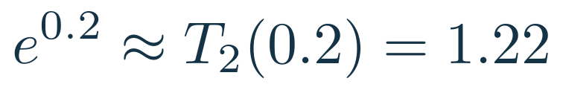
Taylor polynomials
07
Notes:
5 minutes (23–28). T_n is the Taylor polynomial of order n, with degree at most n. Explain that differentiating (x-a)^k k times gives k!, so the coefficient is f^(k)(a)/k!. For exp(x) at 0 all derivatives equal 1. At x=0.2, T1=1.2, T2=1.22, actual exp(0.2)=1.221402758. Higher order is a local approximation idea, not a guarantee of improvement everywhere. A remainder bound is needed for guaranteed accuracy.
Source: Calculus CDS-3-1.ppt, slides 1–11. Examples and derivations adapted for this lesson.
LaTeX source:
T_n(x)=\sum_{k=0}^{n}\frac{f^{(k)}(a)}{k!}(x-a)^k
T_n^{(k)}(a)=f^{(k)}(a),\quad 0\leq k\leq n\qquad (0!=1)
f(x)=e^x,\quad a=0
T_1(x)=1+x,\qquad T_2(x)=1+x+\frac{x^2}{2}
e^{0.2}\approx T_2(0.2)=1.22

Slide 8
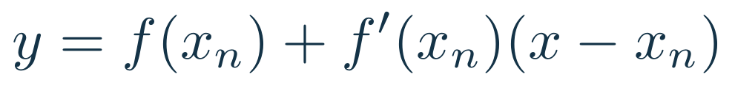
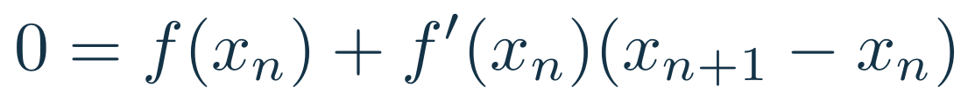
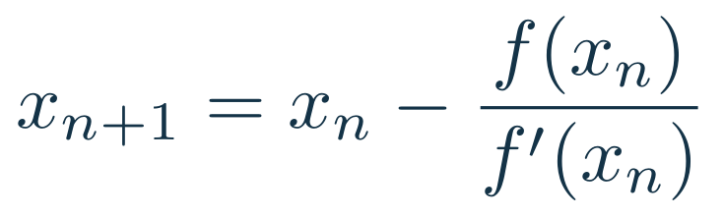
Newton’s method: a tangent-line root
Set the tangent-line height to zero
The intercept gives the next guess
08
Notes:
4 minutes (28–32). Derive the update by solving the tangent-line equation for its x-intercept. In the graph f=x²-2 and x0=2. Its tangent y=4x-6 meets the axis at x1=1.5. The true root is about 1.4142. Rebuild the tangent at the new guess to continue. Distinguish the curve’s root from the tangent’s intercept.
Source: Calculus CDS-3-1.ppt, slides 1–11. Examples and derivations adapted for this lesson.
LaTeX source:
y=f(x_n)+f^{\prime}(x_n)(x-x_n)
0=f(x_n)+f^{\prime}(x_n)(x_{n+1}-x_n)
x_{n+1}=x_n-\frac{f(x_n)}{f^{\prime}(x_n)}

Slide 9
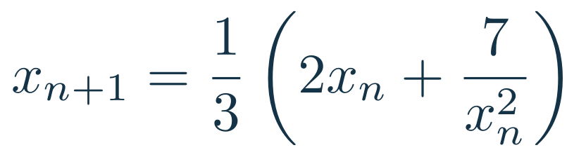
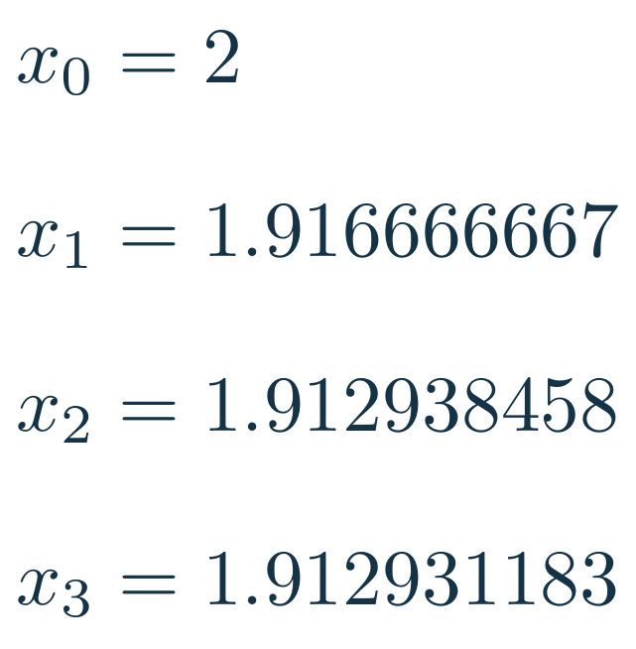
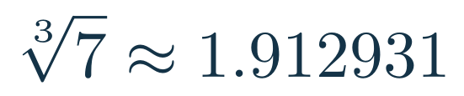
Newton’s method for a cube root
Three updates from the initial guess
Board work · calculate the first two updates
09
Notes:
5 minutes (32–37). Set x³-7=0. Substitute f and f′ in Newton’s formula and simplify. Let students compute x1=(4+7/4)/3=23/12. Then compute x2 and compare with the displayed sequence. Values on slide are rounded for display, not during computation. The positive root is 1.912931182772389.
Source: Calculus CDS-3-1.ppt, slides 1–11. Examples and derivations adapted for this lesson.
LaTeX source:
f(x)=x^3-7,\quad f^{\prime}(x)=3x^2,\quad x_0=2
x_{n+1}=\frac13\left(2x_n+\frac7{x_n^2}\right)
\begin{aligned}x_0&=2\\[7pt]x_1&=1.916666667\\[7pt]x_2&=1.912938458\\[7pt]x_3&=1.912931183\end{aligned}
\sqrt[3]{7}\approx 1.912931

Slide 10
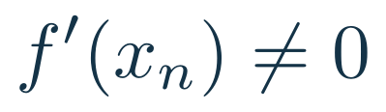
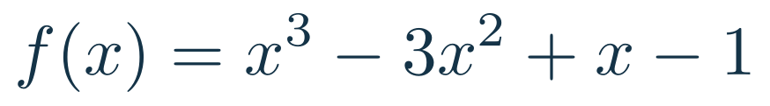
Newton’s method can fail
A nonzero derivative is necessary at every step
This initial guess cycles forever
Monitor the step and residual, and limit the iterations
10
Notes:
4 minutes (37–41). For f=x³-3x²+x-1, f(0)=-1 and f′(0)=1, giving x1=1. At 1, f(1)=-2 and f′(1)=-2, giving x2=0. Thus even nonzero derivatives do not ensure convergence. This is the bad-initial-guess example in the source. Monitor |x_(n+1)-x_n| and |f(x_(n+1))| using scale-appropriate tolerances, set an iteration cap, and watch for small derivatives. Small steps alone do not certify a root. Change the starting point or use a bracketing method if necessary.
Source: Calculus CDS-3-1.ppt, slides 1–11. Examples and derivations adapted for this lesson.
LaTeX source:
f^{\prime}(x_n)\ne0
f(x)=x^3-3x^2+x-1
x_0=0\quad\Longrightarrow\quad x_1=1\quad\Longrightarrow\quad x_2=0\quad\Longrightarrow\quad\cdots

Slide 11
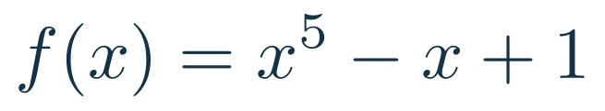
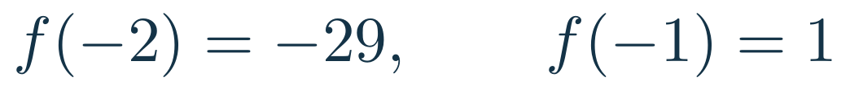
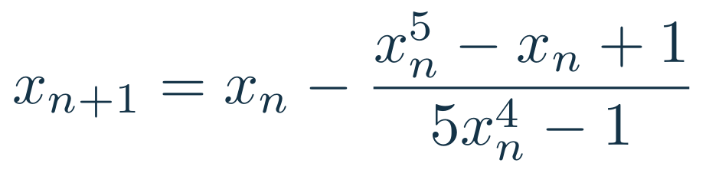
Practice: a zero of a fifth-degree polynomial
A root lies between these points. Start at the right endpoint.
Board work
11
Notes:
4 minutes (41–45). Continuity and opposite signs give a root in (-2,-1). Ask for f′=5x⁴-1 and the iteration. With x0=-1, x1=-1.25 and x2≈-1.178459394. Continued iterations give -1.167537390, -1.167304083, -1.167303978 to displayed precision. Use calculator or board work for the first two updates. Closing question: how does this use the same tangent-line model as linear approximation? If time is short, assign the second update as follow-up.
Source: Calculus CDS-3-1.ppt, slides 1–11. Examples and derivations adapted for this lesson.
LaTeX source:
f(x)=x^5-x+1
f(-2)=-29,\qquad f(-1)=1
x_{n+1}=x_n-\frac{x_n^5-x_n+1}{5x_n^4-1}
x_0=-1\qquad x_1=\ ?\qquad x_2=\ ?

