Slide 1
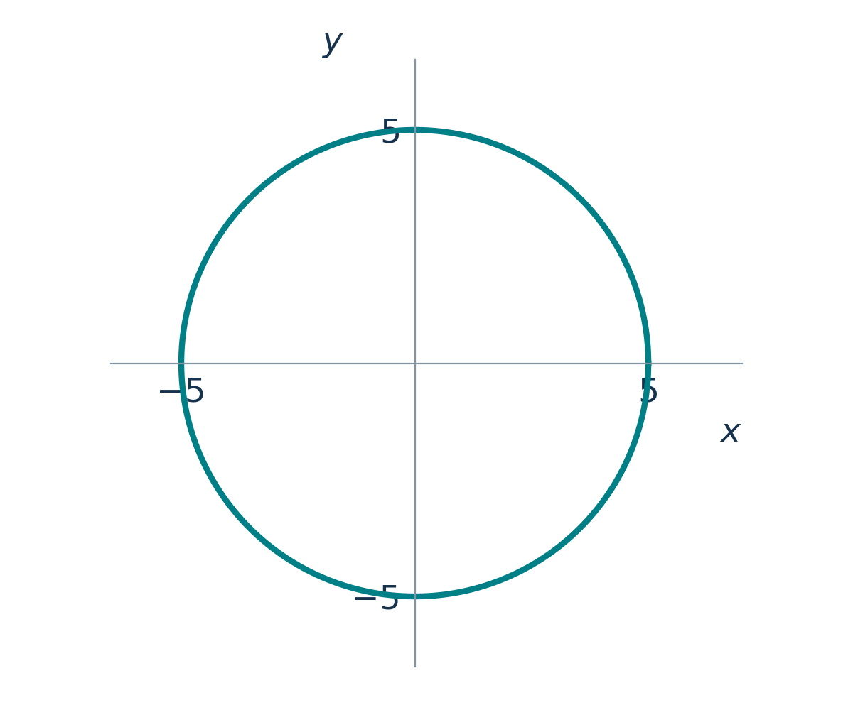

Implicit differentiation
How can we find a tangent without solving for y?
01
Notes:
Lecture 1, minutes 0–2. Suggested time: 2 minutes.
Source: Calculus CDS-2-2.ppt, supplied lecture slides. Examples and explanations adapted for this lecture.
LaTeX source:
x^2+y^2=25

Slide 2

Explicit and implicit forms
Explicit: one variable written in terms of the other
Implicit: a relation between the variables
02
Notes:
Lecture 1, minutes 2–5. Suggested time: 3 minutes.
The explicit formula gives only the upper semicircle. The implicit relation includes both semicircles. Locally, away from the left and right endpoints, each branch is a differentiable function of x.
Source: Calculus CDS-2-2.ppt, supplied lecture slides. Examples and explanations adapted for this lecture.
LaTeX source:
y=\sqrt{25-x^2}
x^2+y^2=25

Slide 3
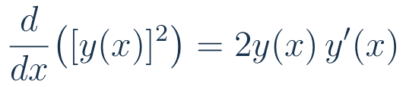
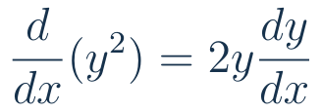
The chain rule in implicit differentiation
The outer function squares; the inner function is y(x).
Differentiate the outer function, then multiply by the inner derivative.
03
Notes:
Lecture 1, minutes 5–9. Suggested time: 4 minutes.
Emphasize the chain rule: outer function u ↦ u², inner function x ↦ y(x). The factor dy/dx is essential because y changes with x. Compare d(y²)/dy=2y with d(y²)/dx=2y dy/dx. Ask students to identify outer and inner functions before differentiating.
Source: Calculus CDS-2-2.ppt, supplied lecture slides. Examples and explanations adapted for this lecture.
LaTeX source:
\frac{d}{dx}\bigl([y(x)]^2\bigr)=2y(x)\,y^{\prime}(x)
\frac{d}{dx}(y^2)=2y\frac{dy}{dx}

Slide 4

A quick chain-rule check
BOARD WORK
Differentiate with respect to x.
What extra factor appears in every answer?
04
Notes:
Lecture 1, minutes 9–12. Suggested time: 3 minutes.
Answers: 4y^3 y′, cos(y)y′, e^y y′. Allow 1 minute of individual work and 2 minutes to discuss.
Source: Calculus CDS-2-2.ppt, supplied lecture slides. Examples and explanations adapted for this lecture.
LaTeX source:
y^4\qquad \sin y\qquad e^y

Slide 5
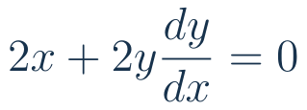
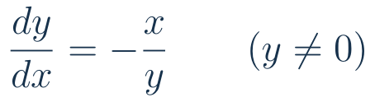
The circle: differentiate both sides
05
Notes:
Lecture 1, minutes 12–16. Suggested time: 4 minutes.
Differentiate term by term, then isolate dy/dx. Explain the restriction before dividing by y.
Source: Calculus CDS-2-2.ppt, supplied lecture slides. Examples and explanations adapted for this lecture.
LaTeX source:
x^2+y^2=25
2x+2y\frac{dy}{dx}=0
\frac{dy}{dx}=-\frac{x}{y}\qquad(y\ne0)

Slide 6
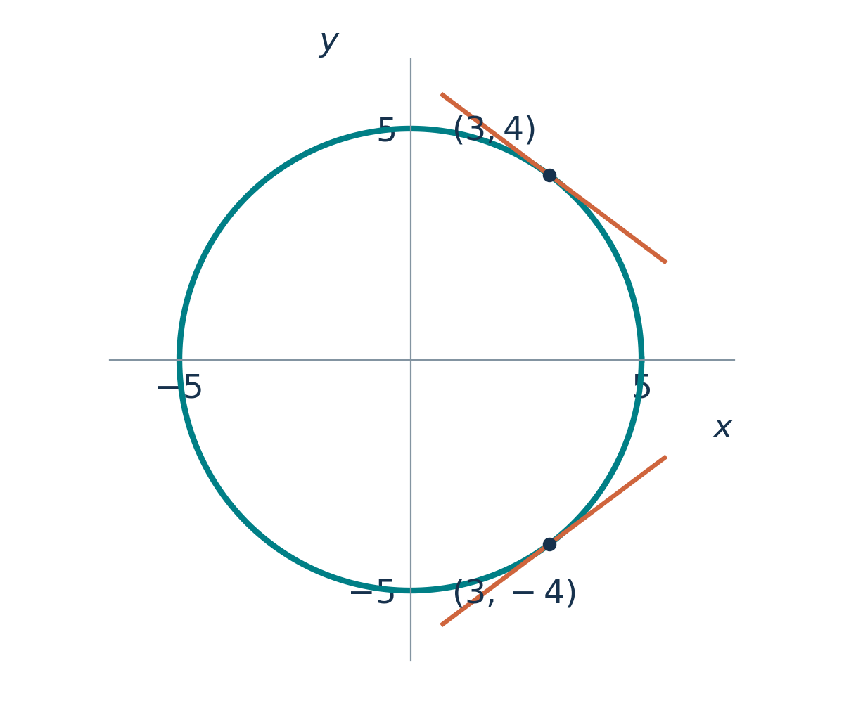
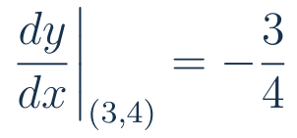
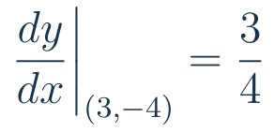
One curve, two tangent slopes
06
Notes:
Lecture 1, minutes 16–20. Suggested time: 4 minutes.
Ask why the signs differ. Read the slopes from the two tangents in the graph.
Source: Calculus CDS-2-2.ppt, supplied lecture slides. Examples and explanations adapted for this lecture.
LaTeX source:
\left.\frac{dy}{dx}\right|_{(3,4)}=-\frac34
\left.\frac{dy}{dx}\right|_{(3,-4)}=\frac34

Slide 7

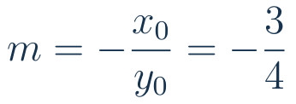
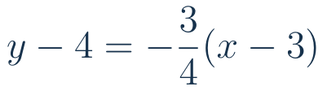
A tangent line: slope and point
BOARD WORK
The derivative gives the slope at this point.
The tangent passes through the same point.
07
Notes:
Lecture 1, minutes 20–24. Suggested time: 4 minutes.
Work through the steps at the board. Verify 3²+4²=25. Evaluate the derivative at the point to get m=-3/4. Use point-slope form y-y₀=m(x-x₀) with (x₀,y₀)=(3,4). The resulting tangent is equivalently 3x+4y=25. Each equation has a different role: the curve specifies the point, the derivative supplies the slope, and point-slope form specifies the tangent.
Source: Calculus CDS-2-2.ppt, supplied lecture slides. Examples and explanations adapted for this lecture.
LaTeX source:
x^2+y^2=25,\qquad P=(3,4)
m=-\frac{x_0}{y_0}=-\frac34
y-4=-\frac34(x-3)

Slide 8
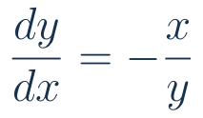
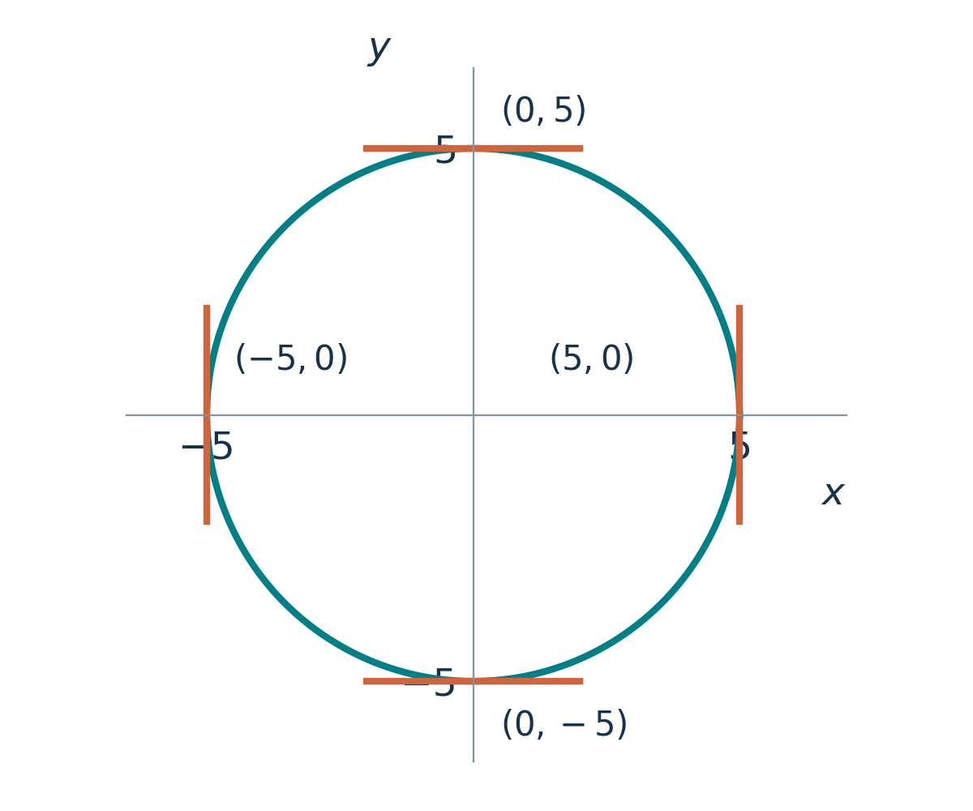
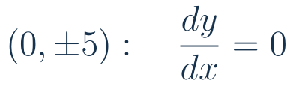

Where are the tangents horizontal or vertical?
At the top and bottom:
At the left and right:
08
Notes:
Lecture 1, minutes 24–27. Suggested time: 3 minutes.
The orange segments mark the four tangents. Top and bottom points have x=0 and y≠0, so their tangent slope is zero. Left and right points have y=0: the formula does not give a finite slope. The circle geometry confirms the tangents there are vertical lines x=±5. A zero denominator by itself is not a general proof of a vertical tangent.
Source: Calculus CDS-2-2.ppt, supplied lecture slides. Examples and explanations adapted for this lecture.
LaTeX source:
\frac{dy}{dx}=-\frac{x}{y}
(0,\pm5):\quad \frac{dy}{dx}=0
(\pm5,0):\quad \text{vertical tangents}

Slide 9


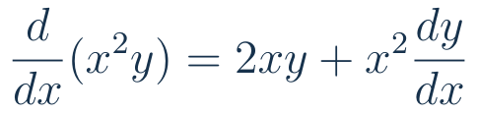
The next example needs the product rule
The mixed term is a product of two functions of x.
09
Notes:
Lecture 1, minutes 27–30. Suggested time: 3 minutes.
Transition: the circle involved a sum of squares. In the next implicit equation, x and y also occur in a product. Both x² and y(x) depend on x, so use the product rule on x²y and the chain rule on y². Identify the two terms in the product-rule result. The next slide applies these rules to the whole equation.
Source: Calculus CDS-2-2.ppt, supplied lecture slides. Examples and explanations adapted for this lecture.
LaTeX source:
x^2y+y^2=x^3
x^2y=x^2\,y(x)
\frac{d}{dx}(x^2y)=2xy+x^2\frac{dy}{dx}

Slide 10

Worked example: differentiate
10
Notes:
Lecture 1, minutes 30–34. Suggested time: 4 minutes.
Source slides 3–4. Let students identify product-rule and chain-rule terms before showing the complete equation. Here and throughout y′ means dy/dx.
Source: Calculus CDS-2-2.ppt, supplied lecture slides. Examples and explanations adapted for this lecture.
LaTeX source:
x^2y+y^2=x^3
2xy+x^2y^{\prime}+2yy^{\prime}=3x^2

Slide 11

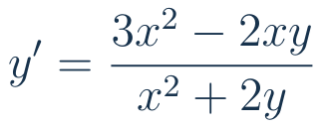

Worked example: collect and solve
11
Notes:
Lecture 1, minutes 34–37. Suggested time: 3 minutes.
Factor y′ rather than moving individual pieces without a plan. The formula applies along a differentiable branch where the denominator is nonzero.
Source: Calculus CDS-2-2.ppt, supplied lecture slides. Examples and explanations adapted for this lecture.
LaTeX source:
(x^2+2y)y^{\prime}=3x^2-2xy
y^{\prime}=\frac{3x^2-2xy}{x^2+2y}
x^2+2y\ne0

Slide 12

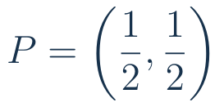
Your turn: an implicit cubic
BOARD WORK
Find the derivative.
Then find the tangent slope at the indicated point.
12
Notes:
Lecture 1, minutes 37–44. Suggested time: 7 minutes.
Source slide 5, extended with a point. Spend 4 minutes in pairs and 3 at the board. 3x²+3y²y′=y+xy′, so y′=(y-3x²)/(3y²-x). At (1/2,1/2), y′=-1; tangent x+y=1.
Source: Calculus CDS-2-2.ppt, supplied lecture slides. Examples and explanations adapted for this lecture.
LaTeX source:
x^3+y^3=xy
P=\left(\frac12,\frac12\right)

Slide 13

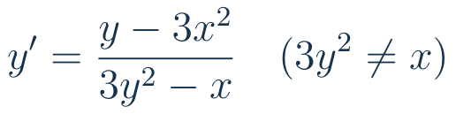

The cubic: solution
13
Notes:
Lecture 1, minutes 44–47. Suggested time: 3 minutes.
Use as a brief check after the board work. Ask where the product rule was used and why x cannot be treated as constant.
Source: Calculus CDS-2-2.ppt, supplied lecture slides. Examples and explanations adapted for this lecture.
LaTeX source:
3x^2+3y^2y^{\prime}=y+xy^{\prime}
y^{\prime}=\frac{y-3x^2}{3y^2-x}\quad(3y^2\ne x)
\left.y^{\prime}\right|_{(1/2,1/2)}=-1

Slide 14
Implicit differentiation: the method
Differentiate both sides with respect to x.
Use the chain rule for every occurrence of y.
Collect the derivative terms and solve.
14
Notes:
Lecture 1, minutes 47–50. Suggested time: 3 minutes.
Final check: ask students for d/dx(sin(xy)) = cos(xy)(y+xy′). This ends the first 50-minute lecture.
Source: Calculus CDS-2-2.ppt, supplied lecture slides. Examples and explanations adapted for this lecture.
LaTeX source:

Slide 15
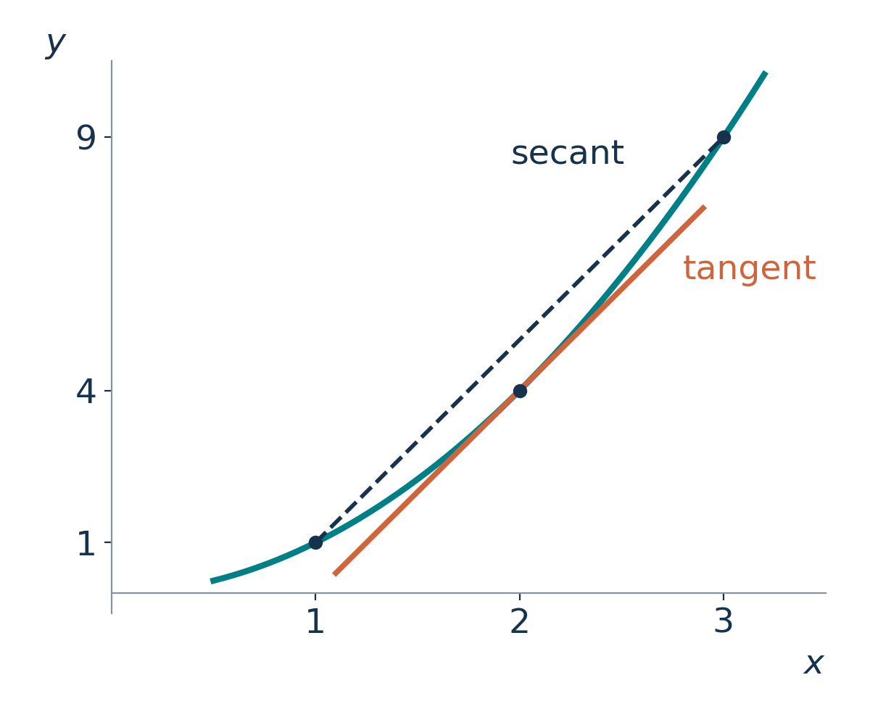
Rolle’s theorem and the MVT
Lecture 2 • 50 minutes
Some tangent line achieves the average slope.
15
Notes:
Lecture 2, minutes 0–1. Suggested time: 1 minutes.
The average slope is the secant slope. Under the MVT hypotheses, at least one interior point has a tangent parallel to the secant. The theorem asserts existence of such a point.
Source: Calculus CDS-2-2.ppt, supplied lecture slides. Examples and explanations adapted for this lecture.
LaTeX source:

Slide 16
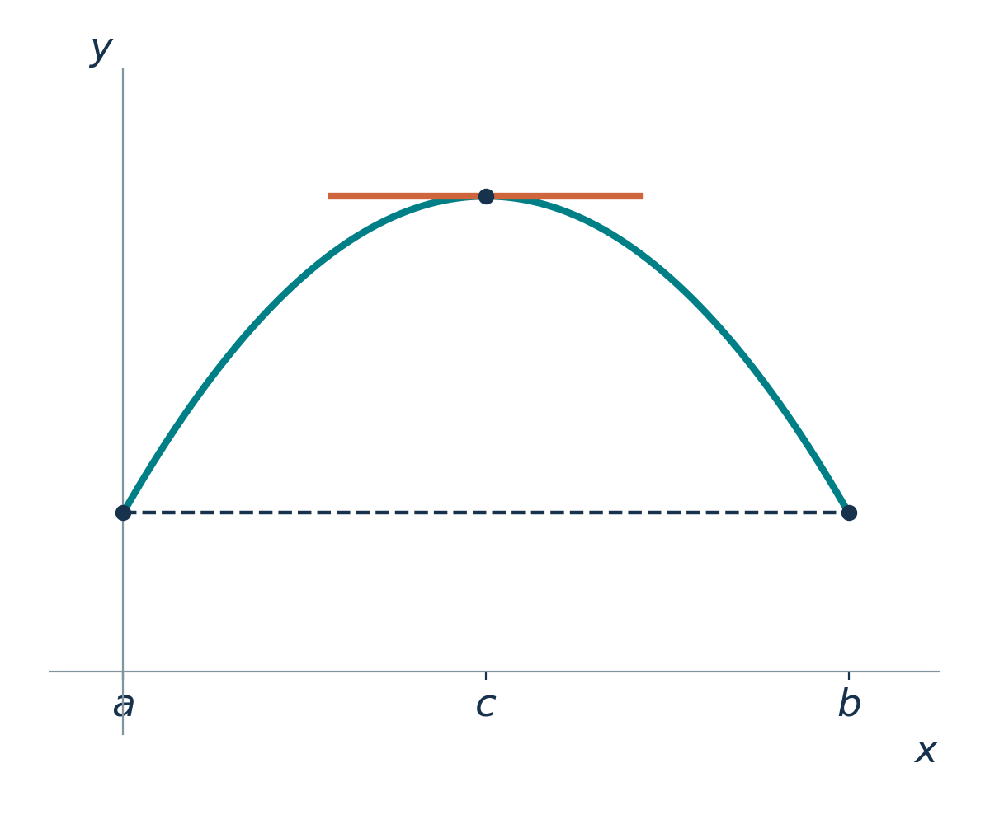

Rolle’s theorem: the geometry
Same height at the endpoints.
A horizontal tangent somewhere between them.
16
Notes:
Lecture 2, minutes 1–4. Suggested time: 3 minutes.
The sketch motivates the statement. A continuous curve can still have a corner, so the hypotheses must be stated next.
Source: Calculus CDS-2-2.ppt, supplied lecture slides. Examples and explanations adapted for this lecture.
LaTeX source:
f(a)=f(b)\qquad f^{\prime}(c)=0

Slide 17


Rolle’s theorem
IMPORTANT THEORY
Continuous on the closed interval
Differentiable on the open interval
17
Notes:
Lecture 2, minutes 4–7. Suggested time: 3 minutes.
Assume a<b. State each hypothesis, distinguishing endpoints from interior points. The conclusion guarantees at least one c.
Source: Calculus CDS-2-2.ppt, supplied lecture slides. Examples and explanations adapted for this lecture.
LaTeX source:
[a,b]
(a,b)
f(a)=f(b)\quad\Longrightarrow\quad\exists c\in(a,b):\ f^{\prime}(c)=0

Slide 18
Why Rolle’s theorem is true
A continuous function attains a maximum and a minimum.
If it is not constant, one occurs in the interior.
18
Notes:
Lecture 2, minutes 7–10. Suggested time: 3 minutes.
Use the extreme value theorem on [a,b]. Since endpoint values agree, a nonconstant function has an interior maximum above them or an interior minimum below them. Fermat’s theorem gives derivative zero. If constant, every interior point works.
Source: Calculus CDS-2-2.ppt, supplied lecture slides. Examples and explanations adapted for this lecture.
LaTeX source:
\text{At an interior extremum:}\quad f^{\prime}(c)=0

Slide 19


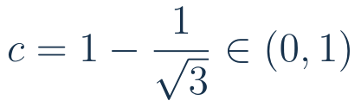
Rolle’s theorem: an example
19
Notes:
Lecture 2, minutes 10–14. Suggested time: 4 minutes.
Source slide 12. Polynomial gives continuity and differentiability. Solve quadratic: roots 1±1/√3; only the minus root lies in (0,1).
Source: Calculus CDS-2-2.ppt, supplied lecture slides. Examples and explanations adapted for this lecture.
LaTeX source:
f(x)=x^3-3x^2+2x+2,\quad [0,1]
f(0)=f(1)=2
f^{\prime}(x)=3x^2-6x+2
c=1-\frac{1}{\sqrt3}\in(0,1)

Slide 20
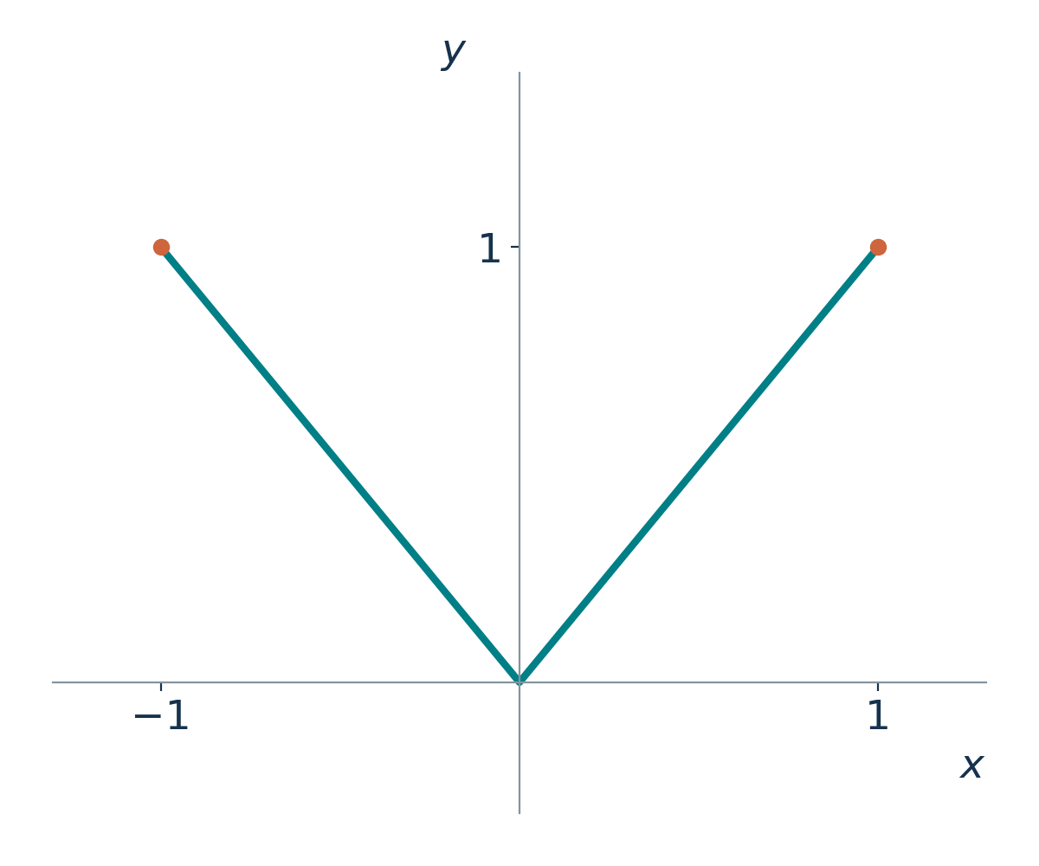



A corner has no tangent slope
BOARD WORK
At the corner, the derivative does not exist.
20
Notes:
Lecture 2, minutes 14–17. Suggested time: 3 minutes.
The graph consists of two exact straight segments meeting at the origin, with no flat segment at the tip. The left derivative is -1 and the right derivative is +1. A horizontal line through the origin touches the graph but is not a tangent in the derivative sense. Away from the corner, the slopes are ±1. Rolle does not apply because differentiability fails at the origin.
Source: Calculus CDS-2-2.ppt, supplied lecture slides. Examples and explanations adapted for this lecture.
LaTeX source:
f(x)=|x|,\qquad [-1,1]
f(-1)=f(1)=1
f^{\prime}_{-}(0)=-1,\qquad f^{\prime}_{+}(0)=1

Slide 21


Rolle guarantees a stationary point
A polynomial is continuous and differentiable.
Rolle guarantees a point between these zeros:
21
Notes:
Lecture 2, minutes 17–20. Suggested time: 3 minutes.
This is an existence proof: the two known zeros and polynomial regularity guarantee a zero of f′ between -1 and 0. No need to solve the derivative equation to establish existence. As a check, c=-1/√3. This prepares the next slide: if f′ never vanishes, two distinct zeros of f are impossible.
Source: Calculus CDS-2-2.ppt, supplied lecture slides. Examples and explanations adapted for this lecture.
LaTeX source:
f(x)=x^3-x,\qquad [-1,0]
f(-1)=f(0)=0
\exists c\in(-1,0):\quad f^{\prime}(c)=3c^2-1=0

Slide 22



Exactly one real root
BOARD WORK
Existence: find a sign change.
Uniqueness: could there be two roots?
22
Notes:
Lecture 2, minutes 20–25. Suggested time: 5 minutes.
Source slide 13. IVT gives a root in (-1,0). If two real roots existed, Rolle would give f′(c)=0 between them, contradicting f′>0. The derivative condition proves at most one, not existence.
Source: Calculus CDS-2-2.ppt, supplied lecture slides. Examples and explanations adapted for this lecture.
LaTeX source:
f(x)=x^3+4x+1
f(-1)=-4,\qquad f(0)=1
f^{\prime}(x)=3x^2+4>0

Slide 23
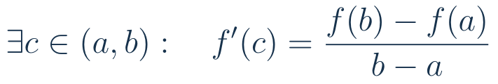
The Mean Value Theorem
IMPORTANT THEORY
Continuous on the closed interval; differentiable inside.
A tangent slope equals the secant slope.
23
Notes:
Lecture 2, minutes 25–28. Suggested time: 3 minutes.
Assume a<b. Explain C[a,b] as notation for continuity on [a,b]. Unlike Rolle, equal endpoint values are not required.
Source: Calculus CDS-2-2.ppt, supplied lecture slides. Examples and explanations adapted for this lecture.
LaTeX source:
f\in C[a,b],\qquad f\text{ differentiable on }(a,b)
\exists c\in(a,b):\quad f^{\prime}(c)=\frac{f(b)-f(a)}{b-a}

Slide 24

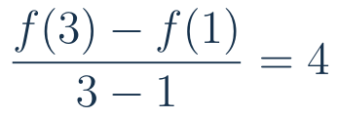

A tangent parallel to the secant
24
Notes:
Lecture 2, minutes 28–31. Suggested time: 3 minutes.
Secant y=4x-3; tangent at c=2 is y=4x-4. Their slopes agree even though the lines differ.
Source: Calculus CDS-2-2.ppt, supplied lecture slides. Examples and explanations adapted for this lecture.
LaTeX source:
f(x)=x^2,\qquad [1,3]
\frac{f(3)-f(1)}{3-1}=4
f^{\prime}(2)=4

Slide 25
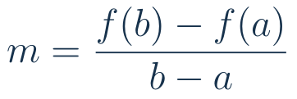



Why the MVT follows from Rolle
Subtract the secant line.
25
Notes:
Lecture 2, minutes 31–35. Suggested time: 4 minutes.
Continuity and differentiability pass to g. Rolle supplies c in (a,b). Geometrically, subtracting the secant removes the overall tilt.
Source: Calculus CDS-2-2.ppt, supplied lecture slides. Examples and explanations adapted for this lecture.
LaTeX source:
m=\frac{f(b)-f(a)}{b-a}
g(x)=f(x)-\bigl[f(a)+m(x-a)\bigr]
g(a)=g(b)=0
g^{\prime}(c)=0\quad\Longrightarrow\quad f^{\prime}(c)=m

Slide 26
Your turn: find the MVT point
BOARD WORK
Check the hypotheses.
Find the secant slope, then the interior point.
26
Notes:
Lecture 2, minutes 35–40. Suggested time: 5 minutes.
Source slide 15. Polynomial satisfies hypotheses. f(0)=1, f(2)=7, secant slope 3. Solve 3c²-2c+1=3: c=(1±√7)/3. Only (1+√7)/3 is in (0,2).
Source: Calculus CDS-2-2.ppt, supplied lecture slides. Examples and explanations adapted for this lecture.
LaTeX source:
f(x)=x^3-x^2+x+1,\qquad [0,2]

Slide 27
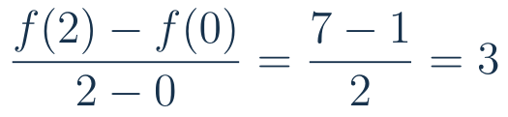

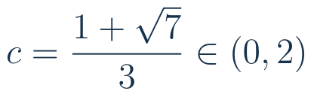
The MVT example: solution
27
Notes:
Lecture 2, minutes 40–42. Suggested time: 2 minutes.
The other quadratic root is negative. Emphasize that the point must lie in the open interval.
Source: Calculus CDS-2-2.ppt, supplied lecture slides. Examples and explanations adapted for this lecture.
LaTeX source:
\frac{f(2)-f(0)}{2-0}=\frac{7-1}{2}=3
3c^2-2c+1=3
c=\frac{1+\sqrt7}{3}\in(0,2)

Slide 28

Zero derivative means constant
IMPORTANT THEORY
Every pair of points has the same function value.
28
Notes:
Lecture 2, minutes 42–45. Suggested time: 3 minutes.
Source slide 16. For any a<b in the interval, differentiability ensures continuity on [a,b], so MVT applies. The interval condition matters.
Source: Calculus CDS-2-2.ppt, supplied lecture slides. Examples and explanations adapted for this lecture.
LaTeX source:
f^{\prime}(x)=0\ \text{throughout an interval}
f(b)-f(a)=f^{\prime}(c)(b-a)=0

Slide 29



The same derivative: a constant difference
Example: find every function with this derivative.
29
Notes:
Lecture 2, minutes 45–48. Suggested time: 3 minutes.
Source slides 16–17. On an interval, apply the preceding result to f-g. Check that all displayed functions have the desired derivative.
Source: Calculus CDS-2-2.ppt, supplied lecture slides. Examples and explanations adapted for this lecture.
LaTeX source:
f^{\prime}=g^{\prime}\quad\Longrightarrow\quad f-g=C
f^{\prime}(x)=3x^2+1
f(x)=x^3+x+C

Slide 30

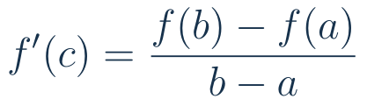
Two theorems, one slope principle
Rolle: equal endpoint values
MVT: arbitrary endpoint values
30
Notes:
Lecture 2, minutes 48–50. Suggested time: 2 minutes.
Exit question: what two regularity assumptions do both theorems share? Continuity on [a,b], differentiability on (a,b). This ends the second 50-minute lecture.
Source: Calculus CDS-2-2.ppt, supplied lecture slides. Examples and explanations adapted for this lecture.
LaTeX source:
f^{\prime}(c)=0
f^{\prime}(c)=\frac{f(b)-f(a)}{b-a}

Slide 31


A bound on the sine function
REFERENCE
Apply the MVT between zero and the given point.
31
Notes:
Optional extension.
Source slide 17. If t>0 use [0,t]; if t<0 use [t,0], yielding the same identity. For t=0 it is immediate. Since |cos c|≤1, the inequality follows. Optional extension beyond the core 100 minutes.
Source: Calculus CDS-2-2.ppt, supplied lecture slides. Examples and explanations adapted for this lecture.
LaTeX source:
\sin t-\sin0=\cos(c)\,t
|\sin t|\le |t|

