Slide 1

CALCULUS FOR SCIENCE & ENGINEERING
50 MIN
Investigating a Function
From derivatives to a convincing graph
01

Slide 2
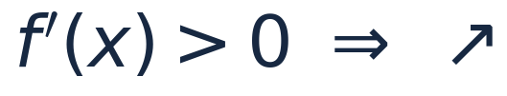
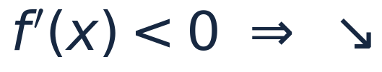
DERIVATIVES / CURVE SKETCHING
4 MIN
The first derivative tells us the direction
POSITIVE SLOPE
NEGATIVE SLOPE
Increasing: the graph rises to the right.
Decreasing: the graph falls to the right.
Find zeros and undefined points of the derivative; then test the intervals.
02

Slide 3


DERIVATIVES / CURVE SKETCHING
4 MIN
Local extrema: watch the sign change
LOCAL MAXIMUM
LOCAL MINIMUM
The function changes from increasing to decreasing.
The function changes from decreasing to increasing.
A critical point is a candidate, not a guarantee of an extremum.
03

Slide 4


DERIVATIVES / CURVE SKETCHING
4 MIN
The second derivative tells us how the slope changes
CONCAVE UP
CONCAVE DOWN
Slopes are increasing; graph bends upward.
Slopes are decreasing; graph bends downward.
At a stationary point: positive second derivative → min; negative → max.
04

Slide 5
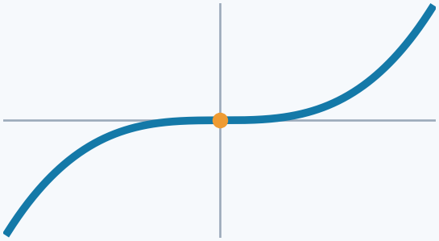
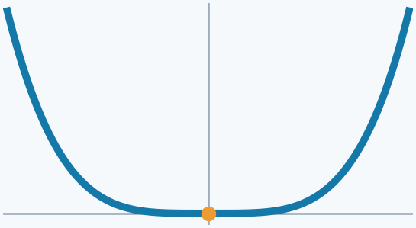
DERIVATIVES / CURVE SKETCHING
3 MIN
A zero derivative is not enough!
01
First derivative
Still increasing through x = 0 — no extremum.
02
Second derivative
Concave up on both sides of x = 0 — no inflection.
Key idea: a zero is a candidate; a sign change tells us what happens.
05

Slide 6
DERIVATIVES / CURVE SKETCHING
5 MIN
The graph-sketching recipe
Domain, intercepts, symmetry
Limits, discontinuities, asymptotes
Critical numbers: signs of the first derivative
Concavity: signs of the second derivative
Mark key points and connect the pieces
This is the curve-sketching workflow distilled from CDS-3-2.
06

Slide 7
DERIVATIVES / CURVE SKETCHING
4 MIN
Example 1 — one cubic, both derivatives
$$f(x)=x^{3}-3x$$
Where are the maxima, minima, and inflection points?
$$f^{′}(x)=3x^{2}-3=3(x-1)(x+1)$$
$$f^{′′}(x)=6x$$
07

Slide 8
DERIVATIVES / CURVE SKETCHING
4 MIN
Example 1 — read the sign charts $f(x)=x^{3}-3x$
FIRST DERIVATIVE
+
−
+
−1
1
Local max at (−1, 2) • local min at (1, −2)
SECOND DERIVATIVE
−
+
0
Concave down for x < 0; concave up for x > 0.
Inflection point: (0, 0)
08

Slide 9
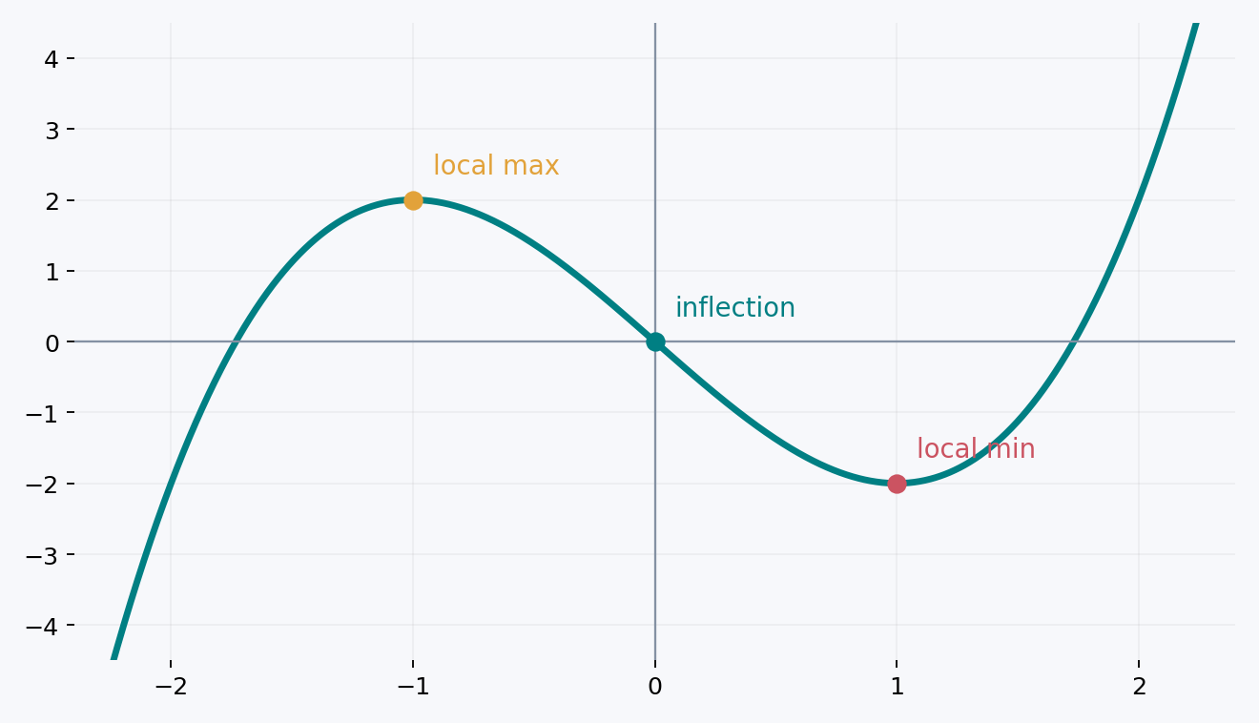
DERIVATIVES / CURVE SKETCHING
3 MIN
Example 1 — now sketch the curve
Three key points
Two turning behaviors
One continuous curve
09

Slide 10
DERIVATIVES / CURVE SKETCHING
4 MIN
Example 2 — domain and asymptotes
$$f(x)=\frac{x}{(x+1)^{2}}$$
DOMAIN
All real numbers except x = −1.
$$\lim_{x→-1^{-}}f(x)=\lim_{x→-1^{+}}f(x)=-∞$$
Vertical asymptote: x = −1
$$\lim_{x→±∞}f(x)=0$$
Horizontal asymptote: y = 0
Intercept: (0, 0)
10

Slide 11
DERIVATIVES / CURVE SKETCHING
5 MIN
$$f(x)=\frac{x}{(x+1)^{2}}$$
Example 2 — derivatives and special points
$$f^{′}(x)=\frac{1-x}{(x+1)^{3}}$$
$$f^{′′}(x)=\frac{2(x-2)}{(x+1)^{4}}$$
LOCAL MAXIMUM
INFLECTION POINT
x = 1, f(1) = 1/4
x = 2, f(2) = 2/9
Do not cross the asymptote at x = −1: it separates two graph branches.
11

Slide 12
DERIVATIVES / CURVE SKETCHING
3 MIN
Example 2 — sign chart → shape
FIRST DERIVATIVE
−
+
−
−1
1
Decreasing | increasing | decreasing
SECOND DERIVATIVE
−
−
+
−1
2
Concave down on both sides of −1 until x = 2; concave up after 2.
12

Slide 13
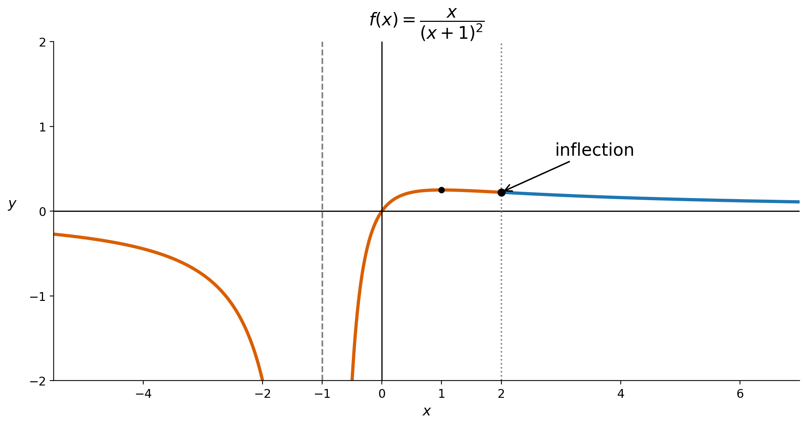
DERIVATIVES / CURVE SKETCHING
3 MIN
Example 2 — finished sketch
13

Slide 14
DERIVATIVES / CURVE SKETCHING
2 MIN
Quick check — what does each derivative tell you?
f′ changes + to −
Local maximum
f′ changes − to +
Local minimum
f″ changes sign
Inflection (if continuous)
f″ = 0
Inconclusive by itself
14

Slide 15
DERIVATIVES / CURVE SKETCHING
2 MIN
Takeaway: five questions before you draw
1. Where is the function defined?
2. Where does it cross the axes, and what happens at the ends?
3. Where is it rising or falling?
4. Where does it bend up or down?
5. How do these facts fit together in one graph?
Read the derivatives. Mark the points. Draw last.
15

