Slide 1
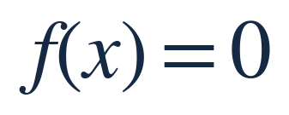
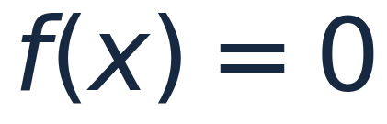
NEWTON–RAPHSON / ROOT FINDING
40–45 MIN
Newton–Raphson Method
Finding roots using tangent lines
One idea • Three applications • When it can fail
01

Slide 2
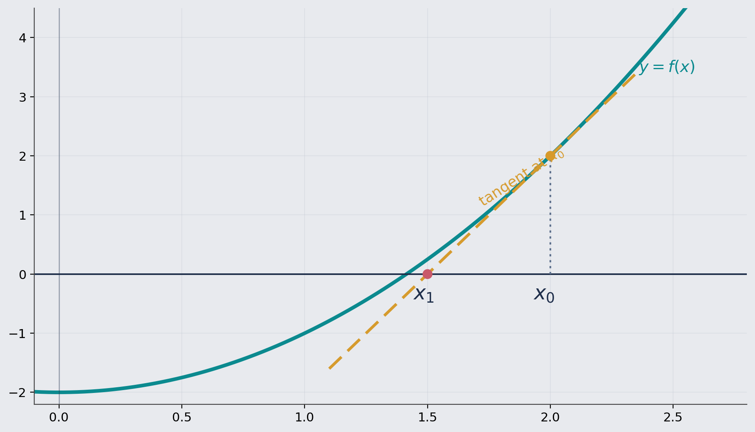
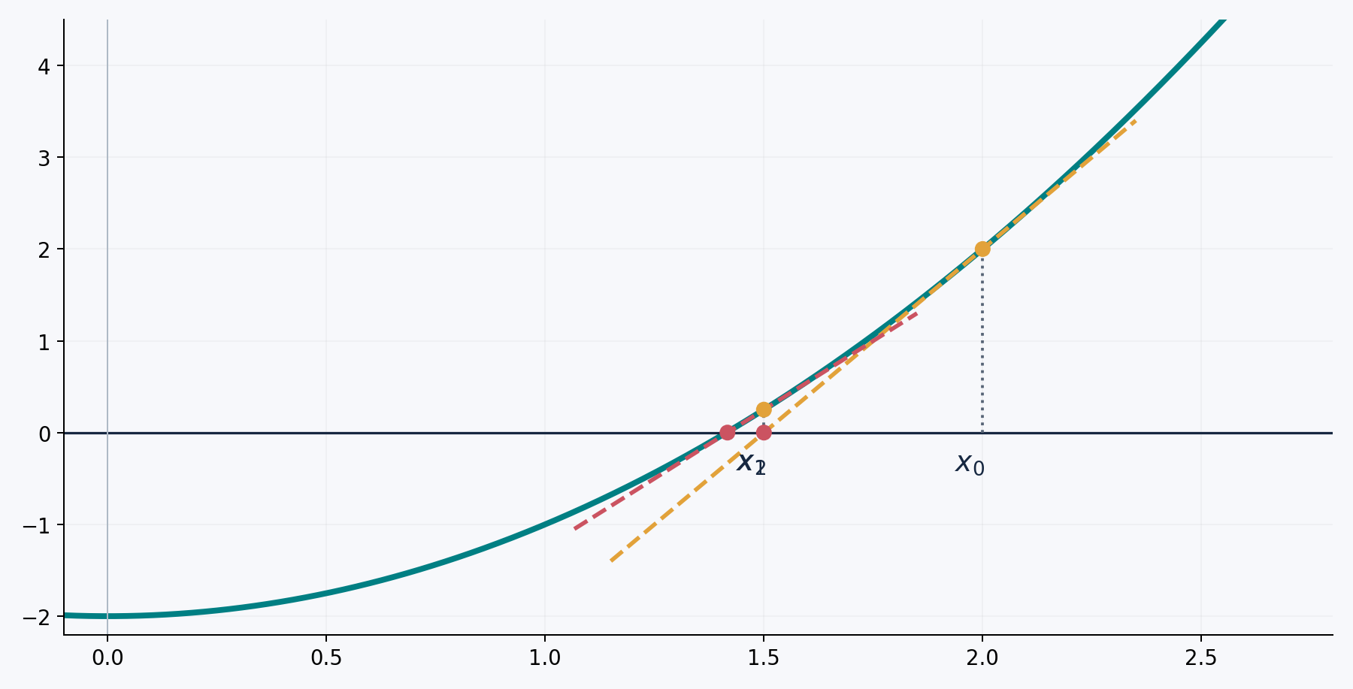
NEWTON–RAPHSON / ROOT FINDING
4 MIN
The idea: replace the curve by its tangent
GEOMETRY
Start at x₀. Draw the tangent. Use its x-intercept as x₁.
02

Slide 3
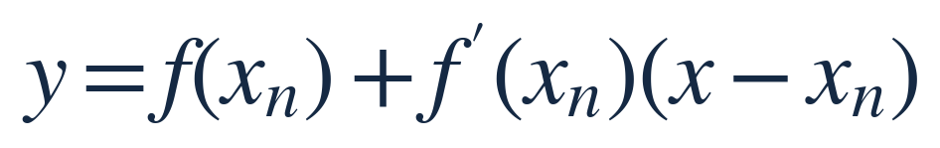
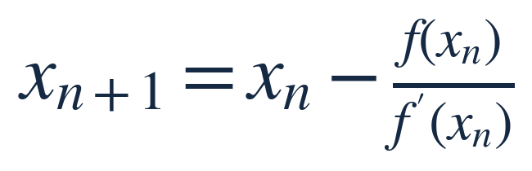
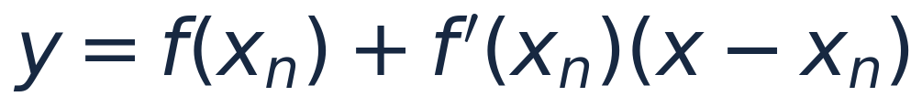
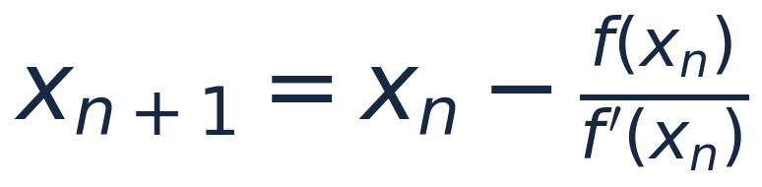
NEWTON–RAPHSON / ROOT FINDING
4 MIN
Derive the Newton iteration
The tangent at the current guess has equation
Set y = 0 to locate its intersection with the x-axis.
03

Slide 4
NEWTON–RAPHSON / ROOT FINDING
3 MIN
How to use it
1
Choose an initial guess x₀ near a root.
2
Compute f(xₙ) and f′(xₙ).
3
Apply the iteration and repeat.
4
Stop when the residual |f(xₙ)| is sufficiently small.
Important: never divide by a zero derivative.
04

Slide 5
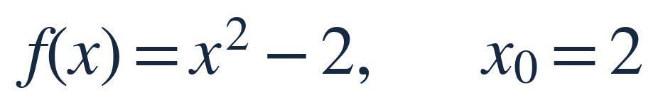
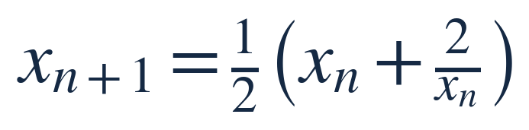
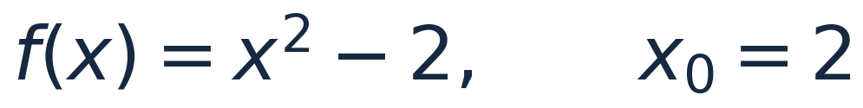
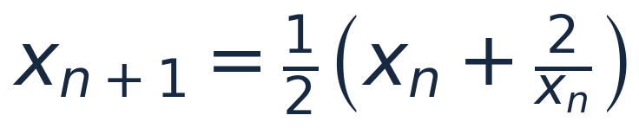
NEWTON–RAPHSON / ROOT FINDING
5 MIN
Example 1: approximate √2
x₀
2
x₁
1.500000000
Four steps give nine correct decimal digits.
x₂
1.416666667
x₃
1.414215686
x₄
1.414213562
05

Slide 6
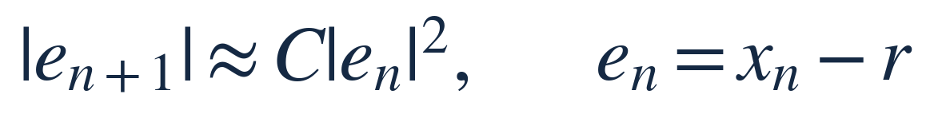

NEWTON–RAPHSON / ROOT FINDING
3 MIN
Why can Newton’s method be so fast?
NEAR A SIMPLE ROOT
The error is often roughly squared at each step.
This is called quadratic convergence (under suitable smoothness and starting conditions).
06

Slide 7
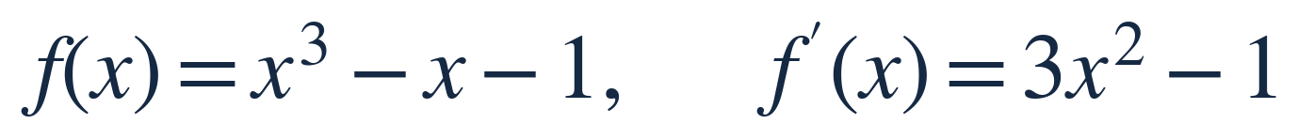
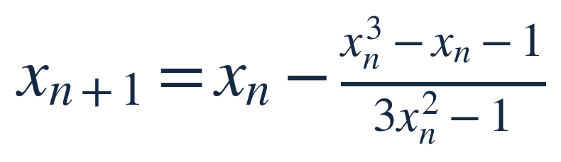
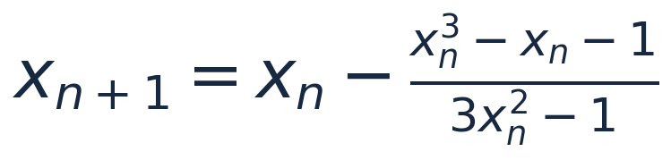
NEWTON–RAPHSON / ROOT FINDING
5 MIN
Example 2: solve x³ − x − 1 = 0
x0 = 1.5000000000
Ask students to compute x₁.
x1 = 1.3478260870
x2 = 1.3252003990
x3 = 1.3247181740
07

Slide 8
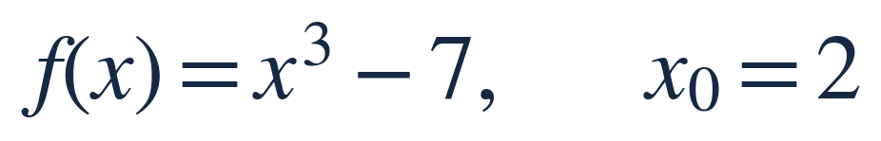
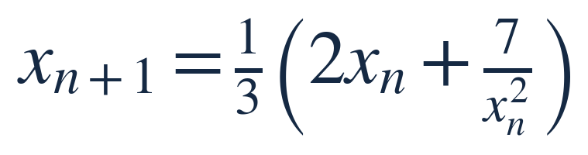
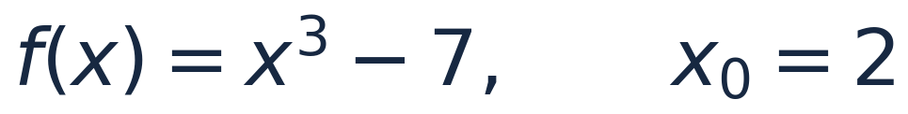
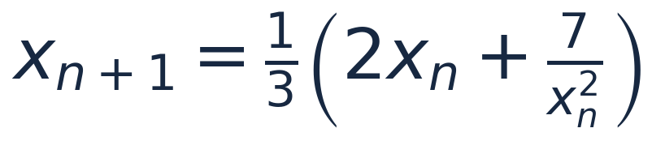
NEWTON–RAPHSON / ROOT FINDING
5 MIN
Example 3: Newton for a cube root
x0 = 2.0000000000
x1 = 1.9166666667
What happens if x₀ = 0?
x2 = 1.9129384583
x3 = 1.9129311828
08

Slide 9
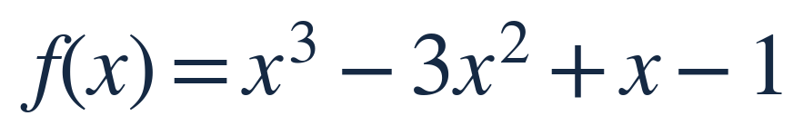
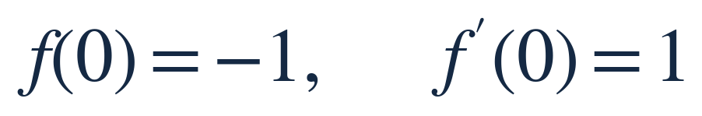
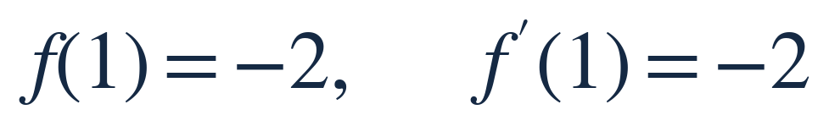

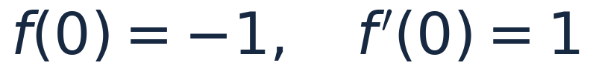
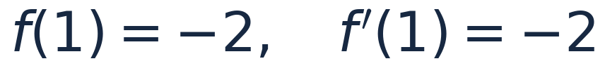
NEWTON–RAPHSON / ROOT FINDING
4 MIN
It can fail: a two-cycle
09

Slide 10
NEWTON–RAPHSON / ROOT FINDING
3 MIN
Other difficulties: horizontal tangents and bad guesses
DIVISION BY ZERO
LARGE STEPS
If f′(xₙ) = 0, the next step is undefined.
If |f′(xₙ)| is tiny, the tangent may jump far away.
Practical safeguards: monitor |f(xₙ)|, limit iterations, or restart with a better guess.
10

Slide 11
NEWTON–RAPHSON / ROOT FINDING
3 MIN
Newton versus bisection
NEWTON
BISECTION
Very fast near a simple root. Requires a derivative and a good initial guess.
Slower but reliable when a continuous function changes sign on a bracket.
Both approximate roots; they offer different speed–reliability tradeoffs.
11

Slide 12
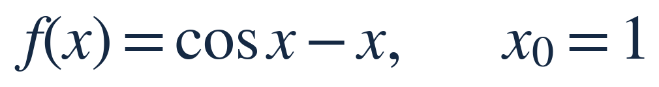
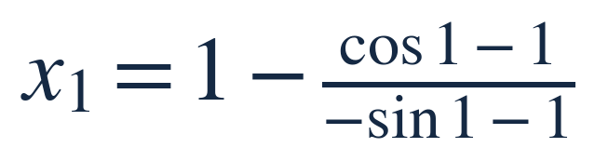
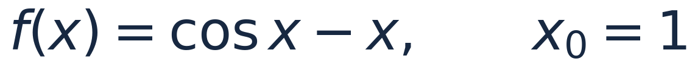
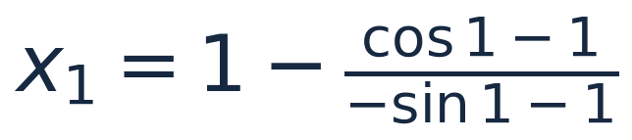
NEWTON–RAPHSON / ROOT FINDING
2 MIN
One-minute check
Write down x₁ (do not calculate it numerically yet).
All trigonometric expressions are in radians.
12

