Slide 1
Exception handling

Slide 2
What is the Exception?
The Exception is unexcepected event during program execution.
Helps to write more reliable code by providing mechanisms to handle unexpected situations.
The Exception is a class which is called when errors occure to display error massages due to have readonly proparities (Massage) such as :
1- Format.
2- OverFlow.
3- Index Out of Bounds.
.

Slide 3
How to deal with ?
Try, Catch and finally Blocks :
try
{ //code;}
catch(exceptionClass obj)
{//How to Handel code;}
finally
{//code to execute}

Slide 4
How to deal with ?
Using throw:
It is usefull when we have exceptional condition in our code.
syntax:
throw /new /exceptionClass/ code to excute;

Slide 5
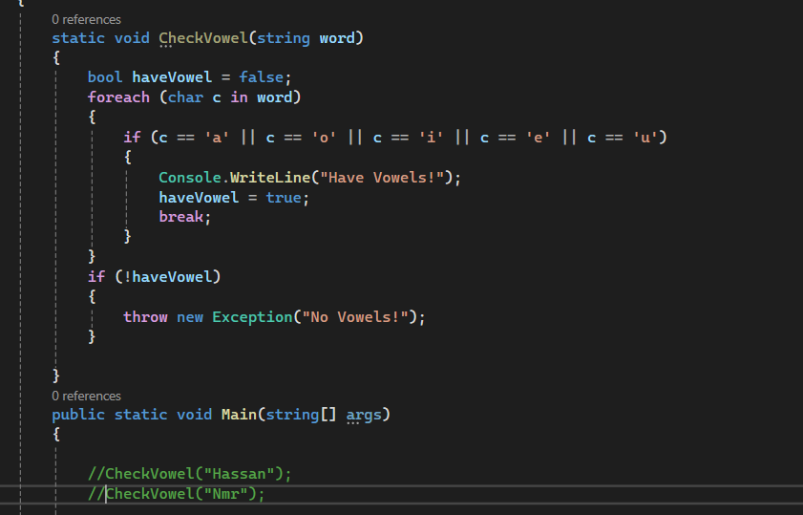
Write a C# program to create a method that takes a string as input and throws an exception if the string does not contain vowels.

Slide 6
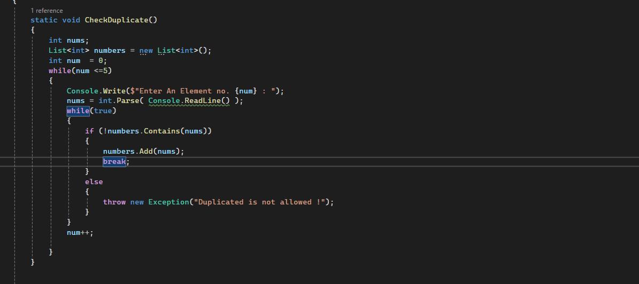
Write a C# program that reads a list of integers from the user and throws an exception if any numbers are duplicates.

