Slide 1
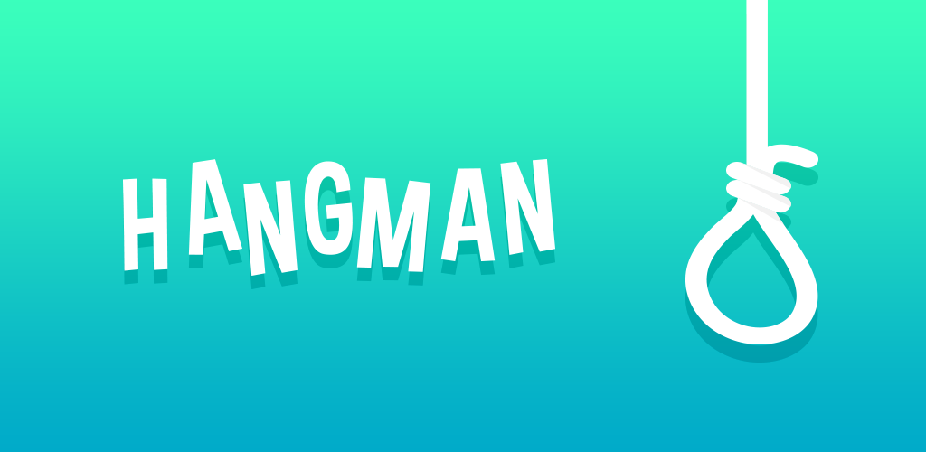
Python project
is a classic word guessing game that challenges players to discover a hidden word by suggesting letters. It's a timeless pastime that combines logic, vocabulary, and a bit of friendly competition.
By:Kenesary,Zhanbolat,Bekzat

Slide 2
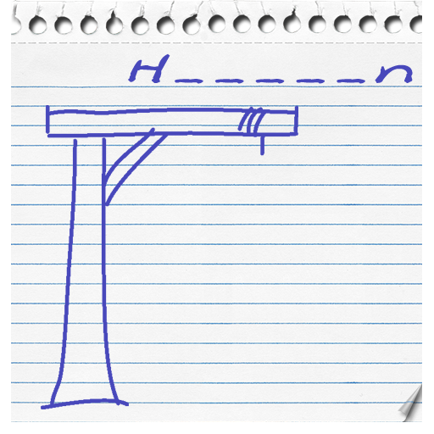
Traditional “Hangman”
Choose a Word
Draw the Gallows
Select a secret word from a dictionary or list, keeping it hidden from the player.
On a piece of paper, draw the outline of the hangman's gallows, leaving blank spaces for the letters of the word.
Prepare Guesses
Set aside a space to keep track of the letters the player has already guessed.

Slide 3

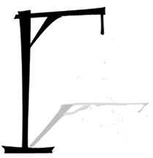
Our “Hangman”
Play on Python
Ready-made Gallows
The Python programming language contributed to this game.
All the necessary elements are located in a special game window.
Quick game
A fast,but no less interesting game for a large company.

Slide 4

Team members
Akylbai Zhanbolat
Khalila Kenesary
Kenganov Bekzat
Responsible for overall game architecture and technical decisions. Writes code.
Selects visual aspects and ensures that the theme and tone of the game match. Writes code.
Collects all files and dictionaries, and adds words to the game. Writes code.

Slide 5
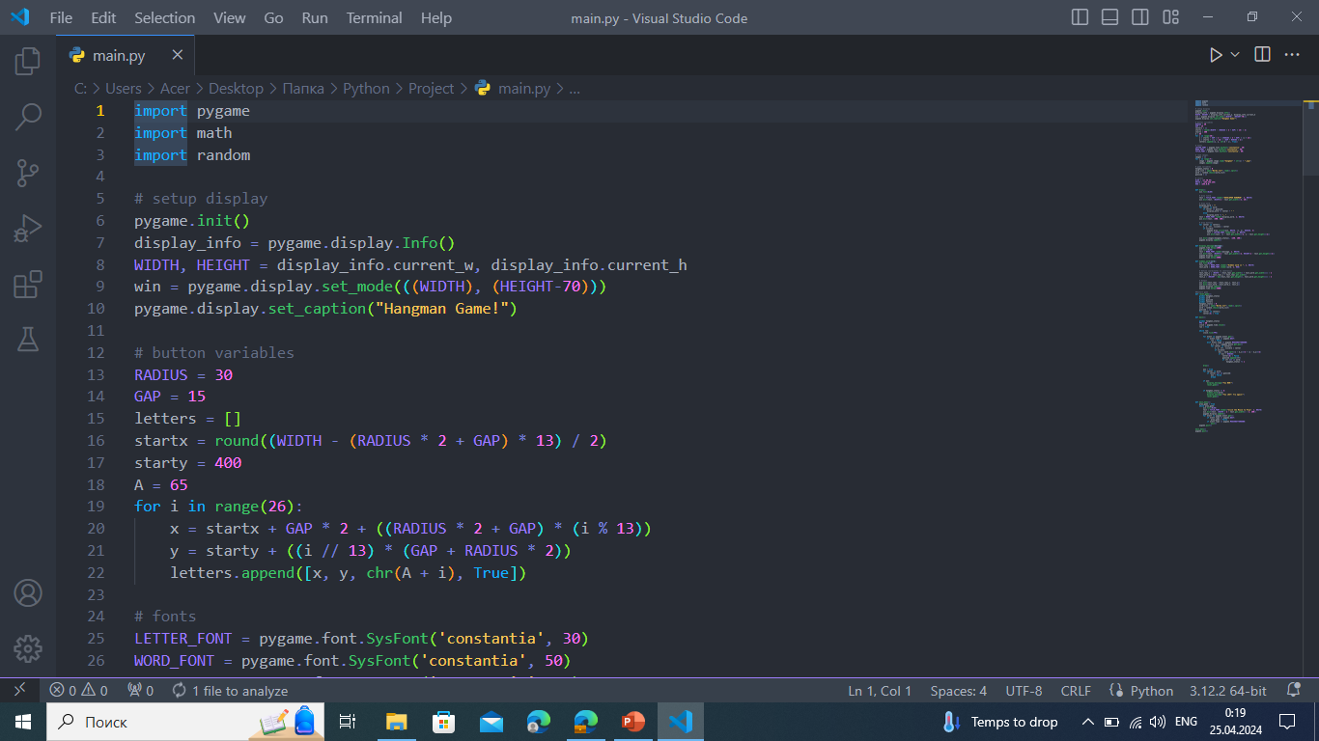
About code
1
The libraries that we used
2
A full semester
“Pygame”,”Math”,”Random”.
We tried to use all the things we've been learning all semester.
3
“Txt” file
To save the unravelable words, we used a txt file.

Slide 6

Conclusion
This game is designed for a great time surrounded by friends, and also for a little competition
We used “Pygame” to implement the project, and also provided links to sources below:
https://pythonist.ru
https://yandex.kz/images
https://replit.com

