Slide 1


SUMMER INTERNSHIP PRESENTATION
by
Mohd Moiz Uddin Zesshan
1604 18 737 024
IT A
at
The Sparks Foundation
for the duration of
September 2021 – October 2021.
Department of Information Technology
Muffakham Jah College of engineering and technology
(Affiliated to Osmania University)

Slide 2
CONTENTS
TOPIC | SLIDE NUMBER
Introduction | 3
Problem Statement | 4
Tools | 5
Overview of the company | 6
Specialization of the company | 7
Overview of activities carried out during internship | 8-10
Specific details of the work/task carried out at the company | 11
Lessons learned | 12-15
Conclusion | 16
Copy of the Internship Certificate | 17

Slide 3
INTRODUCTION
The name of the project is the design and implementation of the Payment Gateway Integration Website.An online payment is a web-based virtual payment method where customers can make the payment and select various methods to pay. The selected method will be genarate to new payment page. This time the website will ask for more information for the transaction. The customer will fill a billing from containing billing details, sender address and his or her payment information like credit card number. The customer will receive an e-mail notification when the payment is successful

Slide 4
PROBLEM STATEMENT
Prepare the Web Page for Online Payment using several designing tools.
An online payment is a web-based virtual payment method where customers can make the payment and select various methods to pay.

Slide 5




TOOLS
HTML
CSS
JavaScript
PayPal API

Slide 6
OVERVIEW OF THE COMPANY
The sparks foundation is working to bring parity in education, making sure children have equal opportunity at success, irrespective of the financial background.
Our Vision Statement
A world of enabled and connected little minds, building future.
Our Mission Statement
Statement: To inspire students, help them innovate and let them integrate to build the next generation
humankind.
Inspire: To inspire, motivate and encourage students to learn, create and help build a better society.
Innovate: To teach new ways of thinking, to innovate and solve the problems on their own.
Integrate: To let the students integrate, and help each other, learn from each other and do well together.

Slide 7
SPECIALIZATION OF THE COMPANY
The Sparks Foundation also give many services like
Software development.
Software Development Kit
Website development.
Mobile app development.
CRM
Inventory management
Analytic, Reporting and Big Data solutions
Dedicated Support Team
Value Added Service Design & Implementation

Slide 8
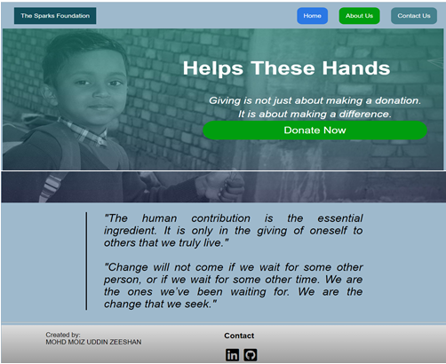
OVERVIEW OF THE ACTIVITIES CARRIED OUT DURING THE INTERNSHIP
.
Front page of the website design using HTML,CSS.

Slide 9
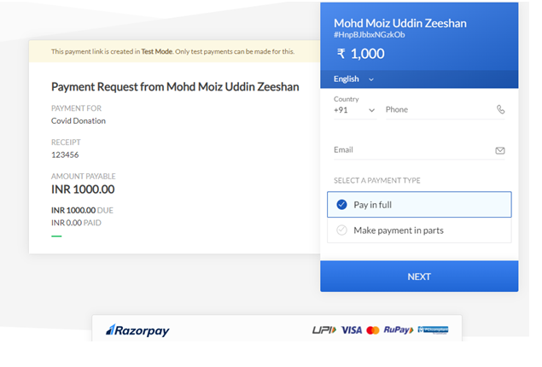
Sign-up page for the donation

Slide 10
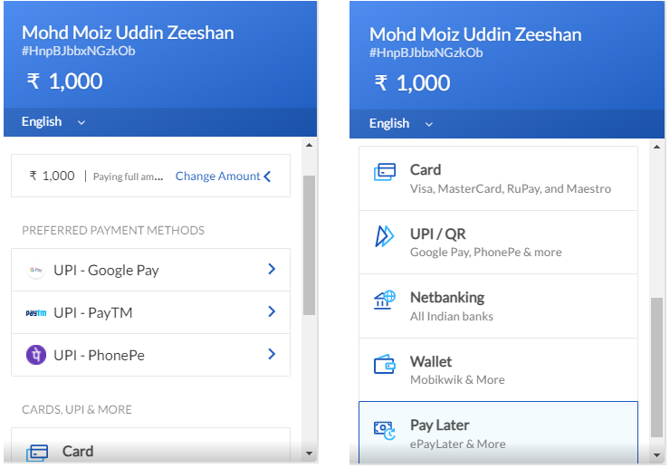
Payment Page using various methods

Slide 11
SPECIFIC DETAILS OF THE WORK CARRIED OUT AT THE COMPANY
Payment Gateway Integration
Create a simple website where payment gateway is integrated.
Add details along with link to access our linkden page,github,etc and company vision and mission.
There will be a simple donate button on homepage. On clicking the donate button, the user will land on the payment page where user can select the amount to be paid and the payment type, e.g. credit card, Paypal, etc.
Create your own temporary / sandbox / testing accounts with 3rd party for integrations.
Host the website at github.io, heroku app or any other free hosting provider. Check in code in gitlab.

Slide 12
LESSONS LEARNED
HTML
Basic HTML (Tags, Element, Attributes, Paragraphs, Headings, Line Breaks,
Horizontal Rule, Lists, Table, Color Codes, Font, Text Linking, Email, Images,
Background, Comments, Meta, Media, Charset)
Basic concept (WWW&amp; HTTP, HTTPS, Client Server Communication)
HTML Forms (Input, Text Fields, Password, Checkbox, Combo Box, Radio, Text Areas, Files, Buttons)
HTML5 features

Slide 13
2. CSS
Basic CSS (selector, internal, external, Inline, Class, Id, Background, font, Text,
Padding, Margin, Border, list CSS, hovering and elements)
Advance CSS (border-radius, opacity, cursor, layers, position, display, float, gradient,
and multiple-column)
Concept of Menus (single menu, dropdown menu)
Template, design using CSS div.

Slide 14
3. Bootstrap
• Environment Setup
• Grid System
• Typography
• Tables, Forms, Buttons, Images
• Drop down, Button group
• Navigation Element
• Bootstrap plug-ins (Transition, Modal, Drop down, Tab, Tool tip, Alert, Button)

Slide 15
4. JavaScript
• Basic JavaScript (Syntax, Enable, Location, Operators, Variables, Events, Alert, Confirm, Prompt, POP up, Date, print)
• JavaScript String (Strings, Length, Split, Search, Replace)
• JavaScript advanced (get Element by Id, Inner HTML, Get table, index, DOM, manipulation, Regular Expression)

Slide 16
CONCLUSION
As we all know, our country is a developing country and it dreams to be a developed country
soon. Hence the government of India has taken many necessary project to fulfilling the
concept of digital India. Day by day our job sector is getting more and more competitive.
As a result every other company is searching for experienced candidates.
Finally, I can claim it & internship that helps me gain experience. Thanks to The Sparks
Foundation, I gained so much more in-depth knowledge of technical skills and personal skills
This project helped me gather theoretical and practical knowledge about HTML4/5, CSS,
MYSQL and other programming language. Beforehand I was confident about designing
and developing frontend of websites. Now I am also confident and competent in backbends.
For those students who are willing to work in web development, there are huge opportunities
available. To give them the scope for online work and development of website, most private
and public organizations employ web designers. With the rapid emergence of the digital
industry, web development professionals & demand is growing, and in the coming days this has
already availed so many job opportunity for newcomers.
My internship company gave me a good scope to learn and discover my potentials. I am very
grateful to them. Now I am able to develop web and mobile applications. I was fortunate for
getting the chance to meet the real life software development environment.

Slide 17

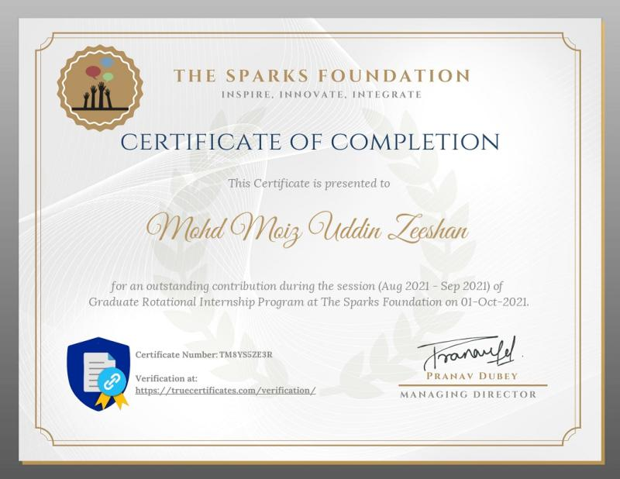
INTERNSHIP CERTIFICATE

Slide 18
THANK YOU
Any Questions?
Mohd Moiz Uddin Zeeshan
1604-18-737-024

