Slide 1
Player Performance Analysis POC

Slide 2
BINARY BURST
→ TEAM MEMBERS :-
TAGORE CHOWDARY K [3BR22CS171]
SATHVIK V S [3BR22CS149]
ZEESHAN [3BR22CS190]
NANDAN RATHOD R [3BR22CS099]

Slide 3
ABSTRACT:
"Player Performance Analysis POC" project employs Python programming and object-oriented design to analyze and monitor cricket player performance throughout a season. The project involves CRUD operations (Create, Read, Update, Delete) for performance data, statistical analysis, and feedback provision based on performance analytics.
→ Key components of the project include:
1. Player Class
2. Performance Data Class
3. Performance Analysis Class
4. Unit Tests
The project's structure facilitates the systematic collection, analysis, and feedback provision for player performance data, aiding coaches and team management in making informed decisions and improving team performance.

Slide 4
SYNOPSIS
The "Player Performance Analysis POC" project is like a digital assistant for cricket teams. It keeps track of how well each player is performing by noting down things like how many runs they've scored, how many wickets they've taken, and how many catches they've made.
Imagine it as having a digital file for each player where their performance details are stored. If a player does something outstanding, like scoring a lot of runs or taking many wickets, the system notices and gives a virtual pat on the back.
it's a handy tool for coaches and team managers because it helps them see who's doing great and who might need a little extra practice. This way, they can make smart decisions to improve the team's overall performance and hopefully win more matches.

Slide 5
PROJECT OVERVIEW
In the "Player Performance Analysis POC" project, we're creating a software tool to manage and analyze cricket player performance. Here's what we're doing:
1. Creating Player Profiles
2. Recording Performance Data
3. Analyzing Performance
4. Providing Feedback
5. Updating and Deleting Data
Overall, our goal is to create a user-friendly tool that coaches and team managers can use to track player performance, identify strengths and weaknesses, and make informed decisions to improve the team's overall success.

Slide 6
MODULE DESCRIPTION
1. Player Class:Attributes:player_id : Represents the unique identifier for each player.name: Stores the name of the player.
Methods:
_init_(self, player_id, name): Constructor method that initializes a Player object with the provided player ID and name.
2. Performance Data Class :Attributes:player : Represents the associated Player object.runs: Stores the number of runs scored by the player.wickets: Stores the number of wickets taken by the player.catches: Stores the number of catches made by the player.
Methods:
_init_(self, player, runs, wickets, catches): Constructor method that initializes a PerformanceData object with the provided Player object and performance metrics.

Slide 7
3. PERFORMANCE ANALYSIS
Class:Attributes:data: A dictionary to store performance data, with player IDs as keys and PerformanceData objects as values.
Methods:
1)_init_(self)
2) create_data(self, player_id, name, runs, wickets, catches)
3) read_data(self, player_id)
4)update_data(self,player_id,runs=None,wickets=None,catches=Non)
5) delete_data(self, player_id)
6) provide_performance_feedback(self, player_id)

Slide 8
4. TestPerformanceAnalysis(unittest.TestCase)
METHODS:
1) setUp(self)
Method Purpose: This method is called before each test method to set up any necessary objects or preconditions required for testing.
Usage: In this method, we create instances of the Player and PerformanceData classes, initializing them with test data.
2) test_create_performance(self)
Method Purpose: Tests the create_performance method of the PerformanceData class.
Usage: It calls the create_performance method to add a performance record for a player and then asserts that the number of performance records for that player is equal to 1.
3) test_update_performance(self)
Method:Purpose: Tests the update_performance method of the PerformanceData class.
Usage: It first creates a performance record for a player, then updates that record using the update_performance method, and finally asserts that the updated score matches the expected value.
4)test_delete_performance(self)
Method Purpose: Tests the delete_performance method of the PerformanceData class.
Usage: It creates a performance record for a player, deletes that record using the delete_performance method, and a sserts that the number of performance records for that player is 0.
5)test_monitor_player_stats(self)
Method Purpose: Tests the monitor_player_stats method of the PerformanceAnalysis class.
Usage: It creates two performance records for a player, calls the monitor_player_stats method to retrieve the performances, and asserts that the number of retrieved performances matches the expected value.
6)test_provide_performance_feedback(self)
Method Purpose: Tests the provide_performance_feedback method of the PerformanceAnalysis class.
Usage: It calls the provide_performance_feedback method with a sample feedback ID and asserts that the returned feedback matches the expected value.

Slide 9
FLOW CHART :
Start
Class initialization
WHILE TRUE
Display menu
Choice=1
Create_data
Display output based on the choice
Choice=2
Read_data
Choice=3
Update_data
Stored in file
Choice=4
Delete_data
Choice=5
feedback
Choice=6
stop

Slide 10
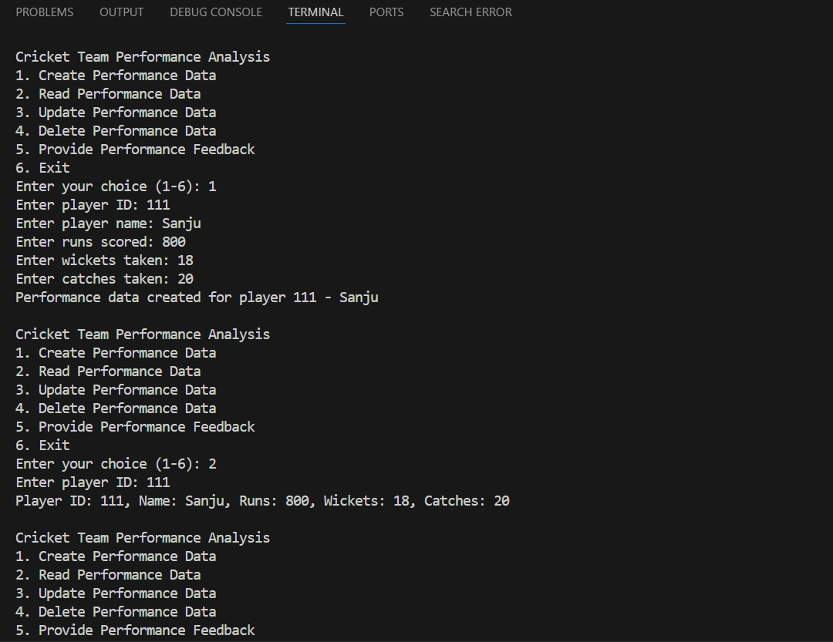
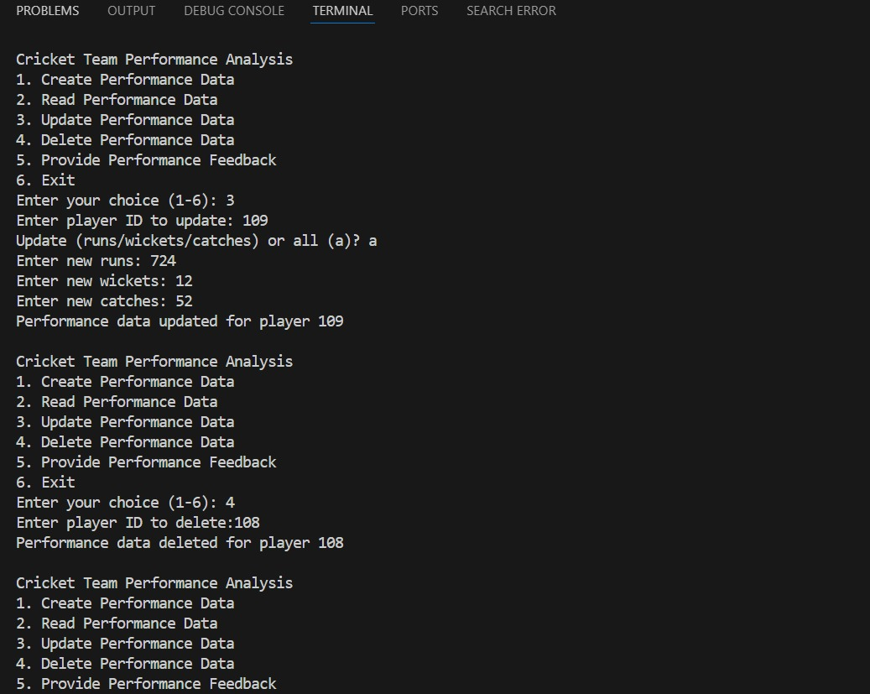
OUTPUT 1 - FILE HANDELING
Performing operations

Slide 11
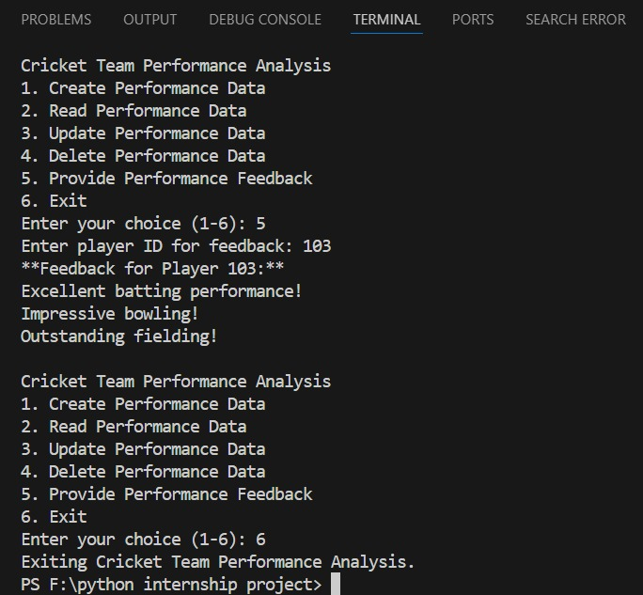

Slide 12
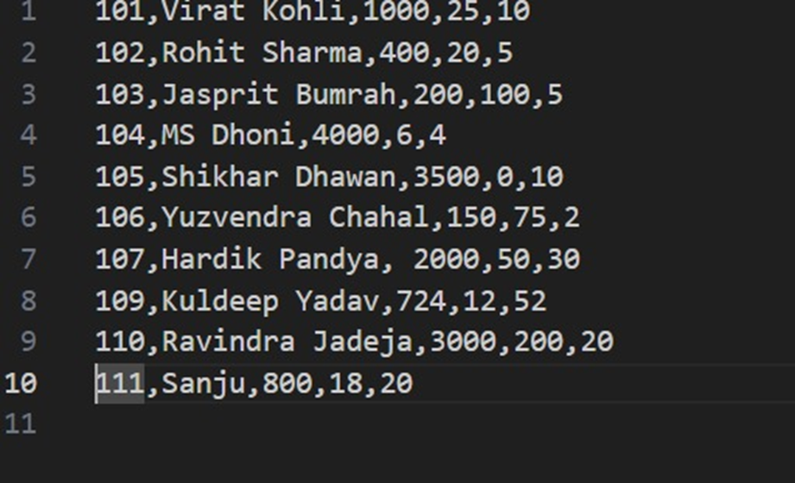
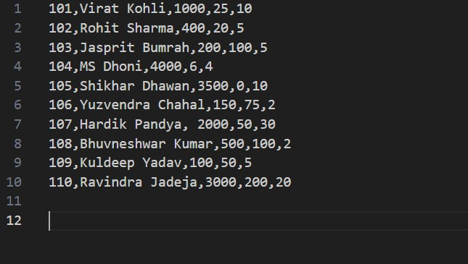
OUTPUT FILE
Input file
INPUT FILE

Slide 13
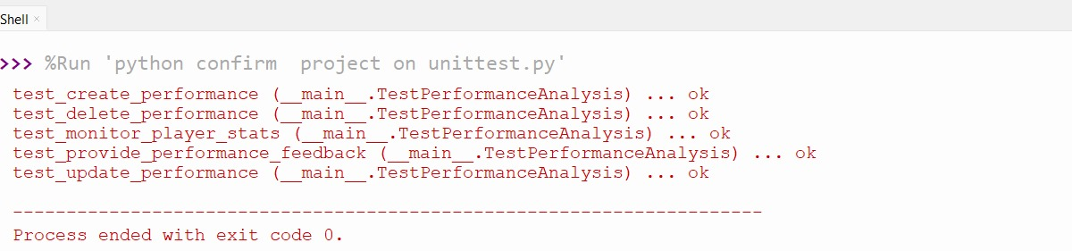
OUTPUT 2 - UNITTEST

Slide 14
Github link:- 1. https://github.com/ZEESHAN55555 2. https://github.com/nandanrathodrnr 3. https://github.com/sathvik-vs-12 4. https://github.com/TagoreChowdary
BIBLIOGRAPHY
Reference link:-
1. https://www.w3resource.com/python-exercises/#google_vignette
2. https://www.programiz.com/python-programming
3. https://www.python.org/

