Slide 1
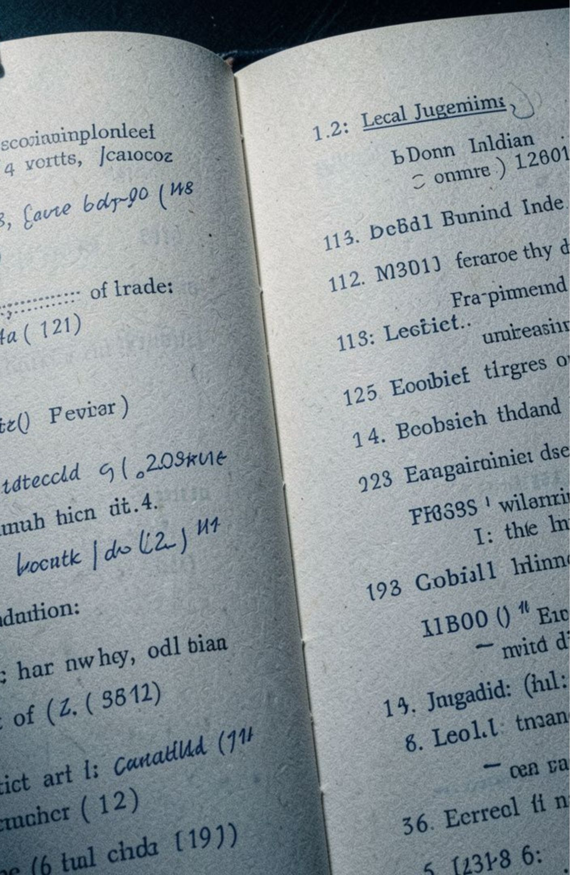
OCTOBER 2026
JurisGraph
Agentic Corrective RAG for Indian Legal Documents
Role-aware retrieval and corrective generation for grounded Indian legal intelligence.
TEAM MEMBERS
ZAHEER SK - 23MID0195
SPURTHI KATOKER - 23MID0302
MONICA S - 23MID0114
EVIDENCE PLATE · ROLE-AWARE LEGAL TEXT

Slide 2
THE GAP
Motivation
Legal RAG fails when argument roles blur
Indian court judgments are long, discursive documents of 30 to over 500 pages that interleave facts, conflicting arguments by petitioners and respondents, statutory quotations and judicial reasoning. Legal professionals do not read them linearly; they look for specific rhetorical elements such as the petitioner's contentions or the operative order. General-purpose LLMs and naive RAG fail here by inverting party attribution, hallucinating statutory grounds and answering confidently when the judgment is silent, a risk highlighted by sanctions in Mata v. Avianca (2023). JurisGraph is motivated by the need for a legally rigorous, grounded workspace where every sentence is role-filtered, relevance-graded and anchored to exact paragraph citations.
Existing approaches leave retrieval, structure, or authority unresolved.
Approach | Limitation | JurisGraph response
Naive RAG | Arbitrary windows | Role-aware chunking
Vanilla InLegalBERT | Erratic label jitter | Viterbi HMM smoothing
Standard CRAG | Web fallback dilution | Closed-corpus correction
Legal NLP benchmarks | Classification stops short of retrieval | End-to-end integration
Motivating event: Mata v. Avianca shows the cost of fabricated citations.
2

Slide 3
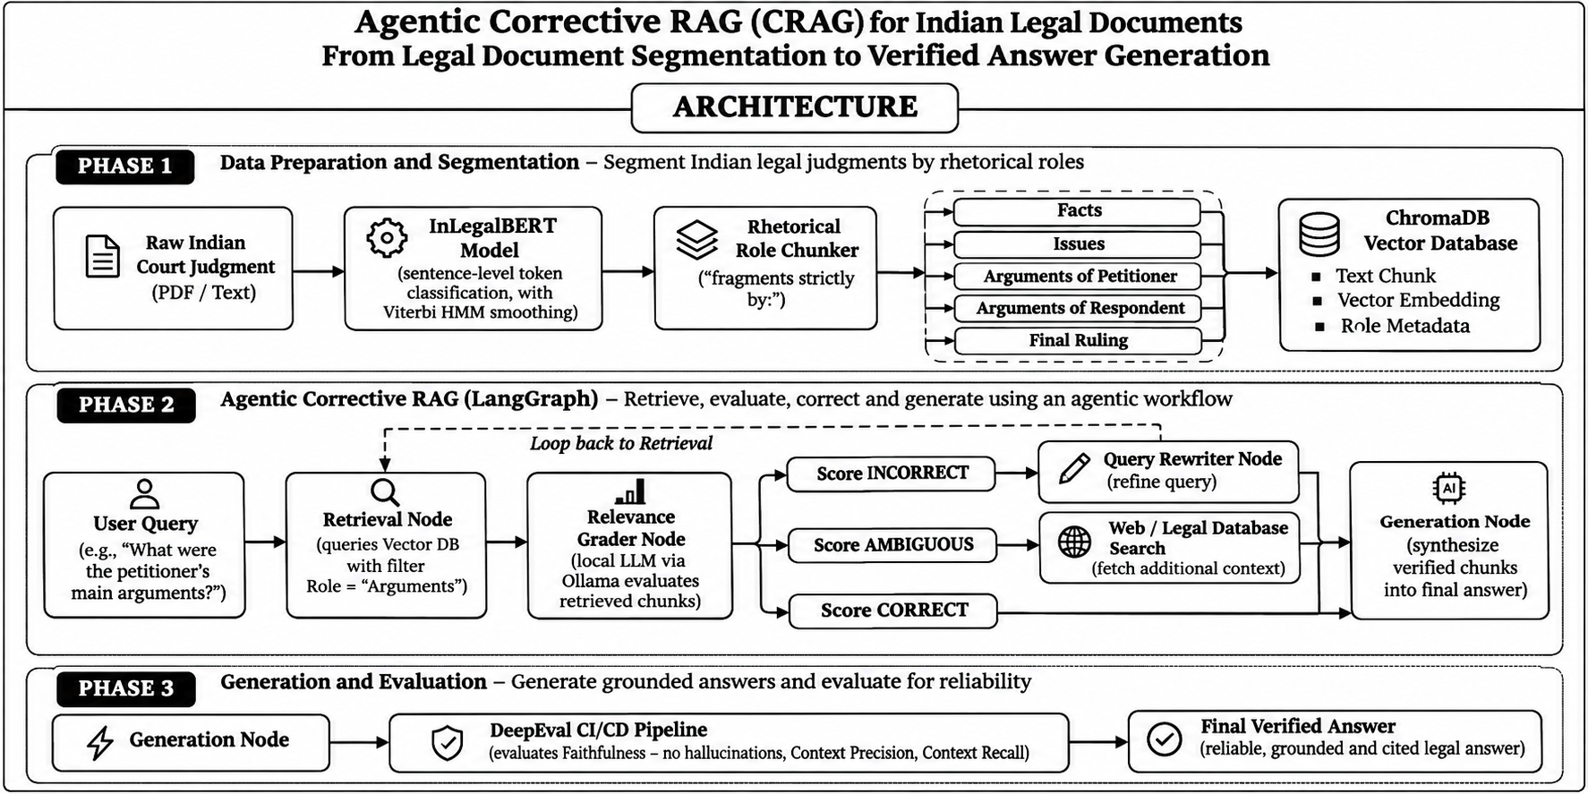
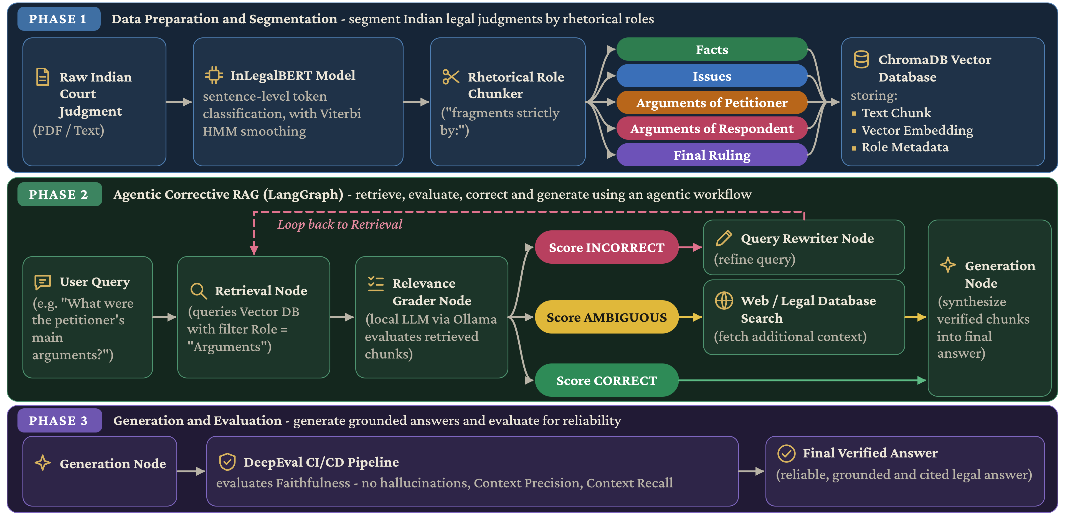
Agentic Corrective RAG (CRAG) for Indian Legal Documents - From Legal Document Segmentation to Verified Answer Generation
ARCHITECTURE
Notes:
Walk the three bands top to bottom: segment and index the judgment by rhetorical role, then run the corrective LangGraph loop of retrieve, grade, rewrite or search, and generate, and finally evaluate the answer with DeepEval before release.

Slide 4




Models
InLegalBERT · BGE-small · ms-marco-MiniLM-L-6-v2 · Ollama llama3.2:3b
Orchestration
SYSTEM STACK
A compact stack for grounded legal intelligence
LangGraph · LangChain Core · deterministic state machine
Data layer
ChromaDB · pypdf · Levenshtein · NumPy Viterbi
Evaluation and UI
Streamlit · Altair · DeepEval · Pytest · Google GenAI judges
4

Slide 5
GROUNDING DATA
Three datasets ground the system
1
LEGALSEG
Indian judgments
7,120
1,492,444 annotated sentences · 7 rhetorical roles.
2
INLEGALBERT CORPUS
Indian decisions
5.4M
Supreme Court and High Court decisions · 1950–2019 · 27 GB.
Gold queries
3
CURATED BENCHMARK SUITE
sample2.pdf, 42 pages · sample3.pdf, 33 pages · 8 adversarial unanswerable queries.
22
5

Slide 6
PROMPT DISCIPLINE
1
Query Router / Role Mapper
Assigns legal role, confidence, and query kind before retrieval.
Three prompts enforce legal discipline
2
Relevance Grader
Checks correctness, ambiguity, and strict party attribution.
3
Grounded Legal Generator
Answers only from retrieved chunks, cites paragraphs, and abstains when evidence is insufficient.
6

Slide 7
END-TO-END PIPELINE
From judgment text to evidence-bounded answers
01
02
03
04
05
06
Extract and preserve text
Segment legal sentences
Classify 7 roles
Smooth with log-space Viterbi
Merge role-aware chunks
Embed into ChromaDB
07
08
09
10
Map query intent
Retrieve and rerank
Grade and self-correct
Generate, audit, and status
Correction thresholds: τ ≥ −0.5 generate · −3.5 ≤ τ < −0.5 relax · τ < −3.5 rewrite up to 2 times, then abstain.
7

Slide 8
EVALUATION
57.52%
74.2%
Test Macro F1
fewer chunks
up from 50.16% with Viterbi smoothing.
105.8 → 27.3 chunks per document.
100.0%
0.0%
abstention rate
false-positive hallucinations
on adversarial unanswerable queries.
in the evaluated benchmark.
Structure and abstention improved together
8

Slide 9
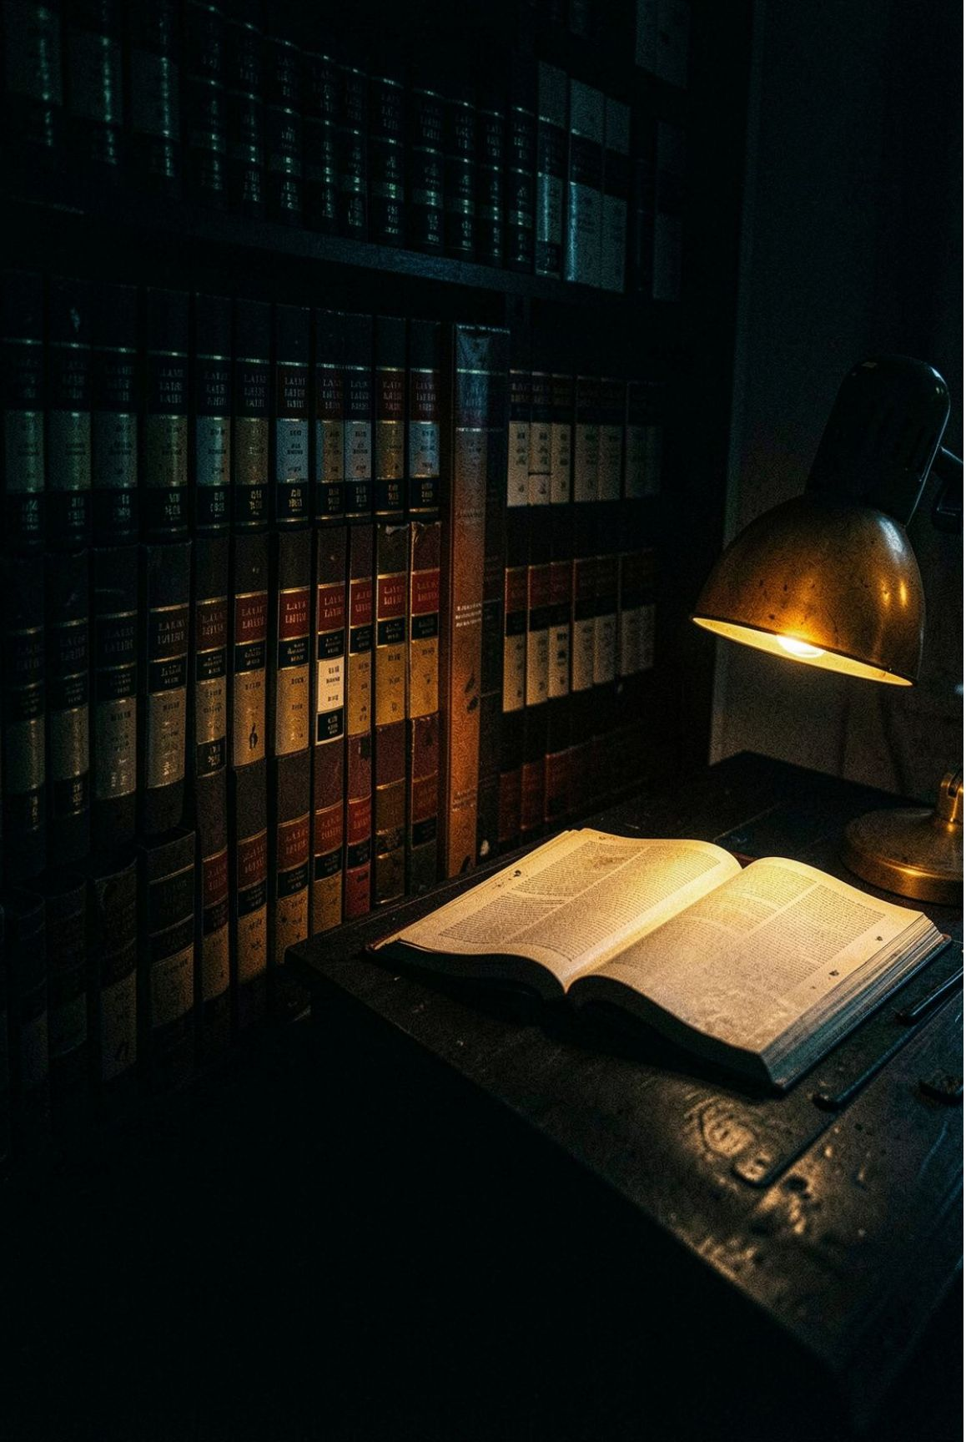
Built for legal research, review, and accountability
WHAT ENTERS
WHAT LEAVES
Inputs
Outputs
English Indian judgments in PDF/TXT, natural-language questions, role filters, and Role-Aware vs Naive Baseline modes.
≤4-sentence grounded answer, inline citations, evidence drawer, execution trace, and VERIFIED / ABSTAINED / NO ANSWER badges.
WHO
Users
appellate advocates · judicial clerks · corporate legal teams · faculty and students.
9

Slide 10
SOURCES
References
Paul et al. (2022), Pre-training Transformers on Indian Legal Text.
01
Nigam et al. (2025), LegalSeg.
02
Bhattacharya et al. (2019), Rhetorical Roles in Indian Legal Judgments.
03
Kalamkar et al. (2022), Structuring Legal Documents.
04
Yan et al. (2024), Corrective Retrieval Augmented Generation.
05
Lewis et al. (2020), Retrieval-Augmented Generation.
06
Es et al. (2024), RAGAS.
07
Xiao et al. (2023), C-Pack (BGE).
08
10

