Slide 1


CDS535 Data Mining
Comparative Data Mining with Mushroom and Ionosphere Datasets
ZENG Xinying — 3162809 ； WU Yanping — 3162225 ； HU Ziqi — 3163047
ZHANG Jiaming — 3163475 ； HU Sirui — 3162768.
2026 – 11 - 10
Group 9

Slide 2
Overview
/CONTENTS
Classification Models and Association Rules
3
Ionosphere Data Analysis
and Preprocessing
1
HU Ziqi
ZENG Xinying
Results and Cross-Dataset Evaluation
4
Mushroom Data Analysis
and Preprocessing
2
ZHANG Jiaming
Discussion, Limitations and Future Work
WU Yanping
5
HU Sirui

Slide 3

PART ONE
Dataset Analysis
ionosphere

Slide 4
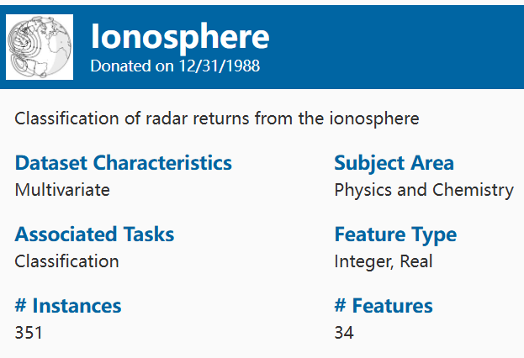

Dataset A: Ionosphere
Dataset Overview
Total Instances: 351 radar records
Total Attributes: 35 (34 numerical predictors and 1 target class)
Data Type: Numerical predictors and one nominal target attribute
Classification Task: Binary classification
Missing Values: 0
Target Variable: class
Bad (b): 126 instances (35.9%)
Good (g): 225 instances (64.1%)
The dataset has a moderately imbalanced class distribution, with class g (good returns) being more common than class b (bad returns).

Slide 5
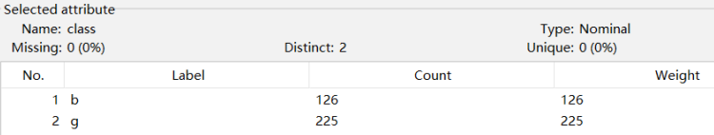
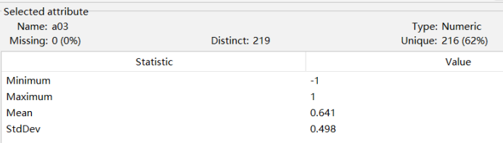
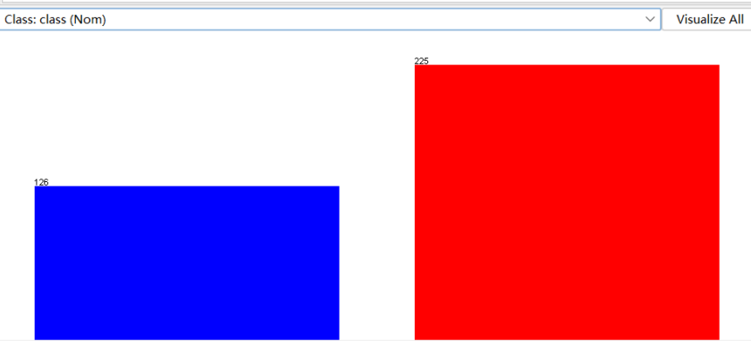
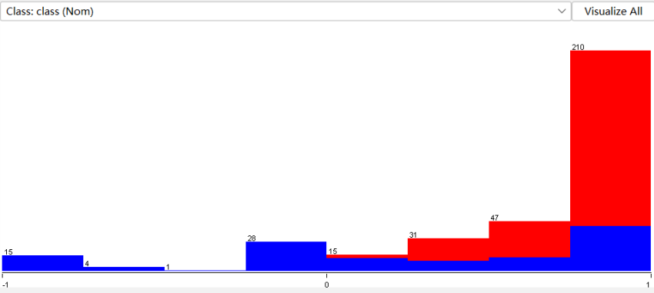
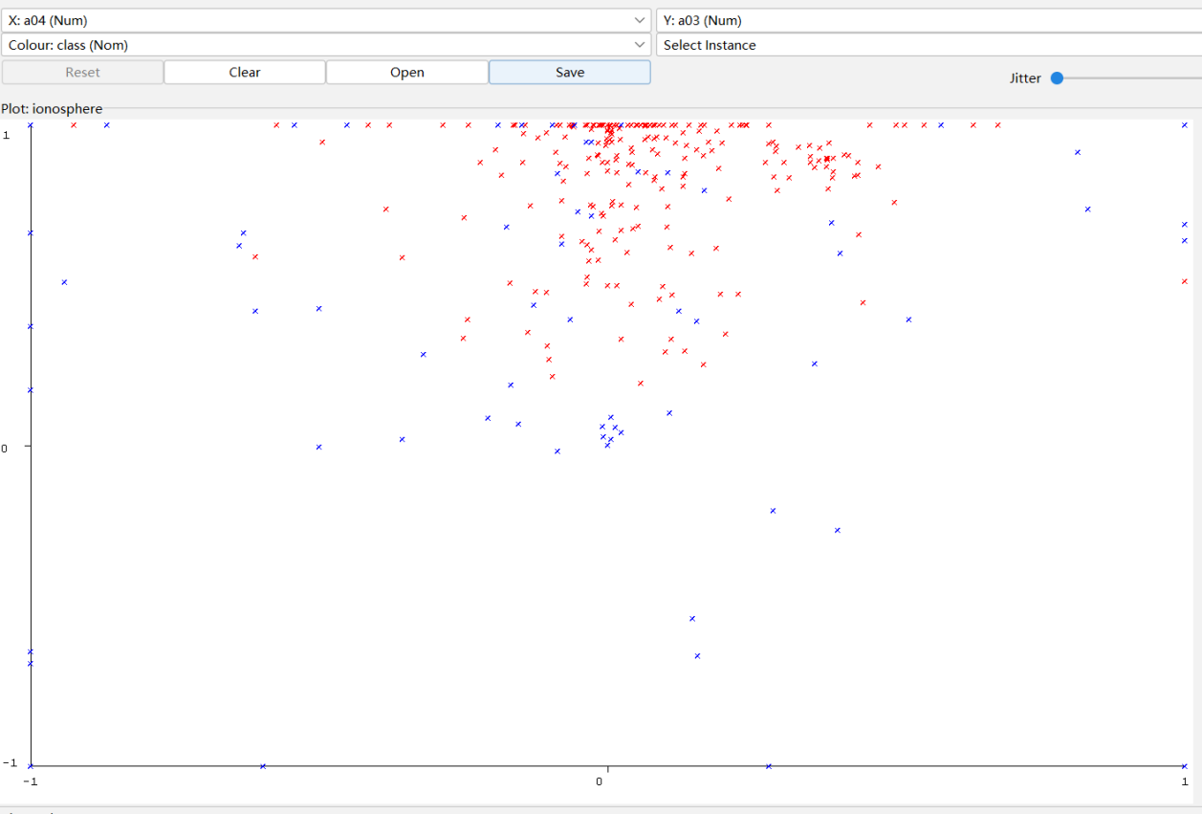
Data Visualisation & Class Distribution
Figure 2. Class Distribution of
the Ionosphere Dataset
Figure 1. Distribution of Attribute a03 by Class
Key Observations
1. Class Imbalance
Class g (64.1%) is more common than class b (35.9%).
2. Feature Distribution
Attribute a03 shows different distributions across the two classes.
3. Class Overlap
The scatter plot shows partial overlap between the two classes.
Figure 3. Scatter Plot of
Attributes a04 and a03 by Class

Slide 6

Data Preprocessing Comparison
Original Dataset vs. Normalized Dataset
Experimental Results
Experimental Settings
Classifier: RandomForest
Filter: Normalize
Evaluation: 10-fold Cross-validation
FilteredClassifier: Prevent data leakage
Metric | Original | Normalize
Accuracy | 92.88% | 92.59%
Weighted F1 | 0.928 | 0.925
Normalization did not improve model performance.

Slide 7
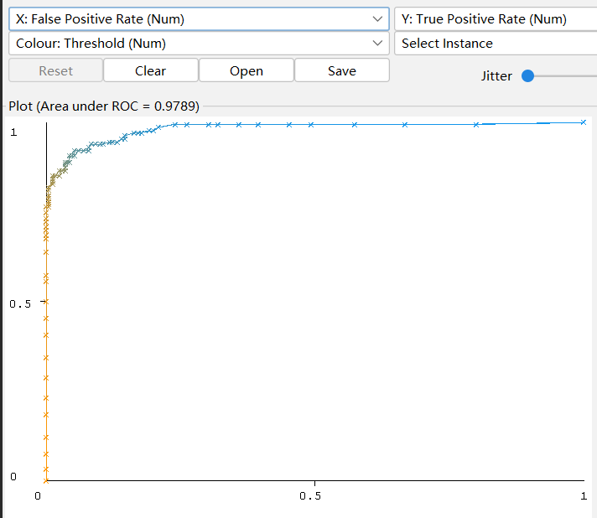
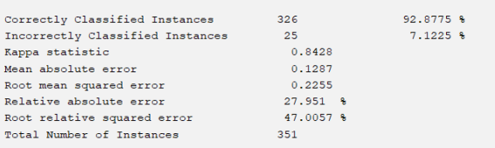
Model Results & Interpretation
/RandomForest Results
10-fold cross-validation
Correct predictions: 326 / 351
Accuracy: 92.88% — highest among four models
ROC-AUC: 0.9789 for class b
Compared with J48 (Experimenter)
Accuracy gain: not significant
AUC gain: significantly higher than J48’s
Figure 4. RandomForest ROC Curve (AUC = 0.9789).

Slide 8
PART TWO
Dataset Overview
Mushroom

Slide 9
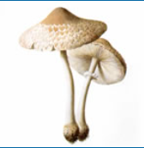
Dataset B: Mushroom
Dataset Overview
Total Instances: 8,124 mushroom records
Total Attributes: 23 (22 descriptive attributes and 1 target class)
Data Type: All attributes are nominal (categorical)
Classification Task: Binary classification
Target Variable: class
Edible (e): 4,208 instances (51.77%)
Poisonous (p): 3,916 instances (48.23%)
The dataset has a relatively balanced class distribution,
with neither class significantly dominating the other.

Slide 10
Dataset B: Mushroom
NO-01
Key Features
Project Objective
The dataset describes mushrooms
using characteristics such as:
1.Cap shape, surface, and color
2.Odor
3.Gill attachment, spacing, size, and color
4.Stalk characteristics
5.Ring type, spore-print color, population, and habitat
To investigate the Mushroom dataset and classify mushrooms as edible or poisonous based on their categorical characteristics, while examining data quality issues and the effects of preprocessing strategies on classification performance.
NO-02

Slide 11
Data Quality Analysis

Slide 12
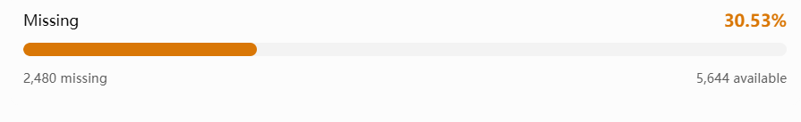
Data Quality Analysis
Missing Values
Constant Attribute
Attribute: veil-type
Only one distinct value appears in the dataset.It provides no useful information for distinguishing the classes.
Attribute: stalk-root
Missing values: 2,480 (30.53%)
Other attributes: No missing values

Slide 13
Data Cleaning

Slide 14
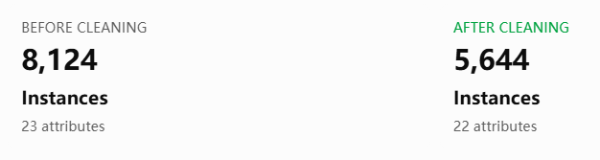
Data Quality Analysis
Remove Constant Attribute
Handle Missing Values
Weka Filter: Remove
Attribute removed: veil-type
Reason: Only one distinct value.
Weka Filter: RemoveWithValues
Attribute: stalk-root
Setting: matchMissingValues = True
Action: Remove instances with missing values.

Slide 15
PART THREE
Classification
Modeling
Mushroom and Ionosphere
Four classifiers, training-only preprocessing and Apriori

Slide 16
Algorithms and Parameters
MODELING METHODS
Model comparison with fixed settings
Experimental Design
Mushroom: 5,644 complete records
Ionosphere: 351 original records
4
16
2
Classifiers
Main runs
Protocols
10-fold CV and 66%/34% split
Fixed parameters and split seed = 1
J48
RandomForest
Logistic and SMO
Pruning confidence factor: 0.25
Minimum instances per leaf: 2
100 trees, model seed = 1
Tree-count runs: 50 / 100 / 200
Logistic: ridge = 1.0E−8
SMO: C = 1, linear kernel

Slide 17
Workflow and Leakage Prevention
PIPELINE AND WEKA DEMO
Mushroom
Ionosphere
Drop missing rows and veil-type
21 nominal predictors
No external standardization
J48 / RF: original predictors
Logistic / SMO: scale within training folds
SMO internal scaling: Neither
Feature Selection
WEKA Workflow Demo
CfsSubsetEval + BestFirst
Nested with J48, select on training data
Apply the same subset to test data
Standardize inside FilteredClassifier
Choose Logistic or SMO, run 10-fold CV
Inspect confusion matrix and positive ROC

Slide 18
Results and Association Rules
CLASSIFICATION AND ASSOCIATION
Classification Results
Mushroom: all four models at 100%
Ionosphere: RF has highest accuracy
CV: 92.88%, split: 91.60%
Accuracy differences are not significant
Apriori Association Rules
Remove class, obtain 20 rules
Example support: 97.236%
Confidence: 100%, lift: 1.003
Frequent consequent drives high confidence

Slide 19
PART FOUR
Results & Evaluation
I led model evaluation and the cross-dataset comparison: two protocols, four classifiers, statistical significance testing, and Apriori review.

Slide 20
My Role & Evaluation
/ ROLE & PROTOCOLS
As the evaluation lead, I applied the same evaluation design to every classifier so the results are comparable and reproducible.
2 Protocols
6 Metrics
Leakage Check
4 Classifiers
10-fold stratified cross-validation and an independent 66%/34% split, seed fixed to 1.
Accuracy, precision, recall, F1-score, ROC-AUC and Kappa; rules use support, confidence and lift.
Data-driven preprocessing is fitted inside each fold, consistent with the modeling pipeline.
J48, RandomForest, Logistic and SMO evaluated on Mushroom and Ionosphere.

Slide 21
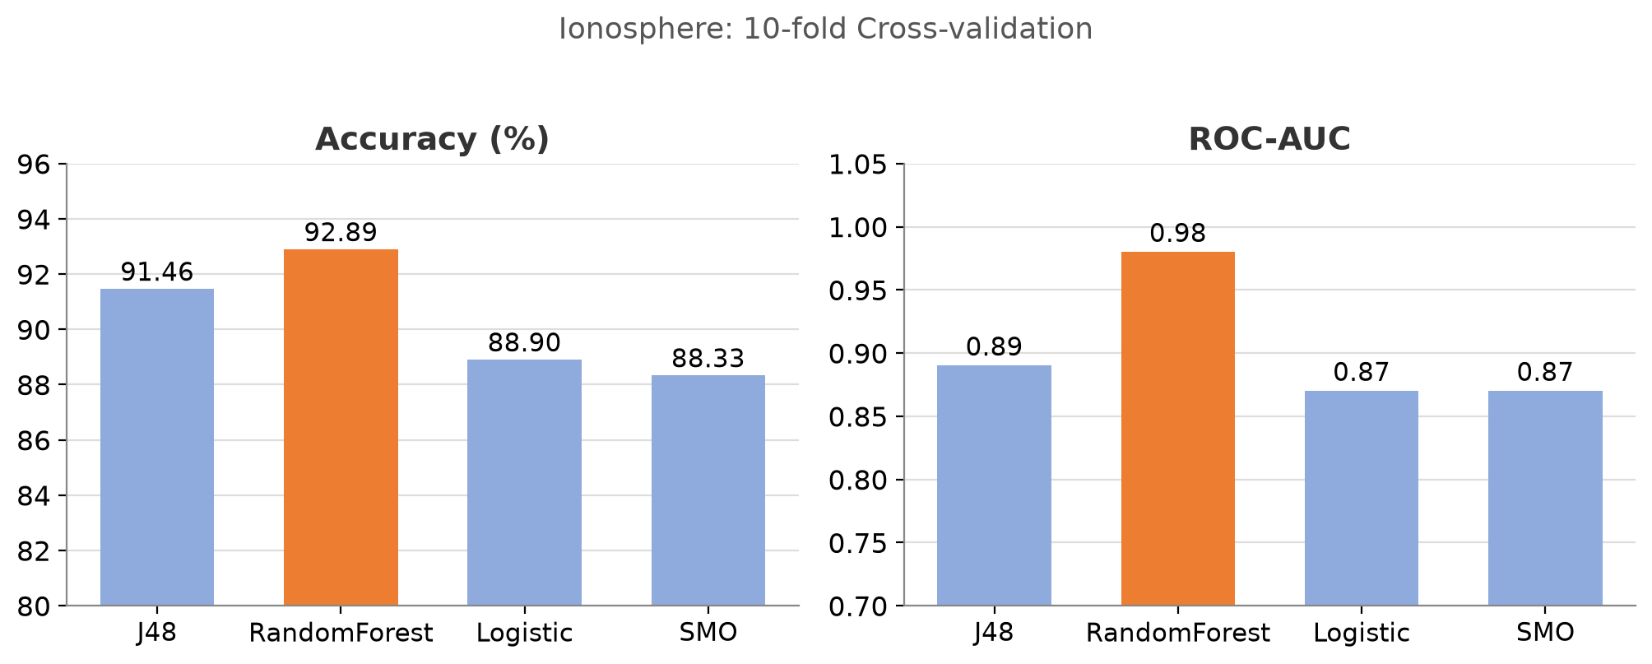
Quantitative Results
/ 10-FOLD CROSS-VALIDATION
Model | Mushroom Acc (%) | Ionosphere Acc (%) | Ionosphere AUC
J48 | 100.00 | 91.45 | 0.89
RandomForest | 100.00 | 92.88 | 0.98
Logistic | 100.00 | 88.89 | 0.87
SMO | 100.00 | 88.32 | 0.87
Best | All tie | RandomForest | RandomForest
RandomForest leads on Ionosphere (92.88%, AUC 0.98), while every classifier reaches 100% on Mushroom.

Slide 22
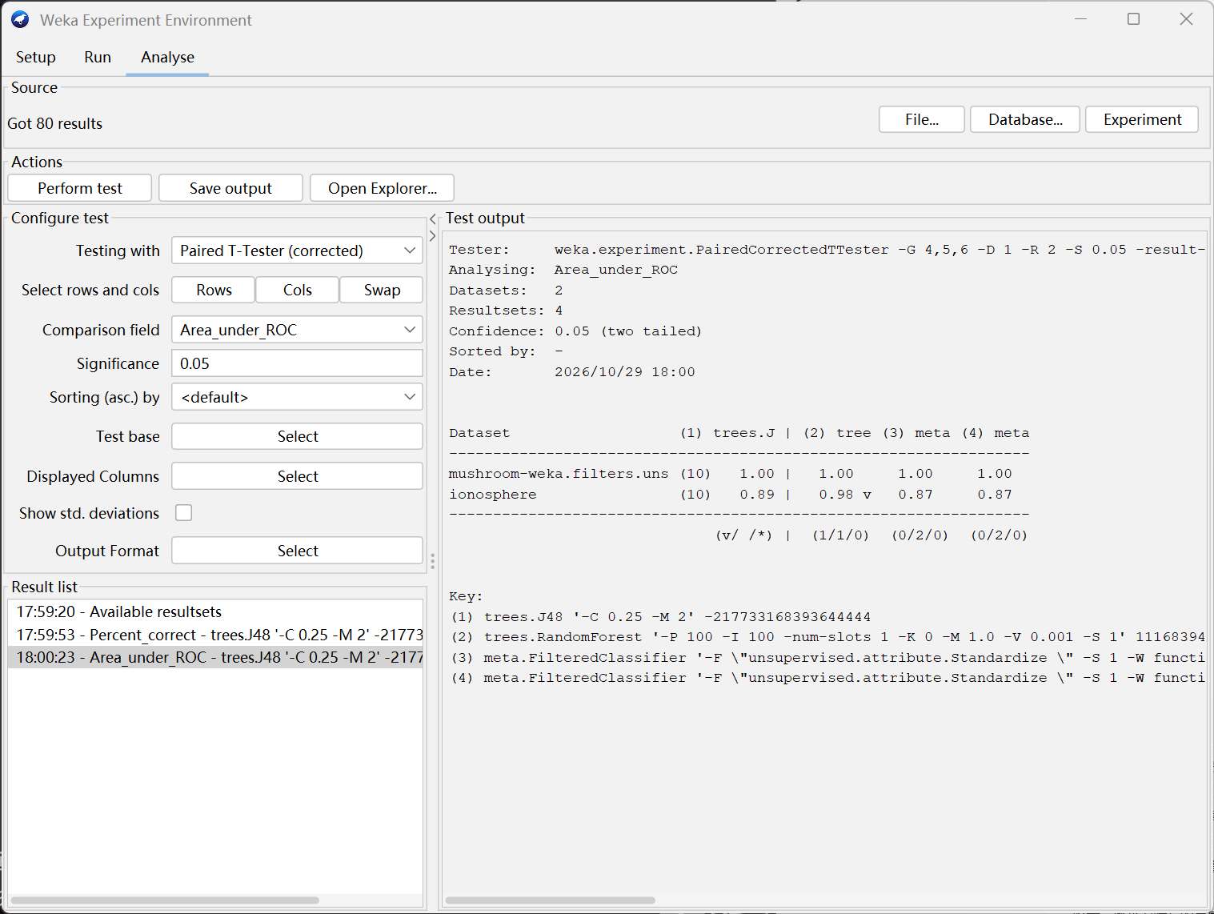
Model Comparison & Significance
/ PAIRED CORRECTED T-TEST, 0.05
What the test shows
Accuracy: no significant gap
All classifiers return 0/2/0 against J48, so the accuracy differences are not statistically significant.
AUC: RandomForest is significant
RF records 1/1/0 and is significantly better than J48 on ROC-AUC.
Careful wording
"Highest observed" is not the same as "significantly best"; significance is confirmed only for RF's AUC.
Weka Experimenter output: ROC-AUC across the ten folds

Slide 23
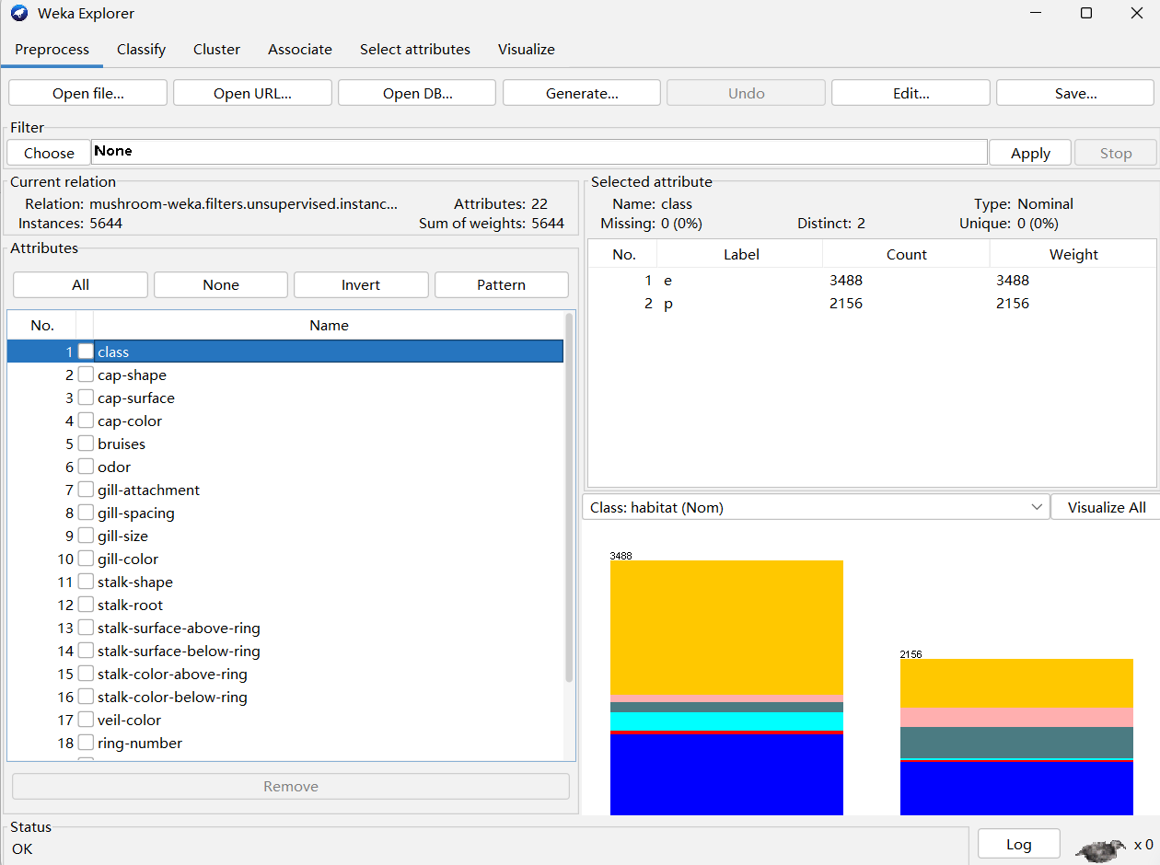
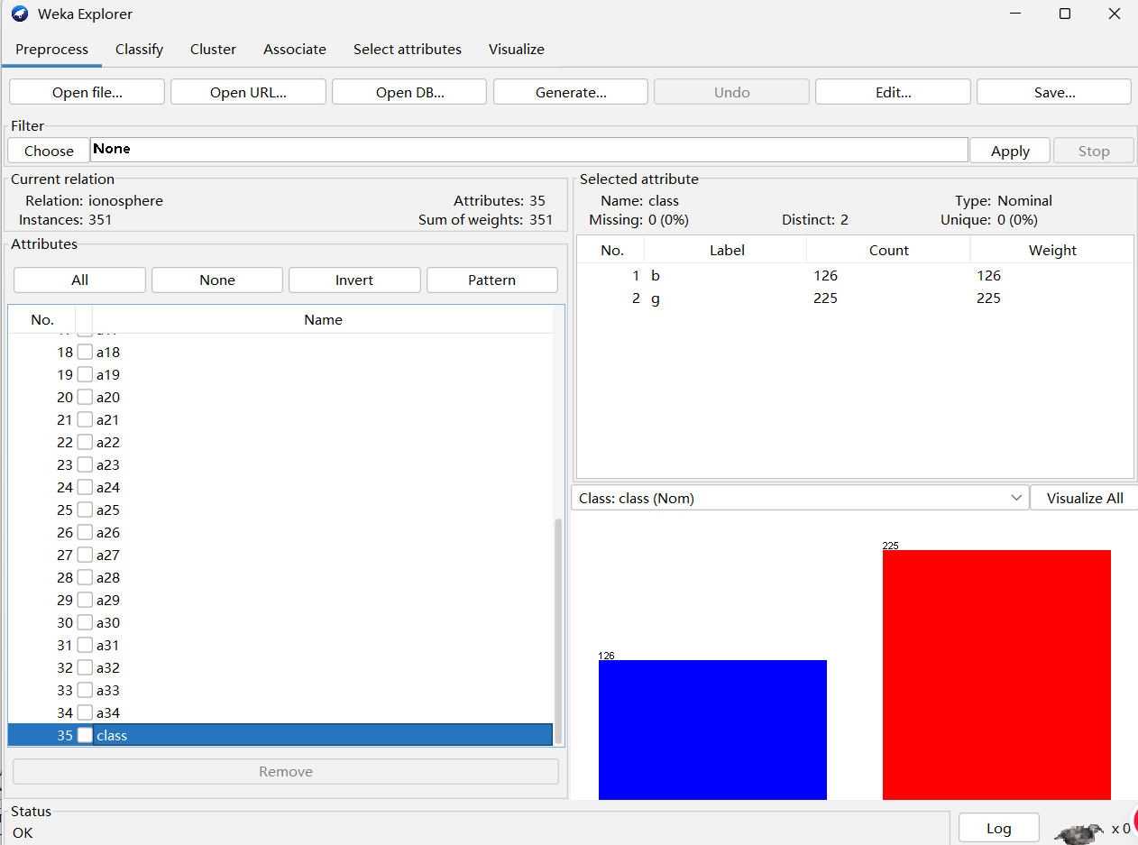
Cross-Dataset Comparison
/ MUSHROOM vs IONOSPHERE
Mushroom: 5,644 instances, 22 attributes
Ionosphere: 351 instances, 35 attributes
Mushroom hits a metric ceiling (all 100%), while Ionosphere differentiates the models. They differ in scale, attribute type, sample retention and parameters, so cross-dataset gaps cannot be attributed to any single factor.

Slide 24
Key Findings
/ SUMMARY & TAKEAWAYS
RandomForest leads on Ionosphere
Highest accuracy (92.88%) and a significantly higher ROC-AUC (0.98).
Mushroom is a perfect tie
All four classifiers reach 100% accuracy and AUC 1.00, so we report a tie rather than ranking them.
Added complexity is not always useful
Neither feature selection nor more trees gave a stable improvement.
Ensembles pay off on noisy data
The ensemble benefit appears only on the noisier, continuous dataset, not on the already-separable nominal one.

Slide 25
PART Five
Discussion & Limitations
Key Findings, Threats to Validity, and Future Work

Slide 26
RandomForest Superiority
All classifiers saturated on Mushroom, but RandomForest clearly separated itself on the harder Ionosphere task.
Ionosphere (harder, continuous, noisy)
Mushroom (nominal, highly separable)
92.88%
100%
Accuracy — RandomForest
Accuracy — all classifiers
ROC-AUC = 0.98
Ceiling — no differentiation
Take-away RandomForest is the clear winner on the challenging radar-signal dataset, while easier nominal problems mask model differences.

Slide 27
The Complexity Boundary
More complex models help only where the data demands them.
✓ Complexity pays off
✗ No added benefit
On Ionosphere —
• RandomForest performs best (92.88%, AUC 0.98)
• Feature selection: no stable gain
• More trees: no stable gain
→ the model helps, but extra tuning did not reliably improve results.
On Mushroom —
• Classes are already well separated
• Nominal / categorical features
• Even simple models reach 100%
→ extra complexity is wasted compute.

Slide 28
Threats to Validity & Limitations
Two issues that affect how far the results can be generalised.
01
Sample Size Constraints
• Ionosphere contains only 351 instances and 34 numerical features.
• Small N creates an inherent risk of overfitting.
• Limits generalisability of models to other radar environments.
02
Class Imbalance
• Ionosphere exhibits moderate imbalance: 64.1% good vs 35.9% bad.
• Raw accuracy alone is insufficient for reliable comparison.
• Multi-metric evaluation (Precision, Recall, F1, Confusion Matrix) is mandatory.

Slide 29
Recommendations & Future Work
Three concrete directions to strengthen the conclusions.
01
02
03
Repeated Stratified
Cross-Validation
External Validation
Datasets
Association Rule
Sensitivity Checks
Replace single train/test splits with multiple stratified folds repeated across random seeds.
→ stabilises accuracy estimates and reduces split-dependent luck.
Test the learned pipelines on fresh radar / nominal datasets outside UCI.
→ confirms that the RandomForest advantage transfers beyond the two studied benchmarks.
Vary support / confidence thresholds and report how the rule set changes.
→ shows that the mined associations are not artefacts of one threshold choice.

Slide 30
Team Contributions
Member ID
Member Name
Main Contributions
3162225
WU Yanping
Dataset Mushroom collection, cleaning, quality analysis and preprocessing.
3162809
ZENG Xinying
Ionosphere data analysis, visualisation and preprocessing.
3163047
HU Ziqi
Classification, association rule mining, feature selection and model workflows.
3163475
ZHANG Jiaming
Model evaluation, cross-validation, significance testing and leakage checks.
3162768
HU Sirui
Report integration, formatting, references, Git management and cross-dataset comparison.

Slide 31
CDS535 Data Mining
Thank you
ZENG Xinying — 3162809 ； WU Yanping — 3162225 ； HU Ziqi — 3163047
ZHANG Jiaming — 3163475 ； HU Sirui — 3162768.
2026 – 11 - 10
Group 9

