Slide 1
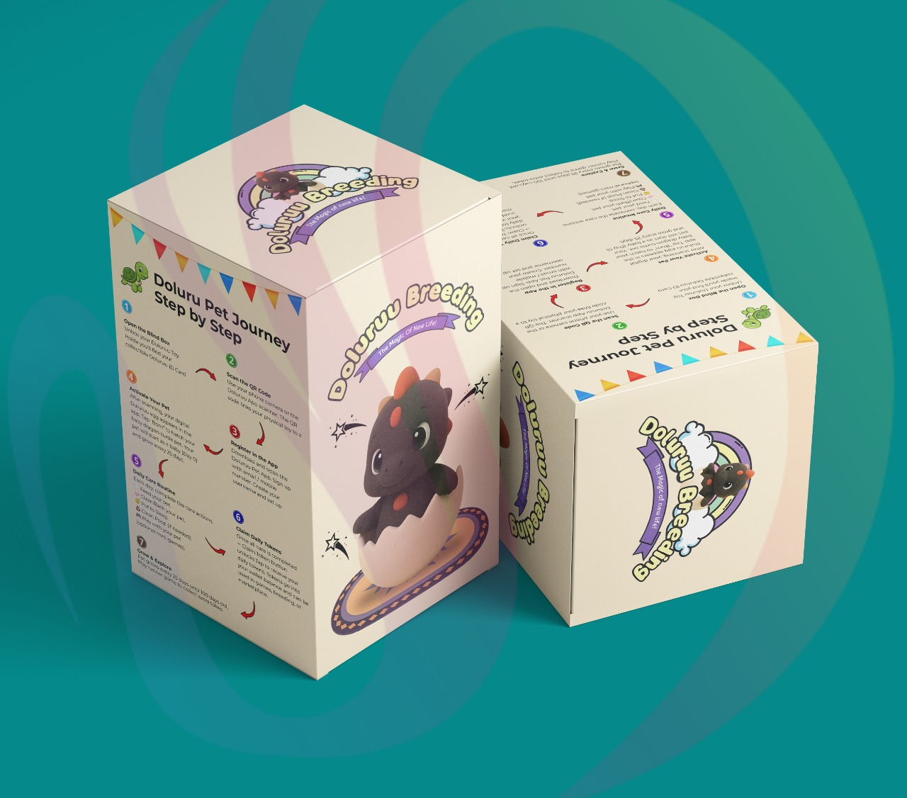
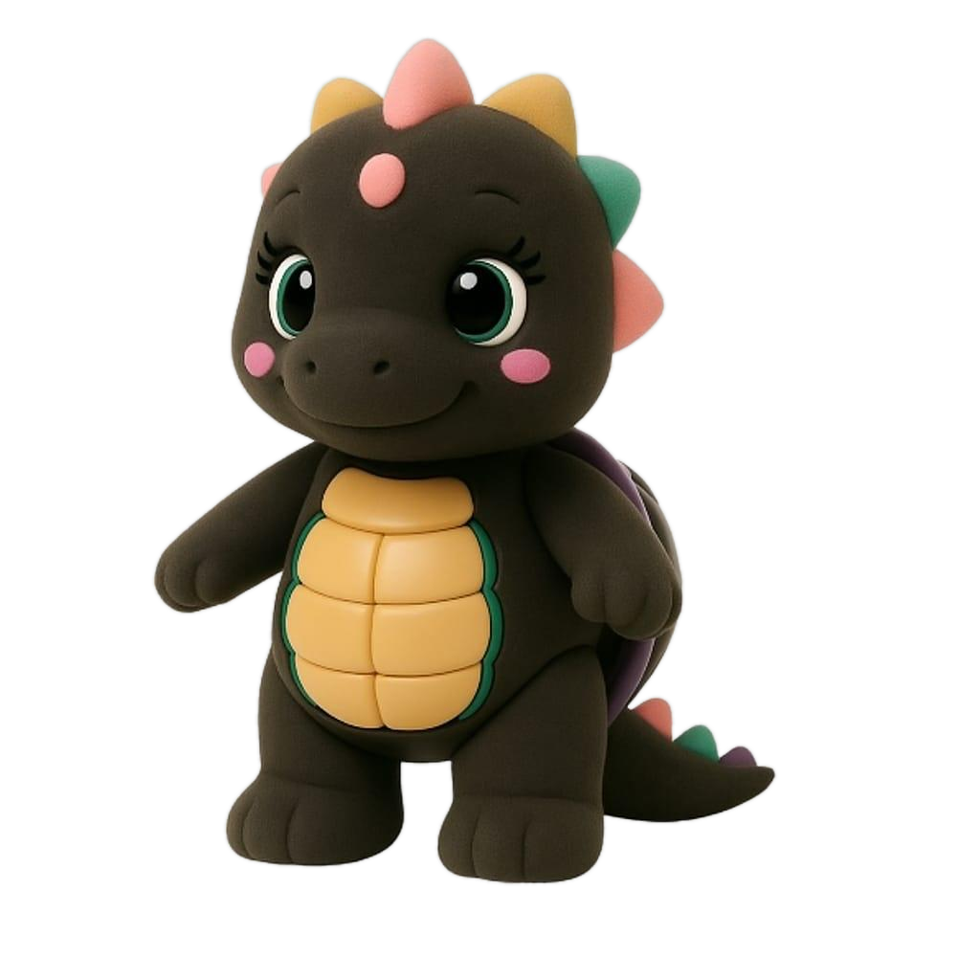
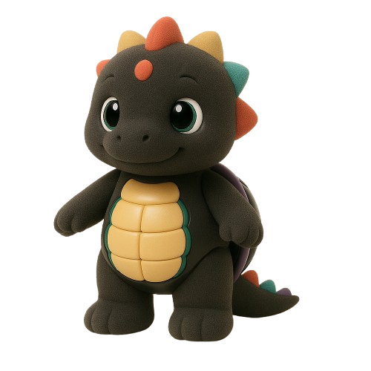
Reborn Wave Group
5-Level Batam Activity Club
Operator-Investor Opportunity: 2 Years $0 Rent
Business owners fund renovation and operations, target capital recovery in 6 months, then keep 70% of monthly net profit from month 7 onward.
75 sqm per unit | IDR main + SGD reference
Reborn Wave Group | Operator-Investor Deck | IDR main + SGD reference
ROI estimates only, not guaranteed returns.

Slide 2
REBORN WAVE GROUP | OPERATOR-INVESTOR DECK
The Opportunity
Tourism, family, nightlife, beauty, KTV, pet cafe, and events in one building.
One Destination
Partner-Led Growth
Cross-Traffic
A five-level Batam club where tourists, families, groups, and nightlife guests can stay longer and spend across multiple activities.
Operators bring capital and operating expertise while Reborn Wave provides space, brand, traffic, website, social media, and shared customer flow.
KTV, kids play, beauty, pet cafe, and live events feed each other through packages, birthdays, competitions, and social content.
Reborn Wave Group | Operator-Investor Deck | IDR main + SGD reference
ROI estimates only, not guaranteed returns.

Slide 3
REBORN WAVE GROUP | OPERATOR-INVESTOR DECK
Operator Deal
A lower-rent-risk path with a 6-month capital recovery target.
$0 rent for 24 months
Operator funds the business
Operator gets two years rent-free from opening or handover date.
Renovation, equipment, staff, stock, licenses, utilities, and operations are covered by the operator.
70/30 split + 6-month target
Transparent reporting
Monthly net profit is split 70% to operator and 30% to Reborn. Base case targets capital back in 6 months.
Sales run through shared POS or audited monthly report; cash sales must be recorded daily.
Reborn Wave Group | Operator-Investor Deck | IDR main + SGD reference
ROI estimates only, not guaranteed returns.

Slide 4
REBORN WAVE GROUP | OPERATOR-INVESTOR DECK
Floor + Unit Breakdown
Updated area assumption: 75 sqm per unit.
1FA
Kids Fun House
1 unit(s)
75 sqm
Family and tourist daytime traffic, prize games, birthday visits, and safe kid-friendly activities.
1FB
KTV Lounge
2 unit(s)
150 sqm
Open singing, group seating, singing competitions, and social video moments for repeat traffic.
2FA
Beauty Salon
1 unit(s)
75 sqm
Repeat appointments, group makeovers, event prep, and cross-traffic from KTV guests.
2FB
Private KTV Rooms
2 unit(s)
150 sqm
Four bookable rooms for birthdays, friend groups, customer hosting, and private celebrations.
3FA
Beauty Salon
1 unit(s)
75 sqm
Beauty service beside VIP KTV supports premium guests, event prep, and recurring spend.
3FB
VIP KTV Rooms
2 unit(s)
150 sqm
Two premium rooms for VIP groups, business hosting, birthday events, and higher table spend.
4F
Pet Cafe
3 unit(s)
225 sqm
Food, drinks, pet community, blindbox tie-ins, photo content, and family-friendly visits.
5F
Live House
3 unit(s)
225 sqm
Live band, performances, dance floor, sea-view events, premium tables, and nightlife traffic.
Reborn Wave Group | Operator-Investor Deck | IDR main + SGD reference
ROI estimates only, not guaranteed returns.

Slide 5
REBORN WAVE GROUP | OPERATOR-INVESTOR DECK
6-Month Capital Recovery Projection
Base-case projections target capital back in 6 months; month 7 onward becomes operator profit.
Business
Setup IDR
Setup SGD
Monthly Net
Operator Annual
ROI
1FA Kids Fun House
Rp875M
S$63K
Rp208M
Rp1.75B
200%
1FB KTV Lounge
Rp1.75B
S$126K
Rp417M
Rp3.5B
200%
2FA Beauty Salon
Rp775M
S$56K
Rp185M
Rp1.55B
200%
2FB Private KTV Rooms
Rp1.9B
S$137K
Rp452M
Rp3.8B
200%
3FA Beauty Salon
Rp775M
S$56K
Rp185M
Rp1.55B
200%
3FB VIP KTV Rooms
Rp2.15B
S$155K
Rp512M
Rp4.3B
200%
4F Pet Cafe
Rp2.5B
S$180K
Rp595M
Rp5.0B
200%
5F Live House
Rp3.6B
S$259K
Rp857M
Rp7.2B
200%
Projection target: operator recovers setup capital in 6 months; month 7 onward becomes operating profit. Exchange assumption: SGD 1 approx. IDR 13,900.
Reborn Wave Group | Operator-Investor Deck | IDR main + SGD reference
ROI estimates only, not guaranteed returns.

Slide 6
REBORN WAVE GROUP | OPERATOR-INVESTOR DECK
1FA Kids Fun House
1 unit(s) | 75 sqm | 70% operator / 30% Reborn Wave
Rp875M
S$63K
Rp208M
Rp1.75B
200%
Setup IDR
Setup SGD
Monthly net
Annual operator
Annual ROI
Monthly assumptions
Why it attracts customers
Operator upside
Revenue: Rp303M Operating costs: Rp95M Net profit before split: Rp208M
Family and tourist daytime traffic, prize games, birthday visits, and safe kid-friendly activities.
Target setup capital back in 6 months. Month 7 onward becomes projected profit. Annual ROI projection: 200%.
Reborn Wave Group | Operator-Investor Deck | IDR main + SGD reference
ROI estimates only, not guaranteed returns.

Slide 7
REBORN WAVE GROUP | OPERATOR-INVESTOR DECK
1FB KTV Lounge
2 unit(s) | 150 sqm | 70% operator / 30% Reborn Wave
Rp1.75B
S$126K
Rp417M
Rp3.5B
200%
Setup IDR
Setup SGD
Monthly net
Annual operator
Annual ROI
Monthly assumptions
Why it attracts customers
Operator upside
Revenue: Rp622M Operating costs: Rp205M Net profit before split: Rp417M
Open singing, group seating, singing competitions, and social video moments for repeat traffic.
Target setup capital back in 6 months. Month 7 onward becomes projected profit. Annual ROI projection: 200%.
Reborn Wave Group | Operator-Investor Deck | IDR main + SGD reference
ROI estimates only, not guaranteed returns.

Slide 8
REBORN WAVE GROUP | OPERATOR-INVESTOR DECK
2FA Beauty Salon
1 unit(s) | 75 sqm | 70% operator / 30% Reborn Wave
Rp775M
S$56K
Rp185M
Rp1.55B
200%
Setup IDR
Setup SGD
Monthly net
Annual operator
Annual ROI
Monthly assumptions
Why it attracts customers
Operator upside
Revenue: Rp270M Operating costs: Rp85M Net profit before split: Rp185M
Repeat appointments, group makeovers, event prep, and cross-traffic from KTV guests.
Target setup capital back in 6 months. Month 7 onward becomes projected profit. Annual ROI projection: 200%.
Reborn Wave Group | Operator-Investor Deck | IDR main + SGD reference
ROI estimates only, not guaranteed returns.

Slide 9
REBORN WAVE GROUP | OPERATOR-INVESTOR DECK
2FB Private KTV Rooms
2 unit(s) | 150 sqm | 70% operator / 30% Reborn Wave
Rp1.9B
S$137K
Rp452M
Rp3.8B
200%
Setup IDR
Setup SGD
Monthly net
Annual operator
Annual ROI
Monthly assumptions
Why it attracts customers
Operator upside
Revenue: Rp687M Operating costs: Rp235M Net profit before split: Rp452M
Four bookable rooms for birthdays, friend groups, customer hosting, and private celebrations.
Target setup capital back in 6 months. Month 7 onward becomes projected profit. Annual ROI projection: 200%.
Reborn Wave Group | Operator-Investor Deck | IDR main + SGD reference
ROI estimates only, not guaranteed returns.

Slide 10
REBORN WAVE GROUP | OPERATOR-INVESTOR DECK
3FA Beauty Salon
1 unit(s) | 75 sqm | 70% operator / 30% Reborn Wave
Rp775M
S$56K
Rp185M
Rp1.55B
200%
Setup IDR
Setup SGD
Monthly net
Annual operator
Annual ROI
Monthly assumptions
Why it attracts customers
Operator upside
Revenue: Rp275M Operating costs: Rp90M Net profit before split: Rp185M
Beauty service beside VIP KTV supports premium guests, event prep, and recurring spend.
Target setup capital back in 6 months. Month 7 onward becomes projected profit. Annual ROI projection: 200%.
Reborn Wave Group | Operator-Investor Deck | IDR main + SGD reference
ROI estimates only, not guaranteed returns.

Slide 11
REBORN WAVE GROUP | OPERATOR-INVESTOR DECK
3FB VIP KTV Rooms
2 unit(s) | 150 sqm | 70% operator / 30% Reborn Wave
Rp2.15B
S$155K
Rp512M
Rp4.3B
200%
Setup IDR
Setup SGD
Monthly net
Annual operator
Annual ROI
Monthly assumptions
Why it attracts customers
Operator upside
Revenue: Rp782M Operating costs: Rp270M Net profit before split: Rp512M
Two premium rooms for VIP groups, business hosting, birthday events, and higher table spend.
Target setup capital back in 6 months. Month 7 onward becomes projected profit. Annual ROI projection: 200%.
Reborn Wave Group | Operator-Investor Deck | IDR main + SGD reference
ROI estimates only, not guaranteed returns.

Slide 12
REBORN WAVE GROUP | OPERATOR-INVESTOR DECK
4F Pet Cafe
3 unit(s) | 225 sqm | 70% operator / 30% Reborn Wave
Rp2.5B
S$180K
Rp595M
Rp5.0B
200%
Setup IDR
Setup SGD
Monthly net
Annual operator
Annual ROI
Monthly assumptions
Why it attracts customers
Operator upside
Revenue: Rp925M Operating costs: Rp330M Net profit before split: Rp595M
Food, drinks, pet community, blindbox tie-ins, photo content, and family-friendly visits.
Target setup capital back in 6 months. Month 7 onward becomes projected profit. Annual ROI projection: 200%.
Reborn Wave Group | Operator-Investor Deck | IDR main + SGD reference
ROI estimates only, not guaranteed returns.

Slide 13
REBORN WAVE GROUP | OPERATOR-INVESTOR DECK
5F Live House
3 unit(s) | 225 sqm | 70% operator / 30% Reborn Wave
Rp3.6B
S$259K
Rp857M
Rp7.2B
200%
Setup IDR
Setup SGD
Monthly net
Annual operator
Annual ROI
Monthly assumptions
Why it attracts customers
Operator upside
Revenue: Rp1.407B Operating costs: Rp550M Net profit before split: Rp857M
Live band, performances, dance floor, sea-view events, premium tables, and nightlife traffic.
Target setup capital back in 6 months. Month 7 onward becomes projected profit. Annual ROI projection: 200%.
Reborn Wave Group | Operator-Investor Deck | IDR main + SGD reference
ROI estimates only, not guaranteed returns.

Slide 14
REBORN WAVE GROUP | OPERATOR-INVESTOR DECK
Reborn Wave Revenue Projection
Reborn receives 30% of each operator's monthly net profit after verified reporting.
Rp1.02B/month
Rp12.28B/year
S$884K/year
Monthly Reborn profit share
Annual Reborn profit share
SGD reference
Why the model works
Portfolio logic
Operators carry setup and operating costs. The base case targets capital back in 6 months, then month 7 onward profit while Reborn monetizes location, brand, traffic, and systems.
Multiple verticals reduce reliance on one business type: family traffic, beauty appointments, KTV bookings, pet cafe visits, and live events.
Reborn Wave Group | Operator-Investor Deck | IDR main + SGD reference
ROI estimates only, not guaranteed returns.

Slide 15
REBORN WAVE GROUP | OPERATOR-INVESTOR DECK
Marketing + Traffic Strategy
Create repeat reasons to visit, post, book, and bring groups.
Singing competitions
Tourist + family packages
Birthday + private events
Weekly competition content, finalists, voting, prize moments, and live audience energy.
Bundled routes for kids fun house, KTV, pet cafe, beauty, and live house nights.
Private KTV rooms, VIP hosting, live band packages, and table reservations.
Performance calendar
TikTok
Instagram
Live bands, dancers, creators, guest singers, and sea-view theme nights.
@reborn.wave.group
@rebornwavegroup
Reborn Wave Group | Operator-Investor Deck | IDR main + SGD reference
ROI estimates only, not guaranteed returns.

Slide 16
REBORN WAVE GROUP | OPERATOR-INVESTOR DECK
Risk Controls
Protect operators, Reborn Wave, and the brand experience.
Shared POS / reporting
Monthly net profit can be verified from sales, costs, and cash records.
Minimum operating hours
Operators must keep the destination active and predictable for customers.
Brand + safety rules
Design, hygiene, service, customer safety, and noise rules protect the building.
Monthly performance review
Slow operators receive action plans before replacement rights are triggered.
Replacement right
Inactive or non-performing operators can be replaced under contract terms.
Reborn Wave Group | Operator-Investor Deck | IDR main + SGD reference
ROI estimates only, not guaranteed returns.

Slide 17
REBORN WAVE GROUP | OPERATOR-INVESTOR DECK
Next Steps
Move from operator interest to signed launch partners.
1. Confirm operators by business type
Match each operator to the right floor zone and budget requirement.
2. Sign LOI
Lock intent, contribution scope, timeline, reporting rules, and 70/30 split principles.
3. Finalize renovation scope
Confirm design, cost, contractor timeline, equipment list, and opening budget.
4. Open pilot marketing campaign
Use TikTok, Instagram, WhatsApp, creators, hotel partners, and event previews.
5. Launch by floor / zone
Open staged areas as operators finish buildout, training, and systems setup.
ROI projections are estimates, not guaranteed returns. Figures require review by qualified legal, tax, and accounting professionals before operator contracts are signed.
Reborn Wave Group | Operator-Investor Deck | IDR main + SGD reference
ROI estimates only, not guaranteed returns.

