Slide 1
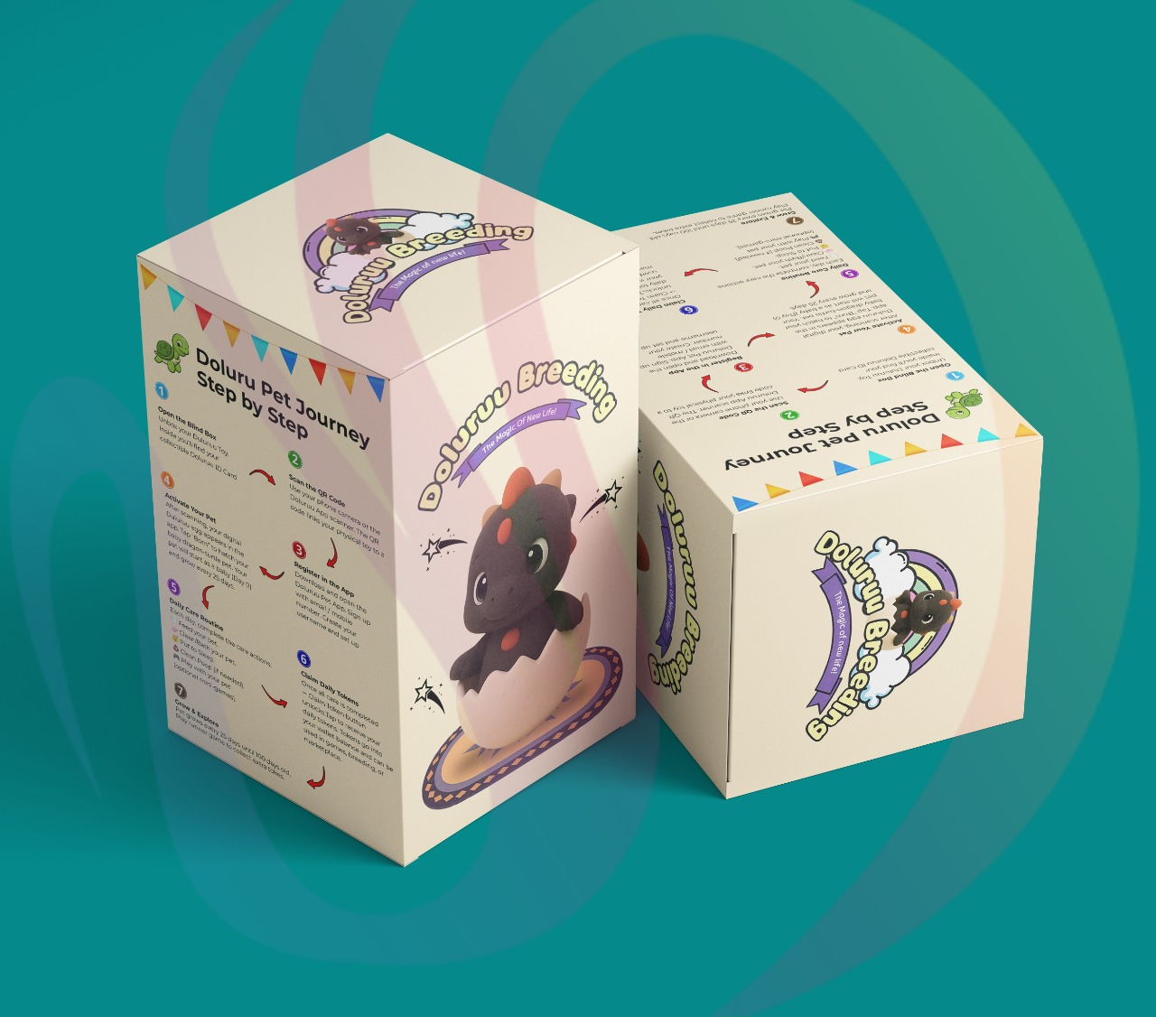
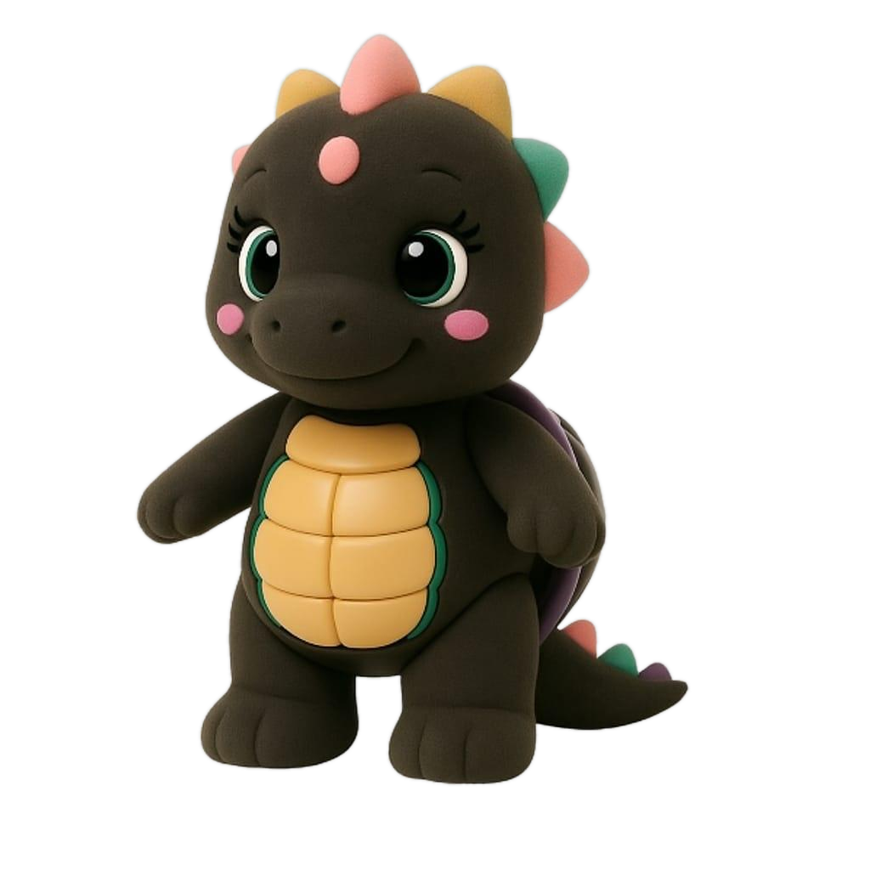
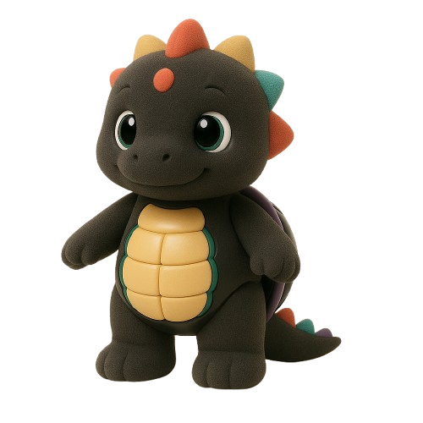
Reborn Wave Group
5-Level Batam Activity Club
Operator-Investor Opportunity: 2 Years $0 Rent
Business owners fund renovation and operations, target capital recovery in 6 months, then keep 70% of monthly net profit from month 7 onward.
75 sqm per unit | IDR main + SGD reference
Reborn Wave Group | Operator-Investor Deck | IDR main + SGD reference
Return estimates only, not guaranteed returns.

Slide 2
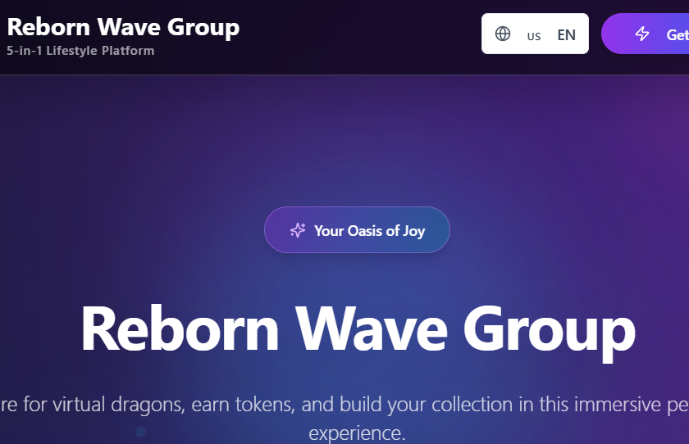
REBORN WAVE GROUP | OPERATOR-INVESTOR DECK
The Opportunity
Tourism, family, nightlife, beauty, KTV, pet cafe, and events in one building.
One Destination
A five-level Batam club where tourists, families, groups, and nightlife guests can stay longer and spend across multiple activities.
Partner-Led Growth
Operators bring capital and operating expertise while Reborn Wave provides space, brand, traffic, website, social media, and shared customer flow.
Website-style premium dark visuals, social content, and shared traffic make the building feel like one destination.
Cross-Traffic
KTV, kids play, beauty, pet cafe, and live events feed each other through packages, birthdays, competitions, and social content.
Reborn Wave Group | Operator-Investor Deck | IDR main + SGD reference
Return estimates only, not guaranteed returns.

Slide 3
REBORN WAVE GROUP | OPERATOR-INVESTOR DECK
Operator Deal
A lower-rent-risk path with a 6-month capital recovery target.
$0 rent for 24 months
Operator funds the business
Operator gets two years rent-free from opening or handover date.
Renovation, equipment, staff, stock, licenses, utilities, and operations are covered by the operator.
70/30 split + 6-month target
Transparent reporting
Monthly net profit is split 70% to operator and 30% to Reborn. Base case targets capital back in 6 months.
Sales run through shared POS or audited monthly report; cash sales must be recorded daily.
Reborn Wave Group | Operator-Investor Deck | IDR main + SGD reference
Return estimates only, not guaranteed returns.

Slide 4
REBORN WAVE GROUP | OPERATOR-INVESTOR DECK
Floor + Unit Breakdown
Updated area assumption: 75 sqm per unit.
1FA
Kids Fun House
1 unit(s)
75 sqm
Family and tourist daytime traffic, prize games, birthday visits, and safe kid-friendly activities.
1FB
KTV Lounge
2 unit(s)
150 sqm
Open singing, group seating, singing competitions, and social video moments for repeat traffic.
2FA
Beauty Salon
1 unit(s)
75 sqm
Repeat appointments, group makeovers, event prep, and cross-traffic from KTV guests.
2FB
Private KTV Rooms
2 unit(s)
150 sqm
Four bookable rooms for birthdays, friend groups, customer hosting, and private celebrations.
3FA
Beauty Salon
1 unit(s)
75 sqm
Beauty service beside VIP KTV supports premium guests, event prep, and recurring spend.
3FB
VIP KTV Rooms
2 unit(s)
150 sqm
Two premium rooms for VIP groups, business hosting, birthday events, and higher table spend.
4F
Pet Cafe
3 unit(s)
225 sqm
Food, drinks, pet community, blindbox tie-ins, photo content, and family-friendly visits.
5F
Live House
3 unit(s)
225 sqm
Live band, performances, dance floor, sea-view events, premium tables, and nightlife traffic.
Reborn Wave Group | Operator-Investor Deck | IDR main + SGD reference
Return estimates only, not guaranteed returns.

Slide 5
REBORN WAVE GROUP | OPERATOR-INVESTOR DECK
Monthly Return Stats
Base-case projections target capital back in 6 months; month 7 onward becomes operator profit.
Business
Setup IDR
Monthly Net
Operator Monthly
Reborn Monthly
Profit After Month 6
1FA Kids Fun House
Rp875M
Rp208M
Rp146M/month
Rp62M/month
Rp875M
1FB KTV Lounge
Rp1.75B
Rp417M
Rp292M/month
Rp125M/month
Rp1.75B
2FA Beauty Salon
Rp775M
Rp185M
Rp129M/month
Rp55M/month
Rp775M
2FB Private KTV Rooms
Rp1.9B
Rp452M
Rp317M/month
Rp136M/month
Rp1.9B
3FA Beauty Salon
Rp775M
Rp185M
Rp129M/month
Rp55M/month
Rp775M
3FB VIP KTV Rooms
Rp2.15B
Rp512M
Rp358M/month
Rp154M/month
Rp2.15B
4F Pet Cafe
Rp2.5B
Rp595M
Rp417M/month
Rp179M/month
Rp2.5B
5F Live House
Rp3.6B
Rp857M
Rp600M/month
Rp257M/month
Rp3.6B
Projection target: operator recovers setup capital in 6 months; month 7 onward becomes operating profit. Exchange assumption: SGD 1 approx. IDR 13,900.
Reborn Wave Group | Operator-Investor Deck | IDR main + SGD reference
Return estimates only, not guaranteed returns.

Slide 6
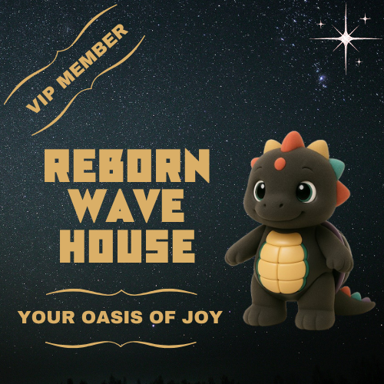
REBORN WAVE GROUP | OPERATOR-INVESTOR DECK
1FA Kids Fun House
1 unit(s) | 75 sqm | 70% operator / 30% Reborn Wave
Rp875M
S$63K
Rp208M
Rp146M/month
Rp62M/month
Setup IDR
Setup SGD
Monthly net
Operator monthly
Reborn monthly
Monthly assumptions
Operator return
Revenue: Rp303M Operating costs: Rp95M Net profit before split: Rp208M
Operator monthly earning: Rp146M/month Projected capital back: 6 months Month 7 onward profit: Rp875M per 6 months
Customer engine
Family and tourist daytime traffic, prize games, birthday visits, and safe kid-friendly activities.
Reborn Wave Group | Operator-Investor Deck | IDR main + SGD reference
Return estimates only, not guaranteed returns.

Slide 7
REBORN WAVE GROUP | OPERATOR-INVESTOR DECK
1FB KTV Lounge
2 unit(s) | 150 sqm | 70% operator / 30% Reborn Wave
Rp1.75B
S$126K
Rp417M
Rp292M/month
Rp125M/month
Setup IDR
Setup SGD
Monthly net
Operator monthly
Reborn monthly
Monthly assumptions
Operator return
Revenue: Rp622M Operating costs: Rp205M Net profit before split: Rp417M
Operator monthly earning: Rp292M/month Projected capital back: 6 months Month 7 onward profit: Rp1.75B per 6 months
Customer engine
Open singing, group seating, singing competitions, and social video moments for repeat traffic.
Reborn Wave Group | Operator-Investor Deck | IDR main + SGD reference
Return estimates only, not guaranteed returns.

Slide 8
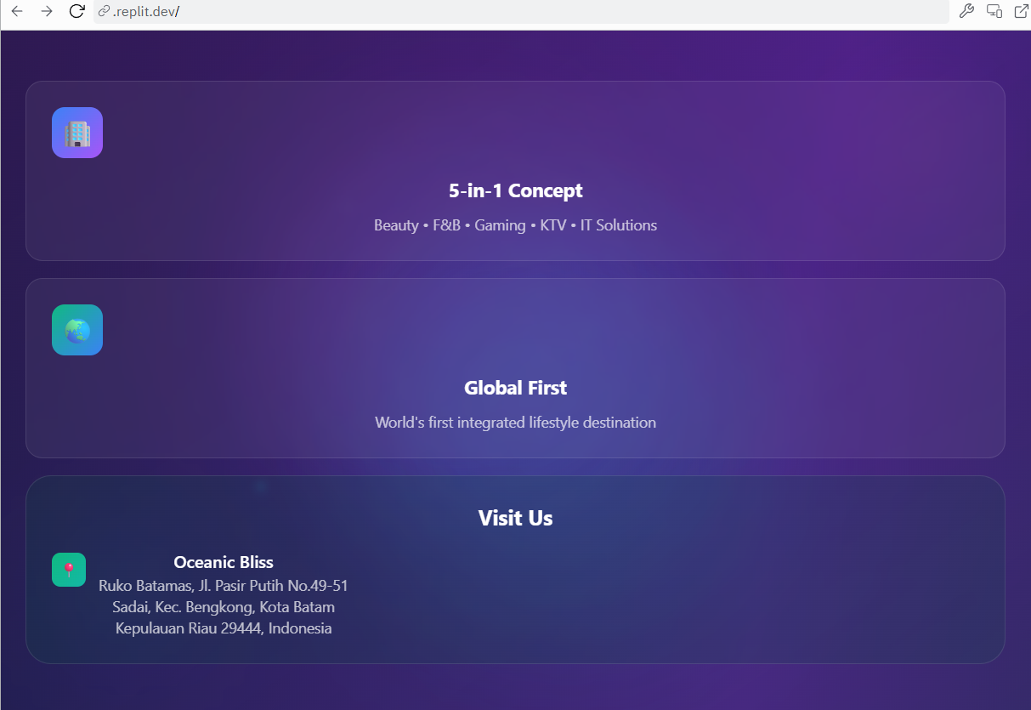
REBORN WAVE GROUP | OPERATOR-INVESTOR DECK
2FA Beauty Salon
1 unit(s) | 75 sqm | 70% operator / 30% Reborn Wave
Rp775M
S$56K
Rp185M
Rp129M/month
Rp55M/month
Setup IDR
Setup SGD
Monthly net
Operator monthly
Reborn monthly
Monthly assumptions
Operator return
Revenue: Rp270M Operating costs: Rp85M Net profit before split: Rp185M
Operator monthly earning: Rp129M/month Projected capital back: 6 months Month 7 onward profit: Rp775M per 6 months
Customer engine
Repeat appointments, group makeovers, event prep, and cross-traffic from KTV guests.
Reborn Wave Group | Operator-Investor Deck | IDR main + SGD reference
Return estimates only, not guaranteed returns.

Slide 9
REBORN WAVE GROUP | OPERATOR-INVESTOR DECK
2FB Private KTV Rooms
2 unit(s) | 150 sqm | 70% operator / 30% Reborn Wave
Rp1.9B
S$137K
Rp452M
Rp317M/month
Rp136M/month
Setup IDR
Setup SGD
Monthly net
Operator monthly
Reborn monthly
Monthly assumptions
Operator return
Revenue: Rp687M Operating costs: Rp235M Net profit before split: Rp452M
Operator monthly earning: Rp317M/month Projected capital back: 6 months Month 7 onward profit: Rp1.9B per 6 months
Customer engine
Four bookable rooms for birthdays, friend groups, customer hosting, and private celebrations.
Reborn Wave Group | Operator-Investor Deck | IDR main + SGD reference
Return estimates only, not guaranteed returns.

Slide 10
REBORN WAVE GROUP | OPERATOR-INVESTOR DECK
3FA Beauty Salon
1 unit(s) | 75 sqm | 70% operator / 30% Reborn Wave
Rp775M
S$56K
Rp185M
Rp129M/month
Rp55M/month
Setup IDR
Setup SGD
Monthly net
Operator monthly
Reborn monthly
Monthly assumptions
Operator return
Revenue: Rp275M Operating costs: Rp90M Net profit before split: Rp185M
Operator monthly earning: Rp129M/month Projected capital back: 6 months Month 7 onward profit: Rp775M per 6 months
Customer engine
Beauty service beside VIP KTV supports premium guests, event prep, and recurring spend.
Reborn Wave Group | Operator-Investor Deck | IDR main + SGD reference
Return estimates only, not guaranteed returns.

Slide 11
REBORN WAVE GROUP | OPERATOR-INVESTOR DECK
3FB VIP KTV Rooms
2 unit(s) | 150 sqm | 70% operator / 30% Reborn Wave
Rp2.15B
S$155K
Rp512M
Rp358M/month
Rp154M/month
Setup IDR
Setup SGD
Monthly net
Operator monthly
Reborn monthly
Monthly assumptions
Operator return
Revenue: Rp782M Operating costs: Rp270M Net profit before split: Rp512M
Operator monthly earning: Rp358M/month Projected capital back: 6 months Month 7 onward profit: Rp2.15B per 6 months
Customer engine
Two premium rooms for VIP groups, business hosting, birthday events, and higher table spend.
Reborn Wave Group | Operator-Investor Deck | IDR main + SGD reference
Return estimates only, not guaranteed returns.

Slide 12
REBORN WAVE GROUP | OPERATOR-INVESTOR DECK
4F Pet Cafe
3 unit(s) | 225 sqm | 70% operator / 30% Reborn Wave
Rp2.5B
S$180K
Rp595M
Rp417M/month
Rp179M/month
Setup IDR
Setup SGD
Monthly net
Operator monthly
Reborn monthly
Monthly assumptions
Operator return
Revenue: Rp925M Operating costs: Rp330M Net profit before split: Rp595M
Operator monthly earning: Rp417M/month Projected capital back: 6 months Month 7 onward profit: Rp2.5B per 6 months
Customer engine
Food, drinks, pet community, blindbox tie-ins, photo content, and family-friendly visits.
Reborn Wave Group | Operator-Investor Deck | IDR main + SGD reference
Return estimates only, not guaranteed returns.

Slide 13
REBORN WAVE GROUP | OPERATOR-INVESTOR DECK
5F Live House
3 unit(s) | 225 sqm | 70% operator / 30% Reborn Wave
Rp3.6B
S$259K
Rp857M
Rp600M/month
Rp257M/month
Setup IDR
Setup SGD
Monthly net
Operator monthly
Reborn monthly
Monthly assumptions
Operator return
Revenue: Rp1.407B Operating costs: Rp550M Net profit before split: Rp857M
Operator monthly earning: Rp600M/month Projected capital back: 6 months Month 7 onward profit: Rp3.6B per 6 months
Customer engine
Live band, performances, dance floor, sea-view events, premium tables, and nightlife traffic.
Reborn Wave Group | Operator-Investor Deck | IDR main + SGD reference
Return estimates only, not guaranteed returns.

Slide 14
REBORN WAVE GROUP | OPERATOR-INVESTOR DECK
Reborn Wave Revenue Projection
Reborn receives 30% of each operator's monthly net profit after verified reporting.
Rp1.02B/month
Rp12.28B/year
S$884K/year
Monthly Reborn profit share
Annual Reborn profit share
SGD reference
Why the model works
Portfolio logic
Operators carry setup and operating costs. The base case targets capital back in 6 months, then month 7 onward profit while Reborn monetizes location, brand, traffic, and systems.
Multiple verticals reduce reliance on one business type: family traffic, beauty appointments, KTV bookings, pet cafe visits, and live events.
Reborn Wave Group | Operator-Investor Deck | IDR main + SGD reference
Return estimates only, not guaranteed returns.

Slide 15
REBORN WAVE GROUP | OPERATOR-INVESTOR DECK
Marketing + Traffic Strategy
Create repeat reasons to visit, post, book, and bring groups.
Singing competitions
Tourist + family packages
Birthday + private events
Weekly competition content, finalists, voting, prize moments, and live audience energy.
Bundled routes for kids fun house, KTV, pet cafe, beauty, and live house nights.
Private KTV rooms, VIP hosting, live band packages, and table reservations.
Performance calendar
TikTok
Instagram
Live bands, dancers, creators, guest singers, and sea-view theme nights.
@reborn.wave.group
@rebornwavegroup
Reborn Wave Group | Operator-Investor Deck | IDR main + SGD reference
Return estimates only, not guaranteed returns.

Slide 16
REBORN WAVE GROUP | OPERATOR-INVESTOR DECK
Risk Controls
Protect operators, Reborn Wave, and the brand experience.
Shared POS / reporting
Monthly net profit can be verified from sales, costs, and cash records.
Minimum operating hours
Operators must keep the destination active and predictable for customers.
Brand + safety rules
Design, hygiene, service, customer safety, and noise rules protect the building.
Monthly performance review
Slow operators receive action plans before replacement rights are triggered.
Replacement right
Inactive or non-performing operators can be replaced under contract terms.
Reborn Wave Group | Operator-Investor Deck | IDR main + SGD reference
Return estimates only, not guaranteed returns.

Slide 17
REBORN WAVE GROUP | OPERATOR-INVESTOR DECK
Next Steps
Move from operator interest to signed launch partners.
1. Confirm operators by business type
Match each operator to the right floor zone and budget requirement.
2. Sign LOI
Lock intent, contribution scope, timeline, reporting rules, and 70/30 split principles.
3. Finalize renovation scope
Confirm design, cost, contractor timeline, equipment list, and opening budget.
4. Open pilot marketing campaign
Use TikTok, Instagram, WhatsApp, creators, hotel partners, and event previews.
5. Launch by floor / zone
Open staged areas as operators finish buildout, training, and systems setup.
Return projections are estimates, not guaranteed returns. Figures require review by qualified legal, tax, and accounting professionals before operator contracts are signed.
Reborn Wave Group | Operator-Investor Deck | IDR main + SGD reference
Return estimates only, not guaranteed returns.

