Slide 1
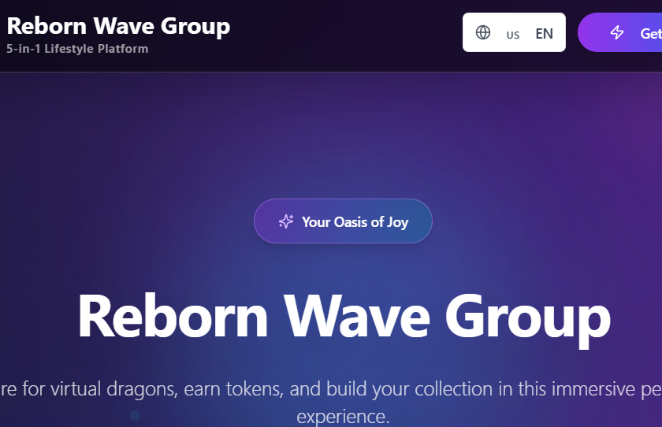
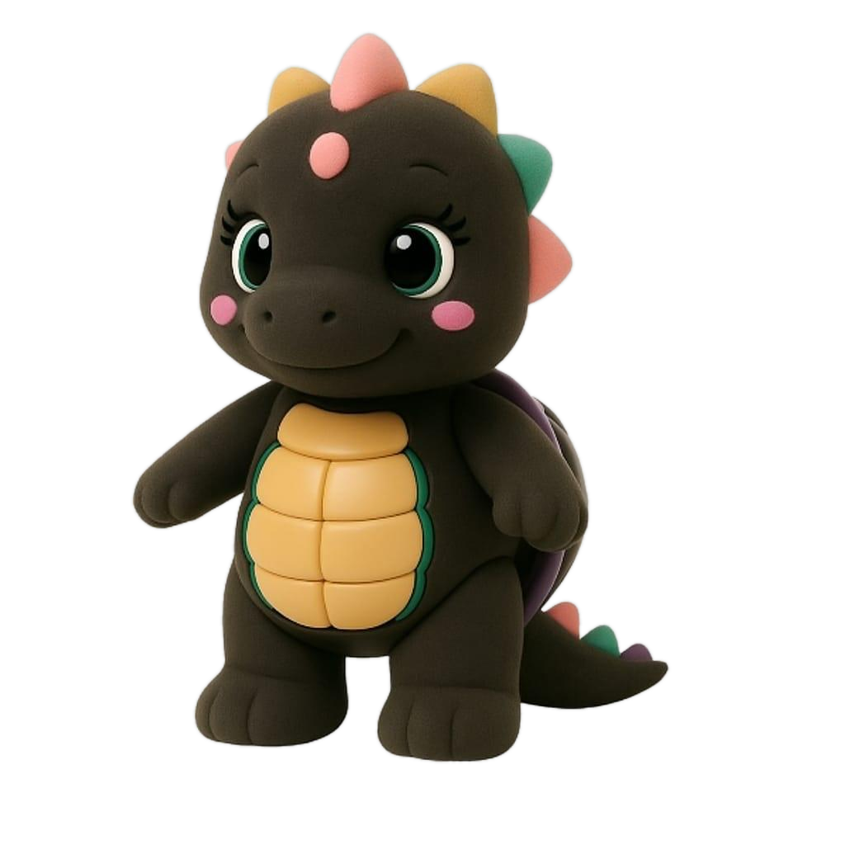
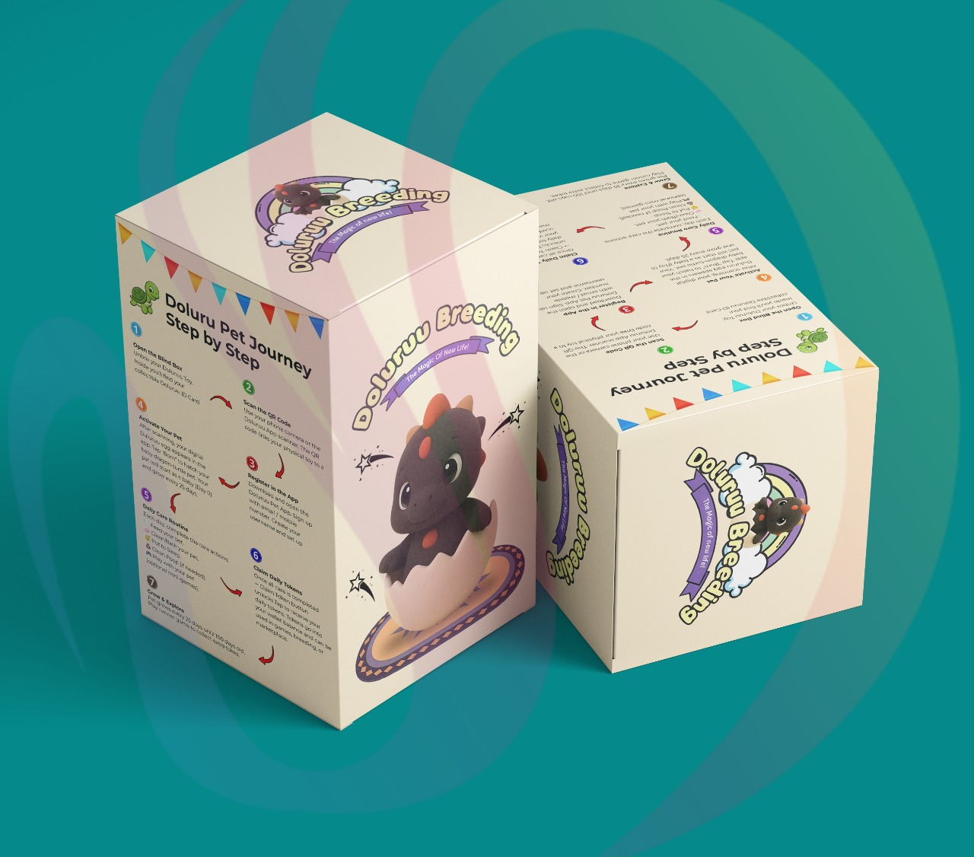
Reborn Wave Group
$500 - $10,000 Investor Package Guide
Choose the business you believe in, receive daily project tokens, share in monthly business profit pools, and grow token value as more investors join.
Portal: rebornwave.group/investor
Reborn Wave Group | Investor Package + Token System
Projected returns only, not guaranteed.

Slide 2
REBORN WAVE GROUP | NORMAL INVESTOR GUIDE
Investor Packages
Each package gives club spending credit, project shares, referral bonus, and selected travel/entertainment gifts.
Amount
Spending credit
Shares
Referral
Extra gift
$500
$500 credit
1 share
10% referral
-
$1,000
$1,000 credit
2 shares
10% referral
2D1N company tour
$3,000
$3,000 credit
6 shares
10% referral
3D2N visit + entertainment
$5,000
$7,000 credit
10 shares
10% referral
3D2N visit + entertainment
$10,000
$15,000 credit
20 shares
10% referral
3D2N visit + entertainment
Shared pool upside
Each share is based on $500 participation for two years. 40% of the company shared pool is allocated to participating investors, with projected 5-10x upside potential, not guaranteed.
Reborn Wave Group | Investor Package + Token System
Projected returns only, not guaranteed.

Slide 3
REBORN WAVE GROUP | NORMAL INVESTOR GUIDE
Choose The Business To Invest In
Investors vote with allocation units. The selected business decides which project tokens they earn daily.
KTV Lounge
Beauty
Game House
Singing, rooms, hosting, competitions
Salon services and glow-up packages
Kids, family games, redemption play
Live House
Pet Cafe
Sea-view band, dance, performances
Food, drinks, pets, blindbox content
Allocation rule
Investor package units must be fully allocated. Example: $10,000 Anchor Pack gives 20 units; investor chooses how many units go to each business.
Reborn Wave Group | Investor Package + Token System
Projected returns only, not guaranteed.

Slide 4
REBORN WAVE GROUP | NORMAL INVESTOR GUIDE
Daily Tokens + Growing Token Value
Tokens reward participation and connect investors to the businesses they choose.
1 unit = 1 token/day
Pool / active tokens
Value grows
Token -> cash
Daily token rule
Token price
Package pool
Sell option
Claim daily
Value can increase
Sell tokens
Investors press Claim Daily Project Tokens in the dashboard. Tokens match their active allocation units.
When more people join, part of package activity enters the global token pool, supporting token price.
Investors can sell eligible active tokens into the cash wallet when pool liquidity is available.
Simple example
$5,000 Founder Pack = 10 units. If 4 units are in KTV and 6 in Live House, daily claim earns 4 KTV tokens + 6 Live House tokens.
Reborn Wave Group | Investor Package + Token System
Projected returns only, not guaranteed.

Slide 5
REBORN WAVE GROUP | NORMAL INVESTOR GUIDE
Monthly Business Profit Pool
The business profit model rewards investors who voted for each business.
Business report
40%
To voters
Units
Monthly verified profit
Investor pool
Distribution
Basis
Who receives
How it splits
What admin checks
Investors who allocated units to that business are treated as voters for that business.
40% of monthly net profit is split by active units/votes for that business.
Sales, operating costs, net profit, investor unit totals, and payout approval.
Example
If Pet Cafe has $10,000 verified monthly net profit, $4,000 goes to the Pet Cafe voter pool and is split by Pet Cafe allocation units.
Reborn Wave Group | Investor Package + Token System
Projected returns only, not guaranteed.

Slide 6
REBORN WAVE GROUP | NORMAL INVESTOR GUIDE
Referral System
Investors can invite others and earn rewards when referred investors purchase packages.
10%
5%
Cash + spending
INV-xxxx
Level 1 reward
Level 2 reward
Reward wallets
Referral code
Level 1
Level 2
Pool support
Direct inviter receives referral reward when their invited investor buys a package.
Second-level inviter can receive an additional smaller reward when eligible.
Unassigned referral reward can flow back into the token pool, supporting token value.
Reward split
The system records referral rewards in cash wallet and spending wallet so investors can withdraw part and use part inside the club.
Reborn Wave Group | Investor Package + Token System
Projected returns only, not guaranteed.

Slide 7
REBORN WAVE GROUP | NORMAL INVESTOR GUIDE
How To Top Up
The portal supports USDT BEP20 top-up and admin-confirmed crediting.
1. Register / login
2. Choose package
3. Connect wallet
Open rebornwave.group/investor/login and enter the investor dashboard.
Pick $500, $1,000, $3,000, $5,000, or $10,000 package.
Connect BEP20 wallet or use manual payment proof if admin allows.
4. Send USDT
5. Submit TX hash
6. Cash wallet credited
Send the exact package amount to the Reborn Wave admin wallet.
Paste transaction hash in dashboard for confirmation.
Once confirmed, cash balance is credited and can be used to purchase the package.
Safety note
Only use the wallet address shown in the investor dashboard or confirmed by official Reborn Wave admin.
Reborn Wave Group | Investor Package + Token System
Projected returns only, not guaranteed.

Slide 8
REBORN WAVE GROUP | NORMAL INVESTOR GUIDE
How To Buy A Package + Allocate Units
After top-up, the investor purchases a package and chooses project allocation.
Select package
Allocate units
Confirm purchase
Choose the package amount. The system calculates units automatically at $500 per unit.
Choose how many units go into each business project before purchase confirmation.
Cash wallet pays for the package and the dashboard records purchase + allocations.
Example A
Example B
$1,000 Builder Pack = 2 units. Investor chooses 1 KTV unit and 1 Pet Cafe unit.
$10,000 Anchor Pack = 20 units. Investor chooses 8 Live House, 6 KTV, 4 Pet Cafe, 2 Beauty.
After purchase
Investors can claim daily project tokens, track token balances, view referrals, sell tokens, request withdrawals, and spend by QR wallet.
Reborn Wave Group | Investor Package + Token System
Projected returns only, not guaranteed.

Slide 9
REBORN WAVE GROUP | NORMAL INVESTOR GUIDE
How To Use The Investor Dashboard
The dashboard is where investors manage top-up, packages, tokens, spending, referrals, and withdrawals.
Packages
Top-ups
Tokens
Choose package and allocate units to selected businesses.
Credit wallet using USDT transaction hash or admin-confirmed payment.
Claim daily project tokens and see active/sold token balances.
Sell tokens
QR spending
Withdrawals
Sell eligible tokens to cash wallet based on current pool price.
Use spending wallet inside the club with investor QR code.
Request cash wallet withdrawal to approved payout wallet.
Dashboard link
Investor home: rebornwave.group/investor | Login/Register: rebornwave.group/investor/login | Dashboard: rebornwave.group/investor/dashboard
Reborn Wave Group | Investor Package + Token System
Projected returns only, not guaranteed.

Slide 10
REBORN WAVE GROUP | NORMAL INVESTOR GUIDE
Rules, Reports, And Risk Controls
Clear records protect investors, operators, and Reborn Wave Group.
Monthly report
Token pool
Admin approval
Profit sharing should use verified revenue, costs, net profit, and approved payout calculations.
Token value depends on pool balance and active token supply. Price can rise or fall.
Top-ups, withdrawals, package settings, and business reports need admin controls.
No guarantee
Professional review
More investors joining can increase pool value, but returns are not guaranteed and depend on actual system activity.
Before public launch, contract, securities rules, tax, accounting, licenses, and investor risk disclosure must be reviewed.
This deck explains the planned investor system. Returns, token value, referral rewards, and profit sharing are projections and are not guaranteed. Legal, tax, accounting, and licensing review is required.
Reborn Wave Group | Investor Package + Token System
Projected returns only, not guaranteed.

Slide 11
REBORN WAVE GROUP | NORMAL INVESTOR GUIDE
Investor Journey Summary
From new account to package purchase and daily rewards.
1. Create account
Register at rebornwave.group/investor/login.
2. Top up
Send USDT BEP20 and submit transaction hash.
3. Buy package
Choose $500 to $10,000 package.
4. Pick businesses
Allocate units to KTV, Beauty, Game House, Live House, or Pet Cafe.
5. Claim daily
Collect project tokens every day from the dashboard.
6. Earn + manage
Track token value, referrals, 40% profit pools, QR spending, and withdrawals.
This deck explains the planned investor system. Returns, token value, referral rewards, and profit sharing are projections and are not guaranteed. Legal, tax, accounting, and licensing review is required.
Reborn Wave Group | Investor Package + Token System
Projected returns only, not guaranteed.

