Slide 1
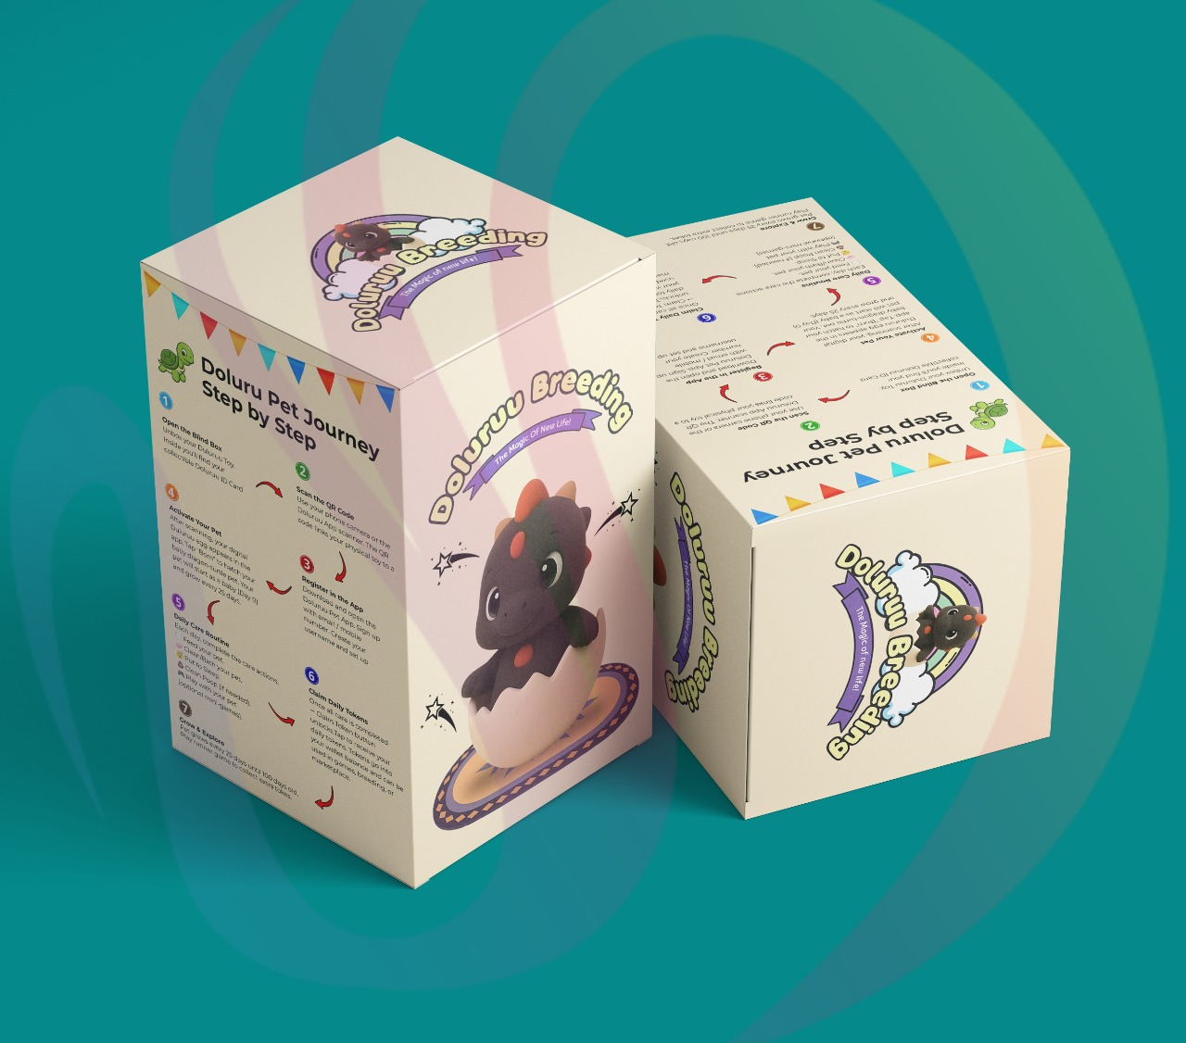
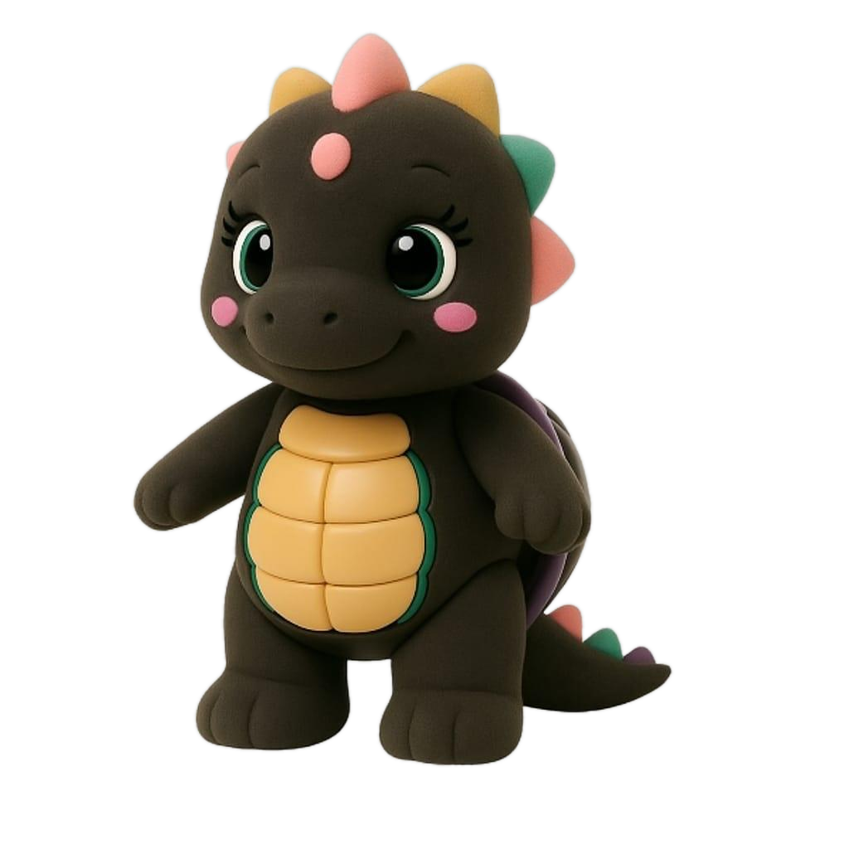
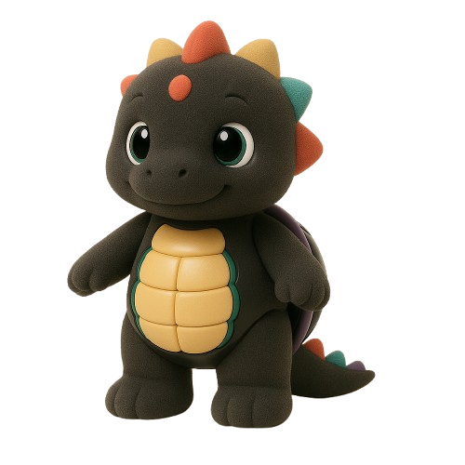
Reborn Wave Group Club Economy
A 5-story waterfront lifestyle ecosystem in Batam built for customers, members, investors, partners, and workers.
$5,000 investor package | $200K capped allocation
Every investor receives 1 free Doluruu blindbox
KTV | Game House | Beauty | Pet Cafe | Sea-View Live House | Blindbox Rewards
ROI target, not guaranteed return.

Slide 2
REBORN WAVE GROUP | INVESTOR DECK
The Opportunity
One venue with multiple spending reasons across day, family, beauty, community, nightlife, and investor-hosted visits.
Customer Traffic
Investor Flywheel
Member Retention
$200K
KTV, kids games, beauty, pet cafe, live music, dance floor, and sea view create multiple audiences.
Credits help investors bring friends, customers, and partners into the club experience.
Blindbox pet feeding, daily tokens, prizes, competitions, and events keep people returning.
Total investor allocation cap
Scarcity supports urgency and clean package communication.
KTV | Game House | Beauty | Pet Cafe | Sea-View Live House | Blindbox Rewards
ROI target, not guaranteed return.

Slide 3
REBORN WAVE GROUP | INVESTOR DECK
Five Floors, One Customer Loop
Each floor gives people another reason to visit, stay longer, post content, and return.
1F
KTV Lounge + Kids Game House
2 units KTV lounge, 1 unit kids game house for singing competitions and family traffic.
2F
Private KTV + Beauty Salon
4 private KTV rooms plus beauty services for repeat bookings.
3F
VIP KTV + Beauty Salon
2 VIP rooms for investor guests, birthdays, business hosting, and premium spend.
4F
Pet Cafe
All 3 units become a pet cafe tied to Doluruu, content, food, drinks, and community.
5F
Sea-View Live House
Live band, dance floor, rooftop sea view, event nights, and premium table sales.
KTV | Game House | Beauty | Pet Cafe | Sea-View Live House | Blindbox Rewards
ROI target, not guaranteed return.

Slide 4
REBORN WAVE GROUP | INVESTOR DECK
Investor Package
$5,000 enters the ecosystem as investor capital and customer-hosting credits.
Invest $5,000
Target $10,000 ROI
Investor receives $5,000 club spending credits for friends, customers, and private hosting.
Target return across 2 years under contract terms and monthly payout rules.
20% Profit Pool
10% New Investor Pool
20% of business profit is allocated monthly and divided among active investors.
10% of every new $5,000 package is shared with earlier active investors.
Investor terms require qualified legal and financial review before public launch or contract signing.
KTV | Game House | Beauty | Pet Cafe | Sea-View Live House | Blindbox Rewards
ROI target, not guaranteed return.

Slide 5
REBORN WAVE GROUP | INVESTOR DECK
Referral Logic
Referral bonuses reward growth and reduce the remaining ROI target.
1
3
5
10
Again
$1,000 referral bonus paid; ROI target reduced by $1,000.
$3,000 bonus total; remaining target becomes $7,000.
$5,000 bonus total; remaining target becomes $5,000.
$10,000 bonus total; ROI target cleared.
Investor may join again after contract completion.
Each invited friend invests $5,000. The inviter receives $1,000, deducted from the inviter's remaining ROI target.
KTV | Game House | Beauty | Pet Cafe | Sea-View Live House | Blindbox Rewards
ROI target, not guaranteed return.

Slide 6
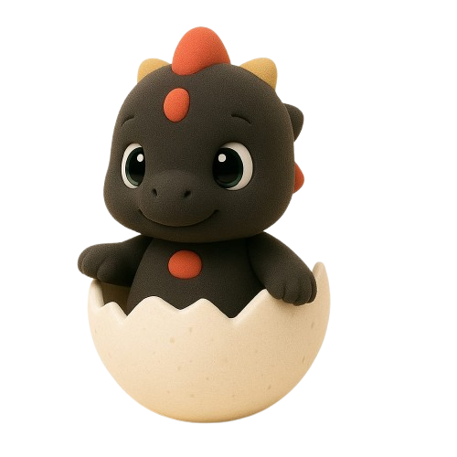
REBORN WAVE GROUP | INVESTOR DECK
Blindbox Pet Economy
Doluruu pets create daily token habits and prize exchange reasons.
Investor Gift
1 free blindbox per investor package.
Male + Female
Owning both unlocks 1 baby pet free.
Daily Tokens
Feed each pet daily to earn tokens.
3 pets = 3 daily tokens: male + female + baby.
Prize Exchange
Tokens can support rewards, upgrades, and club campaigns.
KTV | Game House | Beauty | Pet Cafe | Sea-View Live House | Blindbox Rewards
ROI target, not guaranteed return.

Slide 7
REBORN WAVE GROUP | INVESTOR DECK
Marketing Agent Team
Ruflo-style agents coordinate content, engagement, investor leads, partnerships, and analytics.
Growth Queen
Content Producer
Social Amplifier
Sets weekly priorities, assigns agents, and checks compliance.
Creates Reels, carousels, captions, and multilingual posts.
Runs polls, comments, UGC prompts, and share mechanics.
Investor Leads
Partnerships
Analytics Optimizer
Builds investor posts, WhatsApp scripts, FAQs, and follow-ups.
Targets creators, singers, salons, hotels, pet groups, and events.
Tracks reach, shares, map clicks, inquiries, calls, and signups.
KTV | Game House | Beauty | Pet Cafe | Sea-View Live House | Blindbox Rewards
ROI target, not guaranteed return.

Slide 8
REBORN WAVE GROUP | INVESTOR DECK
Location
A clear Batam destination with map-click convenience for visitors and investor hosting.
Ruko Oceanic Bliss
BATAM
Ruko Oceanic Bliss, Jl. Pasir Putih Harbourfront - Batam Centre.49 blok A. 51, Sadai, Bengkong, Batam City, Riau Islands 29444
Open Google Maps
Open Google Maps
KTV | Game House | Beauty | Pet Cafe | Sea-View Live House | Blindbox Rewards
ROI target, not guaranteed return.

Slide 9
REBORN WAVE GROUP | INVESTOR DECK
Next Steps
Move from interest to launch-ready execution with legal review, campaign assets, and partner outreach.
1. Finalize contract
Legal review for ROI target language, payout rules, risk disclosure, and referral deductions.
2. Launch content engine
Daily short-form video, floor tours, Doluruu posts, and event content.
3. Open investor conversations
Use the deck, website, WhatsApp script, and showroom hosting credits.
4. Recruit the floor team
Hosts, singers, stylists, pet cafe crew, event staff, and promoters.
This deck is a business and marketing draft. ROI references are targets, not guaranteed returns. Investment contracts, payout rules, profit calculations, referral deductions, compliance requirements, and risk disclosures should be reviewed by qualified legal and financial professionals before launch.
KTV | Game House | Beauty | Pet Cafe | Sea-View Live House | Blindbox Rewards
ROI target, not guaranteed return.

