Slide 1
AIR QUALITY / INSIGHT
When does air quality
need attention?
A data-led review of hourly sensor readings, weather measures, and an AQI estimation model.
EcoAir Analytics Centre | UCI source data | March 2004 - April 2005

Slide 2
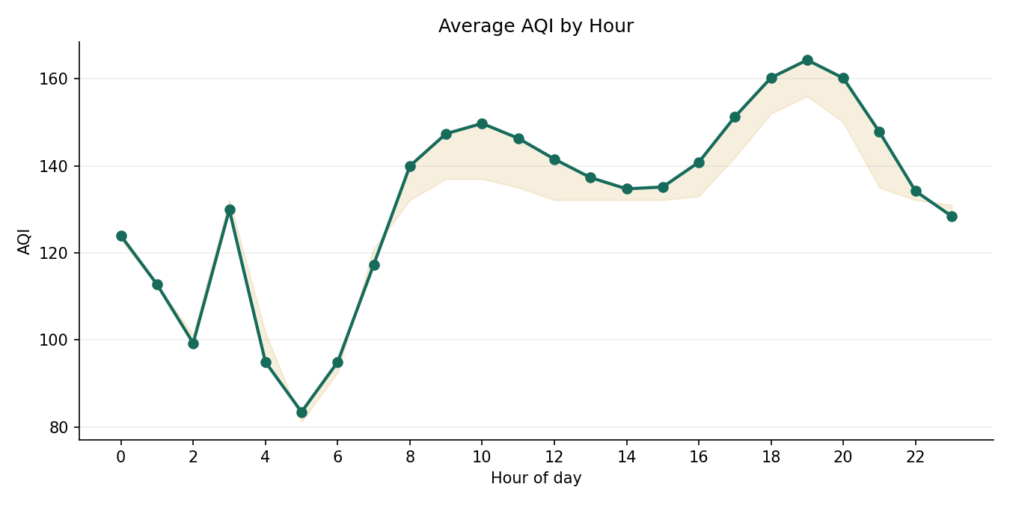
01 / A repeatable time signal
Highest hourly mean
19:00 | AQI 164.3
Lowest hourly mean
05:00 | AQI 83.4
Operational meaning: prioritize checks around historically elevated hours, then confirm with current local monitoring.

Slide 3
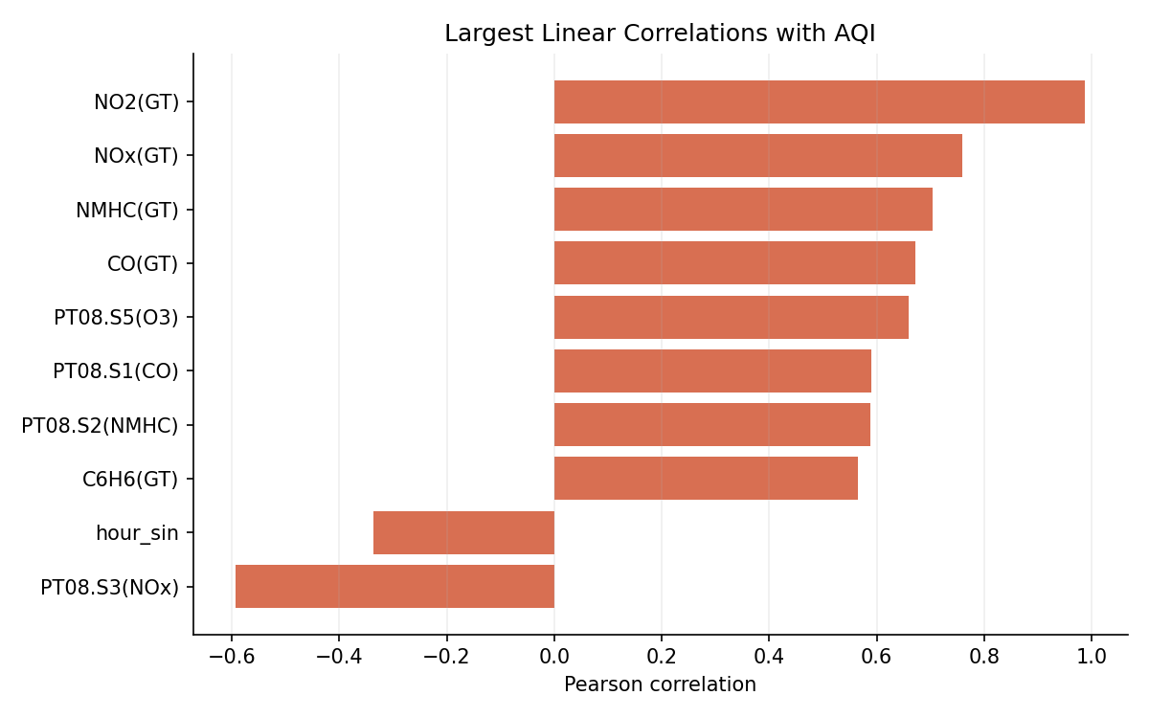
02 / Weather and pollutant signals
Model's strongest useful signals
NO2(GT), CO(GT), NOx(GT)
Temperature and relative humidity are available. Wind, rain, and traffic are not, so the corresponding business questions cannot be tested with this file.
Highest seasonal mean: Winter (155.4)

Slide 4
03 / Model check
MAE 0.52
Mean baseline 49.15
R2 0.997
Chronological holdout 1,799 rows
A random forest estimates the provided AQI value from same-period pollutant and weather readings. This is a nowcast proxy, not a forecast of future pollution or proof of causal drivers.
The AQI target's calculation method is undocumented in the supplied CSV; interpret model scores as agreement with that provided label.

Slide 5
04 / Recommendations and next data
01
Use the observed hourly and seasonal patterns to schedule enhanced review, not as a substitute for current measurements.
02
For city deployment, join timestamped readings to station metadata, traffic volume, wind, rainfall, and holiday calendars.
03
Validate sensor calibration and the AQI calculation before operationalizing any model threshold.
04
Re-train and evaluate by station and future time period once the requested city-level data is available.
Decision: monitor recurring time windows; collect missing drivers before ranking locations or attributing causes.

