Slide 1
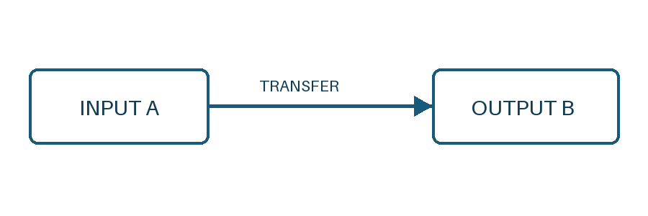
doc2md PPT 示例：A → B

