Slide 1

OBJECT DETECTION USING DEEP LEARNING
Team Member:
Saksham Yadav [RA2011033010156]
Karthik Panicker [RA2011033010159]
Aditya Akshat [RA2011033010170]

Slide 2

ABSTRACT
This report examines Inception, a powerful convolutional neural network for object detection in images. Inception's unique architecture allows it to extract features at different levels of abstraction, improving its performance. Our project showcases Inception's potential for real-world applications in various fields, providing valuable insights for researchers and practitioners.

Slide 3

INTRODUCTION
Object detection in images is a challenging problem in computer vision, with many real-world applications. Convolutional neural networks (CNNs) have become the most popular models for this task, and the Inception model, introduced by Google in 2014, is one of the most successful CNNs for object detection. Its unique architecture allows it to extract features at different levels of abstraction, improving its performance. We explore the Inception model's capabilities for object detection and evaluate its performance using TensorFlow.

Slide 4

DEEP LEARNING
Deep learning has revolutionized the field of computer vision and has become the most widely used approach for object detection in images. Deep learning models, such as convolutional neural networks (CNNs), can learn to extract features from images that are relevant to object detection and can identify objects in images with high accuracy and efficiency.

Slide 5
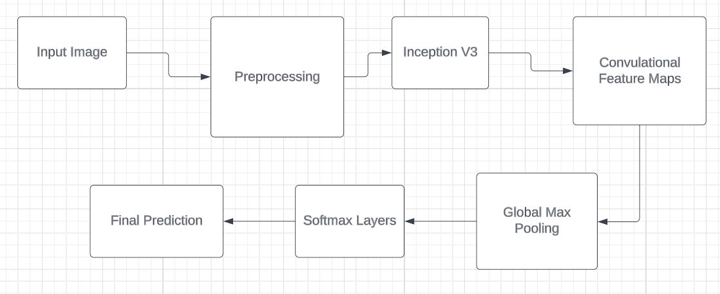
ARCHITECHTURE DIAGRAM

Slide 6
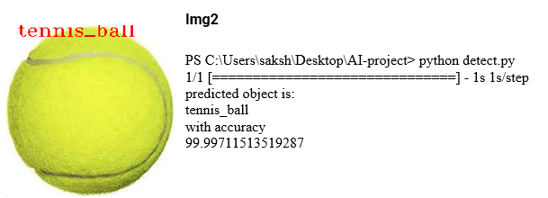
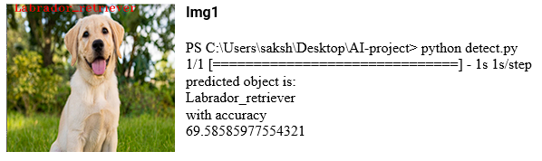
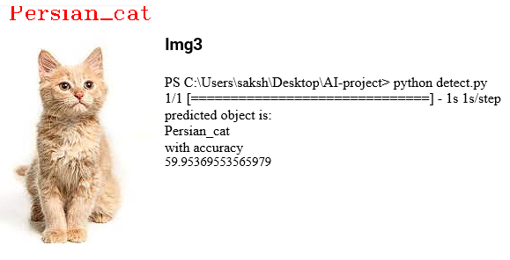
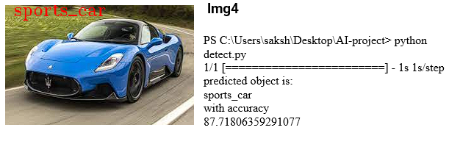
SCREENSHOTS

Slide 7

APPLICATION OF OBJECT DETECTION
Object detection has a wide range of applications across various industries. In the automotive industry, it is used for autonomous driving and collision avoidance systems. In retail, it can be used for product recognition and inventory management.
In the field of security and surveillance, object detection is used for threat detection, crowd monitoring, and facial recognition. It is also used in healthcare for medical imaging analysis and disease diagnosis.

Slide 8
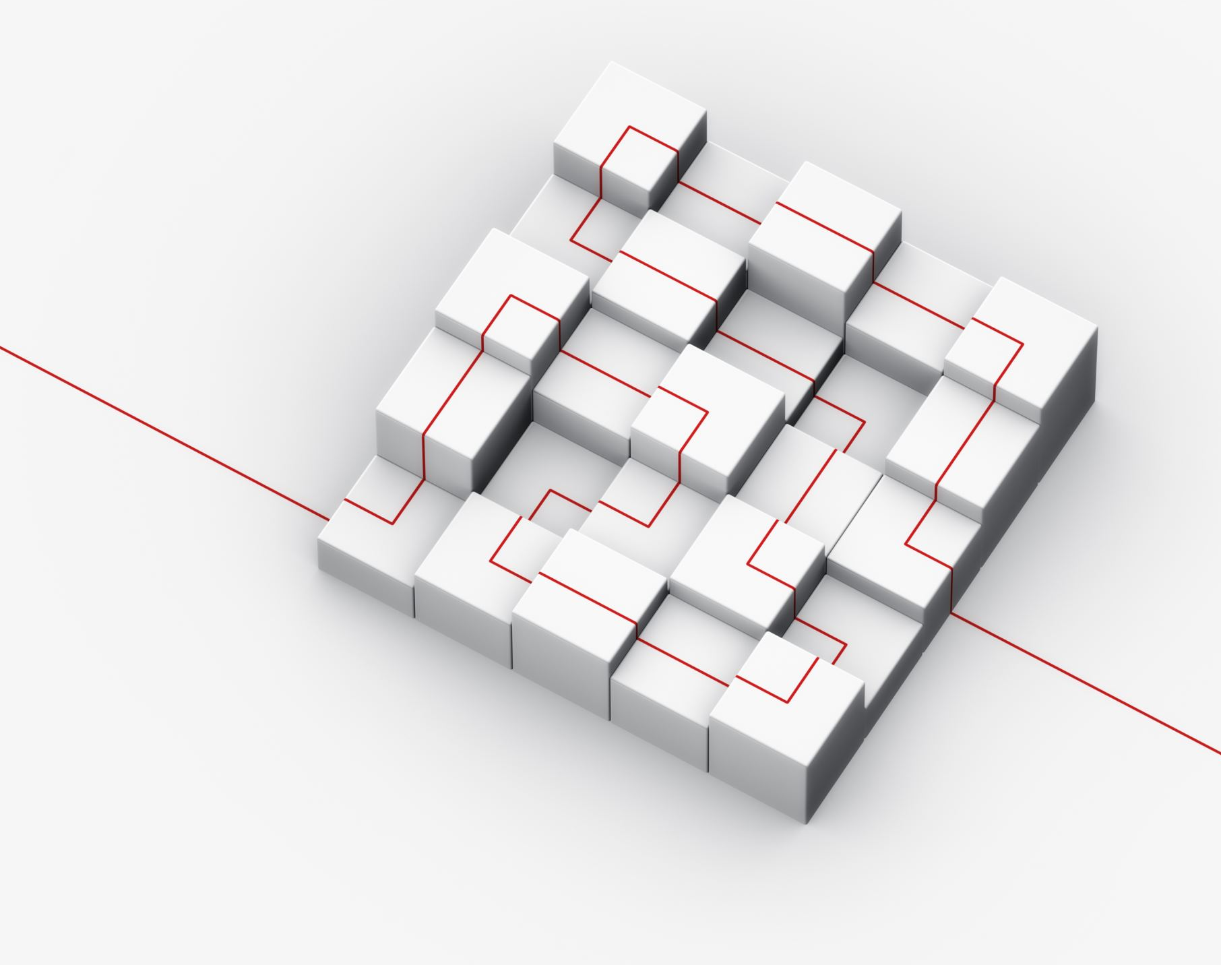
CHALLENGES AND LIMITATIONS
Despite its many benefits, object detection still faces several challenges and limitations. One of the main challenges is the need for large amounts of labeled data to train the algorithms effectively.
Another challenge is the trade-off between accuracy and speed, as more complex algorithms tend to be slower and require more computing power. Additionally, object detection algorithms may struggle with occlusions, cluttered backgrounds, and variations in lighting conditions.

Slide 9

CONCLUSION
In conclusion, this project demonstrated Inception's effectiveness for object detection in images and its potential for various fields. Enhancements can further improve performance and capabilities, making it a valuable resource for researchers and practitioners. It is suitable for real-world applications such as autonomous driving, surveillance, and robotics. Future enhancements include exploring performance on larger datasets, experimenting with hyperparameters and architectures, extending to video object detection, and exploring interpretability.

Slide 10
THANK YOU
GITHUB : https://github.com/Kushak-S/ai_project

