Slide 1
Data Science

Slide 2
Data Preparation for Machine Learning
Data preparation is one of the most critical steps in any ML pipeline — often taking up 60–80% of a project's time.
structured walkthrough of the process:

Slide 3
Data Preparation for Machine Learning
1. Data Collection
- Gather data from relevant sources (databases, APIs, web scraping, surveys, etc.)
- Ensure data is representative of the problem you're solving
- Define the target variable (label) early on

Slide 4
Data Preparation for Machine Learning
2. Exploratory Data Analysis (EDA)
- Understand the shape, types, and distribution of data
Identify patterns, correlations, and anomalies
Key tools: pandas, matplotlib, seaborn, describe(), value_counts()

Slide 5
Data Preparation for Machine Learning
3. Data Cleaning
Create new features from existing ones (e.g., extracting day/month from a date)
Combine features that carry more meaning together
Bin continuous variables into categorical ranges when appropriate
Polynomial features for capturing non-linear relationships

Slide 6
Data Preparation for Machine Learning
4. Feature Engineering
Handle missing values — drop rows/columns, or impute using mean, median, mode, or model-based methods
Remove duplicates — detect and eliminate redundant records
Fix inconsistencies — standardize formats (dates, units, categories)
Handle outliers — detect using IQR/Z-score, then cap, remove, or transform them
Correct errors — fix typos, wrong labels, or impossible values

Slide 7
Data Preparation for Machine Learning
5. Data Transformation
• Encoding categorical variables:
• Label Encoding — for ordinal categories
• One-Hot Encoding — for nominal categories
• Scaling/Normalization:
• Min-Max Scaling — scales to [0, 1]
• Standardization (Z-score) — mean=0, std=1
• Log Transform — for skewed distributions
• Text data — tokenization, stemming, TF-IDF, embeddings
• Image data — resizing, normalization, augmentation

Slide 8
Data Preparation for Machine Learning
6. Feature Selection
- Remove irrelevant or redundant features to reduce noise and overfitting
- Techniques:
Filter methods — correlation, chi-square, variance threshold
Wrapper methods — RFE (Recursive Feature Elimination)
Embedded methods — Lasso, feature importance from tree models
** feature is a variable

Slide 9
Data Preparation for Machine Learning
7. Handling Class Imbalance
Applies to classification problems with skewed class distribution
Strategies:
Oversampling — SMOTE, random oversampling
Undersampling — reduce majority class
Class weights — penalize misclassification of minority class

Slide 10
Data Preparation for Machine Learning
8. Data Splitting
Divide data into:
Training set (~70–80%) — model learns from this
Validation set (~10–15%) — tune hyperparameters
Test set (~10–15%) — final unbiased evaluation
Use stratified splitting for imbalanced datasets
Use time-based splitting for time-series data

Slide 11
Data Preparation for Machine Learning
9. Data Pipelines & Reproducibility
Divide data into:
Training set (~70–80%) — model learns from this
Validation set (~10–15%) — tune hyperparameters
Test set (~10–15%) — final unbiased evaluation
Use stratified splitting for imbalanced datasets
Use time-based splitting for time-series data

Slide 12
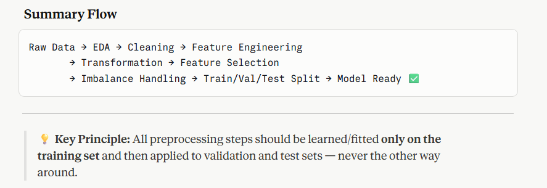
Data Preparation for Machine Learning

Slide 13
Using ML/DL in Scikit-Learn
1. Install & Import Libraries
The first step is setting up your environment by installing scikit-learn along with supporting libraries like NumPy and Pandas. These libraries work together — NumPy handles numerical operations, Pandas manages data in table form, and scikit-learn provides all the ML tools you need.

Slide 14
Using ML/DL in Scikit-Learn
2. Load & Prepare the Data
You bring your data into the environment, either from a file like CSV, a database, or scikit-learn's built-in sample datasets. At this stage, you separate your data into two parts — the features (X), which are the input variables the model will learn from, and the target (y), which is the output or answer you want the model to predict.

Slide 15
Using ML/DL in Scikit-Learn
3. Split the Data
Before doing anything else, you divide your dataset into a training set and a test set. The training set is what the model learns from, and the test set is kept completely separate to evaluate how well the model performs on unseen data. A common split is 80% for training and 20% for testing. For imbalanced datasets, stratified splitting is used to ensure both sets have proportional class representation.

Slide 16
Using ML/DL in Scikit-Learn
4. Preprocess the Data
Raw data is rarely ready for a model. In this step you clean and transform the data so the model can understand it properly. This includes handling missing values by filling them in with a sensible substitute like the mean or median, and scaling the numerical features so that no single variable dominates others just because it has larger numbers. Crucially, all preprocessing rules must be learned from the training data only and then applied to the test data — never the other way around, to avoid data leakage.

Slide 17
Using ML/DL in Scikit-Learn
6. Train the Model
Training is the process of the model learning patterns from your training data. You feed the algorithm both the features and the correct answers, and it adjusts its internal parameters to minimize prediction errors. This is often called "fitting" the model to the data.

Slide 18
Using ML/DL in Scikit-Learn
7. Make Predictions
Once trained, the model is used to predict outcomes on the test set — data it has never seen before. For classification tasks, it can also output probability scores for each class, which is useful when you need to understand the model's confidence level.

Slide 19
Using ML/DL in Scikit-Learn
8. Evaluate the Model
You measure how well the model performed by comparing its predictions against the actual known answers in the test set. The metrics you use depend on the problem type. For classification, common metrics are accuracy, precision, recall, F1-score, and the confusion matrix. For regression, you use metrics like Mean Squared Error (MSE), Mean Absolute Error (MAE), and R² score. These numbers tell you where the model is doing well and where it is failing.

Slide 20
Using ML/DL in Scikit-Learn
9. Build a Pipeline
A pipeline is a way to chain all your preprocessing steps and your model together into a single unified workflow. Instead of applying each step manually one by one, the pipeline handles everything in the correct order automatically. This is considered best practice because it prevents data leakage, makes your code cleaner, and makes deploying the model much easier later.

Slide 21
Using ML/DL in Scikit-Learn
10. Hyperparameter Tuning
Every algorithm has settings called hyperparameters that you control — for example, the number of trees in a Random Forest or the depth of a Decision Tree. These are not learned from the data; you set them yourself. Tuning means systematically trying different combinations of these settings to find which ones produce the best model performance. Grid Search tries every possible combination, while Randomized Search samples random combinations — which is faster when there are many options.

Slide 22
Using ML/DL in Scikit-Learn
11. Cross-Validation
Instead of evaluating the model just once on a single test set, cross-validation splits the training data into multiple folds and trains/tests the model several times on different portions of the data. This gives you a more reliable and unbiased estimate of how your model will perform in the real world, along with a measure of how stable or consistent its performance is.

Slide 23
Using ML/DL in Scikit-Learn
12. Save & Load the Model
Once you are satisfied with your model's performance, you save it to disk so it can be reused without retraining. You can then load it at any time to make predictions on new data — this is the first step toward deploying the model in a real application.

Slide 24
Using ML/DL in Scikit-Learn
Deep Learning in Scikit-Learn
Scikit-learn supports simple neural networks through its MLP (Multi-Layer Perceptron) classifier and regressor. You can define the number of hidden layers, the number of neurons per layer, and the activation function. However, for more complex deep learning tasks like image recognition, natural language processing, or custom architectures, you would step outside scikit-learn and use dedicated frameworks like TensorFlow/Keras or PyTorch, which offer far more flexibility and power.

Slide 25
Using ML/DL in Scikit-Learn
Overall Flow Summary
The overall journey goes from loading and understanding your data, through cleaning and transforming it, then choosing and training a model, followed by evaluating and tuning it, and finally saving it for deployment. Each step builds on the previous one, and skipping or rushing any step typically leads to a model that performs poorly in the real world.

Slide 26
An Example of Data Preparation for ML
We will use data from
Titanic - Machine Learning from Disaster
Titanic - Machine Learning from Disaster | Kaggle

Slide 27
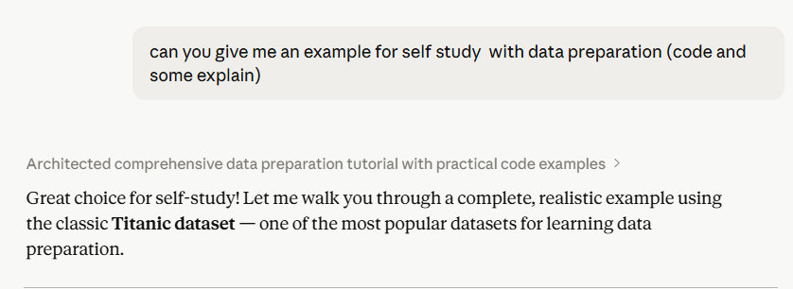
An Example of Data Preparation for ML
And all of this made by Claude

Slide 28
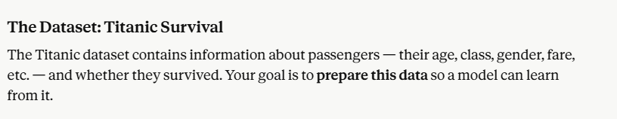
An Example of Data Preparation for ML
made by Claude

Slide 29
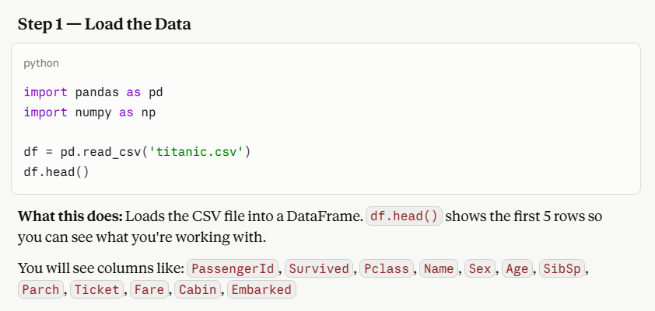
An Example of Data Preparation for ML
made by Claude

Slide 30
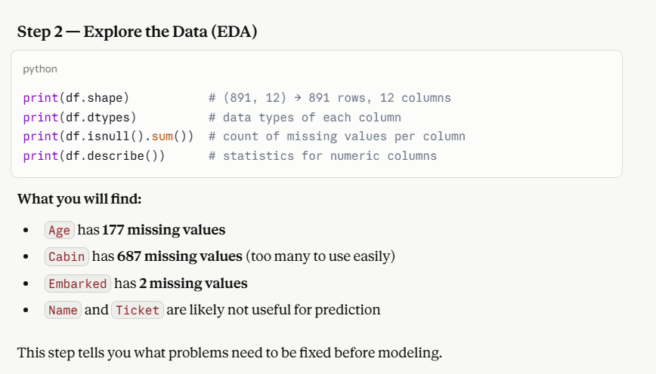
An Example of Data Preparation for ML
made by Claude

Slide 31
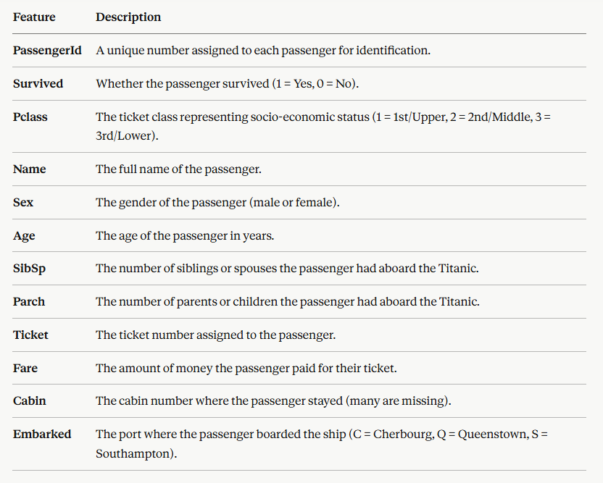

Slide 32
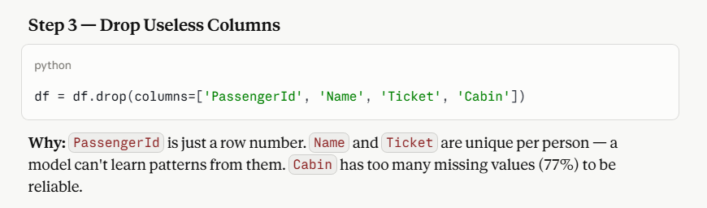
An Example of Data Preparation for ML
made by Claude

Slide 33
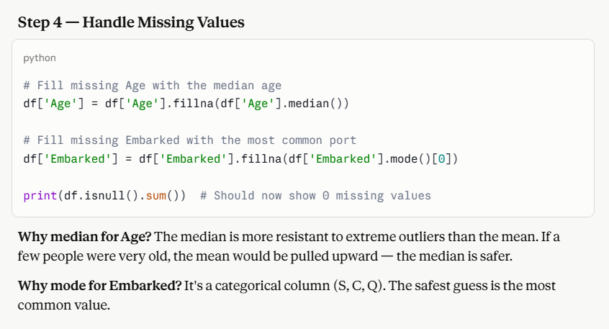
An Example of Data Preparation for ML
made by Claude

Slide 34
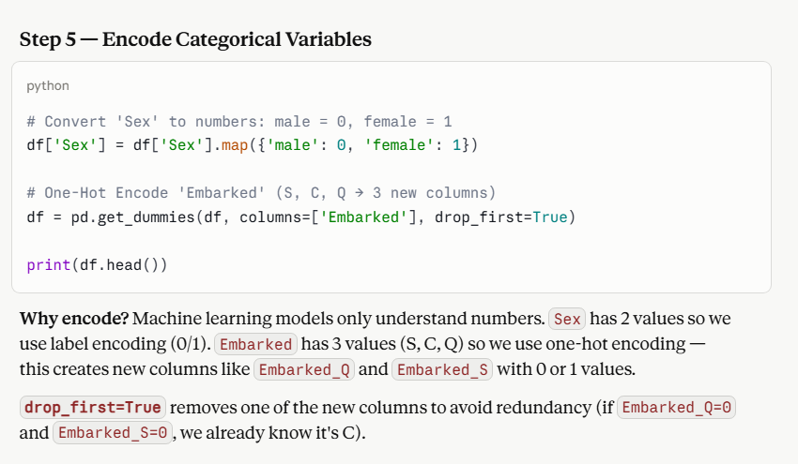
An Example of Data Preparation for ML
made by Claude

Slide 35
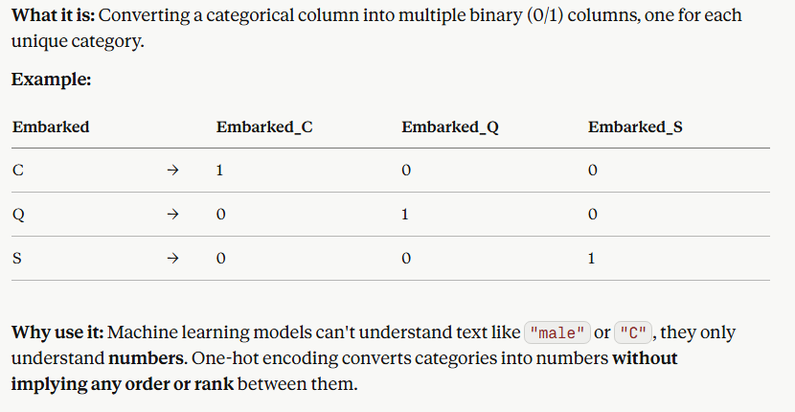
An Example of Data Preparation for ML
made by Claude
One-Hot Encoding

Slide 36
An Example of Data Preparation for ML
made by Claude
One-Hot Encoding
pandas.get_dummies() is a pandas function that automatically applies one-hot encoding to categorical columns.
It automatically creates binary columns for each unique value — so it saves you from manually creating them yourself.
pandas.get_dummies — pandas 3.0.2 documentation

Slide 37
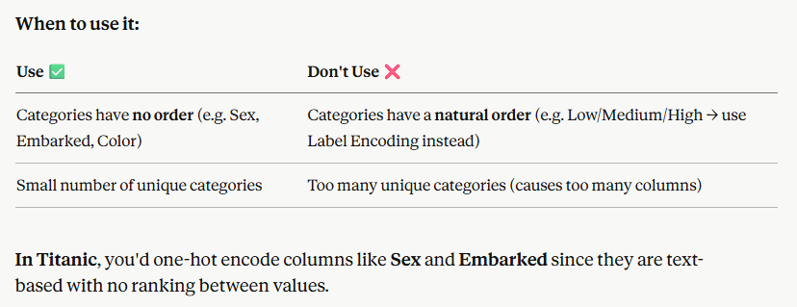
An Example of Data Preparation for ML
made by Claude
One-Hot Encoding

Slide 38
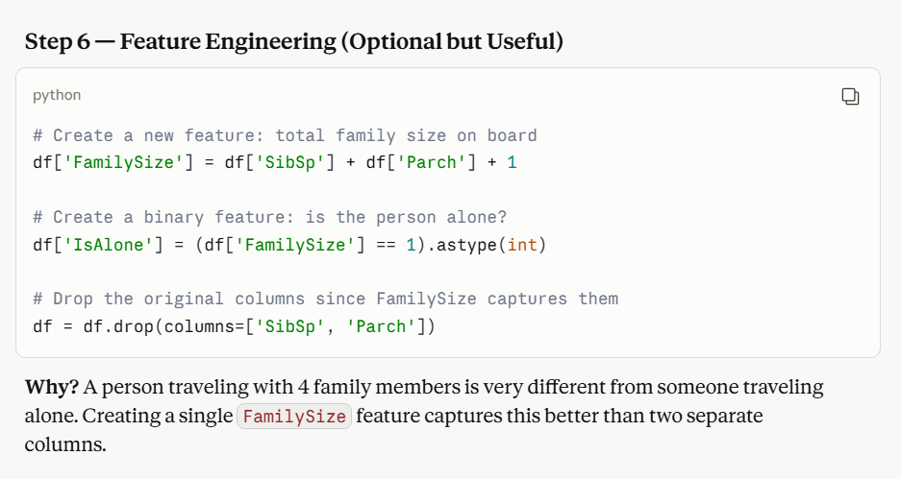
An Example of Data Preparation for ML
made by Claude

Slide 39
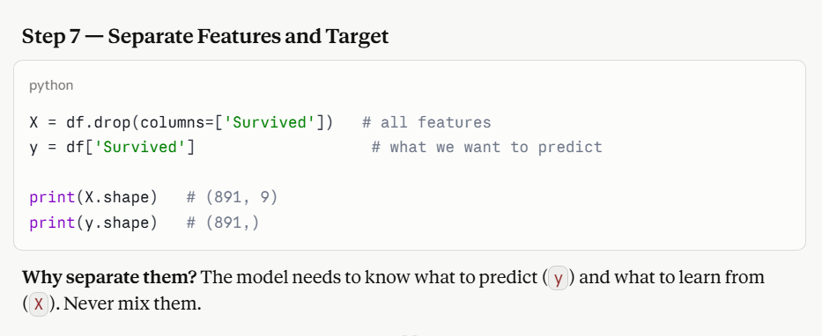
An Example of Data Preparation for ML
made by Claude
** X shape should be 8 columns. **

Slide 40
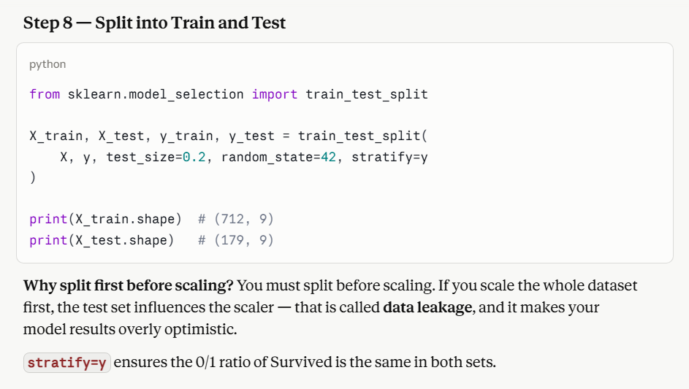
An Example of Data Preparation for ML
made by Claude

Slide 41
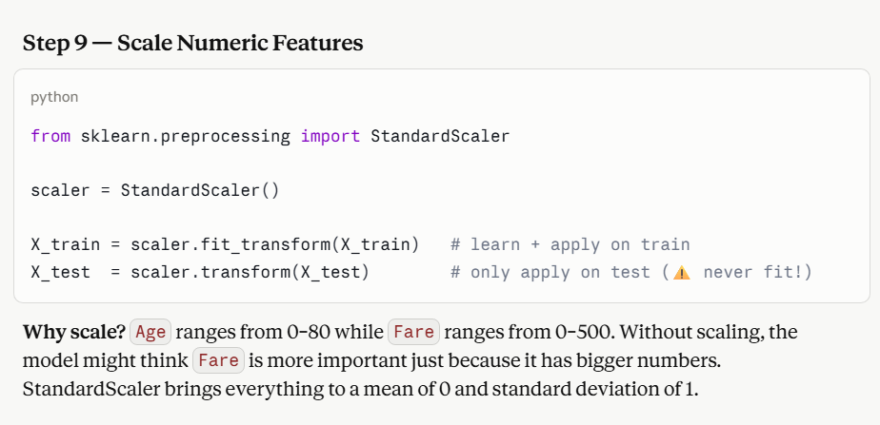
An Example of Data Preparation for ML
made by Claude

Slide 42
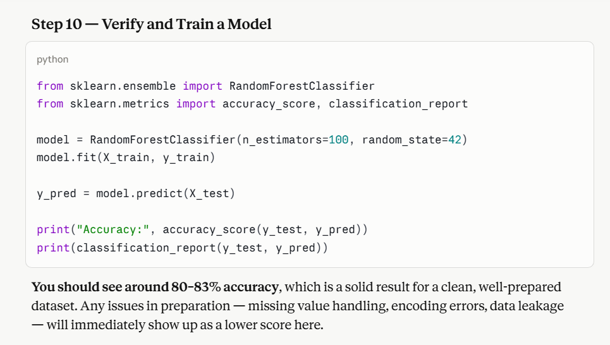
An Example of Data Preparation for ML
made by Claude

Slide 43
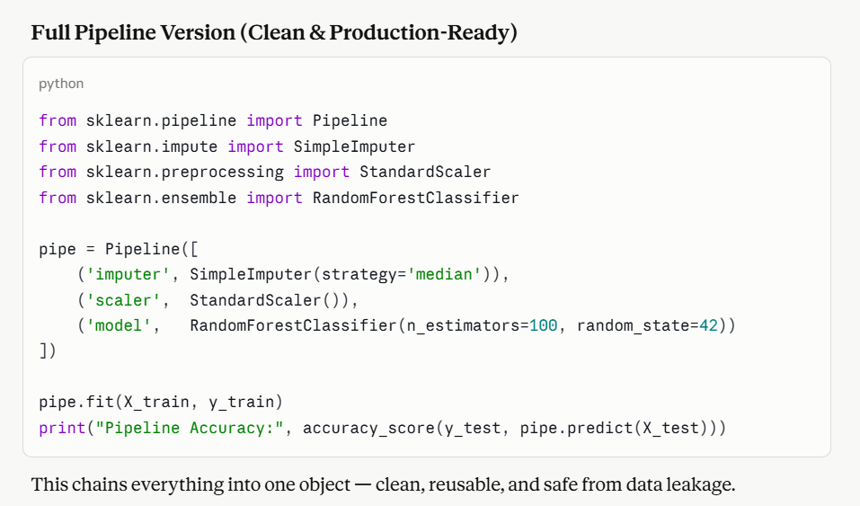
An Example of Data Preparation for ML
made by Claude

Slide 44
An Example of Data Preparation for ML
made by Claude

Slide 45
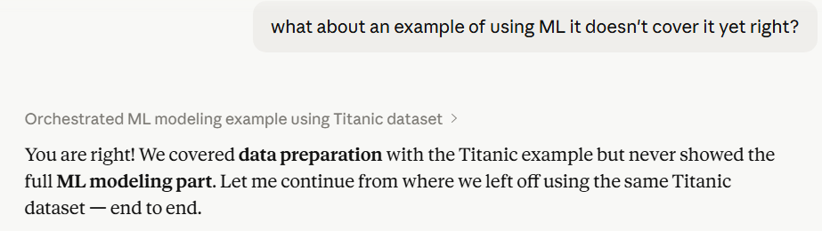
Using Machine Learning Model
made by Claude

Slide 46
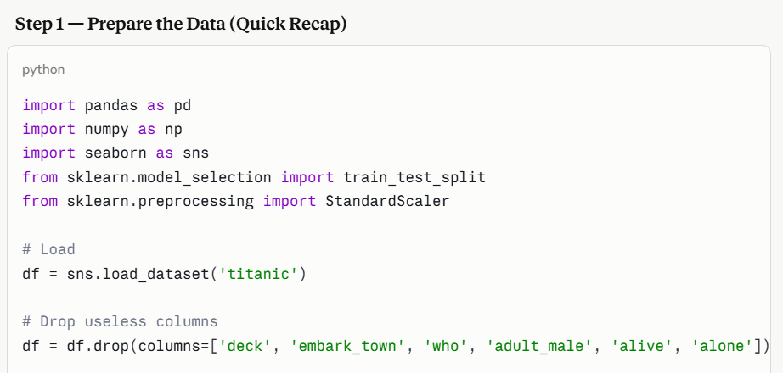
Using Machine Learning Model
made by Claude

Slide 47
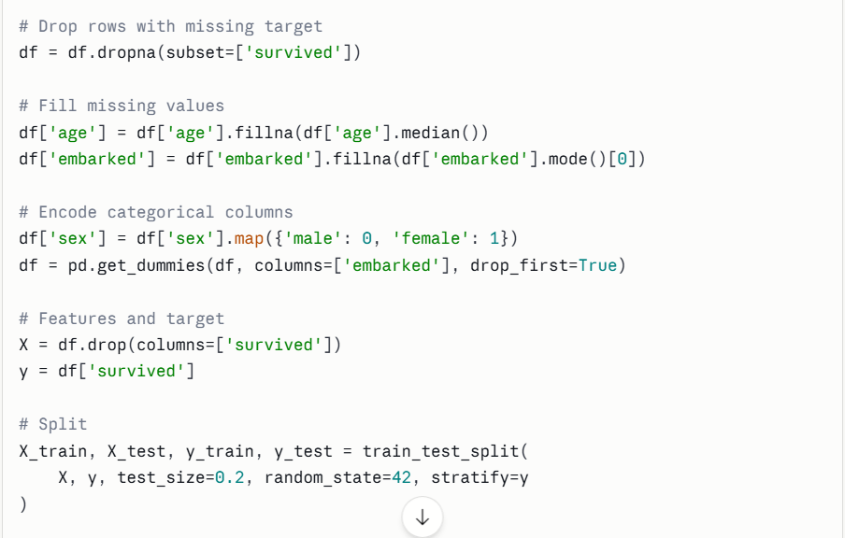
Using Machine Learning Model
made by Claude

Slide 48
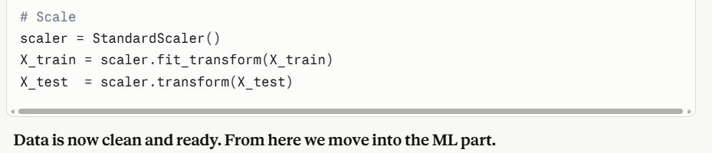
Using Machine Learning Model
made by Claude

Slide 49
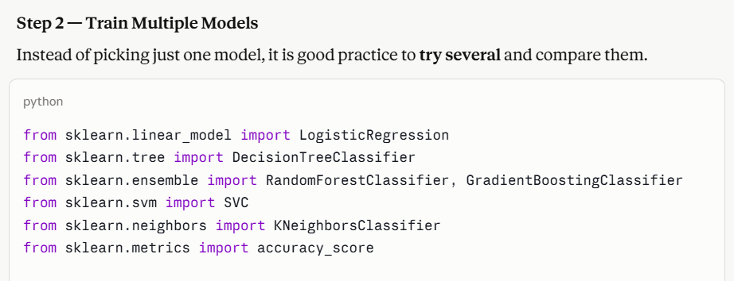
Using Machine Learning Model
made by Claude

Slide 50
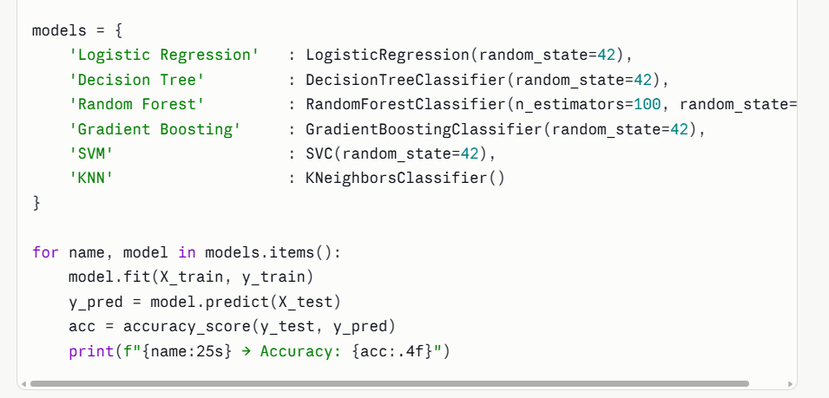
Using Machine Learning Model
made by Claude

Slide 51
Using Machine Learning Model
made by Claude
models = {
'Logistic Regression' : LogisticRegression(random_state=42),
'Decision Tree' : DecisionTreeClassifier(random_state=42),
'Random Forest' : RandomForestClassifier(n_estimators=100, random_state=42),
'Gradient Boosting' : GradientBoostingClassifier(random_state=42),
'SVM' : SVC(random_state=42),
'KNN' : KNeighborsClassifier()
}
for name, model in models.items():
model.fit(X_train, y_train)
y_pred = model.predict(X_test)
acc = accuracy_score(y_test, y_pred)
print(f"{name:25s} → Accuracy: {acc:.4f}")

Slide 52
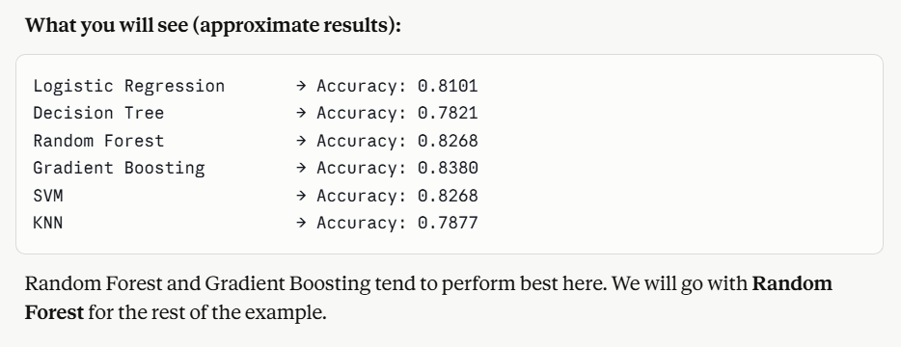
Using Machine Learning Model
made by Claude

Slide 53
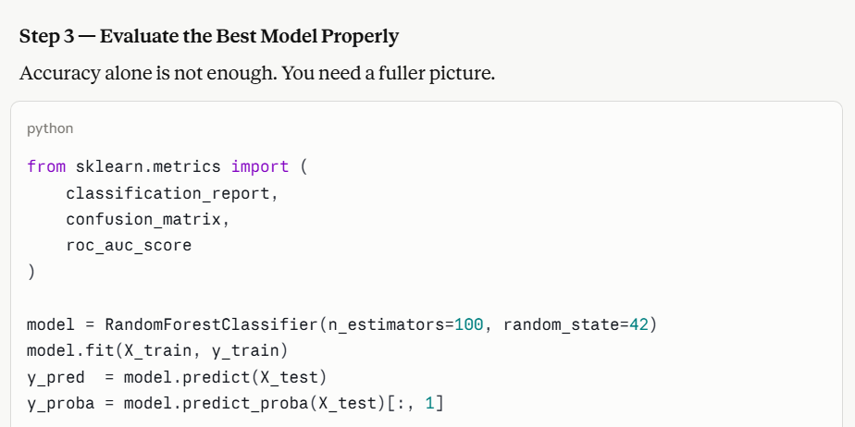
Using Machine Learning Model
made by Claude

Slide 54
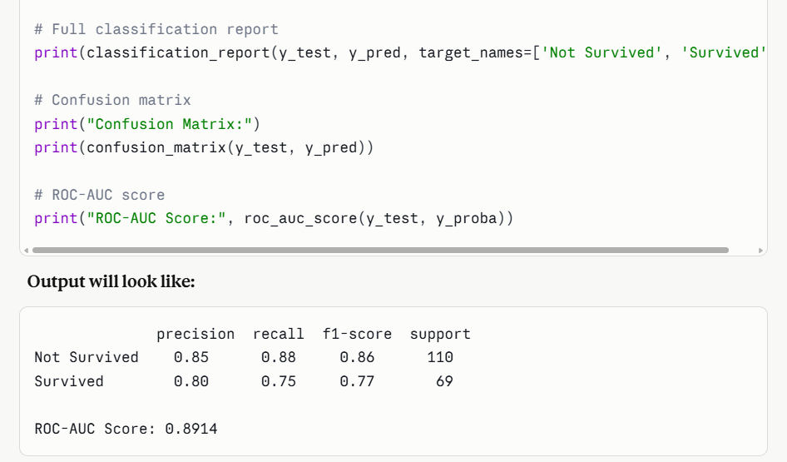
Using Machine Learning Model
made by Claude

Slide 55
Using Machine Learning Model
made by Claude
from sklearn.metrics import (
classification_report,
confusion_matrix,
roc_auc_score
)
model = RandomForestClassifier(n_estimators=100, random_state=42)
model.fit(X_train, y_train)
y_pred = model.predict(X_test)
y_proba = model.predict_proba(X_test)[:, 1]
# Full classification report
print(classification_report(y_test, y_pred, target_names=['Not Survived', 'Survived']))
# Confusion matrix
print("Confusion Matrix:")
print(confusion_matrix(y_test, y_pred))
# ROC-AUC score
print("ROC-AUC Score:", roc_auc_score(y_test, y_proba))

Slide 56
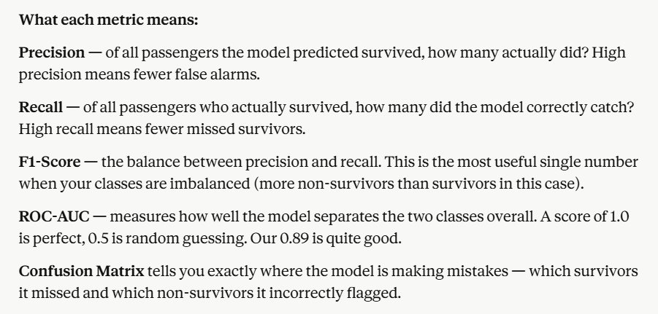
Using Machine Learning Model
made by Claude

Slide 57
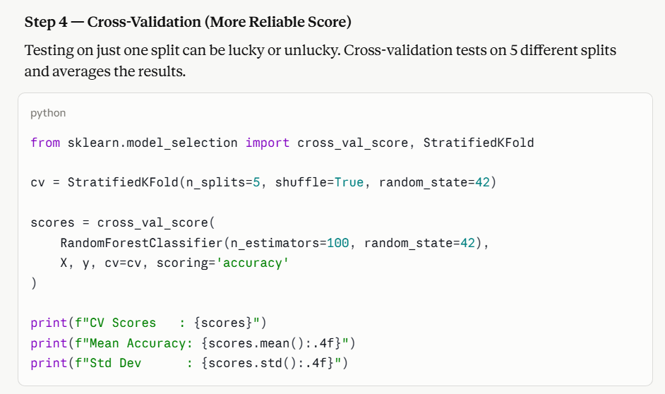
Using Machine Learning Model
made by Claude

Slide 58
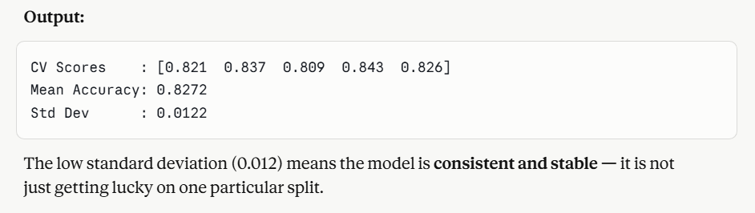
Using Machine Learning Model
made by Claude

Slide 59
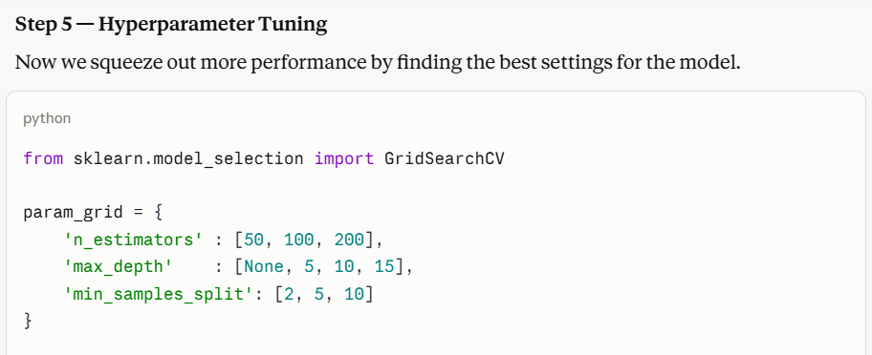
Using Machine Learning Model
made by Claude

Slide 60
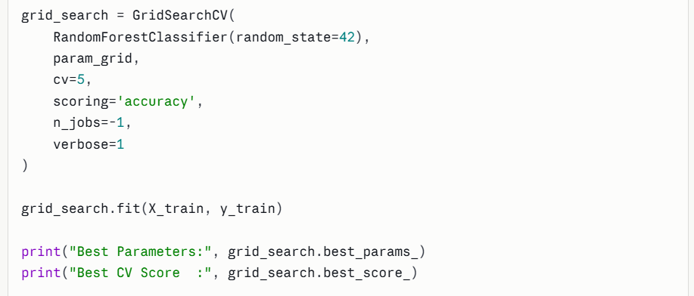
Using Machine Learning Model
made by Claude

Slide 61
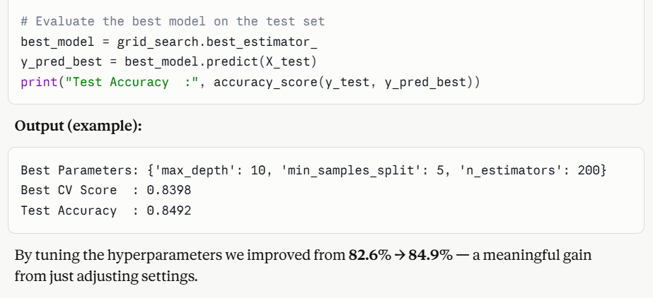
Using Machine Learning Model
made by Claude

Slide 62
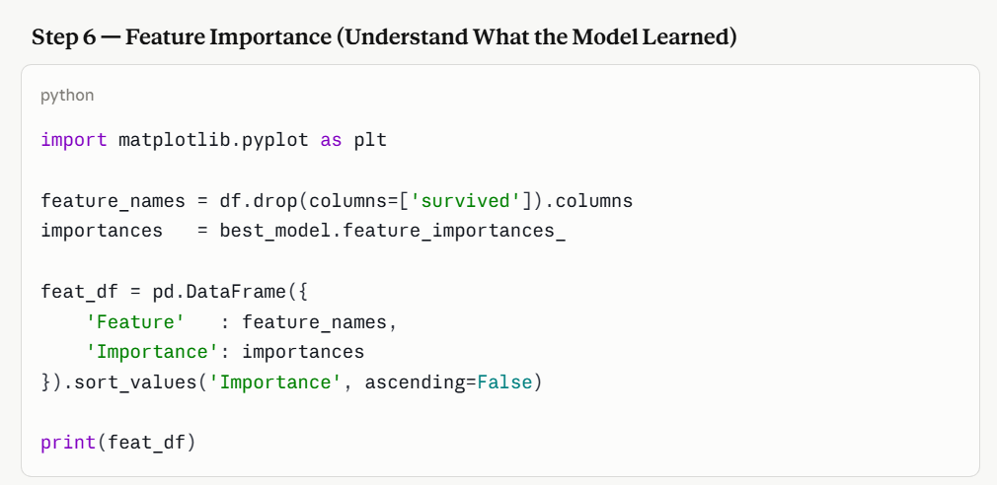
Using Machine Learning Model
made by Claude

Slide 63
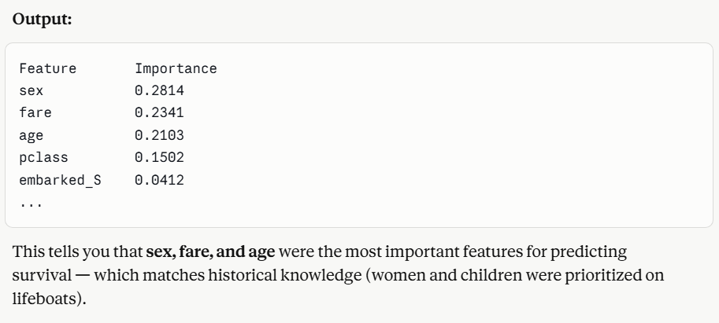
Using Machine Learning Model
made by Claude

Slide 64
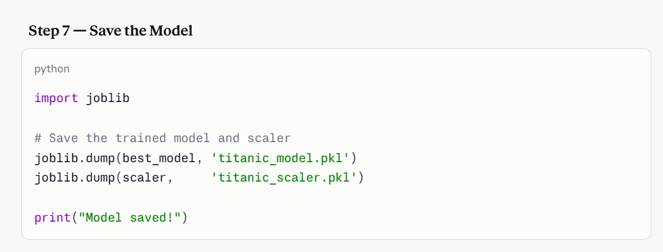
Using Machine Learning Model
made by Claude

Slide 65
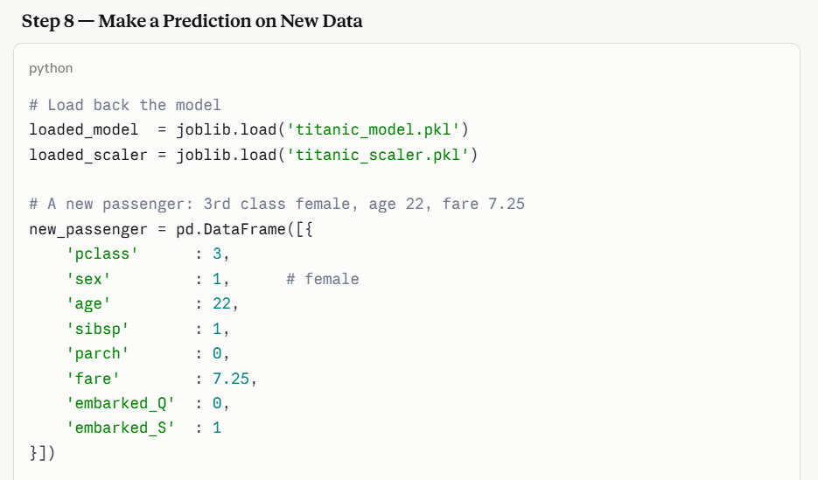
Using Machine Learning Model
made by Claude

Slide 66
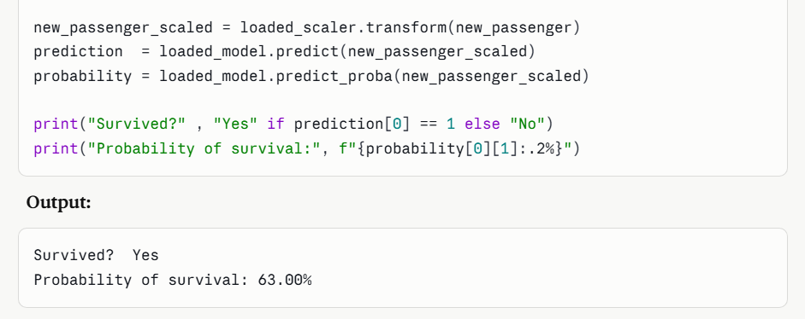
Using Machine Learning Model
made by Claude

Slide 67
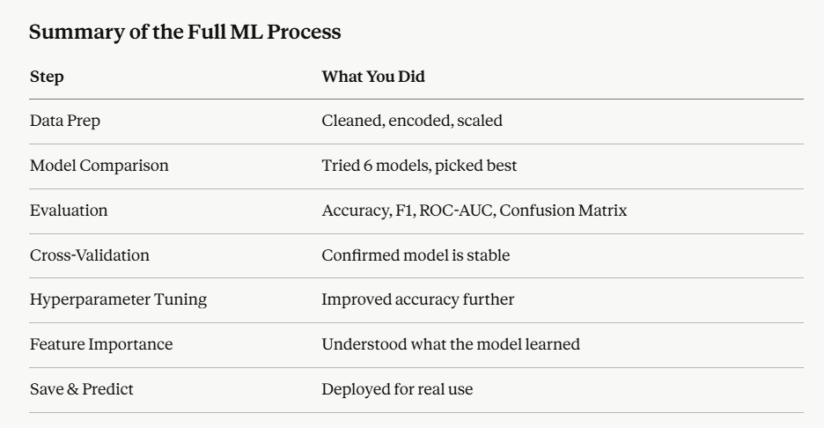
Using Machine Learning Model
made by Claude

Slide 68
Using Machine Learning Model
made by Claude

Slide 69
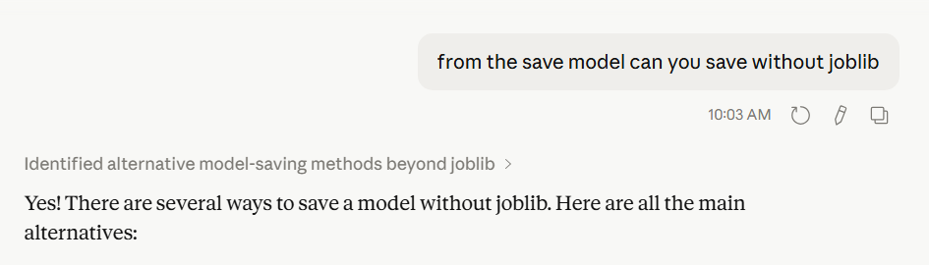
Using Machine Learning Model
made by Claude

Slide 70
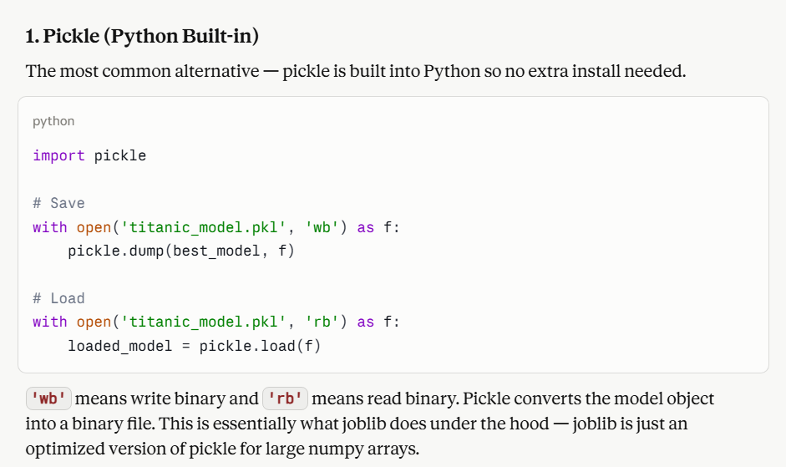
Using Machine Learning Model
made by Claude

Slide 71
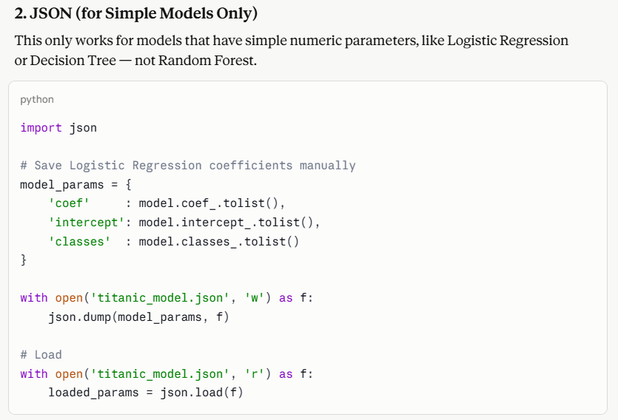
Using Machine Learning Model
made by Claude
Why limited? Complex models like Random Forest have hundreds of trees with thousands of nodes — JSON is not designed to store that kind of structure efficiently. Best for simple models only.

Slide 72
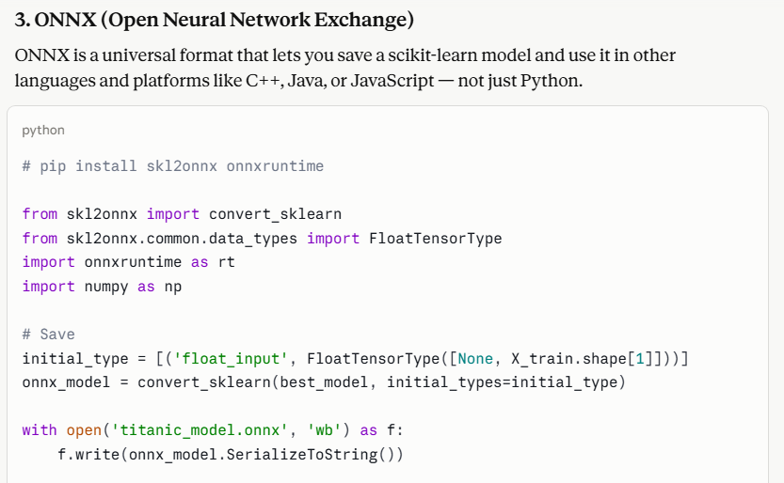
Using Machine Learning Model
made by Claude

Slide 73
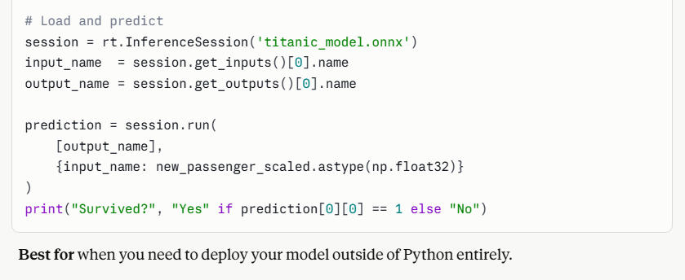
Using Machine Learning Model
made by Claude

Slide 74
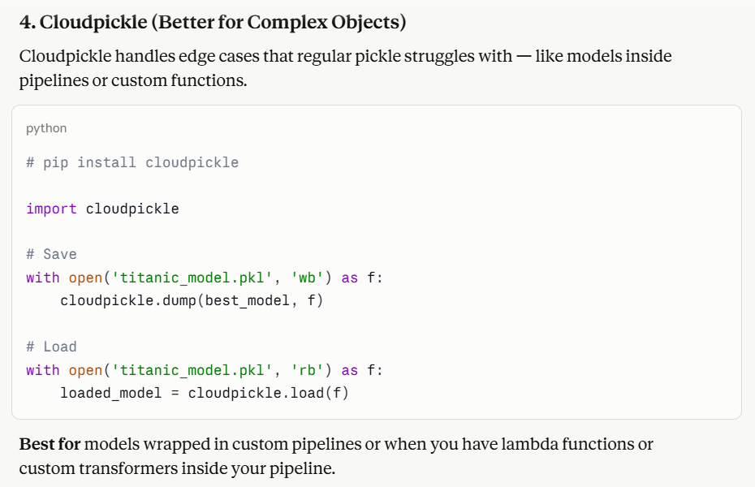
Using Machine Learning Model
made by Claude

Slide 75
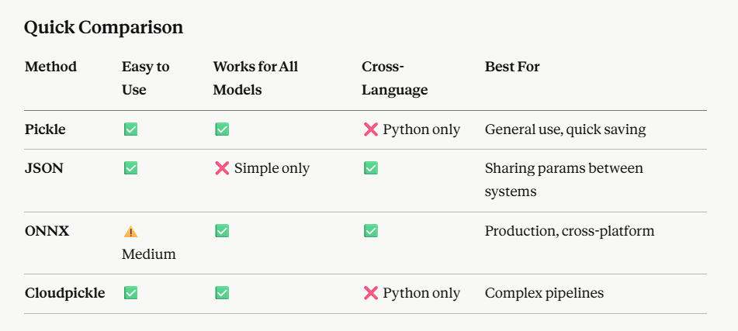
Using Machine Learning Model
made by Claude

Slide 76
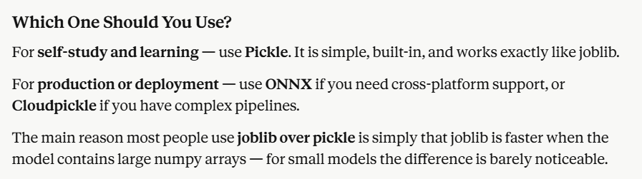
Using Machine Learning Model
made by Claude

Slide 77
Machine Learning Terminology — Brief Explanations

Slide 78
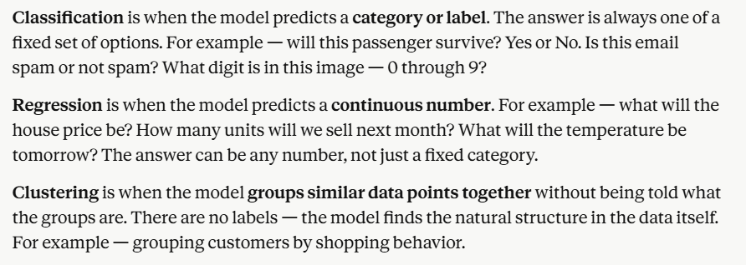
Core Problem Types

Slide 79
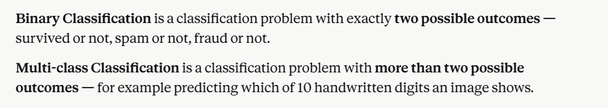
Core Problem Types

Slide 80
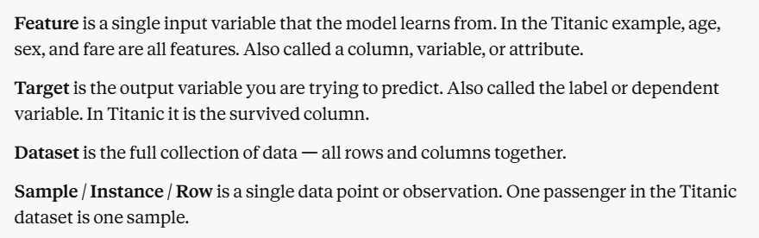
Data Terminology

Slide 81
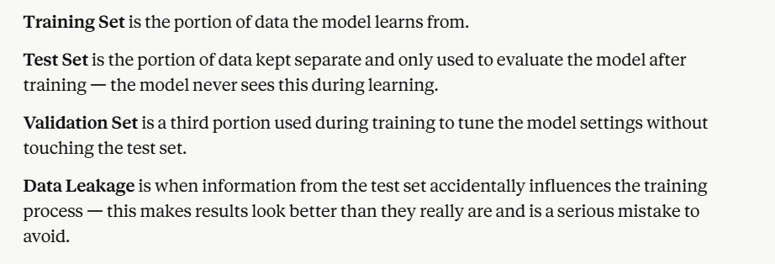
Data Terminology

Slide 82

Model Terminology

Slide 83

Algorithm Names

Slide 84

Algorithm Names

Slide 85

Evaluation Terminology

Slide 86

Evaluation Terminology

Slide 87

Hyperparameter Terminology

Slide 88

Hyperparameter Terminology

Slide 89

Preprocessing Terminology

Slide 90

Preprocessing Terminology

Slide 91


