Slide 1
Basic Pandas

Slide 2
Example Data
data = {
'user': ['Alice', 'Bob', 'Charlie', 'David', 'Emma', 'Frank', 'Grace', 'Henry', 'Iris', 'Jack',
'Kelly', 'Liam', 'Mia', 'Noah', 'Olivia', 'Peter', 'Quinn', 'Rachel', 'Sam', 'Tina'],
'province': ['Bangkok', 'Bangkok', 'Chiang Mai', 'Bangkok', 'Phuket',
'Chiang Mai', 'Bangkok', 'Phuket', 'Chiang Mai', 'Bangkok',
'Phuket', 'Bangkok', 'Chiang Mai', 'Bangkok', 'Phuket',
'Chiang Mai', 'Bangkok', 'Phuket', 'Chiang Mai', 'Bangkok'],
'age': [25, 34, 28, 45, 31, 29, 52, 38, 27, 41,
33, 26, 48, 35, 30, 44, 39, 28, 50, 32],
'income': [35000, 48000, 32000, 65000, 42000,
38000, 75000, 55000, 30000, 62000,
45000, 36000, None, 58000, 47000,
None, 68000, 43000, 52000, 40000],
'spending': [25000, 35000, 28000, 45000, 38000,
32000, 55000, 48000, 25000, 50000,
40000, 30000, 42000, 48000, 42000,
38000, 52000, 39000, 45000, 35000],
'debt': [50000, 120000, 0, 200000, 80000,
30000, 150000, 95000, 0, 180000,
100000, 45000, 70000, None, 88000,
110000, 175000, 92000, 140000, 65000]
}

Slide 3
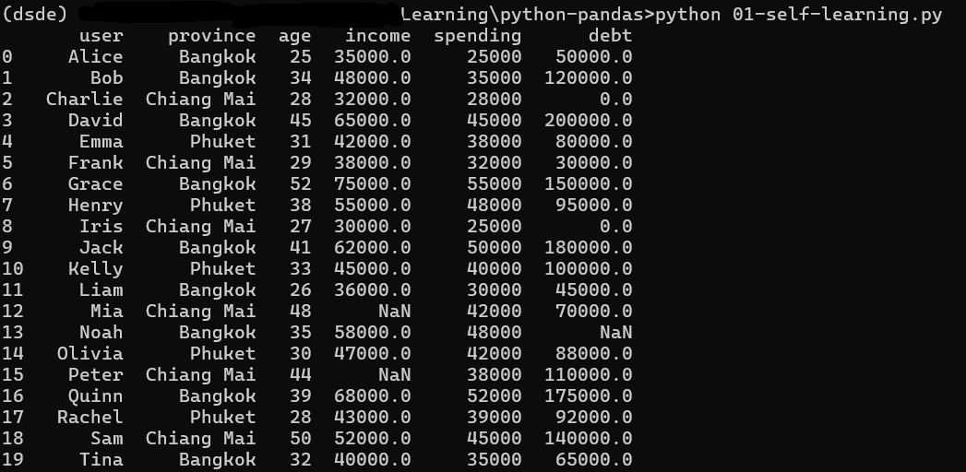
Example Data

Slide 4
Example Data

Slide 5
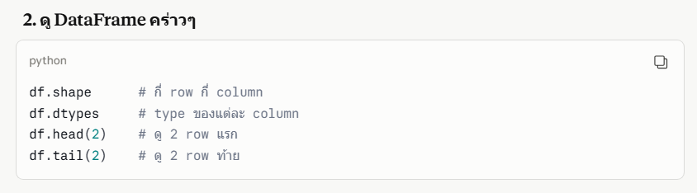
DataFrame - Infomation

Slide 6
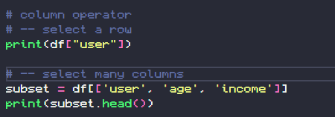
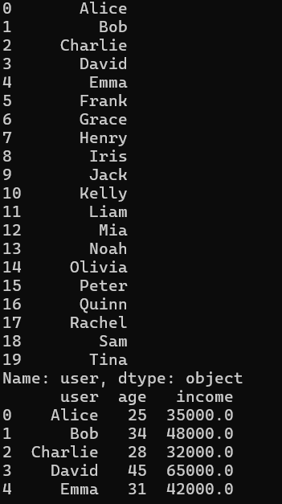
DataFrame – Column Selection

Slide 7
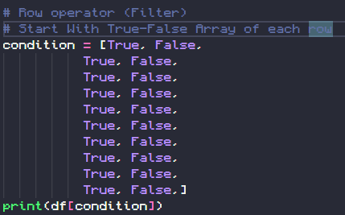
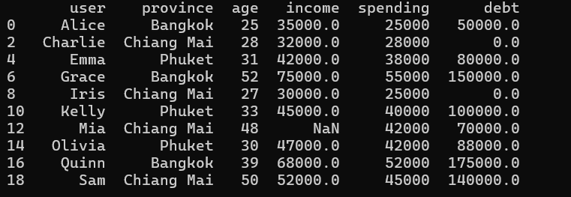
DataFrame – Row Selection
Start with True-False Array of each row. When an True-False array is put in the DataFrame it will select only the true row.

Slide 8

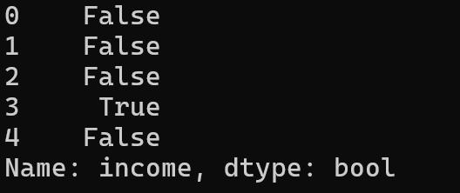
DataFrame – Row Selection
Define the condition (Who earns more than 50,000?)
In the picture we show only the first 5 rows from all 20 rows by using .head(5).

Slide 9

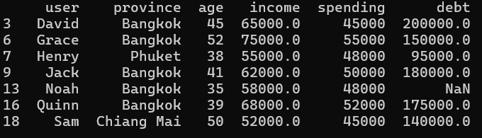
DataFrame – Row Selection
Put the condition in the DataFrame and displayed. It will show only users who have income greater than 50,000

Slide 10
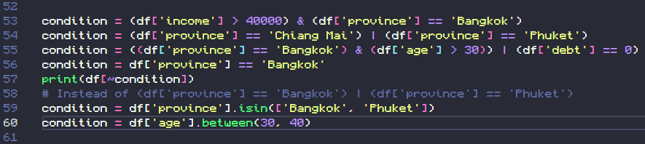
DataFrame – Row Selection
You can use AND (&) OR (|) NOT(~) operator in condition

Slide 11
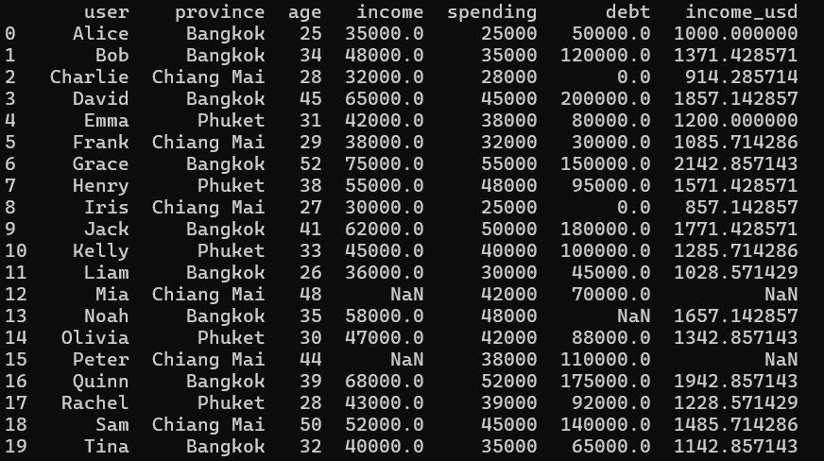

DataFrame – Create Column

Slide 12
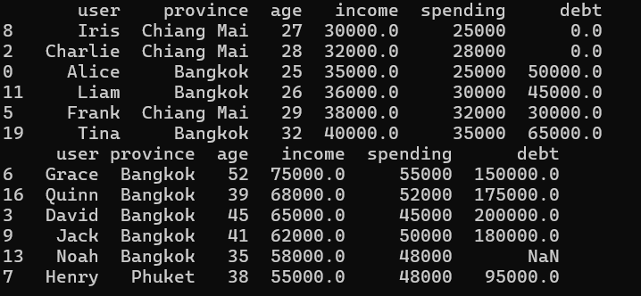
DataFrame – Sort

Slide 13

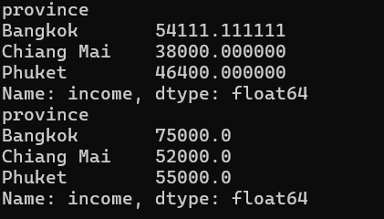
DataFrame – Group By

Slide 14
DataFrame – Group By

Slide 15
Basic Aggregation
01 basic pandas practice

Slide 16
Example Data
import pandas as pd
data = {
"name": ["Alice", "Bob", "Charlie", "Diana", "Eve", "Frank"],
"department": ["HR", "IT", "IT", "Finance", "HR", "Finance"],
"salary": [55000, 72000, 68000, 80000, 52000, 91000],
"age": [29, 34, 28, 41, 35, 47]
}
df = pd.DataFrame(data)

Slide 17
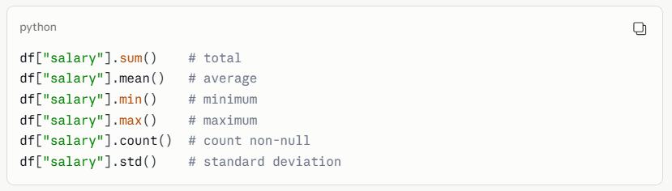
Basic Aggregation (whole column)

Slide 18
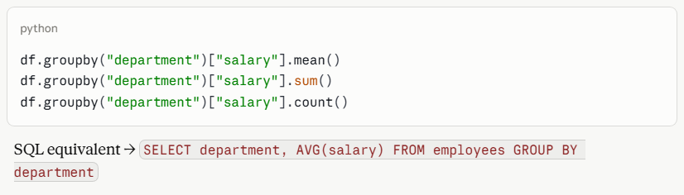
GROUP BY + single aggregate

Slide 19
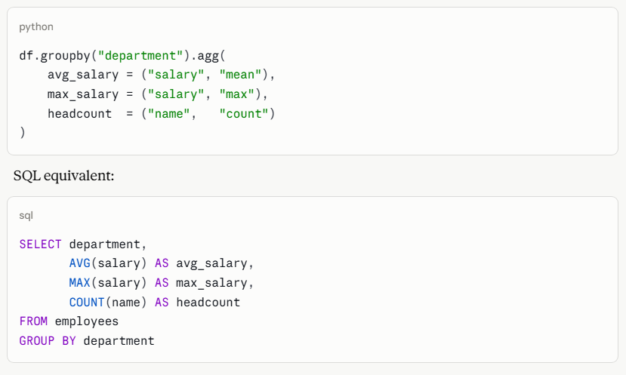
GROUP BY + multiple aggregates

Slide 20
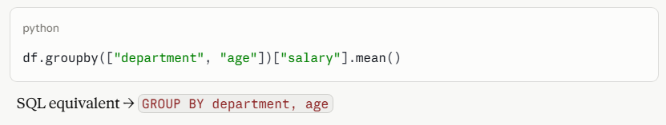
GROUP BY multiple columns

Slide 21
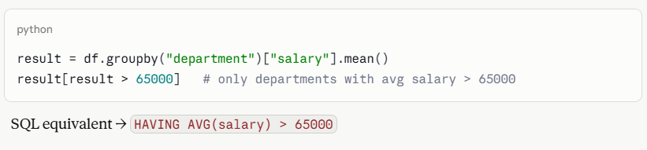
HAVING (filter after group by)

Slide 22
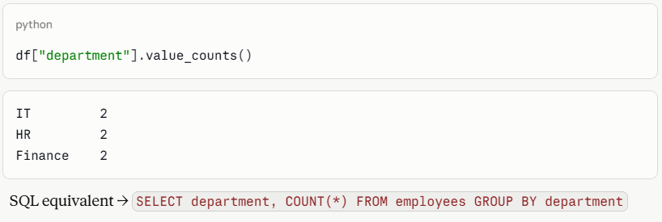
value_counts
(like COUNT + GROUP BY in one shot)

Slide 23
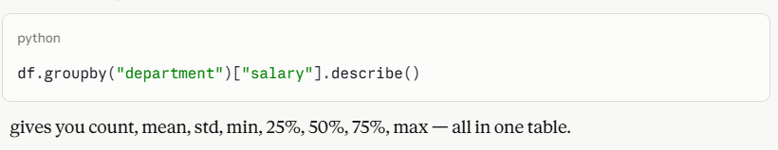
describe() — all stats at once

