Slide 1
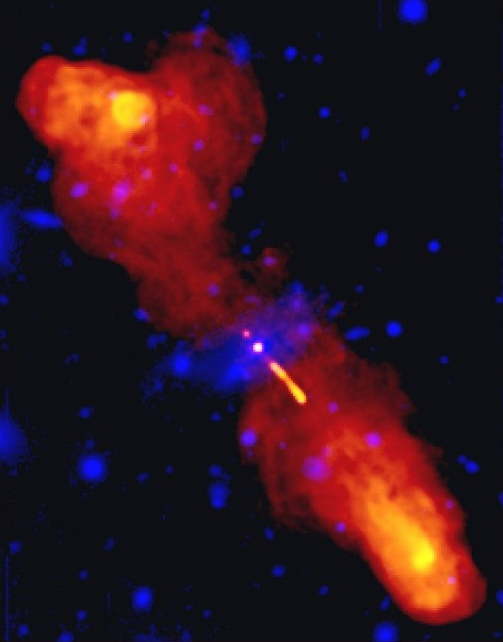
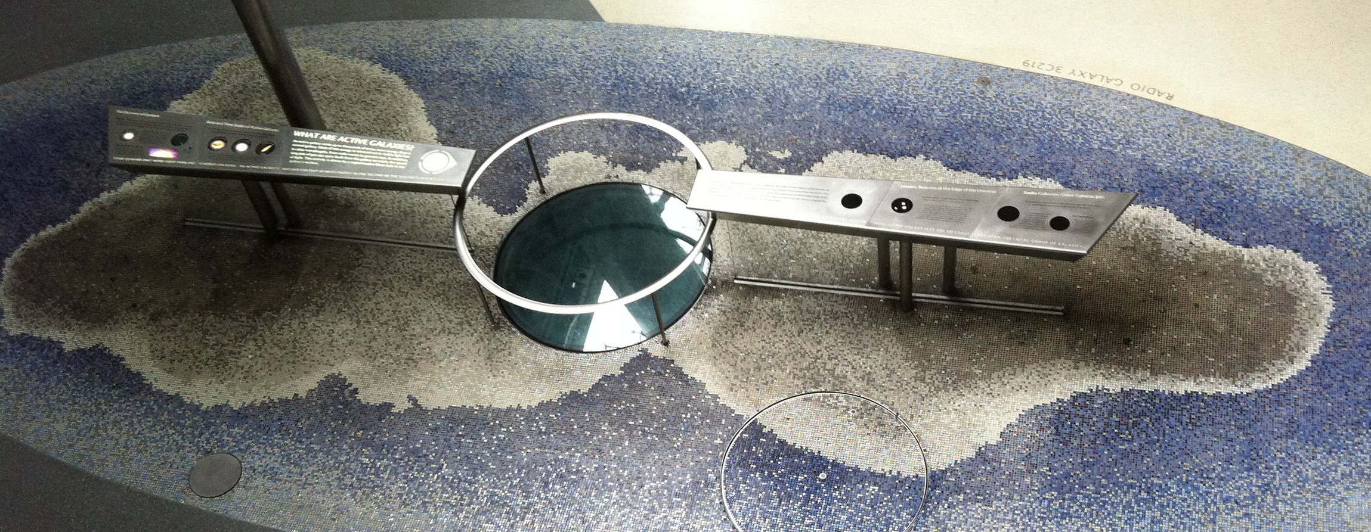
Notes:
When 3C219 first shows, point to where it is on the tie!!

