Slide 1

MediPulse
Smart Clinic
العيادة الذكية | نظام الرعاية الصحية الذكي
ESP32
MAX30105
DS18B20
Node.js
IoT
Graduation Project | 2026 | Smart Healthcare Systems
Notes:
Welcome to MediPulse Smart Clinic presentation. This is a graduation project showcasing an IoT-based smart healthcare system. The project title is MediPulse - Smart Clinic (العيادة الذكية).

Slide 2

👥 Team Members
Ezzat Sadek Ezzat 241400
Mohamed Tharwat Elsayed Ali
241219
Embedded Systems & Hardware
Backend & Server Development
Communication Engineering
Mechatronics Engineering
Supervised by: Prof. Tamer Saleh
Notes:
Introduce each team member and their role in the project.

Slide 3

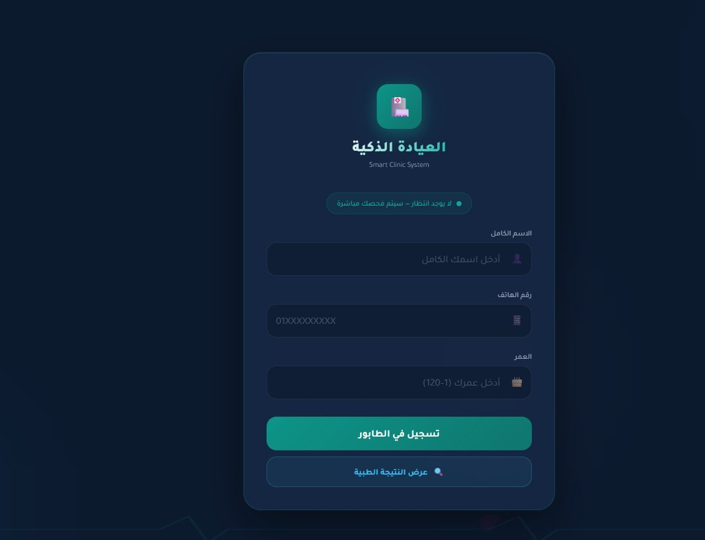
📖 Introduction
المقدمة
Healthcare systems face growing inefficiencies in patient management
Manual queue management wastes time and increases errors
Vital signs measurement often requires expensive dedicated equipment
MediPulse integrates IoT sensors with smart software to solve these problems
Smart Clinic Portal
بوابة العيادة الذكية
The system automates patient intake, vital measurement, and data reporting
Figure 1.1: Patient Registration Interface
Notes:
Introduce the problem space and how MediPulse addresses real-world healthcare inefficiencies. The system bridges the gap between IoT hardware and web-based healthcare management.

Slide 4




⚠️ Problem Statement
تعريف المشكلة
Long Waiting Times
Manual Vital Signs
طول أوقات الانتظار
قياس يدوي للعلامات
Patients queue manually with no automated tracking system
BPM and temperature recorded manually, prone to errors
No Digital Records
No Alerts System
لا سجلات رقمية
لا نظام تنبيهات
Patient results not stored or accessible digitally
Abnormal readings not flagged automatically for doctors
Notes:
This slide outlines the core problems that MediPulse solves: manual queue management, manual vital measurements, lack of digital records, and absence of alert systems.

Slide 5
🎯 Project Objectives
أهداف المشروع
Automate patient queue management via web registration
Measure heart rate (BPM) using MAX30105 optical sensor
01
02
أتمتة إدارة قوائم انتظار المرضى
قياس معدل ضربات القلب باستخدام حساس MAX30105
Measure body temperature using DS18B20 sensor
Transmit results wirelessly to Node.js server via WiFi
03
04
قياس درجة حرارة الجسم باستخدام DS18B20
إرسال النتائج لاسلكياً إلى خادم Node.js
Display real-time data on web dashboard for clinic staff
Alert staff of abnormal readings using buzzer and status flags
05
06
عرض البيانات على لوحة التحكم للطاقم الطبي
تنبيه الطاقم عند القراءات غير الطبيعية بالجرس
Notes:
Six core objectives drive the MediPulse project. Each addresses a specific problem identified in the previous slide.

Slide 6
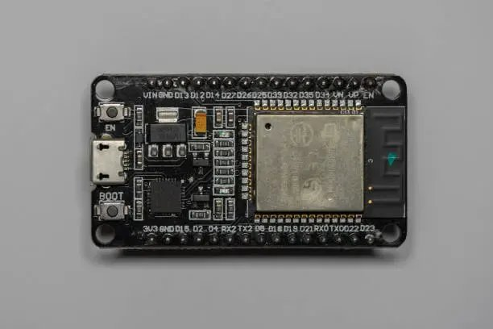
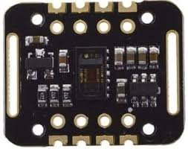
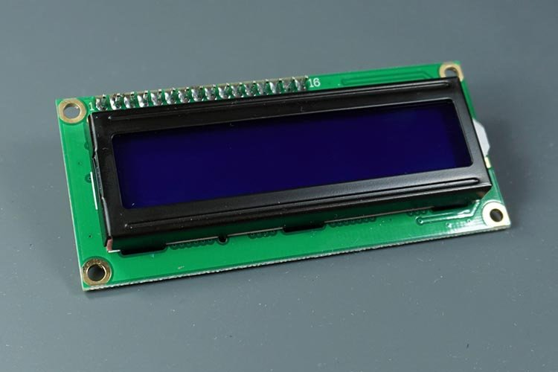
🔧 Hardware Components
المكونات الصلبة
ESP32 Dev Board
MAX30105 Sensor
LCD 16×2 I2C
وحدة التحكم الرئيسية
حساس النبض
شاشة العرض
Dual-core 240MHz, WiFi + BT
Optical heart rate & SpO2
16 chars × 2 rows, I2C 0x27
Figure 4.1: ESP32 Dev Board
Figure 4.2: MAX30105 Sensor
Figure 4.3: LCD 16×2 I2C
Additional Components | مكونات إضافية
DS18B20 Temperature Sensor
Active Buzzer (5V)
OK & NO Push Buttons
I2C Pull-up Resistors
5V Power Supply / USB
Notes:
The hardware consists of an ESP32 as the main controller, MAX30105 for pulse oximetry, DS18B20 for temperature, and a 16x2 LCD for local display. A buzzer provides audio alerts.

Slide 7





💻 Software Technologies
التقنيات البرمجية
Arduino IDE
Node.js + Express
HTML5 / CSS3 / JS
بيئة تطوير Arduino
خادم Node.js
واجهة الويب
ESP32 firmware development using C++ and Arduino libraries
REST API server handling queue, results, and device communication
Responsive web dashboard for patient management and monitoring
HTTP / WiFi
JSON Data Format
File System Storage
بروتوكول الاتصال
تنسيق البيانات
التخزين
ESP32 sends and receives JSON data over WiFi using HTTPClient
All data exchanged as structured JSON between ESP32 and server
data.json persists queue, current patient, and results on disk
Notes:
The software stack spans embedded C++ for ESP32, Node.js for the backend REST API, and vanilla HTML/CSS/JS for the frontend dashboard. Communication uses HTTP over WiFi with JSON payloads.

Slide 8
🏗️ System Architecture
بنية النظام
PATIENT LAYER
SERVER LAYER
DEVICE LAYER
طبقة المريض
طبقة الخادم
طبقة الجهاز
Web Browser
Node.js Server
ESP32 MCU
Mobile Device
REST API
Sensors
← WiFi HTTP →
← WiFi HTTP →
Registration Form
data.json
LCD Display
Communication: HTTP/REST over WiFi | التواصل: HTTP عبر WiFi
Notes:
The three-layer architecture separates concerns: patients interact through the web, the Node.js server orchestrates data flow, and the ESP32 device handles physical measurements.

Slide 9


🔄 System Workflow
تدفق عمل النظام
1
2
3
Patient Registers
Server Queues Patient
ESP32 Fetches Name
يسجل المريض
الخادم يضع المريض في الطابور
ESP32 يجلب اسم المريض
4
5
6
LCD Shows Patient
Press OK → Measure
Results → Dashboard
الشاشة تعرض المريض
اضغط OK → القياس
النتائج تظهر في اللوحة
Notes:
The workflow is a 6-step loop: patient registers on web → server queues → ESP32 fetches current patient → LCD shows name → OK button triggers measurement → results sent to dashboard.

Slide 10
⚙️ Arduino Code Overview
شرح كود Arduino
// Key Libraries Used
#include <WiFi.h>
#include <HTTPClient.h>
#include <LiquidCrystal_I2C.h>
#include "MAX30105.h"
#include <DallasTemperature.h>
// Measure BPM loop
long irValue = sensor.getIR();
if (checkForBeat(irValue)) {
bpmSum += currentBPM;
bpmCount++;
}
// Send results to server
http.POST(jsonPayload);
WiFi Connection
اتصال WiFi — ESP32 connects to local network using ssid/password credentials
Finger Detection
كشف الإصبع — IR value threshold > 50,000 confirms finger placement on sensor
BPM Averaging
متوسط النبض — Multiple BPM readings averaged over 20s for accuracy
HTTP POST Result
إرسال النتيجة — JSON payload with name, BPM, temp sent to /result endpoint
Notes:
The Arduino sketch includes: WiFi connection, periodic polling of the server for the current patient name, MAX30105 finger detection, BPM measurement loop with averaging, DS18B20 temperature reading, and HTTP POST to send results.

Slide 11
🩺 Sensor Technology
تقنية الحساسات
MAX30105 — Pulse Sensor
DS18B20 — Temperature Sensor
• Optical heart-rate + SpO2 sensor
• Digital thermometer, 1-Wire protocol
• Red, IR, Green LEDs + photodetector
• Range: −55°C to +125°C
• I2C interface (SDA/SCL)
• Resolution: 0.0625°C (12-bit)
• checkForBeat() detects pulse
• DallasTemperature library used
• IR > 50,000 = finger present
• Single GPIO pin (Pin 4)
• Sampling: every 200ms
• Normal range: 36.1°C – 37.2°C
Figure 5.1: MAX30105 Sensor Module
Figure 5.2: DS18B20 Temperature Sensor
Notes:
Two sensors power MediPulse: the MAX30105 optical sensor for pulse rate detection, and the DS18B20 digital thermometer for body temperature. Both communicate digitally with the ESP32.

Slide 12
📟 LCD Interface
واجهة شاشة LCD
Idle State
Smart Clinic
Waiting...
Patient Shown
Patient: Ahmed
Press OK
16×2 I2C LCD Display
Measuring
BPM: 85
Temp: 37.2C
Done State
Sent! Next:
Patient Name
Figure 6.1: LCD 16×2 with I2C Backpack
Notes:
The LCD shows the system state at all times: idle, patient waiting, measuring, and done. I2C communication uses only 2 wires (SDA/SCL) keeping wiring minimal.

Slide 13
🖥️ Node.js Server
خادم Node.js
METHOD
ENDPOINT
DESCRIPTION
POST
/add
Register new patient, validate, add to queue
GET
/current
ESP32 fetches current patient name + heartbeat
GET
/next
Advance queue, set next patient as current
POST
/result
Receive BPM + temp from ESP32, save result
GET
/results
Retrieve all results for dashboard display
POST
/search-result
Patient searches own result by name/phone
DELETE
/remove/:id
Admin removes specific patient from queue
POST
/clear
Admin clears entire queue and all results
Notes:
The Node.js Express server exposes 8 REST endpoints. It handles patient registration with duplicate detection, queue management, device heartbeat tracking, and result storage in data.json.

Slide 14
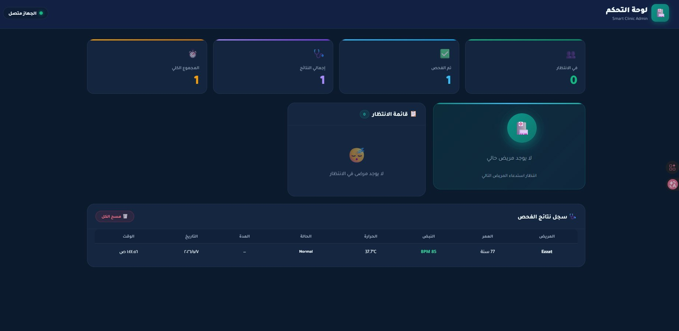
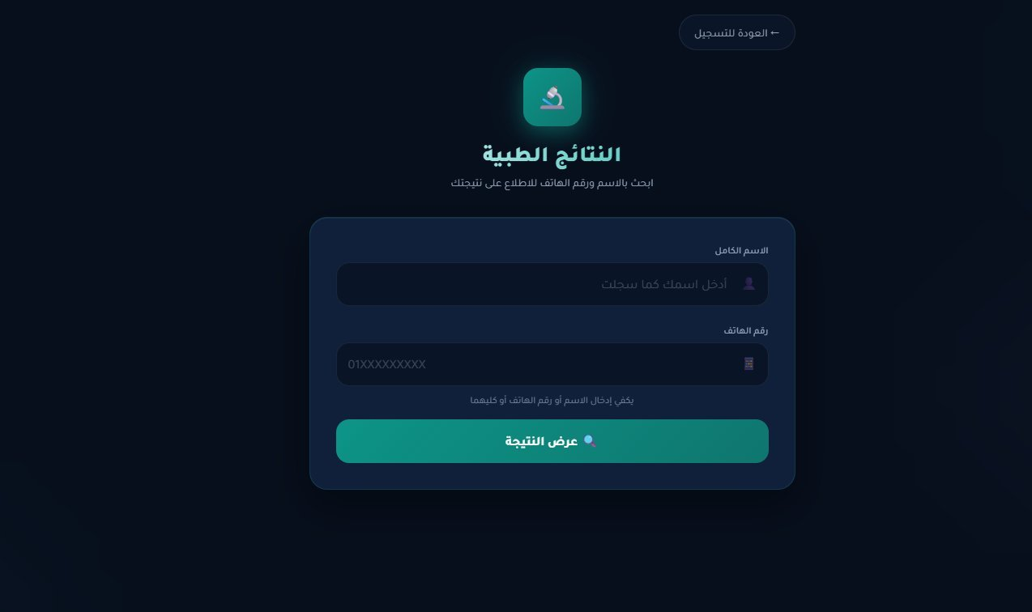
📊 Web Dashboard
لوحة التحكم
Patient Registration
Admin Dashboard
Medical Results
تسجيل المريض
لوحة الإدارة
النتائج الطبية
Figure 9.1: Patient Registration
Figure 9.2: Admin Dashboard
Figure 9.3: Medical Results
Notes:
Three web interfaces: 1) Patient registration form at /, 2) Admin dashboard at /admin showing queue, current patient, and results table, 3) Results search at /result for patients to view their own data.

Slide 15
✨ Key Features
الميزات الرئيسية
Duplicate Prevention
Auto Health Detection
Buzzer Alerts
منع التكرار
كشف الحالة الصحية
تنبيهات صوتية
Same name or phone cannot register twice in queue
BPM < 60 = Low, 60-100 = Normal, > 100 = High
Audio alerts for measurements start, end, and errors
Device Status Tracking
Persistent Storage
Auto Timeout (20s)
تتبع حالة الجهاز
تخزين دائم
إيقاف تلقائي بعد 20 ثانية
Dashboard shows ESP32 online/offline based on heartbeat
data.json saves queue and results across server restarts
Measurement stops after 20s or when finger is removed
Notes:
Six standout features of MediPulse: duplicate patient prevention, automatic health status classification, audio buzzer alerts, real-time device status, persistent data storage, and auto-timeout.

Slide 16
🧪 Testing & Results
الاختبار والنتائج
Test CaseResultDetails
Test Case | Result | Details
Patient Registration | ✓ Pass | Validates name, 11-digit phone, age 1-120
Duplicate Prevention | ✓ Pass | Duplicate name or phone rejected with Arabic message
WiFi Connection | ✓ Pass | Connects in < 5s, reconnects automatically
Finger Detection | ✓ Pass | IR > 50,000 threshold correctly identifies finger
BPM Measurement | ✓ Pass | Average of multiple readings over 20s
Temperature Reading | ✓ Pass | DS18B20 reads within ±0.5°C accuracy
HTTP Result POST | ✓ Pass | JSON payload sent and stored in 200ms
Dashboard Display | ✓ Pass | Real-time updates, device online indicator
Sample Result
Patient: Ezzat | Age: 77
BPM: 85 | Temp: 37.7°C | Status: Normal
Figure 10.1: Admin Dashboard with Results
Notes:
All 8 test cases passed successfully. The sample result shows patient Ezzat: BPM 85, temperature 37.7°C, status Normal - exactly as displayed in the admin dashboard.

Slide 17
🚧 Challenges Faced
التحديات التي واجهناها
Sensor Noise
WiFi Stability
✓ Solution: Implemented averaging over multiple readings to smooth BPM values
✓ Solution: Added reconnection logic and heartbeat tracking for device status
LCD Arabic Text
Queue Sync
✓ Solution: Used English abbreviations and symbols on LCD; Arabic on web only
✓ Solution: ESP32 polls /current every few seconds to stay in sync
Finger Detection Threshold
Data Persistence
✓ Solution: Calibrated IR threshold value after extensive physical testing
✓ Solution: Implemented saveData() / loadData() with data.json on server restart
Notes:
Six main challenges encountered: sensor noise, WiFi stability, LCD Arabic text limitations, queue synchronization, finger detection calibration, and data persistence across server restarts.

Slide 18


🚀 Future Improvements
التطويرات المستقبلية
AI Diagnosis
Mobile App
MQTT Protocol
تشخيص بالذكاء الاصطناعي
تطبيق موبايل
بروتوكول MQTT
ML model to detect arrhythmia and predict health risks from BPM patterns
Dedicated iOS/Android app for patient registration and result viewing
Replace HTTP polling with MQTT pub/sub for real-time low-latency updates
Authentication
Database (MongoDB)
SpO2 Monitoring
المصادقة والأمان
قاعدة بيانات
قياس تشبع الأكسجين
Admin login system with JWT tokens to secure the dashboard
Replace data.json with MongoDB for scalable patient record management
Add blood oxygen saturation (SpO2) readings using MAX30105 red LED
Notes:
Future roadmap includes: AI-powered diagnosis, mobile app, MQTT for real-time comms, admin authentication, MongoDB database, and SpO2 monitoring using the existing MAX30105 sensor.

Slide 19
📝 Conclusion
الخاتمة
MediPulse successfully demonstrates an end-to-end smart clinic automation system
Project
The ESP32 device reliably measures and transmits vital signs over WiFi
Impact
The Node.js server efficiently manages patient queues and medical records
8
REST Endpoints
The web dashboard provides real-time visibility for clinic administrators
3
Web Interfaces
All project objectives were achieved within the project timeline
2
Sensors
The system is scalable and ready for integration into real clinic environments
20s
Avg Measure Time
Notes:
MediPulse achieved all its objectives: automated queue management, reliable vital signs measurement, and a real-time dashboard. The system is production-ready for small clinic deployment.

Slide 20
شكراً لكم
Thank You
MediPulse Smart Clinic | العيادة الذكية
Questions & Discussion | أسئلة ومناقشة
Notes:
Thank the audience. Open the floor for questions. Be ready to demonstrate the live system if possible.

