Slide 1
State Machine
Designing components using a finite state machine model.

Slide 2
When State Matters
Some components behave differently depending on what state they are in.
Examples:
Alarm Clock
Calculator
Stop Watch
Point of Sale (POS) device
most parsers

Slide 3
Simple Example: Stopwatch
Stopwatch behaves differently when it is running or stopped.

Slide 4
Identify States
Stopwatch states: RUNNING and STOPPED
RUNNING
STOPPED

Slide 5
Events
Events are actions that can cause a state machine to change state.
What events cause a stopwatch to change state?
RUNNING
STOPPED

Slide 6
Action
The stopwatch performs some action in response to an event.
RUNNING
entry/ start timer
STOPPED
entry/ stop timer

Slide 7
Activities
An activity is something that lasts for some time.
An action is (nearly) instantaneous.
In the StopWatch UI, "update display" is an activity.

Slide 8
Programming a State Machine
Design the state machine first – step by step.
1. Identify the states
2. Identify events: external and internally generated
3. Identify actions or activities the state machine performs in response to events or change in state.
4. Draw a state machine diagram.
Finally,
5. Code state-dependent behavior using state machine.

Slide 9
What behavior depends on state?
We use the attribute running to keep track of state.
class StopWatch {
private boolean running;
public void start( ) {
if (running) return;
startTime = System.nanoTime();
running = true; // change state
}

Slide 10
What behavior depends on state?
public double getElapsed() {
if (running)
return (System.nanoTime()-startTime)
* NANOSECONDS;
else
return (stopTime-startTime)
* NANOSECONDS;
}
public void stop() {
if (! running ) return;
stopTime = System.nanoTime();
running = false;
}

Slide 11
The State Variable
We used a boolean variable to record the state.
This works when there are only 2 states.
For more states we need another type of state variable.
Consider: a StopWatch with Start, Stop, and Hold states.

Slide 12
2 ways to represent state
// use "int" or "char"
class StopWatch {
int state;
final int STOPPED = 0;
final int RUNNING = 1;
final int HOLDING = 2;
public void start( ) {
if (state == RUNNING)
// use an enum
public enum State {
STOPPED,
RUNNING,
HOLDING;
}
class StopWatch {
State state;
public void start() {
if (state == RUNNING)

Slide 13
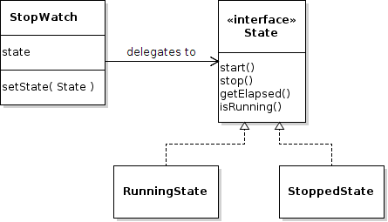
The O-O Approach
Use Objects to encapsulate state and the behavior that depends on state.
The context delegates behavior to state objects.

Slide 14
Delegating Behavior
Delegate means "let someone else do it".
Stopwatch delegates behavior to the state.
public class StopWatch {
private State state;
public void start( ) { state.start(); }
public void stop() { state.stop(); }
public double getElapsed() {
return state.getElapsed();
}

Slide 15
State Objects and Changing State
The context (StopWatch) needs a setState method as a way of changing the state.
// Create states with a reference to the
// stopwatch
final State RUNNING = new RunningState(this);
final State STOPPED = new StoppedState(this);
private State state = STOPPED;
// provide a method for changing the state
public void setState(State newstate) {
this.state = newstate;
}

Slide 16
Example of Changing State
If the stopwatch is running and the Stop button is pressed, then change to stopped state...
class RunningState implements State {
private StopWatch context;
public void stop() {
context.stopTime = System.nanoTime();
context.setState( context.STOPPED );
}
public void start() {
// already running so do nothing
}

Slide 17
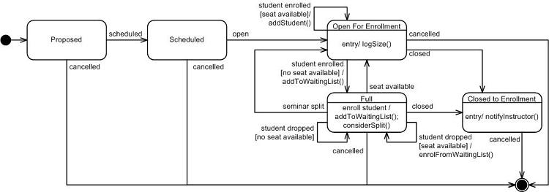
UML State Machine Diagram

Slide 18
UML State Machine Diagram
Read UML Distilled, chapter 10.
Also good: UML for Java Programmers, chapter 10.

Slide 19
Exercise: Skytrain Ticket Machine
1. What are the states.
2. What are the events.
3. What actions/activities does ticket machine perform?
4. Draw a UML State Machine Diagram.

Slide 20
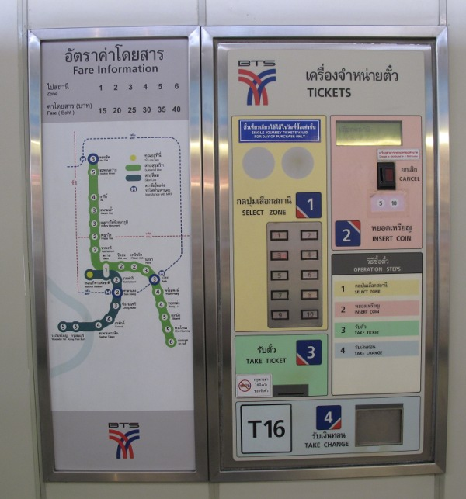

Slide 21
Exercise: Syllable Counter
Count the syllables in a word.
As a heuristic, we will count vowel sequences.
Example:
object = (o)bj(e)ct = 2 vowel sequences
beauty = b(eau)t(y) = 2 vowel sequences
Special cases:
l(a)y(ou)t = treat "y" as consonant after other vowel
l(a)the = don't count final "e" if it is a single vowel
m(o)v(ie) = 2 vowel seq. "final e" rule doesn't apply here.
th(e) = exception. count final "e" if it is only vowel
anti-oxident = (a)nt(i)-(o)x(i)d(e)nt "-" is non-vowel

Slide 22
Example Words
How many vowel sequences in these words:
remarkable
selfie
county
coincidentally
she
mate
isn't

Slide 23
Exercise: Calculator
A calculator that behaves like Windows calc.
Use: http://www.online-calculator.com
1. What are the states.
2. What are the events.
3. What actions/activities does ticket machine perform?
4. Draw a UML State Machine Diagram.
(not so easy)

Slide 24
PA5: Cheap Digital Clock
cheap digital alarm clock.
Use states!

