Slide 1
State Machine
Designing components using a state machine model.

Slide 2
When State Matters
Some components behave differently depending on the state they are in.
Examples:
Alarm Clock - showing time, setting alarm, ringing
Stop Watch - running or stopped
Calculator - has value or not, has operand or not
parsers - state depends on previous value

Slide 3
Simple Example: Stopwatch
Stopwatch behaves differently when it is running and stopped.

Slide 4
Identify States
Stopwatch states: RUNNING and STOPPED
RUNNING
STOPPED

Slide 5
Events
Events are actions that can cause a state machine to change state.
What events cause a stopwatch to change state?
?
RUNNING
STOPPED
?
?

Slide 6
Events
Events can be user actions or other external events.
stop event
RUNNING
STOPPED
start event (no effect)
start event

Slide 7
Actions
The stopwatch performs an action in response to an event.
As shown here, some events cause it to change state.
stop event
RUNNING
STOPPED
start event (no effect)
start event

Slide 8
More Actions
The stopwatch performs an action whenever it enters a new state.
RUNNING
entry/ start timer
STOPPED
entry/ stop timer

Slide 9
Activities
An activity is something that lasts for some time.
An action is (nearly) instantaneous.
In the StopWatch UI, "update display" is an activity.

Slide 10
Programming a State Machine
Design the state machine first – step by step.
1. Identify the states
2. Identify events: external and internally generated
3. Identify actions & activities the state machine performs
4. Draw a state machine diagram.
Finally,
5. Code state-dependent behavior using state machine.

Slide 11
What behavior depends on state?
We use the attribute running to keep track of state.
class StopWatch {
private boolean running;
public void start( ) {
if (running) return;
startTime = System.nanoTime();
running = true; // change state
}

Slide 12
What behavior depends on state?
start(), stop(), getElapsed(), isRunning()
public double getElapsed() {
if (running)
return (System.nanoTime()-startTime)
* NANOSECONDS;
else
return (stopTime-startTime)
* NANOSECONDS;
}
public void stop() {
if (! running ) return;
stopTime = System.nanoTime();
running = false;
}

Slide 13
Two Implementations of State Machine
1. State variable
- use a variable to represent state
- use a "switch" statement inside state-dependent methods. States are "case" in the switch.
2. Object-Oriented Approach
- an Interface for State.
- one class for each concrete state.

Slide 14
State Variable
We used a boolean variable (running) to record the state.
This works when there are only 2 states.
For more states we need another type of state variable.
Example: a StopWatch with Start, Stop, and Hold states.

Slide 15
State variable to remember state
// use "int" or "char"
class StopWatch {
final int STOPPED = 0;
final int RUNNING = 1;
final int HOLDING = 2;
int state;
public void stop( ) {
switch(state) {
case RUNNING:
// handle "stop" when
// stopwatch is in
// RUNNING state
// use an enum
class StopWatch {
enum State {
STOPPED,
RUNNING,
HOLDING;
}
State state;
public void stop() {
switch(state) {
case RUNNING:
// handle "stop" when
// stopwatch is in
// RUNNING state

Slide 16
State variable with "switch"
// Stopwatch with enum for states
class StopWatch {
private State state;
public void start() {
switch (state) {
case RUNNING:
return; // do nothing
case STOPPED:
// start the stopwatch
startTime = System.nanoTime();
state = State.RUNNING;
return;
case HOLD:
...

Slide 17
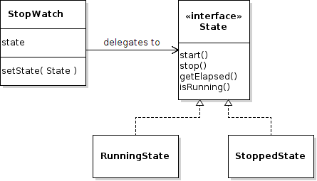
The O-O Approach
Use Objects to encapsulate state and the behavior that depends on state.
The context (StopWatch) delegates behavior to state objects.

Slide 18
Interface for State-dependent Behavior
Actual states must each provide this behavior.
public class State {
/** Handle start event */
public void start();
/** Handle stop event */
public void stop();
/** Get the elapsed time */
public double getElapsed();
/** Inquire if stopwatch is running */
public boolean isRunning();

Slide 19
States without "if"
Each state knows exactly what to do.
public class RunningState {
/** Handle start event */
public void start() {
// do nothing -- already running
}
/** Inquire if stopwatch is running */
public boolean isRunning() {
return true;
}

Slide 20
Delegating Behavior
Delegate means "let someone else do it".
Stopwatch delegates behavior to the state.
public class StopWatch {
private State state;
public void start( ) {
state.start();
}
public void stop() { state.stop(); }
public double getElapsed() {
return state.getElapsed();
}

Slide 21
State Objects and Changing State
The context (StopWatch) needs a setState method as a way of changing the state.
// Create states with a reference to stopwatch
final State RUNNING = new RunningState(this);
final State STOPPED = new StoppedState(this);
// initially the Stopwatch is stopped
private State state = STOPPED;
// a method for changing the state
public void setState(State newstate) {
this.state = newstate;
}

Slide 22
Example of Changing State
If the stopwatch is running and the Stop button is pressed, then change to stopped state...
class RunningState implements State {
private StopWatch context;
public RunningState(StopWatch sw) {
this.context = sw;
}
public void stop() {
context.stopTime = System.nanoTime();
// CHANGE STATE
context.setState( context.STOPPED );
}

Slide 23
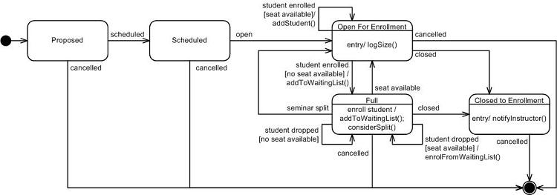
UML State Machine Diagram
States for course enrollment.

Slide 24
UML State Machine Diagram
Read UML Distilled, chapter 10.
Also good: UML for Java Programmers, chapter 10.

Slide 25
Exercise: Syllable Counter
Count the syllables in a word.
As a heuristic, count vowel sequences.
Examples:
object = (o)bj(e)ct = 2 vowel sequences
beauty = b(eau)t(y) = 2 vowel sequences
Special cases:
l(a)y(ou)t = treat "y" as consonant if after other vowel
l(a)the = don't count final "e" if it is a single vowel
m(o)v(ie) = 2 vowel seq. "final e" rule doesn't apply here.
th(e) = exception: count final "e" if it is the only vowel
anti-oxidant = (a)nt(i)-(o)x(i)d(a)nt "-" is non-vowel

Slide 26
Example Words
How many vowel sequences in these words?
remarkable
selfie
county
coincidentally
she
mate
isn't

Slide 27
States for Syllable Counter
Using the above vowel counting houristic, what are the states?
consonant - last seen letter is a consonant
single_vowel - recent letter was first vowel in sequence
multi_vowel - recent letter was vowel after another vowel
hyphen - most recent char is a hyphen
nonword - the character sequence is not a word (violates some rule for word such as containing an invalid character, .e.g. a digit)

Slide 28
States for Syllable Counter
What should be the starting state​?
See Syllable Counter Lab on for details.

Slide 29
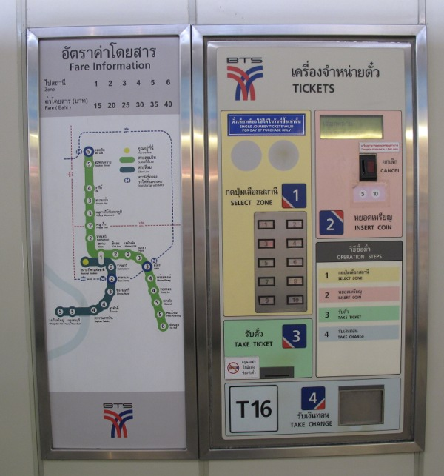
Exercise: Skytrain Ticket Machine

Slide 30
Skytrain Ticket Machine
1. What are the states?
2. What are the events?
3. What actions/activities does ticket machine perform?
4. Draw a UML State Machine Diagram.

