Slide 1
Design Patterns
Software Engineering
CS 561

Slide 2
Last Time
Introduced design patterns
Abstraction-Occurrence
General Hierarchy
Player-Role

Slide 3
This Time
Singleton pattern
Observer pattern
Delegation pattern
Adapter pattern
Façade pattern
Immutable pattern
Read-Only Interface pattern
Factory pattern

Slide 4
Singleton
Context
Common to want only one instance of a class
Referred to as a singleton
E.g. a Company or University class
Problem
How to ensure only one instance
Forces
Public constructor will not guarantee only one instance
Constructor must be accessible to all classes that need it, though.

Slide 5
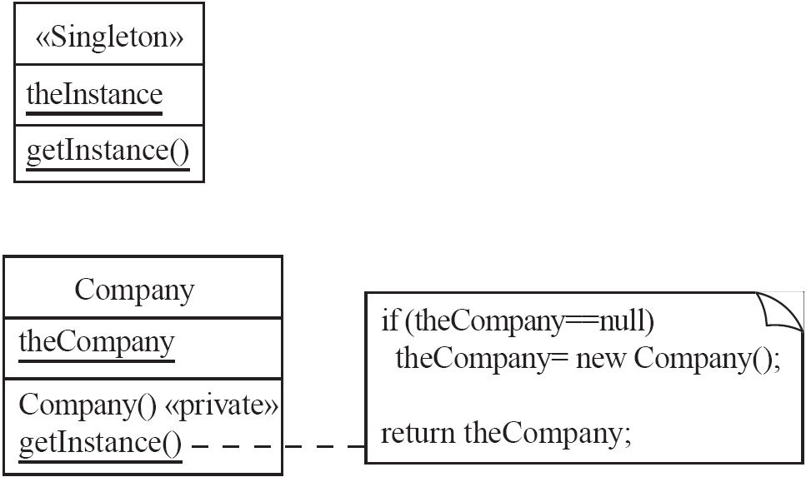
Singleton
Solution
Use a private class variable for one (the) instance of the class
Use a public static class method runs the constructor only on its first call, and make the constructor private

Slide 6
Observer
Context
Two way associations make code for pairs of classes inseparable
Need both classes for reuse
Problem
How to reduce interconnection between classes
How to ensure communication with other objects without knowing what class they belong to
Forces
Maximize flexibility

Slide 7
Observer
Solution
Create abstract class called <<Observable>>
Includes mechanism to add and remove observers
Method to send an update message to each <<Observer>>
Allow any application class to be <<Observable>>
<<Observer>> is an interface with an abstract update method

Slide 8
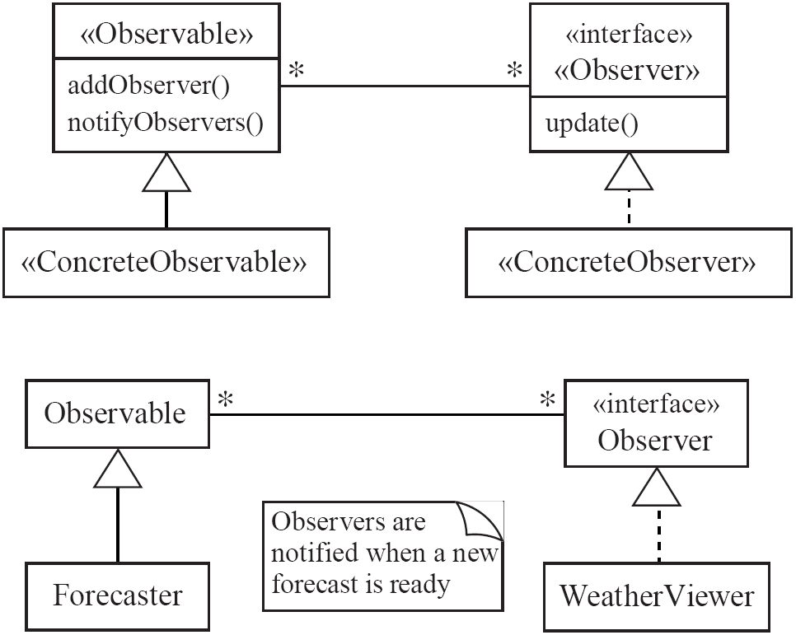
Observer

Slide 9
Observer
Examples
A Forecaster object would perform many calculations
WeatherViewer is needed to obtain values from this object
Java contains an Observer interface and an Observable class
Anti-patterns
Connecting an observer directly to something that is observable
Making observers subclasses of what is observable

Slide 10
Delegation
Context
Creating a method for a class
Another class already has that operation
Inheritance should not be used because the “is-a” rule does not apply
Problem
Effectively make use of a method existing in another class
Forces
Development costs should be minimized by reusing methods from other classes
Ensure work is completed by an appropriate class

Slide 11
Delegation
Solution
Create a <<Delegator>> class that calls a method in an associated <<Delegate>> class
Typically an association already exists between the <<Delegator>> and the <<Delegate>>
Sometimes such an association is created if it reduces system complexity
Delegation could be viewed as a form of selective inheritance
Some languages like C# support delegates using a keyword

Slide 12
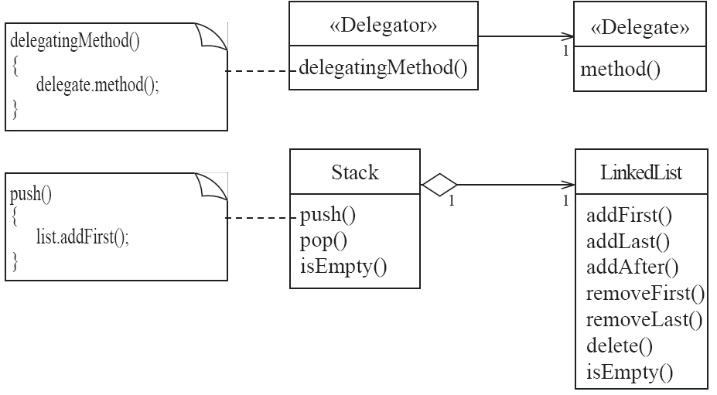
Delegation

Slide 13
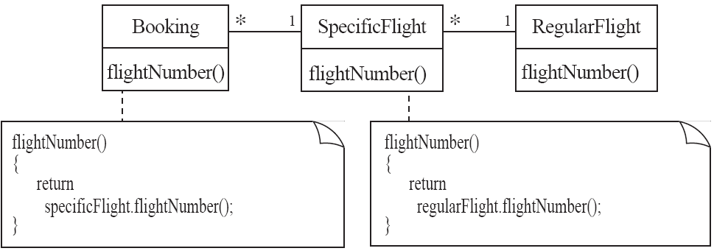
Delegation

Slide 14
Delegation
Anti-patterns
Common to inherit method to be reused instead of delegating it
Should avoid duplicating code unless necessary
Should avoid directly accessing code within the delegate class that is outside of the delegated method

Slide 15
Adapter
Context
Incorporate an existing class into an inheritance hierarchy
Methods may have different names and class may be part of its own inheritance hierarchy
Problem
How to use polymorphism when reusing a class with the same functionality but a different signature
Forces
Assume multiple inheritance does not exist

Slide 16
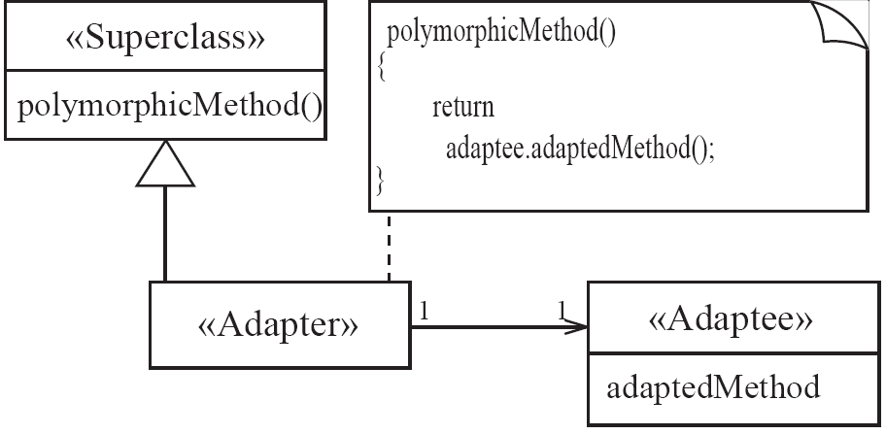
Adapter
Solution
Create an <<Adapter>> class that connects via association to an <<Adaptee>>
The methods of <<Adapter>> delegate to those of the <<Adaptee>>
Sometimes called a wrapper class

Slide 17
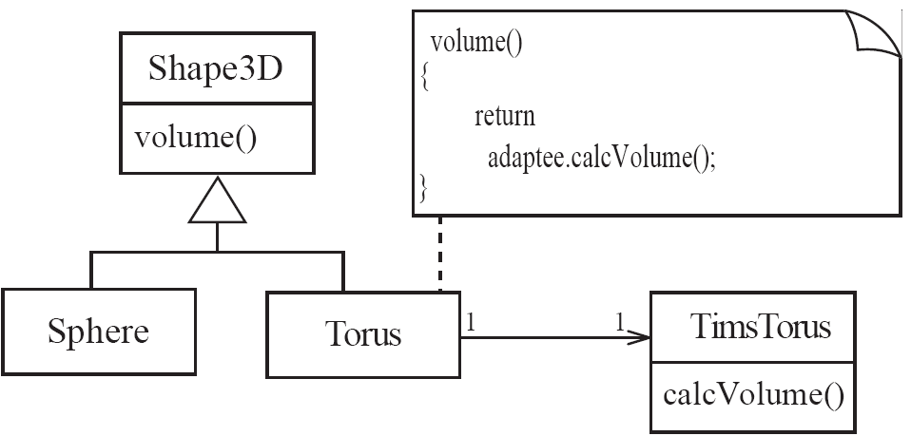
Adapter

Slide 18
Façade
Context
Need to manipulate many different classes in many packages
Problem
Simplify the programmer’s view of these packages
Forces
Often hard to understand and use an entire subsystem
Modifications made to the package would necessitate a complete review of its subsystems

Slide 19
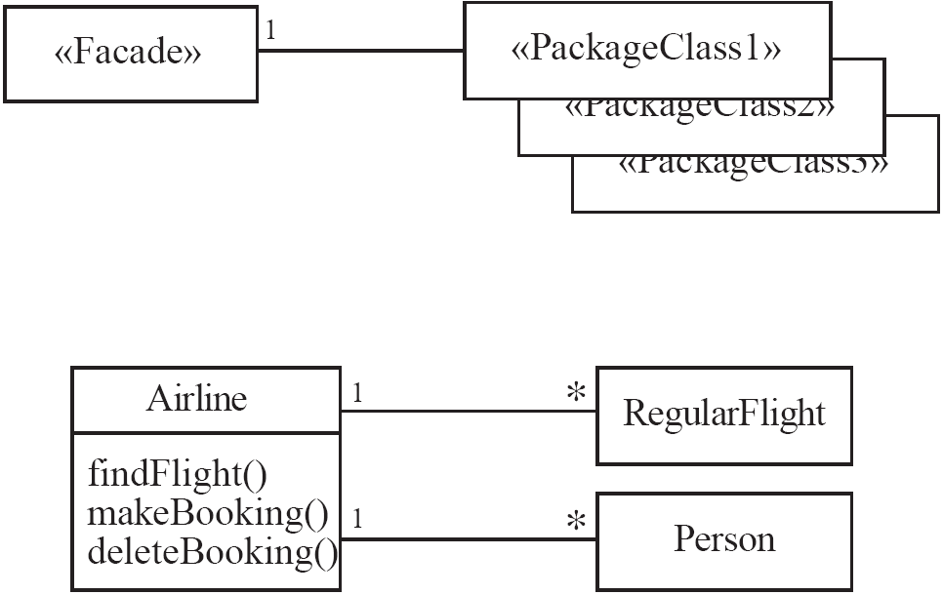
Façade
Solution
Use a <<Façade>> class to simplify use of the package(s)
Create a simplified set of public methods to interact with the package(s)
Changes should only need to be made to the <<Façade>> rather than the package(s)

Slide 20
Immutable
Context
Immutable object has a state that never changes after creation – e.g. a Java String
Content can be trusted to not change unexpectedly
Problem
How to create a class with immutable instances
Forces
Immutability must be enforced
Don’t allow loopholes
Solution
Only allow instance variables to be modified within the constructor
Instance methods should have no side effects
Instead of using side effects to modify instance variables, instance methods should create a new instance of the class and return a new object with new values containing the results of the side effect

Slide 21
Read-Only Interface
Context
Create a privileged class that may modify attributes of objects that are otherwise immutable
Problem
How to create a situation where some classes see another as read-only
Forces
Java allows access control by public, private, and protected keywords, but public access still allows read and write access
Solution
Create a <<Mutable>> class that you may pass instances of to methods that are allowed to make changes
Allow associations to unprivileged classes only through a <<ReadOnlyInterface>>

Slide 22
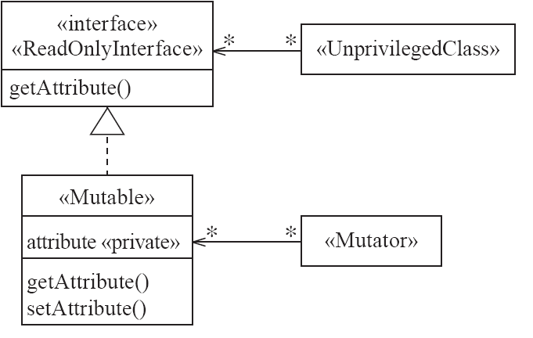
Read-Only Interface

Slide 23
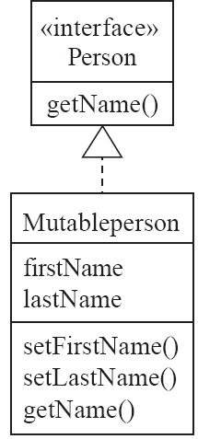
Read-Only Interface

Slide 24
Proxy
Context
Sometimes it is time consuming or complicated to create instances of a class that has lots of data (a heavyweight class)
Could cost CPU time, memory usage, etc.
Problem
Reduce the need to create instances of such classes
Forces
Want availability of such heavyweight objects without the cost
Persistence of these objects from run to run is key
Solution
Create a simpler version of the <<HeavyWeight>> class called a <<Proxy>>
The <<Proxy>> has the same interface as the <<HeavyWeight>>

Slide 25
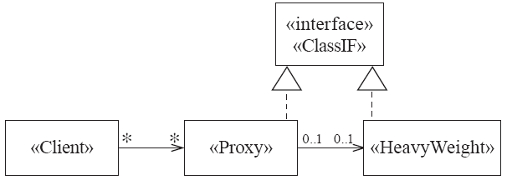
Proxy

Slide 26
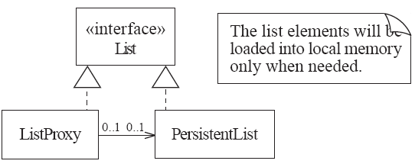
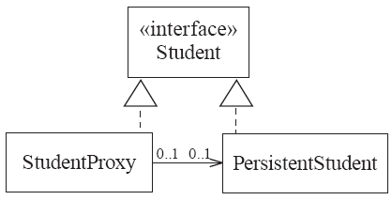
Proxy

Slide 27
Factory
Context
Have reusable framework that creates objects but created objects depend upon the application
Problem
Allow programmer to add an <<ApplSpecificClass>> into the framework
Allow framework to instantiate this class without modifying the framework
Forces
Want framework benefits and flexibility of having the framework to create and work with application-specific classes that the framework does not yet know about
Solution
Framework delegates creation of instances of <<ApplSpecificClass>> to a specialized class <<ApplSpecificFactory>>
<<ApplSpecificFactory>> implements a generic <<Factory>> interface that is predefined within the framework
<<Factory>> contains an abstract method called createInstance that is implemented by <<ApplSpecificFactory>>
A <<CreationRequester>> declares a method to create a <<Factory>> of <<GenericClass>> which can be carried out with an <<ApplSpecificFactory>> and an <<ApplSpecificClass>>

Slide 28
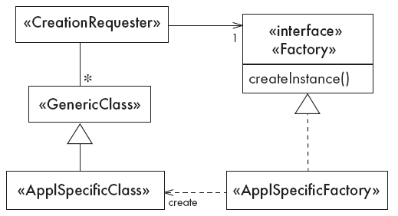
Factory

Slide 29
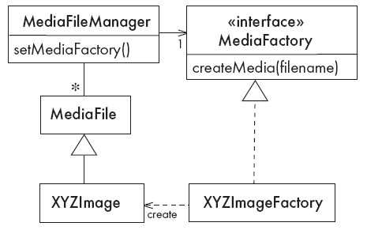
Factory

