Slide 1
Frameworks
Reusable Software

Slide 2
Frameworks are ...
a reusable application or environment that can be modified by adding (your) application-specific code, without modifying the framework code.
frameworks provide a reusable architecture, not just reusable code.

Slide 3
Examples
Java Collections Framework
use it to create custom collections that reuse the base collections logic and interfaces
Web Frameworks
provide logic and architecture for request mapping, session management, database access, and more.
Spring Framework, Play (Java)
Django (Python)
Rails (Ruby)
Symphony, CakePHP, Lavarel (PHP)
JUnit Testing Framework

Slide 4
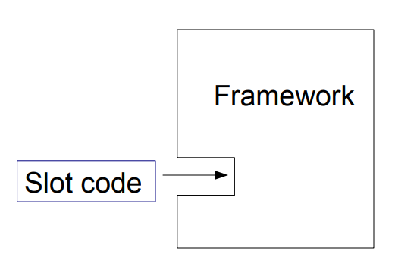
"Slots": Required Customization
Frameworks often require you to add some code before they can be used.
These methods are called slots.
Slot can be a class or a method.

Slide 6
Object Client-Server Framework
OCSF is a TCP-based client-server framework.
Client Side:
connect to server
send messages to server
receive message from server
handle connect & disconnect events
Server Side:
manage connections to clients
receive messages from clients
send messages to clients

Slide 7

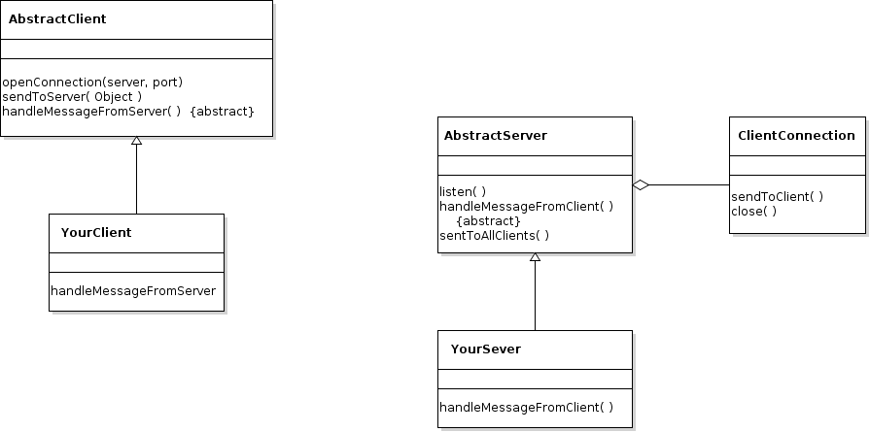
OCSF
Network

Slide 8
"slots" are usually callbacks
A callback is a method in your code that the framework invokes. You start the framework, then it calls you back when an event occurs.
This is also called inversion of control:
You start the framework, then the framework takes control.
In OCSF, the required callbacks (slots) are:
Client: handleMessageFromServer
Server: handleMessageFromClient
That's it! You can write a network client-server application just by writing 2 methods.

Slide 9
Code Reuse, Architecture Reuse
OCSF provides the architecture and code for a TCP client-server application.
You can use the framework without knowing how it works
(or how TCP works).
but you should study OCSF to learn how to use networking in Java.
You can modify and extend the framework by overriding callbacks (slots and hooks).

Slide 10
OCSF AbstractClient
<<controls>> (commands to the framework)
openConnection( )
sendToServer( Object )
closeConnection()
<<hooks>> (optional callbacks)
connectionEstablished( )
connectionClosed( )
connectionException( )
<<slot>> (required callbacks)
handleMessageFromServer(Object) {abstract}
<<accessors & mutators>>
isConnected()
getPort( ), setPort(port)
getHost( ), setHost(server)

Slide 11
OCSF AbstractServer
<<controls>> (commands to the framework)
listen( )
stopListening( )
sendToAllClients(Object msg)
<<hooks>> (optional callbacks)
clientConnected( )
clientDisconnected( )
several others
<<slot>> (required callbacks)
handleMessageFromClient(Object) {abstract}
<<accessors & mutators>>
isListening()
getClientConnection(int id)
getPort( ), setPort(port)

Slide 12
How to Use a Framework?
In OCSF you create a subclass and define the required abstract methods.
You may override: hook methods
You may call (but don't override): controls, queries, mutator methods
Some other frameworks use dependency injection instead.

Slide 13
Example
A messaging client that sends strings (message).
All clients receive the message.
Use port 5555 (port > 1024 is suggested for Linux and MacOS).

Slide 14
Client side
Extend AbstractClient & implement the callback method
import com.lloseng.ocsf.client.AbstractClient;
public class ChatClient extends AbstractClient {
public ChatClient(String host, int port) {
super(host, port);
}
@Override
protected void handleMessageFromServer(Object msg)
{
System.out.println("> " + msg);
}
}

Slide 15
Run the client
Create a client with server (host) name and server port.
Connect to the server.
In a loop...
wait for user to type a message
send message to server
TODO: provide a way to quit

Slide 16
Server Side: an Echo Server
Create a server that just echoes messages to all client.
Extend AbstractServer. Override the "slot" method.
public class EchoServer extends AbstractServer {
/** create a new echo server */
public EchoServer(int port) {
super(port);
}
@Override
protected void handleMessageFromClient(
Object msg, ConnectionToClient client) {
super.sendToAllClients(msg);
}

Slide 17
Running the Server
private static final int PORT = 5555;
public static void main(String[] args) {
EchoServer server = new EchoServer(PORT);
try {
server.listen();
System.out.printf("Listening on port %d\n",
PORT);
} catch (IOException e) {
System.out.println("Couldn't start server:");
System.out.println(e);
}
}

Slide 18
Using Hooks
Server:
print a message when a client connects or disconn.
Client:
print a message if server closes the connection.
What hooks (callbacks) can we should use to do this?

Slide 19
How OCSF Works
You don't know how a framework works in order to use it.
This is the advantage of a framework; it provides an abstraction for what you want to do.
Think "value added" … don't waste time re-inventing logic and architecture that has been done already.

Slide 20
TCP is Connection Oriented
In TCP, a server listens for connections on a port number.
A client connects using server's IP address and port number.
Either side can send messages.
A server can accept many connections on the same port.
When a client connects, the server creates a new thread to handle communication with one client.

Slide 21
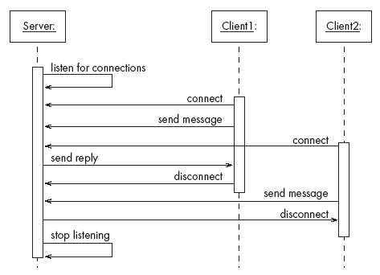
TCP Example

Slide 22
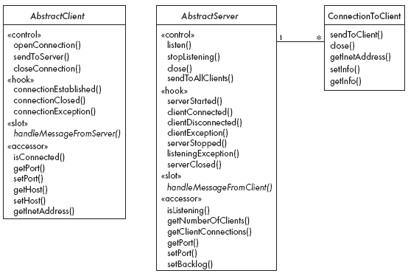
OCSF's Main Classes

Slide 23
The Client Side
AbstractClient must be subclassed
Any subclass must provide an implementation for handleMessageFromServer
Takes appropriate action when a message is received from a server
Implements the Runnable interface
Has a run method which
Contains a loop that executes for the lifetime of the thread

Slide 24
The public interface of AbstractClient
Control methods (you can call these, but don't override)
openConnection
closeConnection
sendToServer
Status and Accessor/Mutator
isConnected
getHost
setHost
getPort
setPort
getInetAddress

Slide 25
Callback methods of AbstractClient
Callbacks that may be overridden:
connectionEstablished
connectionClosed
Callback that must be implemented:
handleMessageFromServer

Slide 26
References
Object Client-Server Framework
http://www.site.uottawa.ca/school/research/lloseng/supportMaterial/ocsf/ocsf.html (OCSF is in chapter 3 and chapter 6)
Youtube lecture by one of the authors of OCSF:
https://www.youtube.com/watch?v=hGM1eT8EVuI
XMPP - another messaging framework with many applications.
https://xmpp.org/
Smack - Java XMPP client library

