Slide 1
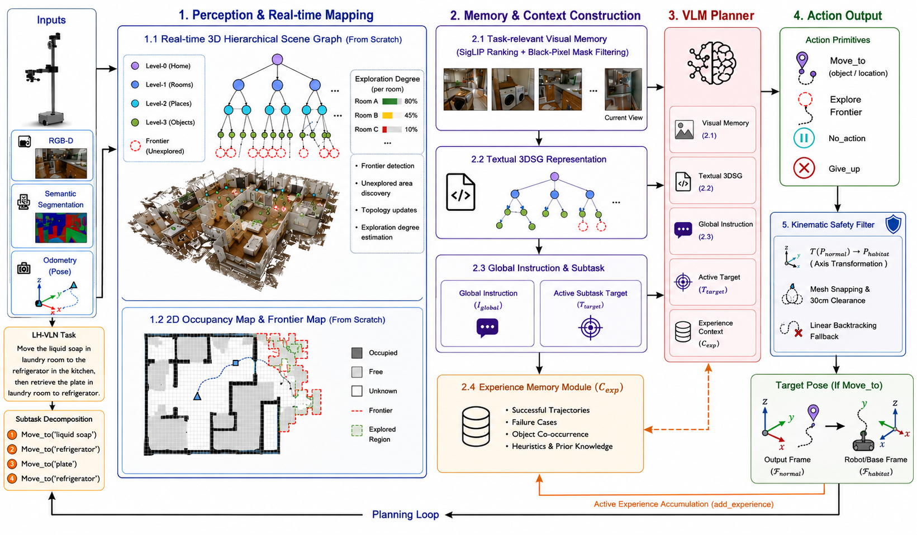
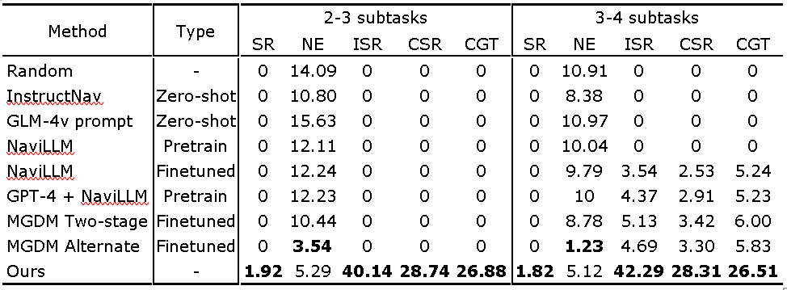
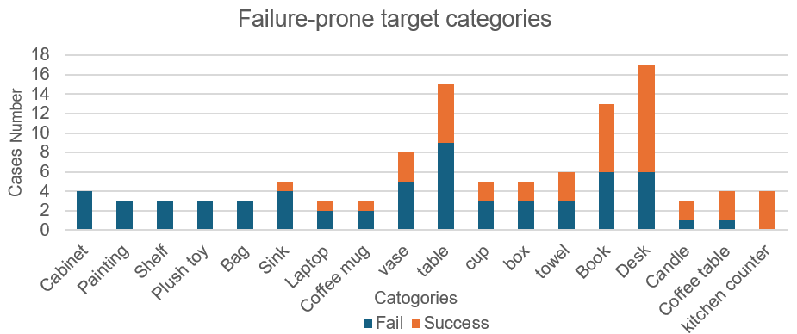
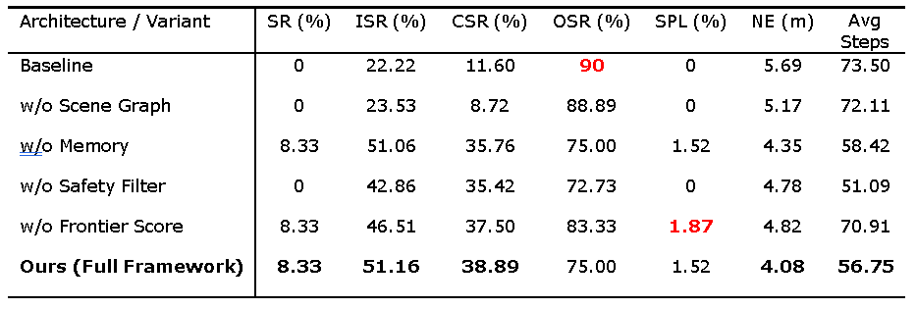
Dual-Channel Memory Architecture via 3D Semantic Scene Graph for Zero-shot LH-VLN
Background
Objectives
Vision-Language Navigation (VLN) enables autonomous agents to follow natural language instructions in unknown environments. However, scaling VLN to long-horizon tasks introduces major challenges, including semantic-spatial disconnect, memory overload, and error accumulation across sequential sub-tasks. Existing approaches often rely on either unstructured historical logs or rigid 2D maps, which limits their ability to combine cross-task reasoning with dense 3D spatial execution.
This project aims to design a zero-shot long-horizon navigation framework that integrates dynamic 3D scene graphs with a vectorized experiential memory. The main objectives are to:
Build a hierarchical 3D scene graph for real-time spatial grounding
Develop an experience memory for cross-task knowledge reuse
Design a 4D frontier scoring mechanism for active exploration
Apply a kinematic safety filter to prevent invalid physical execution
Methodology
The proposed framework consists of four interacting modules: hierarchical perception and mapping, cognitive memory retrieval, hierarchical planning, and navigation execution.
First, a Hierarchical 3D Semantic Scene Graph (3DSG) is constructed online from RGB-D observations to represent the environment at building, room, region, and object levels [2]. This module acts as the spatial “Hippocampus”, preserving real-time semantic and geometric structure for long-horizon reasoning.
Second, an independent Vectorized Experience Memory stores successful trajectories, failure cases, and task heuristics as compact embeddings. This module functions as the “Cerebral Cortex”, enabling cross-task retrieval and memory pruning without excessive storage growth.
Third, a Hierarchical VLM Planner performs semantic reasoning using the current subtask, global instruction, agent state, serialized 3DSG, and retrieved experience context. As illustrated in the planner framework, the planner contains two complementary branches: Semantic Object Evaluation branch that directly matches candidate object nodes within the scene graph Multi-factor Frontier Exploration branch that actively selects unexplored frontiers when no confident semantic target exists. If both strategies fail, final fallback mechanism triggers a global object-level search before terminating the task.
Figure 1. Overall architecture of the Dual-Channel Memory framework for LH-VLN
Finally, during navigation execution, a 4D Frontier Semantic Scoring mechanism ranks candidate frontiers using information gain, unexplored ratio, semantic relevance, and distance cost. A Kinematic Safety Filter further adjusts target coordinates to ensure that all generated navigation goals remain physically reachable and collision-free.
Results
Evaluated on 62 LHPR-VLN [1] tasks in HM3D [3], our system achieved 42.41% ISR, 29.48% CSR, and 71.43% OSR under a strict single-view setting. Ablation results confirmed that the scene graph, memory, frontier scoring, and safety filter each contribute to the final performance.
The remaining failures are mainly concentrated on visually ambiguous or instance-rich categories such as cabinet, painting, shelf, sink, table, box, and book. In particular, repeated furniture-like objects and shelf-mounted targets are difficult under strict point-based evaluation, especially in cluttered indoor scenes.
Conclusion
Reference
This work presents a dual-channel memory framework for zero-shot LH-VLN that combines 3D spatial grounding with experiential reasoning. By integrating a hierarchical 3D scene graph, vectorized memory, frontier-guided exploration, and safety-aware execution, the system improves sequential navigation consistency in complex long-horizon tasks. The results show substantial gains over the baselines, suggesting that explicit spatial structure and reusable memory are both critical for scalable embodied navigation in unseen environments.
[1] Xinshuai Song, Weixing Chen, Yang Liu, Weikai Chen, Guanbin Li, and Liang Lin, “Towards Long-Horizon Vision-Language Navigation: Platform, Benchmark and Method,” arXiv preprint arXiv:2412.09082, 2024.
[2] Saumya Saxena, Blake Buchanan, Chris Paxton, Peiqi Liu, Bingqing Chen, Narunas Vaskevicius, Luigi Palmieri, Jonathan Francis, and Oliver Kroemer, “GraphEQA: Using 3D Semantic Scene Graphs for Real-Time Embodied Question Answering,” arXiv preprint arXiv:2412.14480, 2024.
[3] K. Yadav et al., “Habitat-Matterport 3D Semantics Dataset,” in Proc. IEEE/CVF Conference on Computer Vision and Pattern Recognition (CVPR), 2023, pp. 4927–4936.
Student: Zibo Zheng
Email: ssyzz32@nottingham.edu.cn
Supervisor: Adam Rushworth

