Slide 1





Combating Exacerbated Heterogeneity for Robust Models in Federated Learning
Jianing Zhu¹, Jiangchao Yao^{2, 3}, Tongliang Liu⁴, Quanming Yao⁵, Jianliang Xu¹, Bo Han¹
¹Hong Kong Baptist University ²Shanghai Jiao Tong University ³Shanghai AI Laboratory
⁴Sydney AI Centre, The University of Sydney ⁵Tsinghua University

Slide 2
Outline
Combating Exacerbated Heterogeneity for Robust Models in Federated Learning
Background
Intensified Heterogeneity
Slacked Federated Adversarial Training (SFAT)
Summary

Slide 3
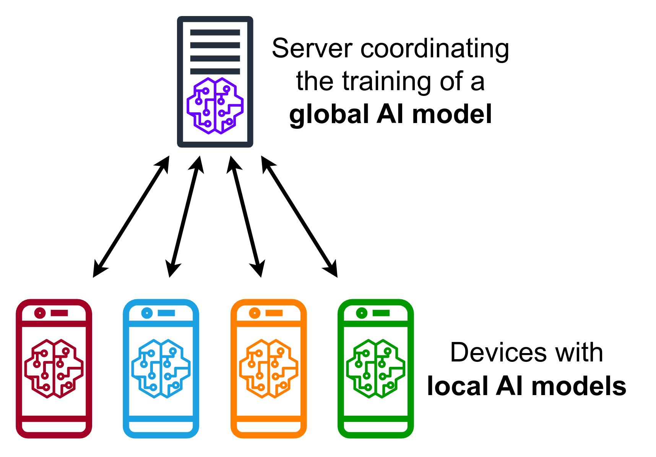
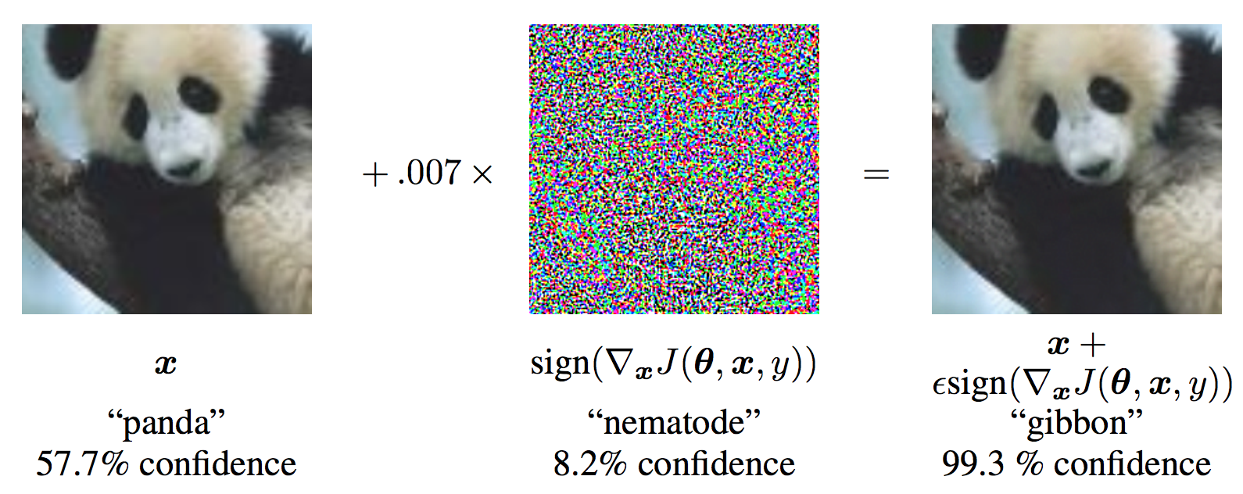
Federated Adversarial Training
Combating Exacerbated Heterogeneity for Robust Models in Federated Learning
Adversarial Vulnerability in Device-edge
a. Local Adversarial Training
b. Federated Model Aggregation

Slide 4
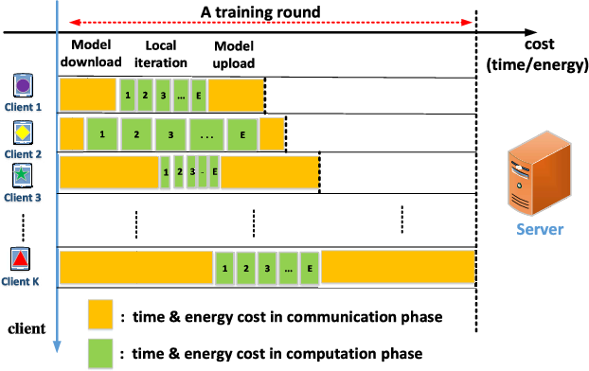
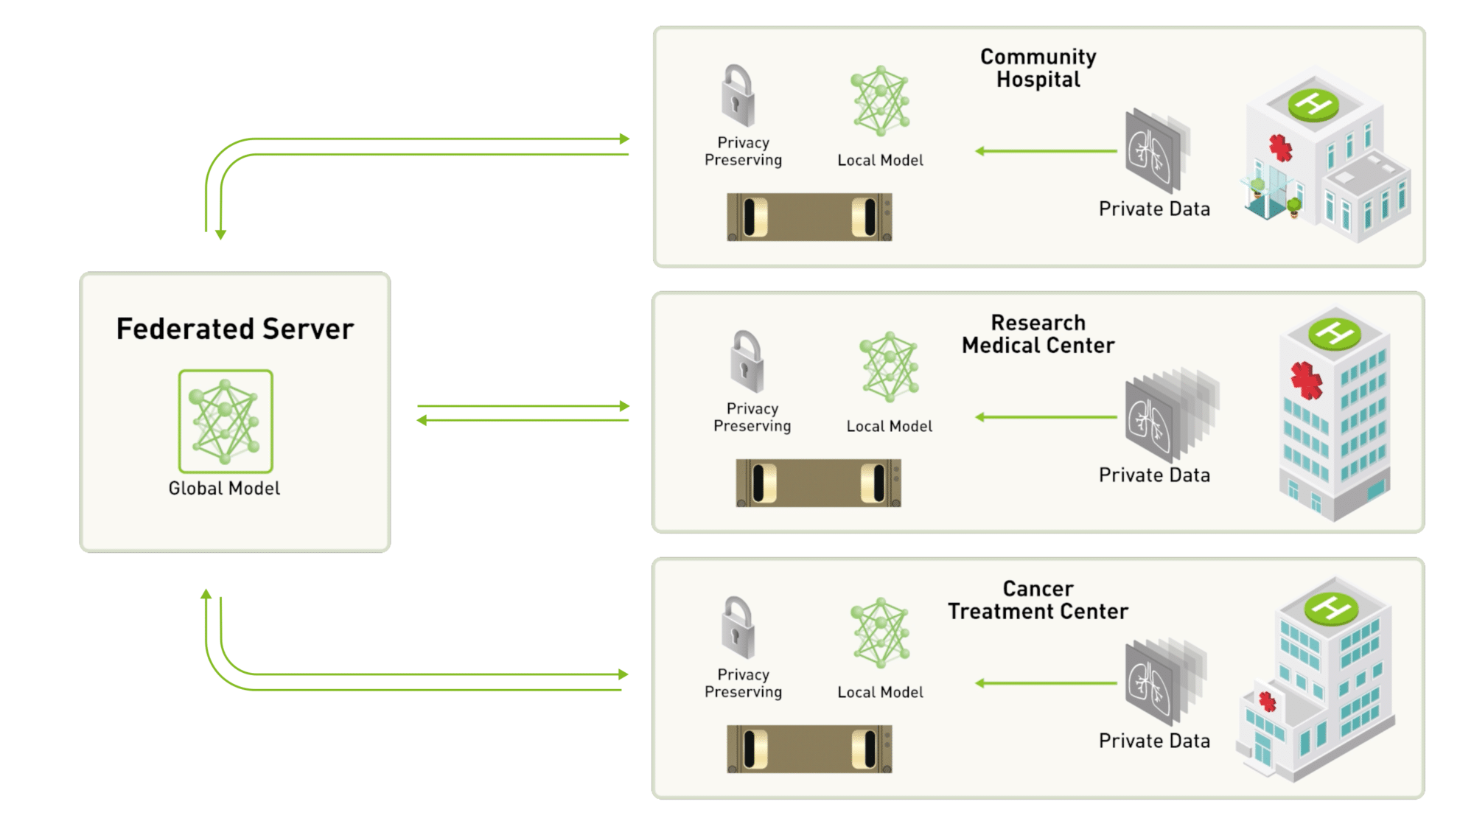
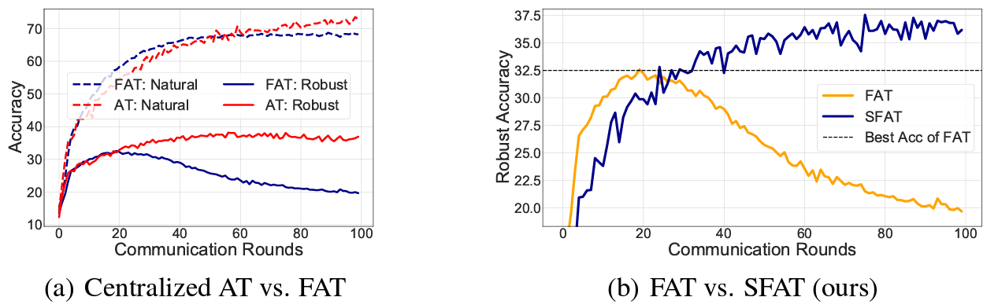
Previous Work
Towards distributed adaptability of federated adversarial training
Issues on Distributed Systems
Communication Cost
Hardware Capacity
Unexpected Robust Deterioration
Towards the algorithmic challenge of federated adversarial training

Slide 5
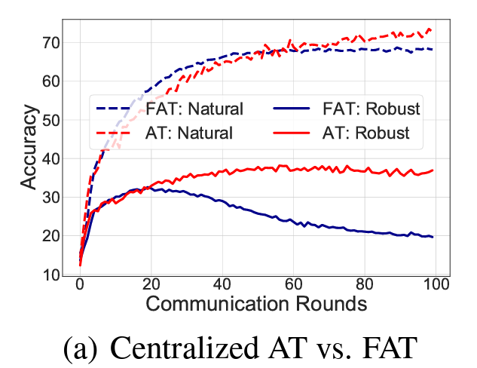
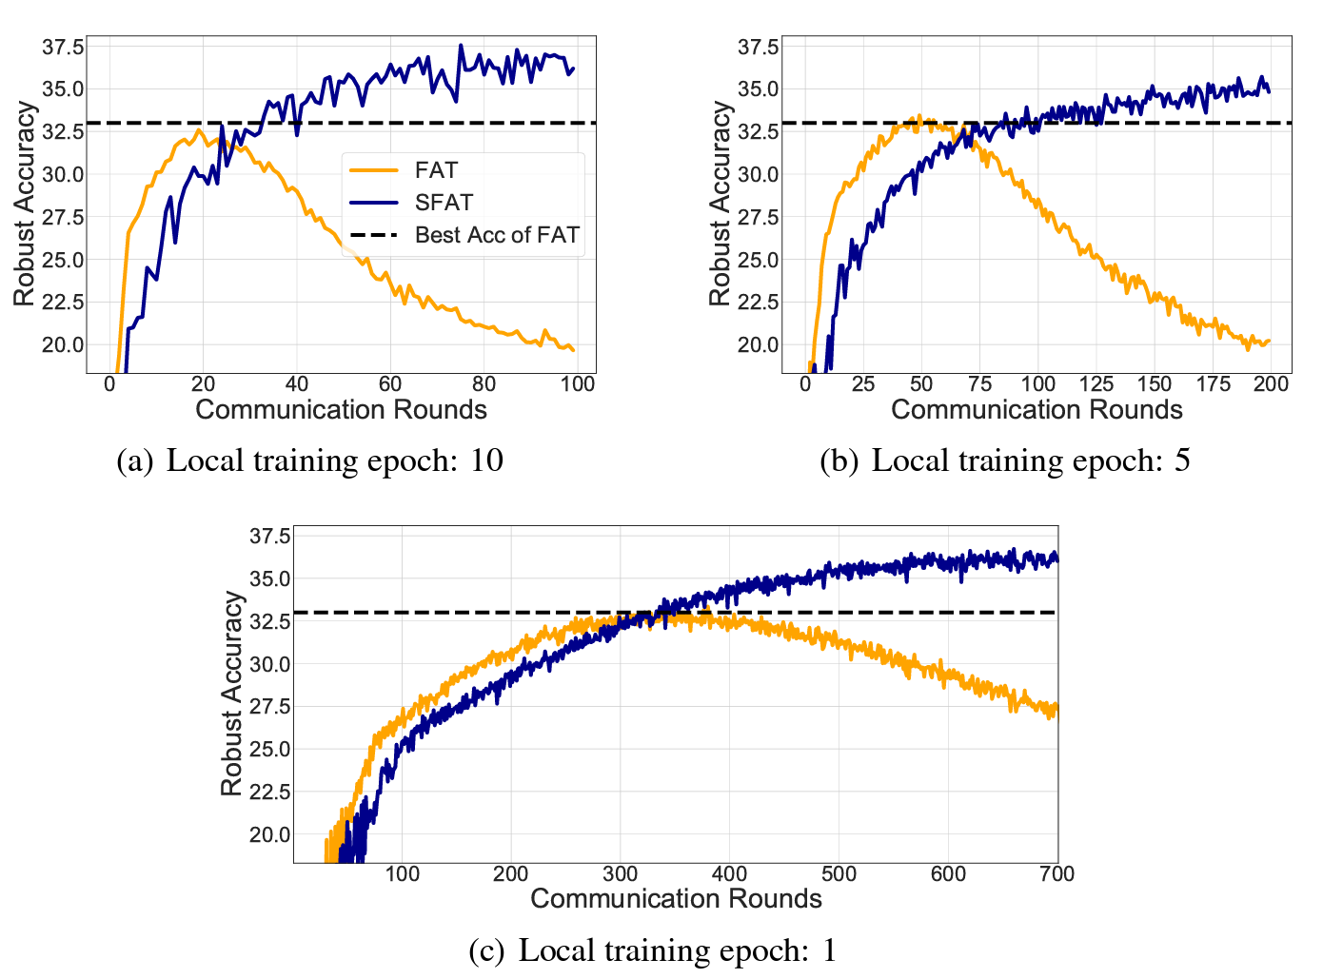
Unexpected Robust Deterioration
Combating Exacerbated Heterogeneity for Robust Models in Federated Learning
AT vs. FAT
Unexpected Robust Deterioration:
The robust accuracy in federated adversarial training show consistently decreasing compared with the centralized adversarial training during 100 communication rounds.

Slide 6
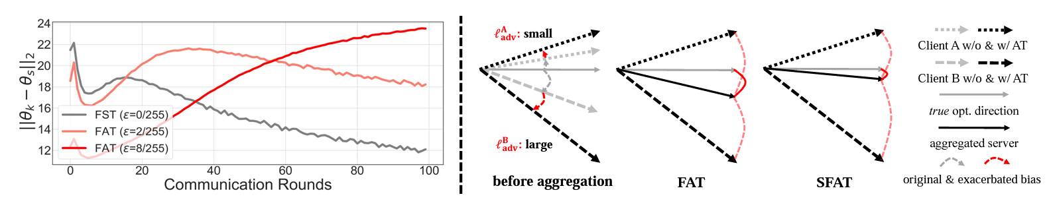
Intensified Heterogeneity
Combating Exacerbated Heterogeneity for Robust Models in Federated Learning
Adversarial Training with FL
the inner-maximization for pursuing adversarial robustness would exacerbate the data heterogeneity among local clients in federated learning.

Slide 7
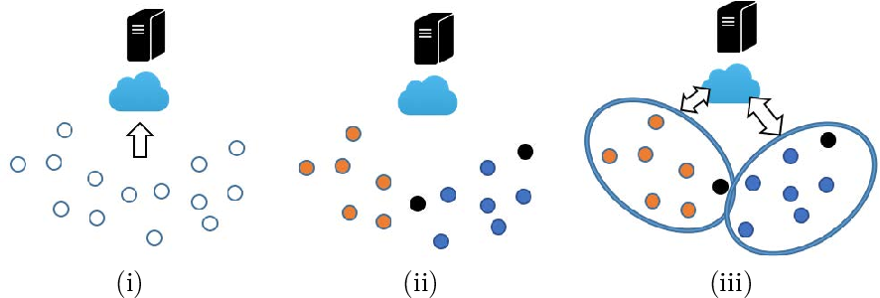
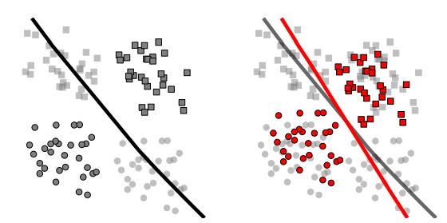
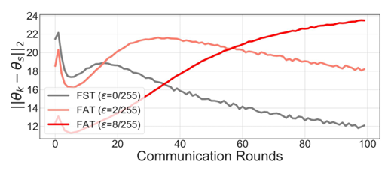
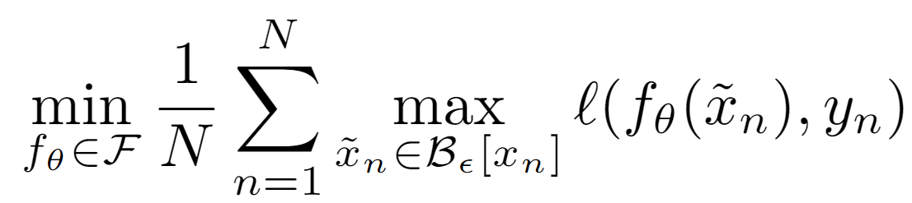
Intensified Heterogeneity
Combating Exacerbated Heterogeneity for Robust Models in Federated Learning
Heterogeneity in FL

Slide 8

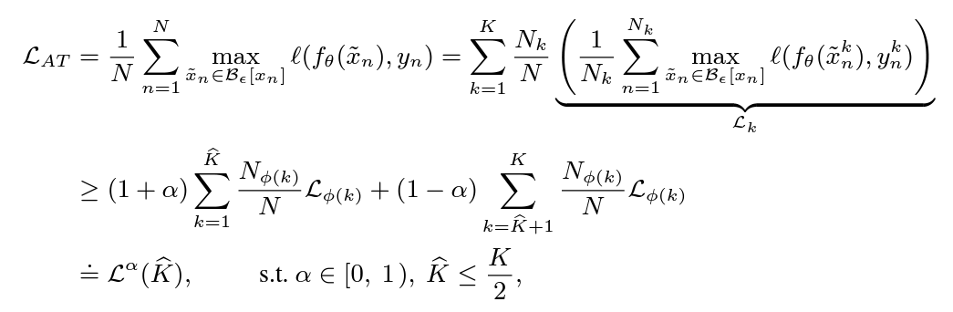
Intensified Heterogeneity
Combating Exacerbated Heterogeneity for Robust Models in Federated Learning
α-Slack Mechanism

Slide 9
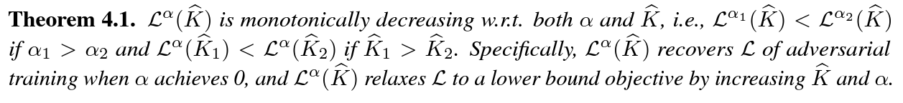
SFAT
Combating Exacerbated Heterogeneity for Robust Models in Federated Learning
α-Slack Mechanism

Slide 10
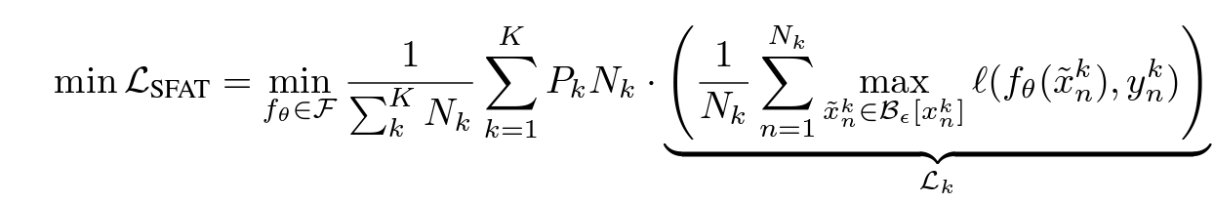
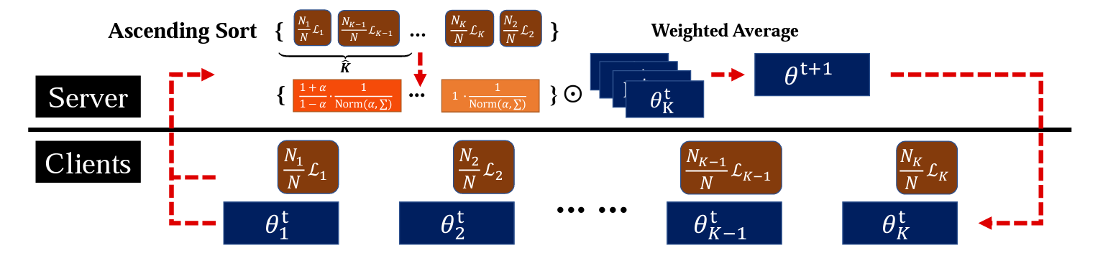
Slacked Federated Adversarial Training
Combating Exacerbated Heterogeneity for Robust Models in Federated Learning
SFAT

Slide 11
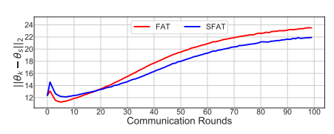
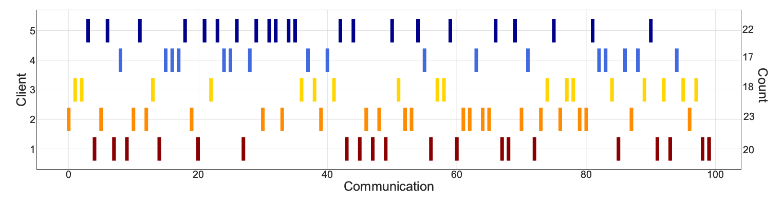
SFAT
Combating Exacerbated Heterogeneity for Robust Models in Federated Learning
Empirical Properties
a. Alleviate Intensified Heterogeneity
b. Selected Client for Down-weight

Slide 12
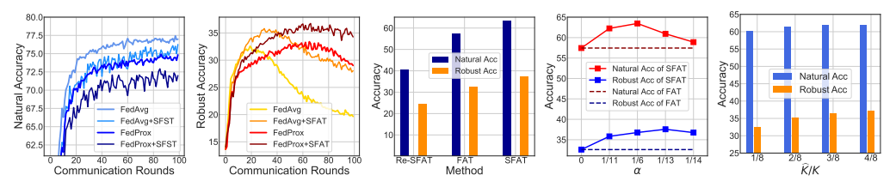
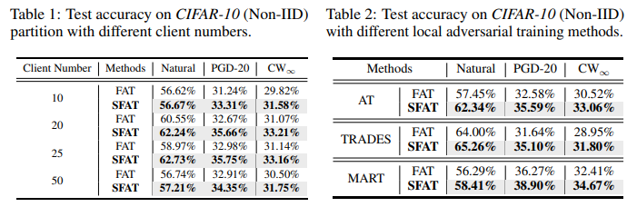
Experiment
a. Ablation Study
b. Performance on different views

Slide 13
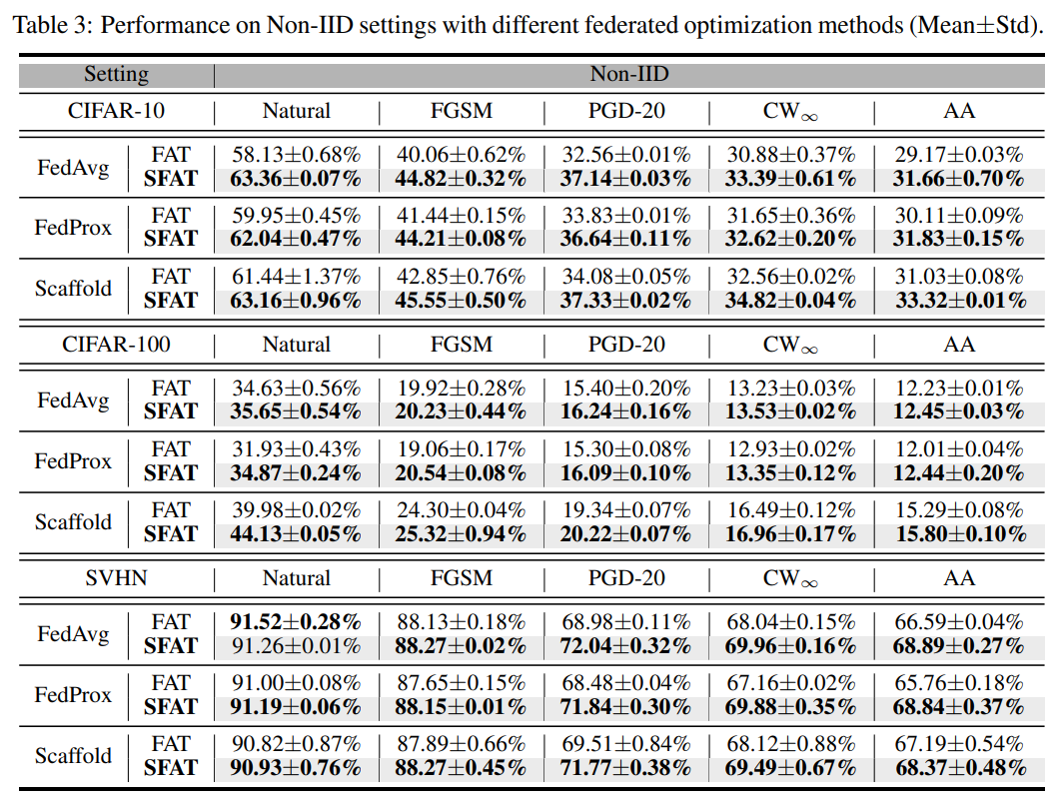
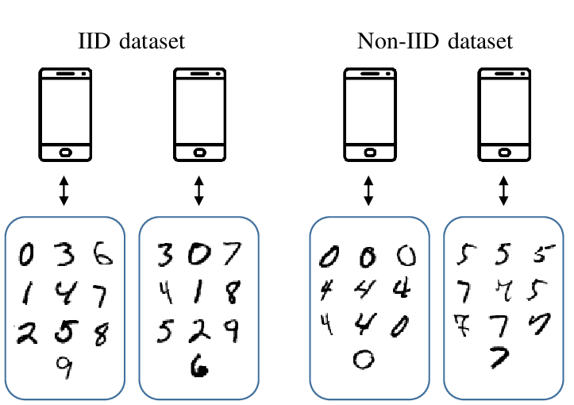
Experiment
In the performance comparison, we demonstrate the effectiveness of SFAT in Three datasets.

Slide 14
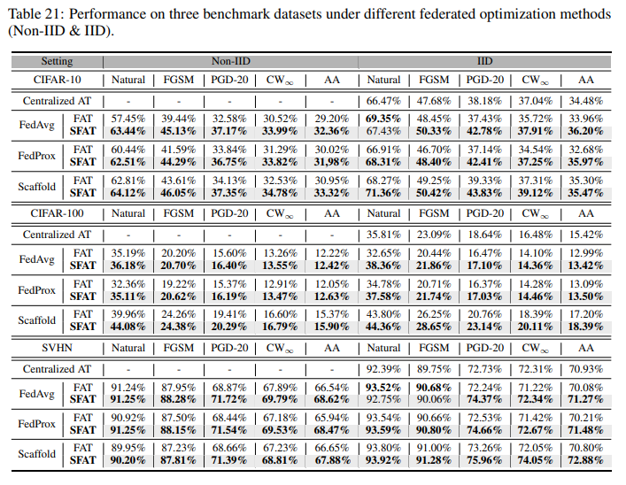
Experiment
We find that our method could improve the original FAT on not only
Non-IID but also IID setting in FL.

Slide 15


Summary
In this work, We study the critical robustness deterioration in FAT, and discover that the reason behind this phenomenon may attribute to the intensified data heterogeneity induced by the adversarial generation in local clients.
We derive an α-slack mechanism for adversarial training to relax the inner-maximization to a lower bound, which could asymptotically approach the original goal towards adversarial robustness and alleviate the intensified heterogeneity in federated learning.
Thank You!

