Slide 1

Unreal Engine Mass
A brief technical overview
https://github.com/ZG-Gary/UEMassOverview

Slide 2
Why should you care?
Performance

Slide 3
What will we cover?
Mass Plugin Structure
ECS Concepts in Mass
Entities & Creation
Entity Manager and Entity Queries
Mass Command Buffer
Processors & Execution
Multithreading (automatic)
Translators (actor agents)
Observer Processors
Mass Crowd
Mass Representation (visualization)
State Tree Processor
Smart Objects
Movement Processor
Mass Navigation
Mass Replication
Mass Debugger
Bonus!

Slide 4
Resources
Official introduction & quick-start: https://dev.epicgames.com/community/learning/talks-and-demos/37Oz/large-numbers-of-entities-with-mass-in-unreal-engine-5
Official “First 60 Minutes with Mass”: https://dev.epicgames.com/community/learning/tutorials/JXMl/unreal-engine-your-first-60-minutes-with-mass
Unofficial: https://dev.epicgames.com/community/learning/tutorials/0RxY/ue5-massai-crowd-in-your-project-step-by-step-guide
Community Project: https://github.com/Megafunk/MassSample
Documentation: https://docs.unrealengine.com/5.1/en-US/mass-entity-in-unreal-engine/

Slide 5
MassEntity
MassGameplay
Engine/Plugins/Runtime/MassEntity
Engine/Plugins/Runtime/MassGameplay
Mass Archetype
Mass Commands
Entity Manager
Entity Subsystem
Mass Executor
Processing Context
Processing Phases
Mass Fragment
Mass Tag
Entity Handle
Entity View
Mass Processor
Mass Requirements
Mass Observer
Mass Actor
Mass Agent
Encoded Scalars & Vectors
Mass LOD
Mass Movement
Mass Replication
Mass Representation
Mass Signals (events)
Mass Simulation
Mass Smart Objects
Mass Spawner
Entity Config Asset
MassAI
MassCrowd
Engine/Plugins/AI/MassAI
Engine/Plugins/AI/MassCrowd
Mass Behavior
Mass State Tree
Mass Smart Object
Mass AI Replication
Mass Zone Graph Navigation
Mass Navigation
Avoidance
Steering
Smooth Orientation
Mass Crowd Representation
Crowd Server Representation
Crowd Spawner
Crowd Replication
Crowd Member
Notes:
There is no “entity” object.

Slide 6
Entity Component System
Data
Functionality
Fragments
Archetype
Chunks
Processors (there are many kinds)
Abstract
Entities
Notes:
ECS is a method of separating data from functionality.
Data is organized into smaller containers which can be processed in batches.
Entities represent how multiple types of data are grouped together for processing as a single unit.

Slide 7
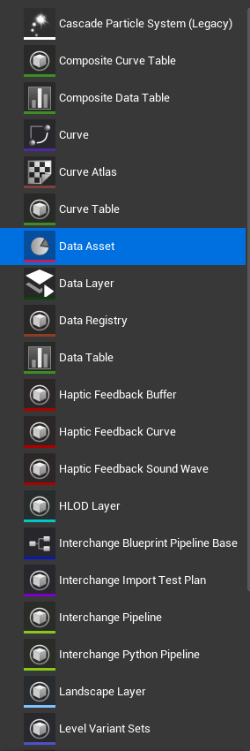
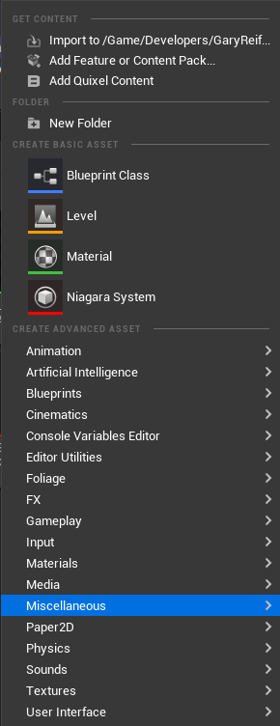
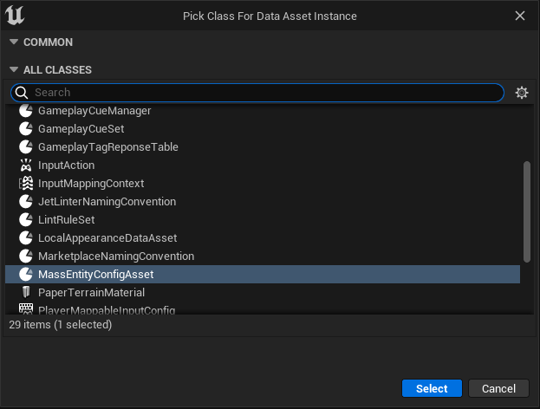
Entity Creation - Editor

Slide 8
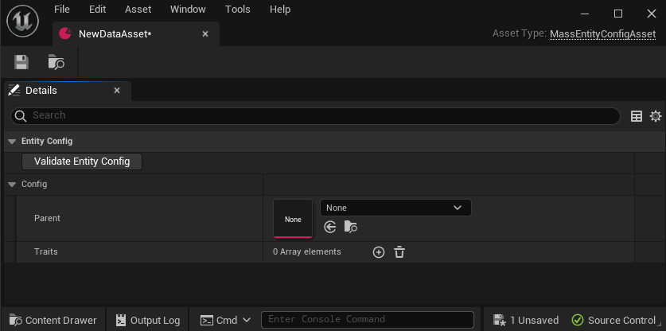
Entity Creation - Editor

Slide 9
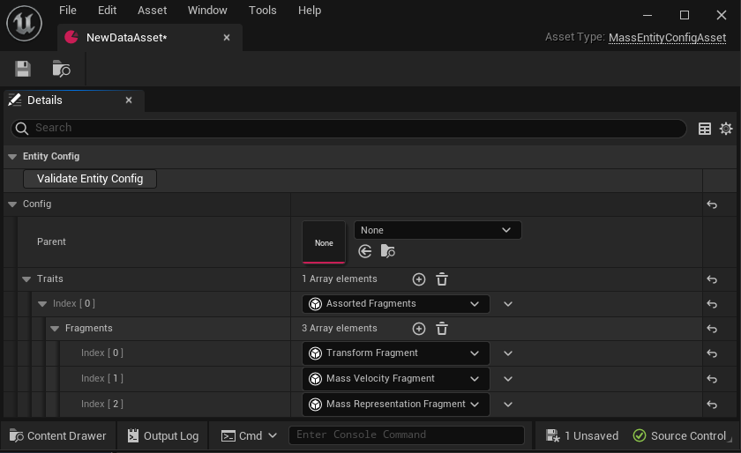
Entity Creation - Editor

Slide 10
Entity Creation - Code
Archetype
TArray
TArray
FMassFragmentBitSet
Fragment
Fragment
New Archetype
TArray
TArray
TArray
Fragment
Fragment
Fragment
Notes:
To create a new entity config without a config asset, need to create the archetype first
Can create by extending an existing archetype

Slide 11
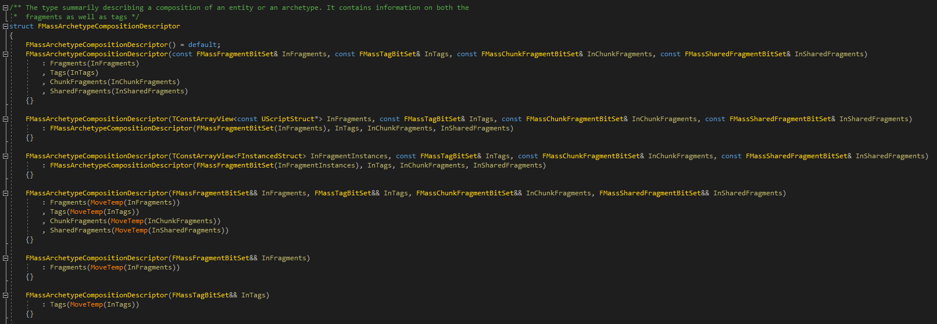
Entity Creation - Code
Notes:
Or create a new archetype from scratch by describing the composition

Slide 12

Entity Creation - Engine
Notes:
You call the CreateEntity function of EntityManager to create an entity.
This can even create a new archetype if necessary.

Slide 13
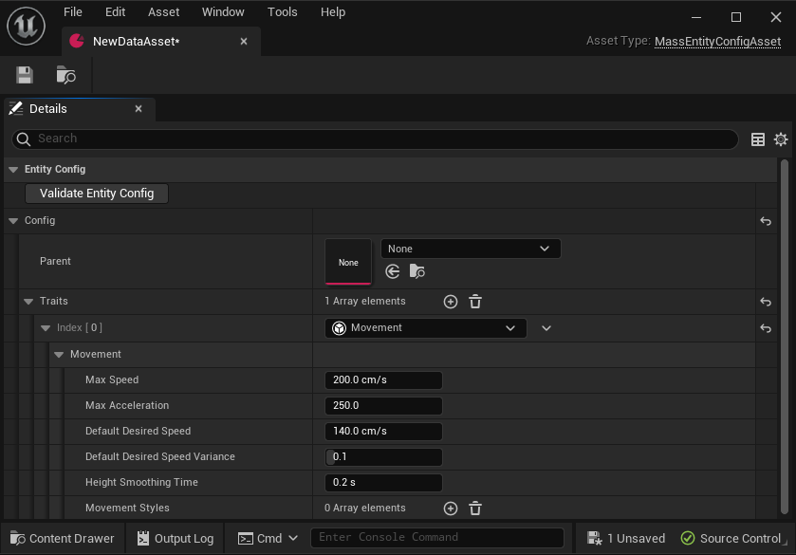
Entity Traits
Notes:
Instead of adding each fragment individually, we can use traits
Traits also allow us to create configuration data that can be shared between multiple fragments or accessed anywhere else

Slide 14
Entity Traits
BuildTemplate
Adds fragments (including shared) and tags
Require the presence of fragments (without adding them)
Specialized functionality (see translators)

Slide 15
How to Reference an Entity
FMassEntityHandle
Lightweight
Only data is an Index and a Serial Number
Has a few utility functions
Can be used in many functions to get entity data (e.g. fragments) or perform operations on entities (add/remove tags, etc.)
Notes:
FMassEntityHandle exists while entity exists in Entity Manager
FMassEntityView is a struct view to a transient struct created for processing
Chunk index is preferred method as it will happen during normal processing flow and is therefore safest

Slide 16
How to Reference an Entity
FMassEntityHandle
Lightweight
Only data is an Index and a Serial Number
Has a few utility functions
Can be used in many functions to get entity data (e.g. fragments) or perform operations on entities (add/remove tags, etc.)
FMassEntityView
Transient (don’t pass out of scope where it was created)
More heavyweight method of representing an entity
Multiple functions for getting fragment and tag data
Notes:
FMassEntityHandle exists while entity exists in Entity Manager
FMassEntityView is a struct view to a transient struct created for processing
Chunk index is preferred method as it will happen during normal processing flow and is therefore safest

Slide 17
How to Reference an Entity
FMassEntityHandle
FMassEntityView
Lightweight
Only data is an Index and a Serial Number
Has a few utility functions
Can be used in many functions to get entity data (e.g. fragments) or perform operations on entities (add/remove tags, etc.)
Transient (don’t pass out of scope where it was created)
More heavyweight method of representing an entity
Multiple functions for getting fragment and tag data
Entity Index (in Chunk)
For loop from 0 to (NumEntities – 1)
Access each fragment array by this index
Entity
Transform Fragment
Velocity Fragment
Representation Fragment
1
Data
1
Data
1
Data
Notes:
FMassEntityHandle exists while entity exists in Entity Manager
FMassEntityView is a struct view to a transient struct created for processing
Chunk index is preferred method as it will happen during normal processing flow and is therefore safest

Slide 18
Entity Manager
CreateEntity / BuildEntity
CreateArchetype / GetArchetypeForEntity
Add/Remove fragment to/from entity
AddFragmentListToEntity
Add/Remove tag to/from entity
IsEntityValid / IsEntityBuilt / IsEntityActive
GetFragmentDataChecked / GetFragmentDataPtr / GetFragmentDataStruct
GetOrCreateSharedFragment
Defer()
TChunkedArray<FEntityData> Entities
TMap<UInt32, TArray<TSharedPtr<FMassArchetypeData>>> FragmentHashToArchetypeMap
TMap<const UScriptStruct*, TArray<TSharedPtr<FMassArchetypeData>>> FragmentTypeToArchetypeMap
TArray<FConstSharedStruct> ConstSharedFragments
TArray<FSharedStruct> SharedFragments

Slide 19
Entity Query
Inherits from FMassFragmentRequirements and FMassSubsystemRequirements
ForEachEntityChunk
GetArchetypes
HasMatchingEntities / GetNumMatchingEntities
SetChunkFilter / ClearChunkFilter / HasChunkFilter
Example processor constructor that initializes the entity query:
FMassFragmentRequirements
FMassSubsystemRequirements
AddRequirement
AddTagRequirement
AddChunkRequirement
AddSharedRequirement (also const version)
AddSubsystemRequirement (subsystem must implement TMassExternalSubsystemTraits)

Slide 20
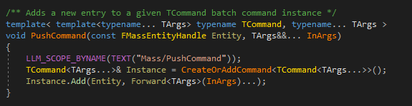
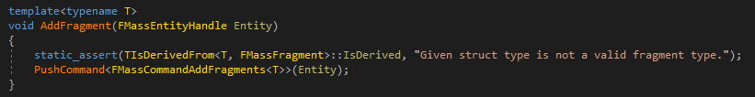
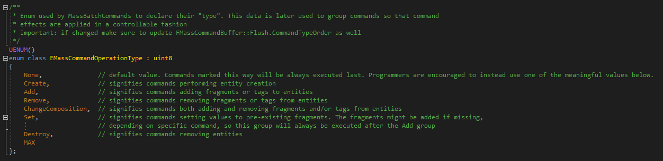
Mass Command Buffer
Used to safely manipulate archetypes/fragments/etc.
Available from many endpoints (EntityManager, Context, etc.).
Create your own custom commands or just use “PushCommand” with a lambda.

Slide 21
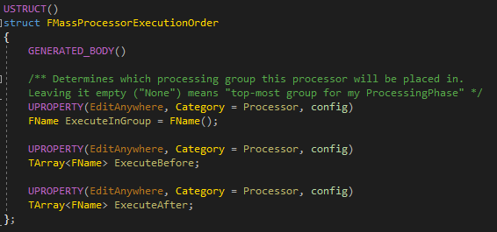
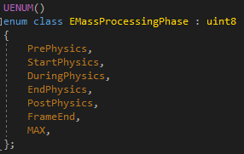
Mass Processor
bRequiresGameThreadExecution
ConfigureQueries
Execute
UMassCompositeProcessor
Automatically multithreaded based on requirements (fragments, subsystems, etc.)

Slide 22
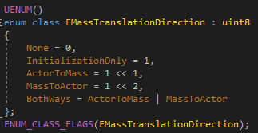
Translator Processor
Child of UMassProcessor
Used to transfer data between fragments and UObjects.
Initial step required in trait BuildTemplate function to collect UObject references and initialize fragment data from them.

Slide 23
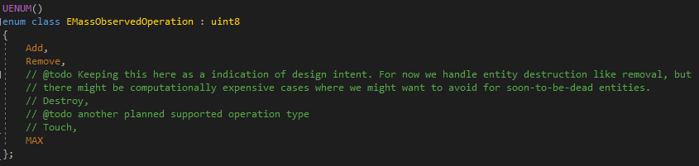
Observer Processor
Child of UMassProcessor
One per fragment type
Runs when fragment is either added or removed (specified in processor constructor)
Used to initialize fragments or update subsystems

Slide 24
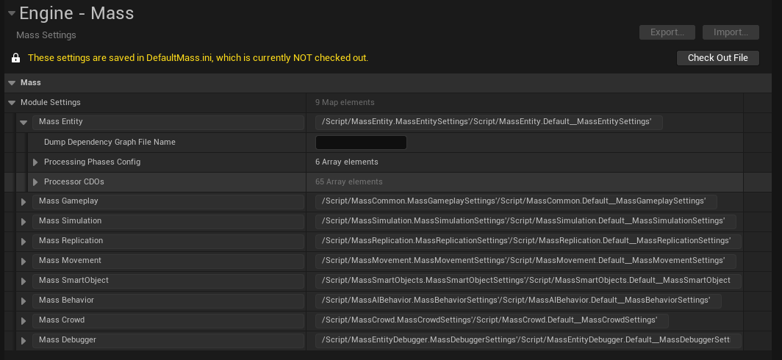
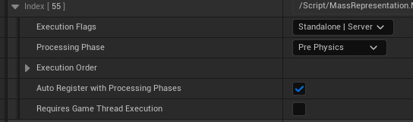
Mass Representation (Visualization)
Used to visually represent Mass entities in game world
UActors or instanced static meshes
No restrictions on UActors, so they can have their own logic
Use translator processors to ensure entity and actor stay in sync
LOD based
High/Medium/Low/Off
Configure by count and distance from player
Debug vs crowd vs base
Non-crowd visualization processors may be disabled by default
Enable in Project Settings->Engine->Mass->Module Settings->Mass Entity->Processor CDOs
Or edit DefaultMass.ini

Slide 25
State Tree Processor
FMassStateTreeEvaluatorBase
FMassStateTreeTaskBase
Wrappers for state tree evaluator/task
Uses FStateTreeConditionBase (no wrapper)
Task Tick: Mass Signals
Hard-coded…

Slide 26
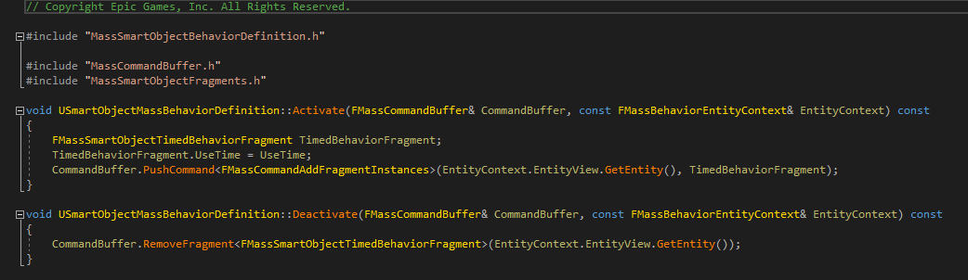
Smart Object Processor
FMassSmartObjectUserFragment
How entity interacts with smart object
USmartObjectMassBehaviorDefinition
Activate
Deactivate
Manipulate entity through the command buffer.

Slide 27
Navigation & Move Processors
Avoidance
Neighbor-driven forces
Steering
Force toward goal
Orientation
Rotation toward facing target
FMassForceFragment
FMassVelocityFragment
FMassTransformFragment

Slide 28
Mass Replication
Client Bubble
Custom structs for data replication
Custom data handler
Entity data stored in array property of replicated struct on custom AActor

Slide 29
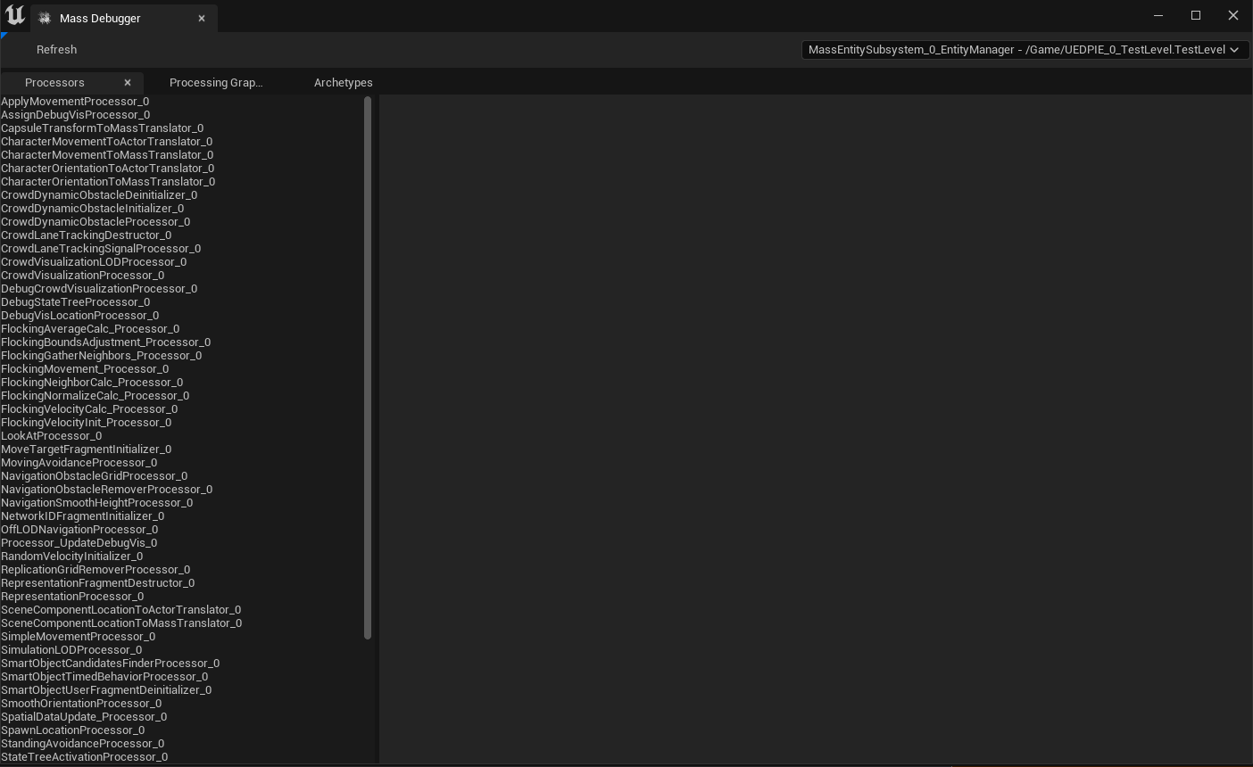
Mass Entity Debugger

Slide 30
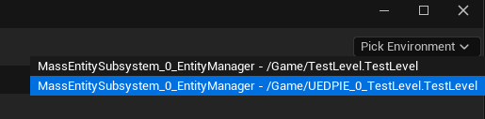
Mass Entity Debugger

Slide 31
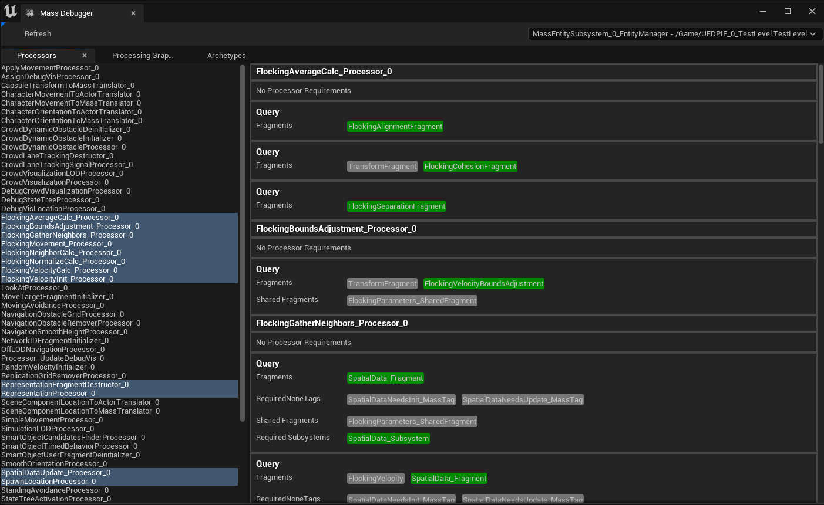
Mass Entity Debugger

Slide 32
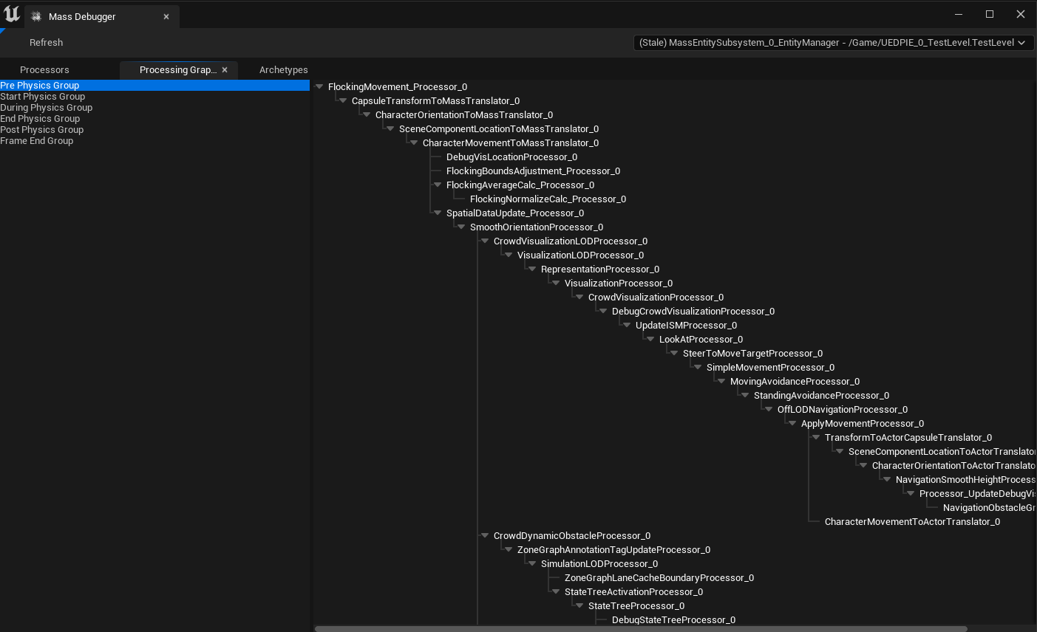
Mass Entity Debugger

Slide 33
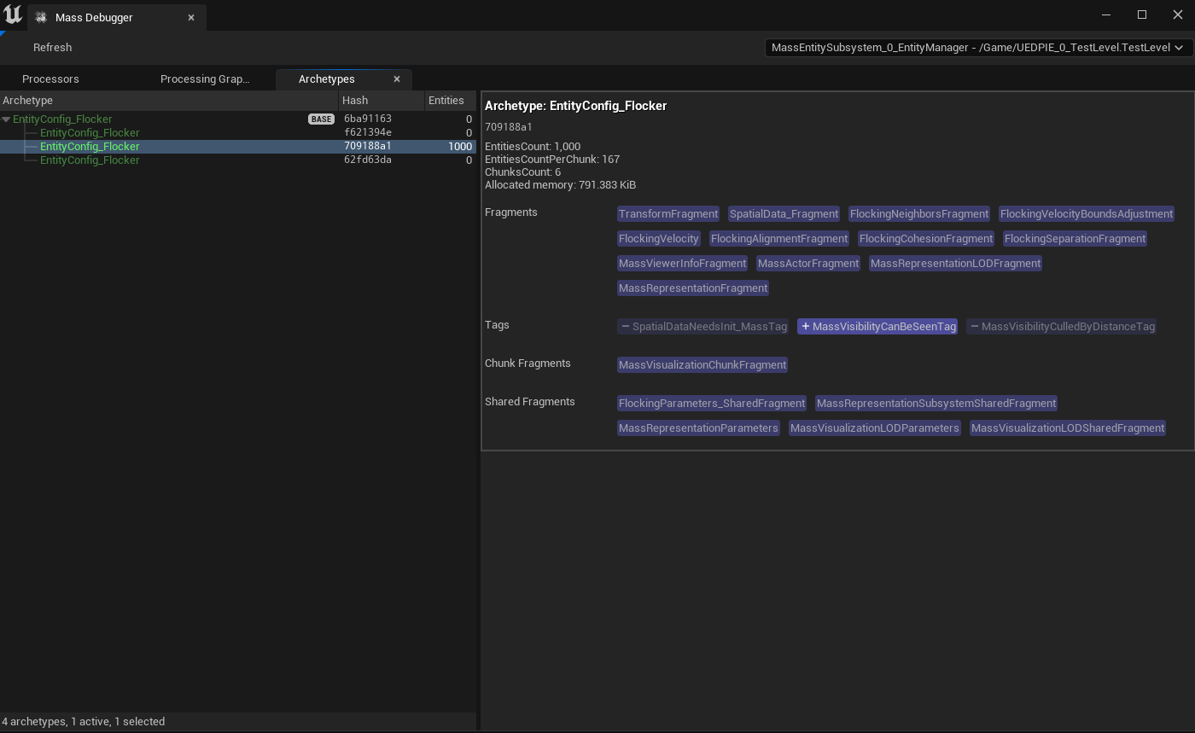
Mass Entity Debugger

Slide 34
Bonus
Parallel chunk execution: Processing groups.
Can hurt as much as help.
Don’t forget to initialize entity queries.
Can do this as part of the constructor.
Or you have to manually register.
Initialize fragments with observer processors.
Add/remove only.
Subsystem requirements in entity queries: How to apply to engine subsystems?
When should processor execute on game thread?
Which processors are registered?
Should the processor execute on the client?
“Next frame” mindset.
Parallel fragment access: ReadOnly vs ReadWrite

Slide 35

Thank you!
https://github.com/ZG-Gary/UEMassOverview

