Slide 1




DC conductivity, superfluid stiffness, and phase diagrams of quasi 2d organic Mott insulators Charles-David Hébert Patrick Sémon André-Marie Tremblay Louis Bourassa
Phys. Rev. B 92, 195112

Slide 2
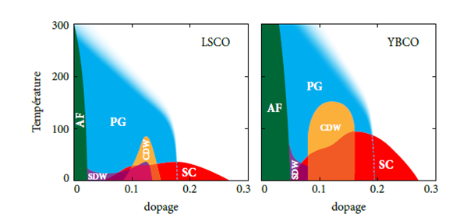

High Tc - BEDT Comparison
Motivation
κ-(BEDT)X
X$=Cu\left[N{\left(CN\right)}_{2}\right]Cl$(t’ ~ 0.4t)
PH.D thesis, Simon Verret,
Université de Sherbrooke, 2018
S. Lefebvre, and al,PRL. 85, 5420 (2000)

Slide 3
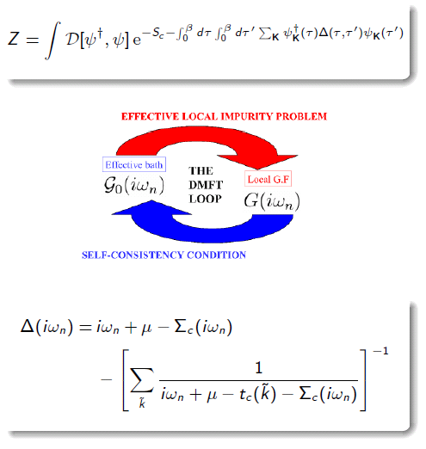
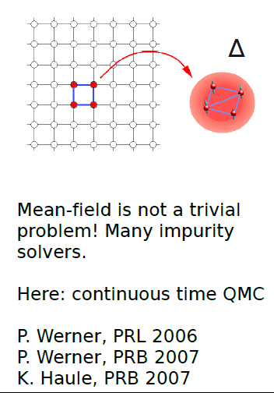
Theory
C-DMFT
K

Slide 4
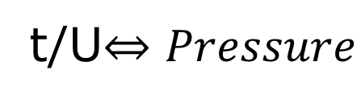
Results: Half-filling
S. Lefebvre, and al, PRL 85, 5420 (2000)
t/U$⇔Pressure$

Slide 5
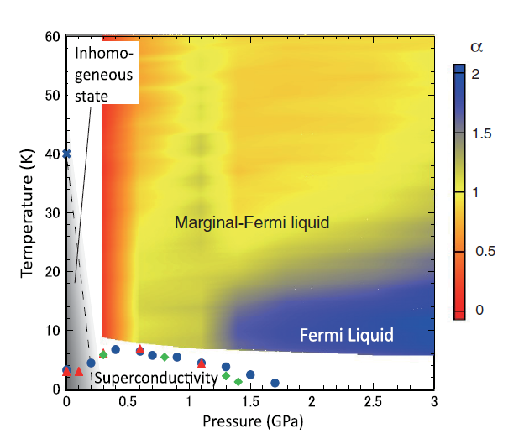
1
2
3
Results: Finite doping
H. Oike, and al. Phys. Rev. Lett. 114, 067002(2015)

Slide 6
1
2
3
Results: Finite doping

Slide 7
1
2
3
Results: Finite doping
H Oike, and al. Phys. Rev. Lett. 114, 067002(2015)

Slide 8
Results
Proposed phase diagram for the organics (schema on the left and calculations on the right).
8
The Widom line is correlated to the position of the superconducting dome.

Slide 9
Results: Superfluid stiffness 1
M. I. Larkin and al. Phys. Rev. B 64, 144514
(2001)

Slide 10
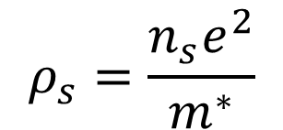
Results: Effective mass
M. I. Larkin and al. Phys. Rev. B 64, 144514
(2001)
$$ρ_{s}=\frac{n_{s}e^{2}}{m^{∗}}$$

Slide 11
Results: Superfluid stiffness 2
2
1
1
2

Slide 12
Pseudo-gap as a continuation of the Mott insulating state at finite doping Superconducting dome strongly correlated with pseudogap-metal transition Non-BCS behaviour of superfluid stiffness
Conclusion

Slide 13

Thank you!

