Slide 1




A brief introduction to variational methods and Boltzmann machines Charles-David Hébert

Slide 2
1. Monte Carlo Methods 2. Metropolis-Hastings Algorithm 3. Variational Monte Carlo (VMC) 4. Boltzmann Machine as a wave function ansatz 5. Boltzmann Machine and VMC References: Given in Group meeting email.
Plan

Slide 3
Monte Carlo Basics
Evaluate the following integral with M points
Central limit theorem
 |  | Trapezoidal rule | Monte Carlo
Error Scaling 1-D |  | O(M⁻²) | O(M^{-1/2})
Error Scaling K-D |  | O(M^{-2/K}) | O(M^{-1/2})

Slide 4

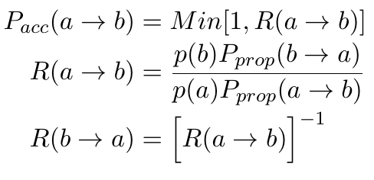
Metropolis-Hastings Algorithm
Markov Chain
Normalisation
Global balance condition
Detailed balance condition

Slide 5
Variational Monte Carlo 1
Setup a variational wave function (trial wave function)
Evaluate the expectation value of the energy with the trial wave function
Find a minimum (variational energy) of the energy expectation value with respect to the variational parameters
Calculate various physical observables with the obtained wave function from previous steps

Slide 6
Variational Monte Carlo 2
α = « Variational parameters »
x = configuration (of electrons in space)
= Trial wave function
Real space
Importance sampling

Slide 7
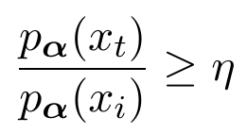
Variational Monte Carlo 3
Importance sampling in practice (Hubbard like model):
0.) Pick a random initial config x_{i}
1.) Propose to move a randomly chosen electron to a randomly chosen neighboring site, thus producing a trial config x_{t}
2.) Accept new config x_{t} if:
3.) GO TO 1
Random number drawn from [0,1[

Slide 8
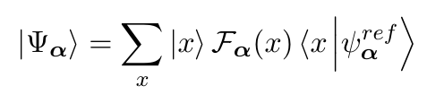

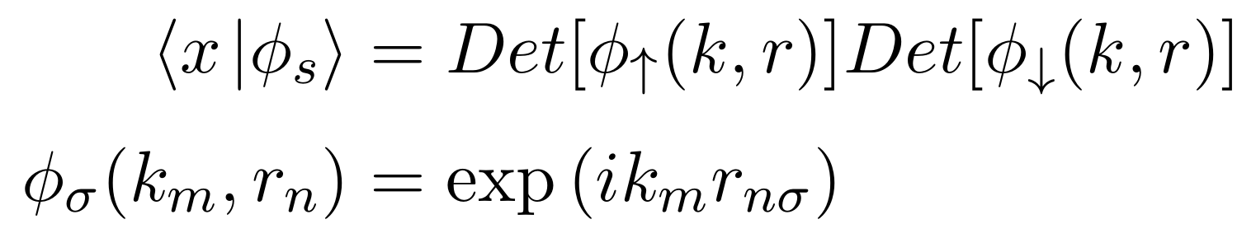

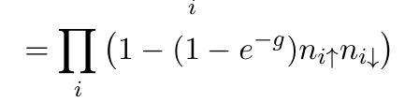
Trial wave function 1: simplest form
Fock space basis
Gutzwiller Factor

Slide 9

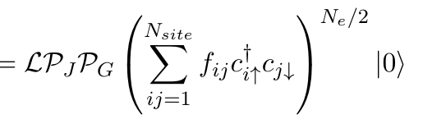

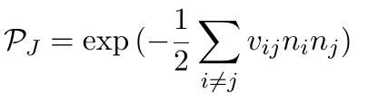
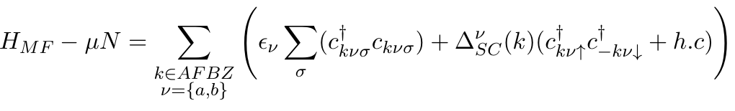
Trial wave function 2: mVMC
Quantum number /Symmetry projector
Gutzwiller Factor
Jastrow Factor
Geminal wave function

Slide 10
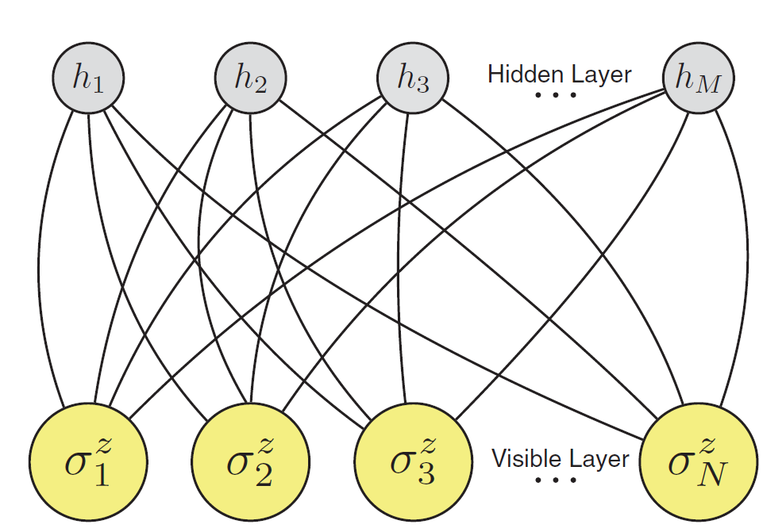
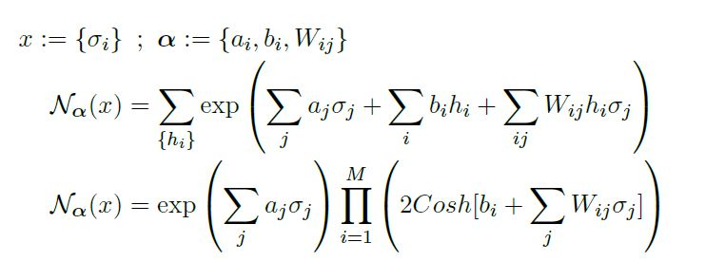
Trial wave function 3: Restricted Boltzmann machine
Local magnetic field for physical spins
Local magnetic field for Hidden spins
Coupling
Carleo et al., science.aag2302

Slide 11
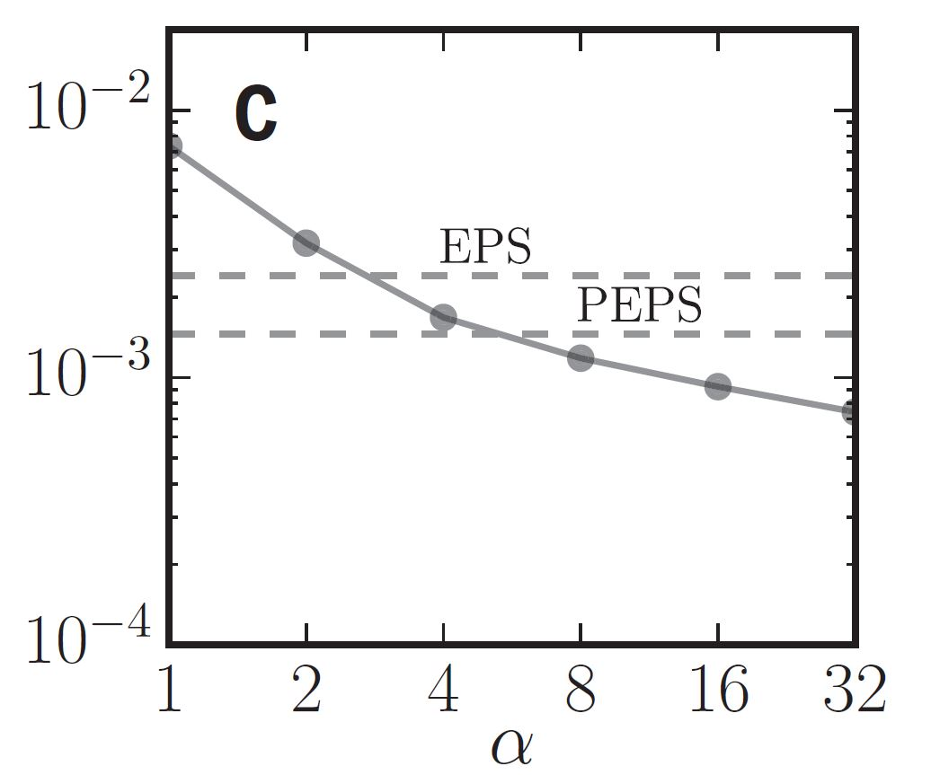
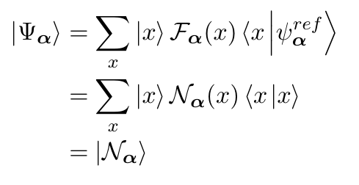
Two dimensional Antiferromagnetic Heisenberg model on Square lattice.
Carleo et al., science.aag2302
Compared to SSE MC,
Phys. Rev. B 56, 11678
Hidden variable density

Slide 12
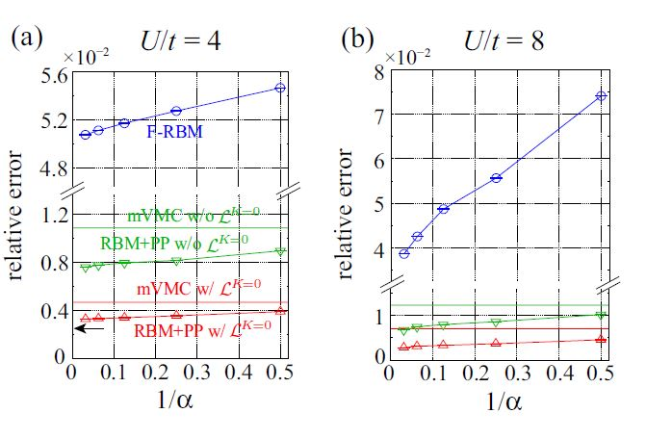
Nomura et al.
Compared to AUX MC

Slide 13

Thank you!

Slide 14
Minimisation details

