Slide 1
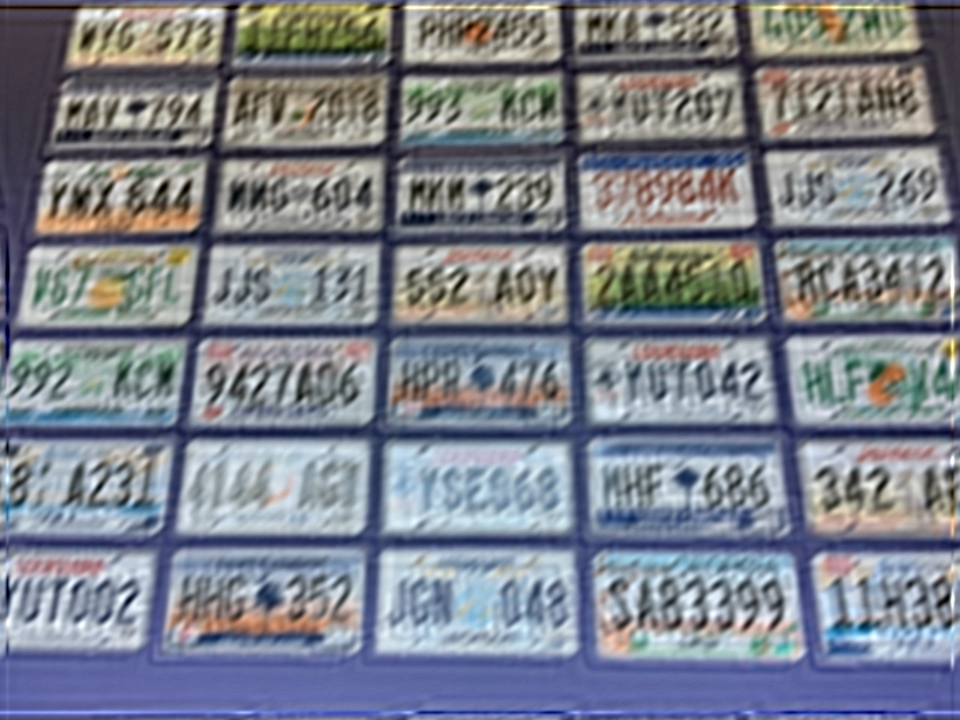
WYG573
1FFH756
PHH2455
MKA532
405ZMU
MAV794
AFV2018
993KCN
YMUY207
7121AH8
YMX644
MMG604
MKM239
378984K
JJS269
V67GFL
JJS131
552AOY
2AA4510
RCA3412
992KCN
9427A06
HPR476
YU7042
HLFV4
8A231
4144AGI
YSE068
MHF686
342A
YUT002
HHG352
JGN048
SA83399
11H38

