Slide 1
System Diagram

Slide 2
Key Modules

Slide 3
Experiment Logic

Slide 4
Run Results
The model successfully completed a zero-shot forecasting run on the ETTh1 dataset.
As input, it used 512 past time steps as, as output it predicted the next 64 future time steps.
The model produced:
Mean Absolute Error: 0.3623
Mean Squared Error: 0.3556
Lower MSE and MAE indicate better forecasting performance. These values show that the model produced a valid forecast with measurable prediction error.
Furthermore, we can use this data to argue that TS-RAG improves zero-shot forecasting by comparing it against other methods, like RAF.

Slide 5
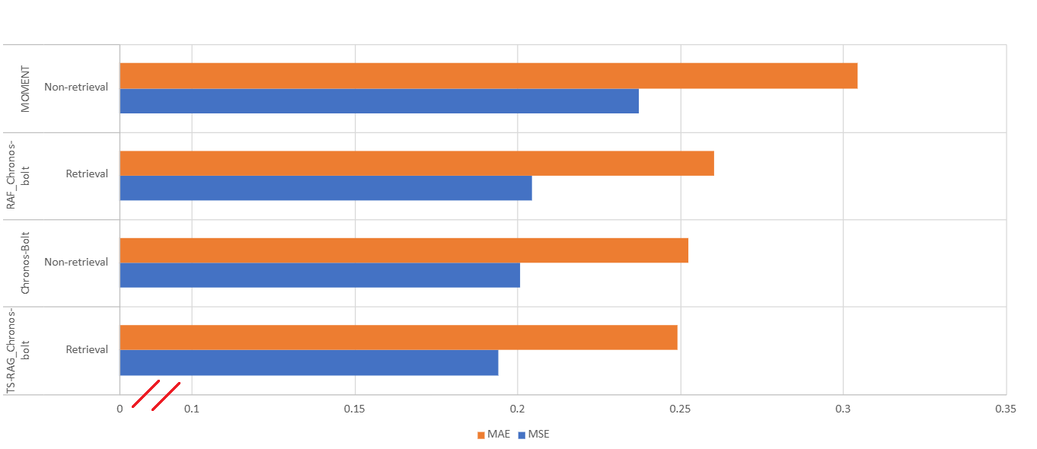
Averages across seven datasets: ETTh1, ETTh2, ETTm1, ETTm2, Weather, Traffic, and Electricity (ECL)
Comparing against other methods

Slide 6
Critical Insite

