Slide 1
Machine Learning Analysis of Multimodal Health Dataset
Predict High vs. Low Loneliness
Intelligent Systems - CSC 500
Zoe Rochelle
Team 3
04-05-2026
1

Slide 2
0
Workflow tools
Tech Stack
Workspace: VS Code/Github
Platform: AWS
Storage: S3
Compute: Glue/Spark
SQL/DB: Athena
Modules/Libraries
PySpark (ETL)
Pandas
NumPy
Scikit-Learn
XGBoost
2

Slide 3



0
Workflow overview: AWS
S3
Glue
Athena
S3 -> store the dataset and tables
Glue/Spark -> data cleanup, transformations, building Athena tables, data processing
Athena -> querying/viewing data: Aware, Oura, Watch, Survey
2

Slide 4
1
Problem Definition
Goal: predict high vs. low loneliness from a multimodal health dataset.
This is defined as supervised learning, and a binary classification problem.
Target labels were created from the 20-item UCLA Loneliness Scale.
Each participant received one total UCLA score after response mapping and reverse scoring: Never -> 1, Rarely -> 2, etc.
A median split was used: above the median = high loneliness; at or below the median = low loneliness.
Each row in the final modeling dataset represents one participant.
2

Slide 5
2
Data Preprocessing
The dataset included AWARE smartphone data, Oura wearable data, and survey data.
Raw CSV files were cleaned, renamed when needed, and converted into Parquet datasets.
Schemas and Athena tables were checked and corrected so the data types matched the Parquet files – had some issues here.
Survey data was reshaped into a long-format table for easier filtering and scoring.
3

Slide 6
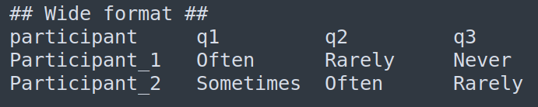
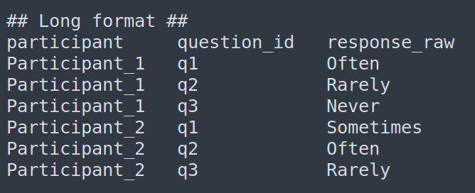
2
Data Preprocessing (cont.)
The survey files are inconsistent: different surveys can have different numbers of questions.
This change made the survey files easier to query.
Now we can filter rows like:
only UCLA surveys
only q1
only one participant
2

Slide 7
2
Data Preprocessing (cont.)
UCLA responses were mapped from text to numbers, reverse-scored for positive items, and summed into a total loneliness score. Positively worded questions were manually identified.
Higher average = more loneliness
Lower average = less loneliness
I feel lonely: 4
I feel connected: 4 (becomes) 1
So, when we average up the scores, happy responses lead to a lower score.
Participant-level features were created from AWARE and Oura tables, and missing numeric values were filled with the median.
3

Slide 8
3
Models Used
Four models were trained, as required by the project: SVM, Random Forest, XGBoost, and a Neural Network.
The input feature was built from participant level AWARE and Oura features.
The target variable was loneliness_label_binary.
As per the instructions, I decided to use stratified cross-validation as a way of splitting the data into several training/testing folds. Based on my research, this would keep the evaluation fairer and more consistent on a small dataset.
Also, as per the instructions, the models were evaluated using accuracy, precision, recall, F1 score, and ROC-AUC (measures a model's ability to distinguish between classes).
4

Slide 9
3
Models Used (cont.)
Also, as per the instructions, the models were evaluated for:
Accuracy: more predictions are correct
Precision: when the model predicts high loneliness, it is correct more often
Recall: what percentage of actual high-loneliness participants did the model find
F1 Score: better balance between precision and recall
ROC-AUC: how well the model seperates between the two classes
4

Slide 10
4
Results and Insights
XGBoost performed best overall and achieved the strongest prediction results.
Random Forest did not perform as well, but it provided a more balanced and interpretable feature-importance profile.
Important features included battery related phone data, sleep efficiency, awake time, deep sleep, resting heart rate, and call duration.
5

Slide 11
4
Results and Insights (cont.)
Higher = better
5

Slide 12
5
Conclusion
These findings suggest that loneliness may influence both phone usage behavior and sleep or recovery patterns.
In this project, battery related phone features were especially important, along with sleep related features like awake time, sleep efficiency, deep sleep, sleep duration, and resting heart rate.
This suggests that loneliness may affect daily habits, communication, and some physical routines.
However, because the dataset is small overfitting is a possible issue, and because XGBoost relied heavily on one feature.
Using stratified cross-validation helps, but doesn't eliminate the issue completely. Interpret these results with caution.
5

Slide 13
6
Sources
Source paper​
Smartphone Data Gathered Early in Depression Treatment Predicts Treatment Outcome - https://dl.acm.org/doi/10.1145/3721201.3721380​
Source dataset​
Loneliness and well-being in Finnish immigrants: A multimodal dataset from wearables and passive data collection​
https://datadryad.org/dataset/doi:10.5061/dryad.qz612jmrn
Models
https://scikit-learn.org/stable/modules/svm.html
https://scikit-learn.org/stable/modules/generated/sklearn.ensemble.RandomForestClassifier.html
https://scikit-learn.org/stable/modules/neural_networks_supervised.html
https://xgboost.readthedocs.io/en/stable/get_started.html
5

