Slide 1
Group_8_Airbnb_Chicago_Visualization_Project_Zhang _ Yu_Liu
File created on: 2022-05-08 4:07:38 PM

Slide 2
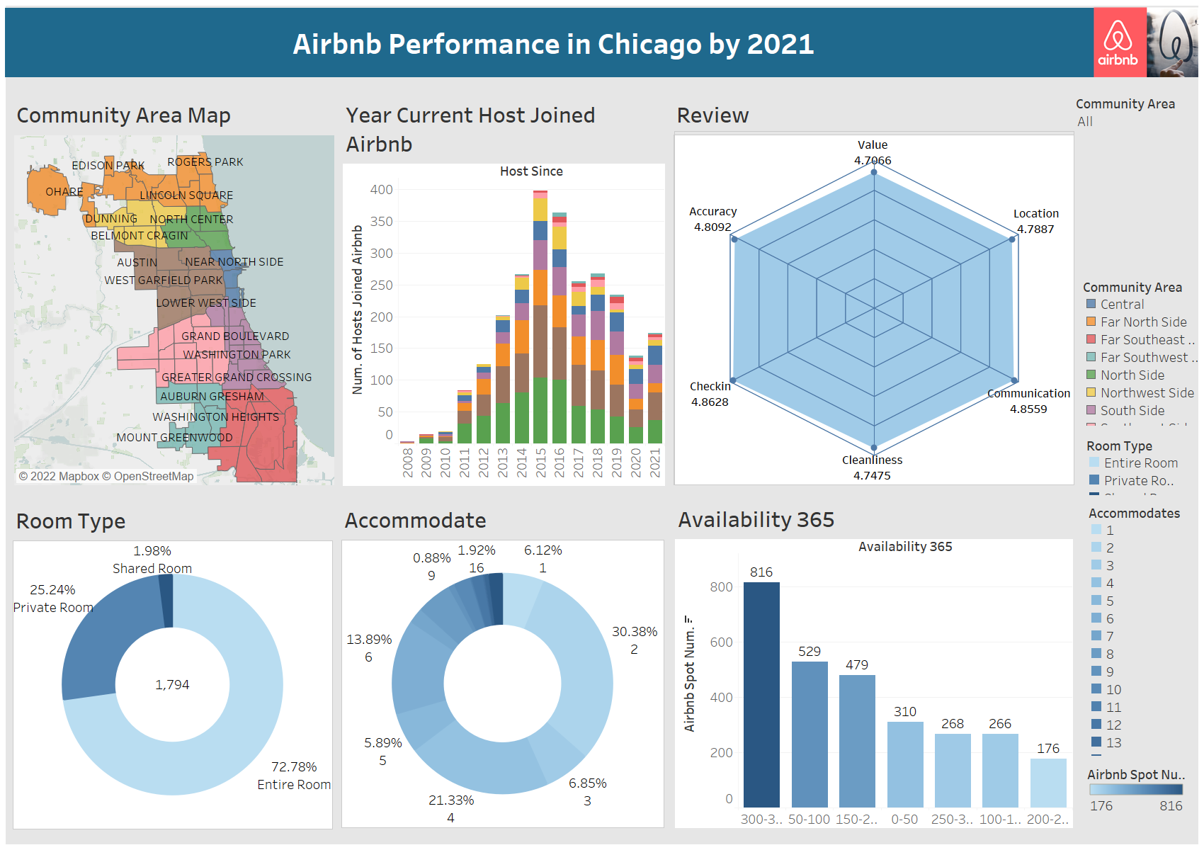

Slide 3
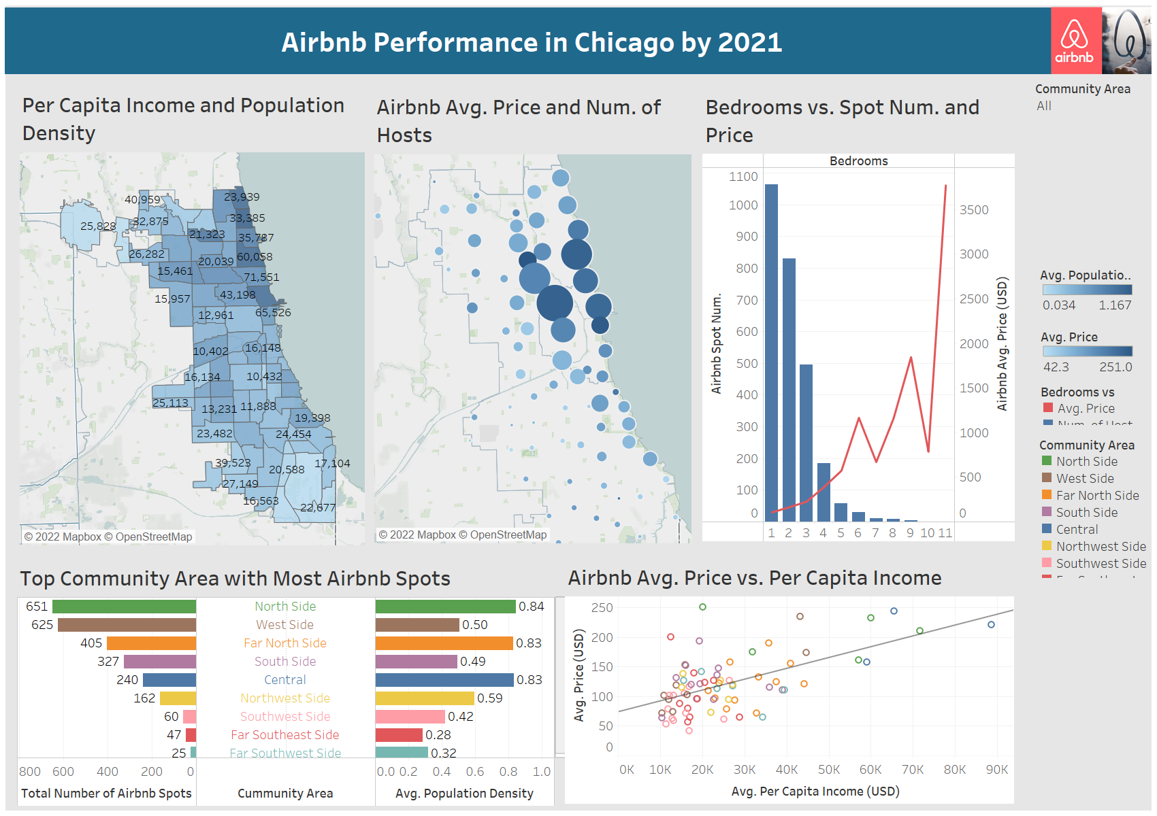

Slide 4
