Slide 1
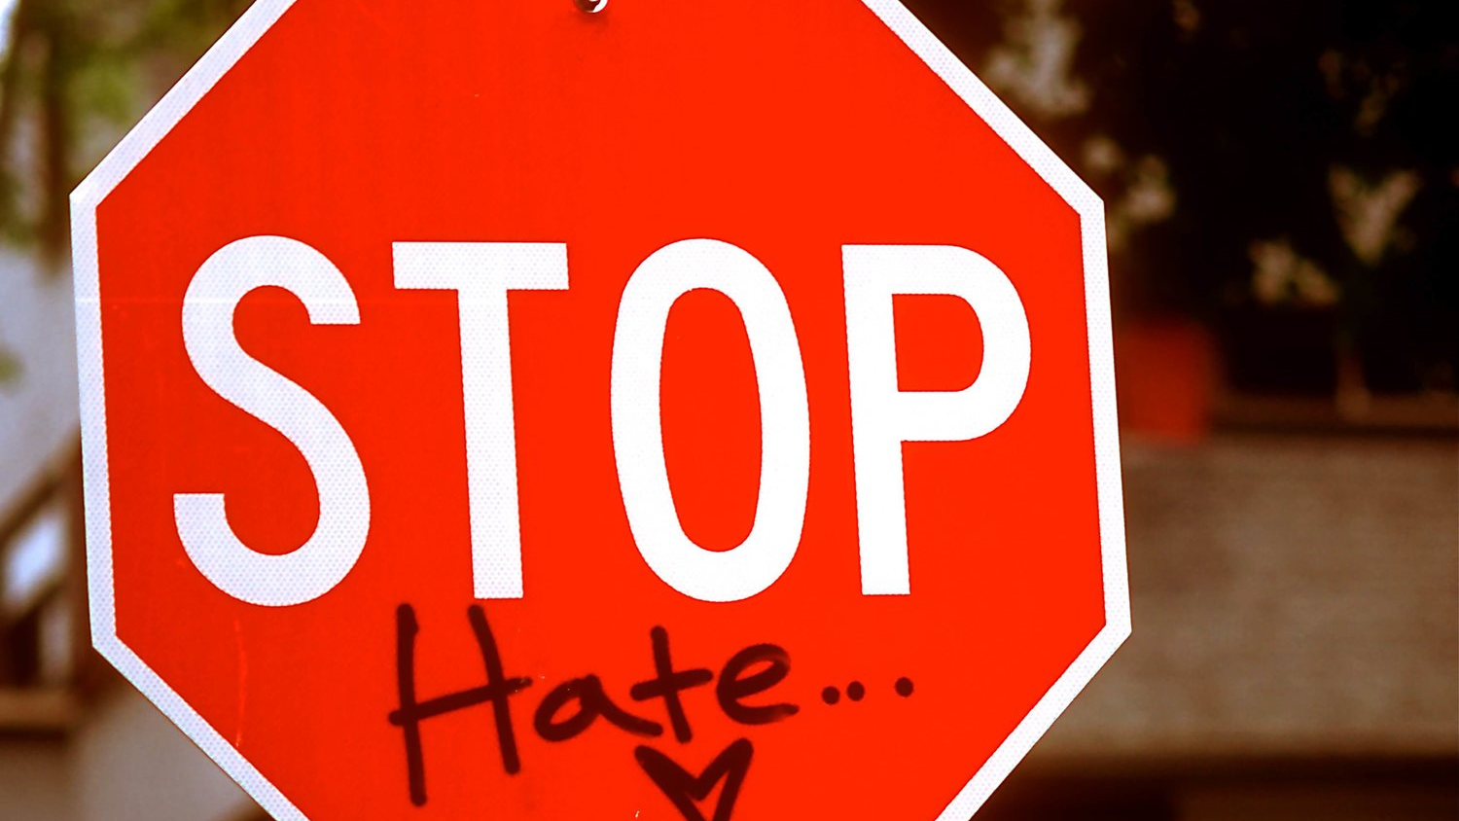
Hate Crime Study:
Analysis of hate crimes in 2009 and 2017. Special consideration for political and socioeconomic make-up by state.

Slide 2
Hypothesis:
Hypothesis: "Intolerance is the first sign of an inadequate education." This quote by Aleksander Solzhenitsyn sums up a general belief about prejudice, that with education these attitudes can be erased. However, is this really the case? Through research, are we able to prove a correlation between people who graduate high school and lack of hate crimes?
It is well known that the factors that contribute to socioeconomic status affect crime rates around the world. Therefore, areas that experience higher rates of poverty, relatively low per capita income, and high rates of income inequality (according to the Gini Index), should also experience higher rates of hate crimes.
In today’s divisive political climate, Democrats and Republicans often try to place blame on one another for various problems facing our society. One of these problems, which is a huge source of media attention, is discrimination of race, religion, sexuality, and gender. In this study, we will use the rates of specific hate crimes to measure the targeted attacks against these groups. So, the question is, is there a correlation between political affiliation and race, religion, sexuality, gender-based discrimination?

Slide 3
Top 5 Share of Hate Crimes per State:
State | Hate Crimes Committed | Total Hate Crimes (Year) | Share per State (%)
2009
California | 1018 | 6612 | 15.4
New York | 641 | 6612 | 9.69
New Jersey | 549 | 6612 | 8.3
Massachusetts | 317 | 6612 | 4.79
Michigan | 315 | 6612 | 4.76
2017
California | 1094 | 7334 | 14.92
New York | 554 | 7334 | 7.55
Washington | 511 | 7334 | 6.97
New Jersey | 499 | 7334 | 6.8
Michigan | 457 | 7334 | 6.23

Slide 4
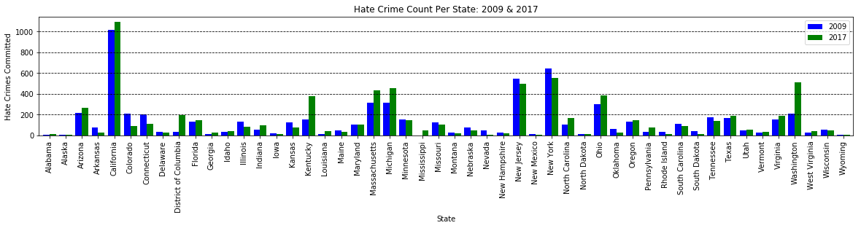

Slide 5
Top 5 Share of Hate Crimes per State:
2009
Total Count of Hate Crimes Among Top 5 in 2009: 2,840
Total Share of Hate Crimes Among Top 5 in 2009: 42.92%
2017
Total Count of Hate Crimes Among Top 5 in 2017: 3115
Total Share of Hate Crimes Among Top 5 in 2017: 42.47%
Average Hate Crime Count(All): 132
Average Hate Crime Count(All): 147

Slide 6
Top 5 Hate Crime Rates per State:
State | Total Hate Crimes Committed | Hate Crime Rate per 100,000 Population.
2009
New Jersey | 549 | 6.24
District of Columbia | 37 | 6.11
Connecticut | 200 | 5.6
South Dakota | 42 | 5.15
Massachusetts | 317 | 4.83
2017
District of Columbia | 194 | 29.44
Kentucky | 378 | 8.57
Washington | 511 | 7.22
Massachusetts | 434 | 6.44
New Jersey | 499 | 5.6

Slide 7
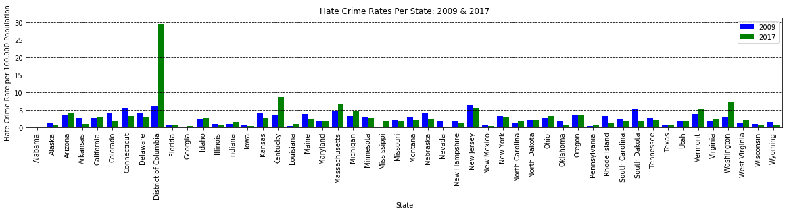

Slide 8
Top 5 Share of Hate Crimes per State:
2009
State with Highest Hate Crime Rate: New Jersey = 6.24
State with Second Highest Hate Crime Rate: Washington D.C. = 6.11
2017
State with Highest Hate Crime Rate: Washington D.C. = 29.44 (roughly a 400% increase)
State with Second Highest Hate Crime Rate: Kentucky = 8.57 (roughly a 150% increase)
Average Hate Crime Rate: 2.46
Average Hate Crime Rate: 2.80

Slide 9

Education Analysis:
Hypothesis: "Intolerance is the first sign of an inadequate education." This quote by Aleksander Solzhenitsyn sums up a general belief about prejudice, that with education these attitudes can be erased. However, is this really the case? Through research, are we able to prove a correlation between people who graduate high school and lack of hate crimes?

Slide 10
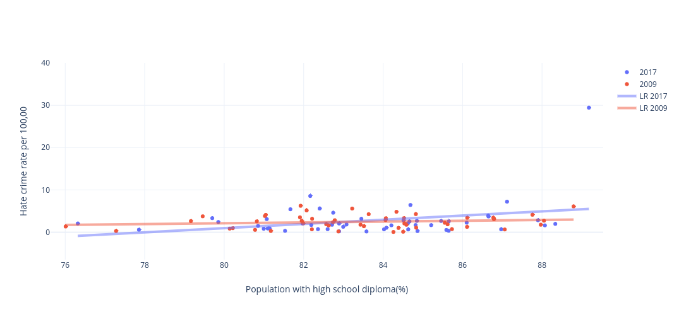
Hate crime vs High school
https://plot.ly/~maximusrex/3/#/plot

Slide 11
Education Conclusions
It is widely believed that education helps cure prejudice, however the data we have shows that the effect a high school education has on impacting hate crimes is negligible.

Slide 12

Socioeconomic Analysis:
Hypothesis:
It is well known that the factors that contribute to socioeconomic status affect crime rates around the world. Therefore, areas that experience higher rates of poverty, relatively low per capita income, and high rates of income inequality (according to the Gini Index), will also experience higher rates of hate crimes.

Slide 13
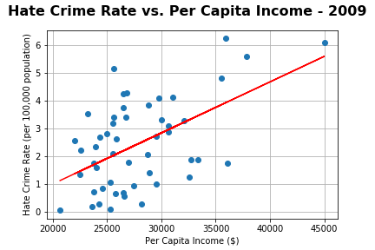
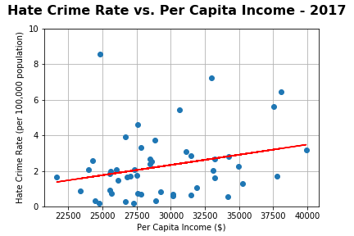
Hate Crime Rate vs. Per Capita Income

Slide 14
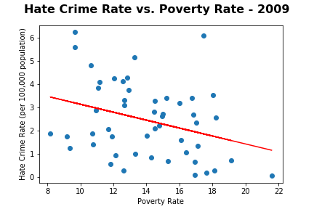
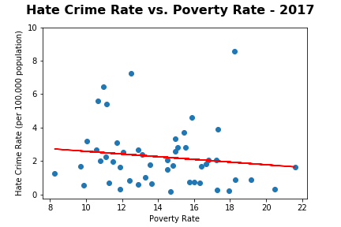
Hate Crime Rate vs. Poverty Rate

Slide 15
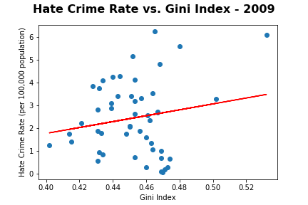
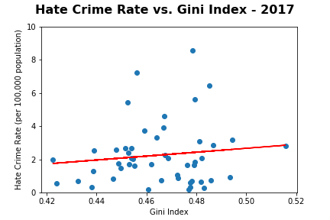
Hate Crime Rate vs. Gini Index

Slide 16
Major Findings from Socioeconomic Analysis:
It is widely believed that violent crimes, and thus hate crimes occur at greater rates in poorer areas. However, this seems to contradict our findings. Higher rates of poverty do not seem to be the only determinant in whether a state experiences more hate crimes.
Factors associated with income and income inequality are correlated with, and positively affect the hate crime rate in a given state. Hate crime rates tend to increase as the level of income inequality increases. This is likely due to public perception because a disproportionate amount of income is concentrated in the hands of fewer people.
It is important to note that average state level values are not wholly representative of all communities within a given state. Fluctuations in per capita income, income inequality and other socioeconomic factors over time, give rise to different hate crime outcomes in each community. Therefore, additional research and analysis for multiple years of data at the city, community, or census tract level is required to produce more thorough and descriptive results.

Slide 17
Sources of Income Inequality: How do these factors contribute to public perception of those with more and those with less?
Income: The market price of a skill, and hence the wage for the job that requires the skill, is low if a higher share of workers are willing and able to offer that skill but only a few employers need it. On the contrary, when there is low supply but high demand for a skill, the wage for a job requiring the skill increases.
Education: The level of education is often proportional to the level of skill. With a higher level of education, a person often has more advanced skills that few workers are able to offer, justifying a higher wage.
Globalization, Capital and Technology: Globalization and growth in technology renders joblessness at all skill levels. Additionally, the income gap between workers who earn by their skills and owners who earn by investing in capital has widened.
Gender, Race and Ethnicity: Differential earnings exist for several minority groups, and women of all major racial and ethnic groups earn less than men of the same group.
Personal Preference: Innate ability may not be the only difference in individual income. Diversity of preferences, within a society or among different societies, contributes to the difference in wealth. When it comes to working harder or having fun, equally capable individuals may have totally different priorities, resulting in a difference in their incomes. Their saving patterns may also differ, leading to different levels of accumulated wealth.

Slide 18
Political Analysis:
Hypothesis: In today’s divisive political climate, Democrats and Republicans often try to place blame on one another for various problems facing our society. One of these problems, which is a huge source of media attention, is discrimination of race, religion, sexuality, and gender. In this study, we will use the rates of specific hate crimes to measure the targeted attacks against these groups. So, the question is, is there a correlation between political affiliation and race, religion, sexuality, gender-based discrimination?

Slide 19
States With The Most Hate Crimes By Type
2009 | State | Voting Affiliation 2009 | Total Population | Race Related Incidents | Religion Related Incidents | Sexuality Related Incidents | Gender Related Incidents | Total Hate Crimes | Hate Crime Rate
1 | California | Hard Left | 36308527 | 597 | 191 | 222 | 84 | 1018 | 2.72739
2 | New York | Hard Left | 19423896 | 234 | 286 | 117 | 9 | 641 | 3.304443
3 | New Jersey | Middle Left | 8650548 | 271 | 208 | 66 | 9 | 549 | 6.242972
4 | Massachusetts | Hard Left | 6511176 | 189 | 58 | 67 | 0 | 317 | 4.831879
5 | Michigan | Middle Left | 10039208 | 220 | 27 | 62 | 19 | 315 | 3.182698
6 | Ohio | Middle Left | 11511858 | 177 | 25 | 48 | 23 | 303 | 2.627116
2017 | State | Voting Affiliation 2017 | Total Population | Race Related Incidents | Religion Related Incidents | Sexuality Related Incidents | Gender Related Incidents | Total Hate Crimes | Hate Crimes per 100,000
1 | California | Hard Left | 38982847 | 602 | 200 | 247 | 78 | 1094 | 2.830222
2 | New York | Middle Left | 19798228 | 189 | 284 | 65 | 20 | 554 | 2.812546
3 | Washington | Middle Left | 7169967 | 328 | 85 | 73 | 72 | 511 | 7.224508
4 | New Jersey | Middle Left | 8960161 | 261 | 180 | 52 | 9 | 499 | 5.597022
5 | Michigan | Middle Right | 9925568 | 312 | 71 | 59 | 36 | 457 | 4.61169
6 | Massachusetts | Middle Left | 6789319 | 208 | 116 | 60 | 25 | 434 | 6.437122

Slide 20
States With The Highest Hate Crime Rate
2009 | State | Voting Affiliation 2008 | Total Population | Race Related Incidents | Religion Related Incidents | Sexuality Related Incidents | Gender Related Incidents | Total Hate Crimes | Hate Crimes per 100,000
1 | New Jersey | Middle Left | 8650548 | 271 | 208 | 66 | 9 | 549 | 6.24297239
2 | District of Columbia | Hard Left | 588433 | 6 | 0 | 31 | 0 | 37 | 6.10803967
3 | Connecticut | Hard Left | 3494487 | 126 | 43 | 27 | 10 | 200 | 5.59877029
4 | South Dakota | Middle Right | 796513 | 33 | 5 | 4 | 2 | 42 | 5.14787264
5 | Massachusetts | Hard Left | 6511176 | 189 | 58 | 67 | 0 | 317 | 4.83187882
6 | Kansas | Middle Right | 2777835 | 83 | 15 | 20 | 8 | 122 | 4.27892562
2017 | State | Voting Affiliation 2016 | Total Population | Race Related Incidents | Religion Related Incidents | Sexuality Related Incidents | Gender Related Incidents | Total Hate Crimes | Hate Crimes per 100,000
1 | District of Columbia | Hard Left | 672391 | 109 | 14 | 57 | 18 | 194 | 29.43814
2 | Kentucky | Hard Right | 4424376 | 285 | 36 | 26 | 28 | 378 | 8.567564
3 | Washington | Middle Left | 7169967 | 328 | 85 | 73 | 72 | 511 | 7.224508
4 | Massachusetts | Middle Left | 6789319 | 208 | 116 | 60 | 25 | 434 | 6.437122
5 | New Jersey | Middle Left | 8960161 | 261 | 180 | 52 | 9 | 499 | 5.597022
6 | Vermont | Middle Left | 624636 | 19 | 5 | 7 | 2 | 34 | 5.42915

Slide 21
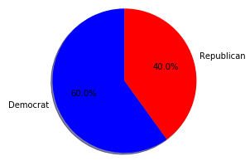
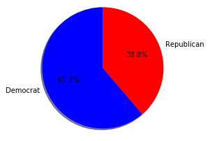
Contribution to the national hate crime rate from Democrat States and Republican States
2009 Percentages
2017 Percentages

Slide 22
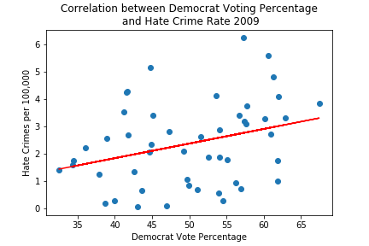
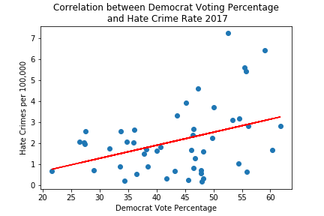
Correlation between Percentage of Votes for Democrats and Hate Crime Rate
*Outlier Washington DC have been omitted from 2009.
*Outliers Kentucky and Washington DC have been omitted from 2017.

Slide 23
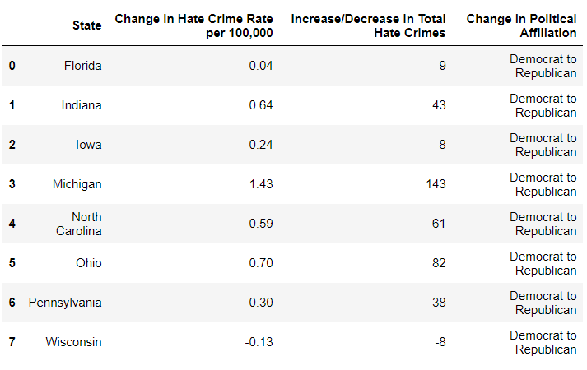
States that Change Affiliation From 2009-2017

Slide 24
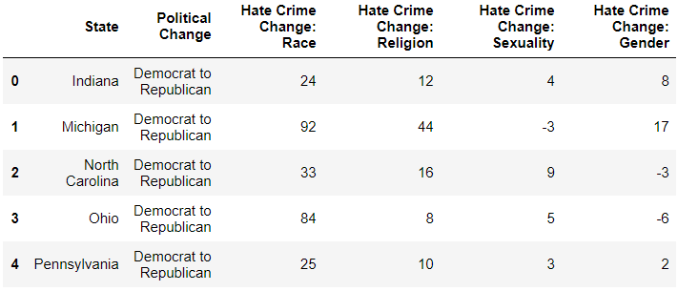
States with Significant Change

Slide 25
Political Analysis Conclusions
There are slight positive correlations between the increase of Democrat voter percentage and hate crime rate as well as Democratic states contributing to the majority of the hate crime rate in America, and, a majority of the states that changed from Democrat to Republicans from 2009 to 2017 saw their hate crime rate’s go up, some quite significantly. However, these subtle correlations in no way imply causation and the evidence found in our data does not prove anything about Republicans or Democrats. These correlations could be caused by several hidden variables.

Slide 26
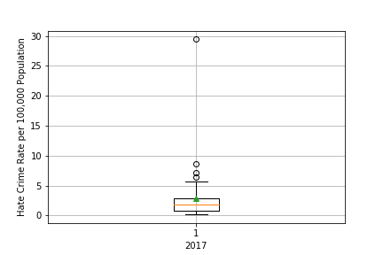
Washington D.C. as an Outlier in 2017:
There have been multiple reports which seek to bring attention to the rise in hate crimes across the country, especially in D.C. Based on the results of our analysis, it appears that the socioeconomic factors (specifically the rise in income inequality), social division and political partisanship across the country substantially affects and contributes to the rise in hate crimes in this particular state.

Slide 27
Hate Crime Datasets:
FBI Crime Data Explorer: Hate Crime Specific
https://crime-data-explorer.fr.cloud.gov/downloads-and-docs
Limitations:
All law enforcement agencies, whether they submit Summary Reporting System (SRS) or National Incident-Based Reporting System (NIBRS) reports, can contribute hate crime data to the UCR Program using forms specified to collect such information. However, not all hate crime related incidents are reported to the proper authorities, thus not collected in the UCR Program dataset.
States that have better systems for reporting hate crimes may be overrepresented in this dataset.
Also, Hawaii is either not included, or has not been reported to the FBI UCR Program.
US Census API Wrapper:
https://github.com/datamade/census

Slide 28
Hate Crime Datasets cont’d:
US Census: American Fact Finder Gini Index of Income Inequality
https://factfinder.census.gov/faces/tableservices/jsf/pages/productview.xhtml?pid=ACS_10_1YR_B19083&prodType=table
MIT Election Data: Science Lab
https://electionlab.mit.edu/
Limitations:
State level data is typically not as accurate, nor descriptive as city/local data.

