Slide 1
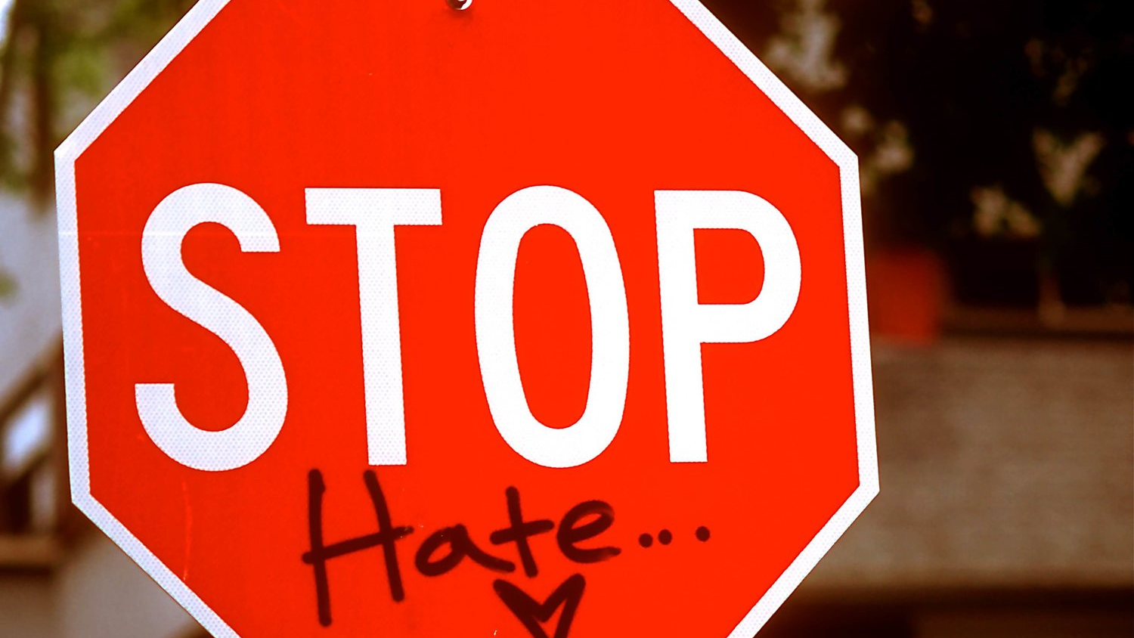
Hate Crime Study:
An analysis of hate crime data from 2009 and 2017, with consideration for political and socioeconomic make-up per state.

Slide 2
Hate Crime Datasets:
FBI Crime Data Explorer: Hate Crime Specific
https://crime-data-explorer.fr.cloud.gov/downloads-and-docs
Limitations:
All law enforcement agencies, whether they submit Summary Reporting System (SRS) or National Incident-Based Reporting System (NIBRS) reports, can contribute hate crime data to the UCR Program using forms specified to collect such information. However, not all hate crime related incidents are reported to the proper authorities, thus not collected in the UCR Program dataset.
US Census API Wrapper:
https://github.com/datamade/census

Slide 3
Hate Crime Datasets cont’d:
US Census: American Fact Finder Gini Index of Income Inequality
https://factfinder.census.gov/faces/tableservices/jsf/pages/productview.xhtml?pid=ACS_10_1YR_B19083&prodType=table
MIT Election Data: Science Lab
https://electionlab.mit.edu/
Limitations:
State level data is typically not as accurate, nor descriptive as city/local data.

Slide 4
Describe basic stats

Slide 5
Socioeconomic Analysis:
Hypothesis:

