Slide 1

PERFORMANCE EVALUATION AND APPLICATIONS
ZHANG YUEDONG
Codice Persona: 10580582
Email: yuedong.zhang@mail.polimi.it
Professore: MARCO GRIBAUDO

Slide 2

Outline
Simulation with MATLAB
Fit the unknown distribution
Rebuild the model with Phase-Type distributions
Solve the ode45 function, plot the probability of the various states for the time T = [0, 20] and T = [0, 10000]
Compute the steady-state
Compute the average energy consumption through state rewards
Computer the on frequency through transition reward
Simulation with Java Modelling Tools (Double-check the result of MATLAB)
Build the model
Compute the average energy consumption through the steady-state
Compute the on frequency through the throughput

Slide 3


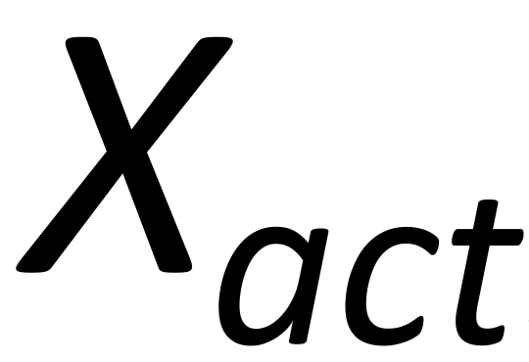

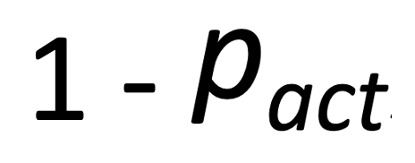
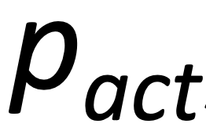

1-Off
2-On
？
4-Action
3-Processing

Slide 4
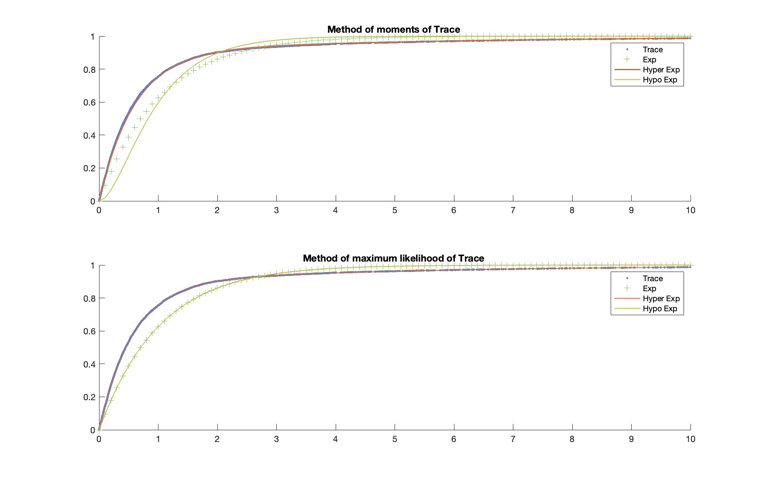

Slide 5
1-Off
Exp(0.1s⁻¹)
Exp(1s⁻¹)
2-On
HyperExp(0.2219s⁻¹, 1.7739s⁻¹, 0.1148)
Exp(3s⁻¹)
4-Action
Exp(5s⁻¹)
3-Processing

Slide 6
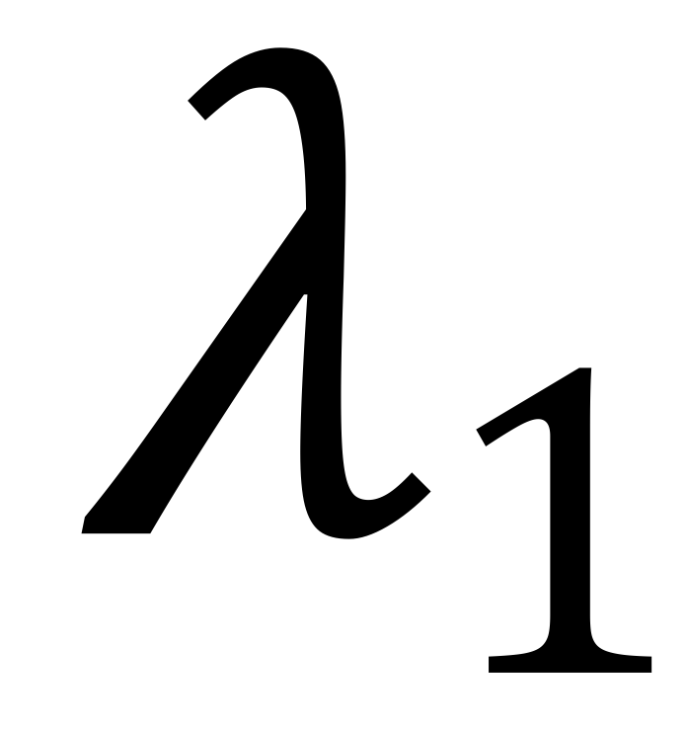
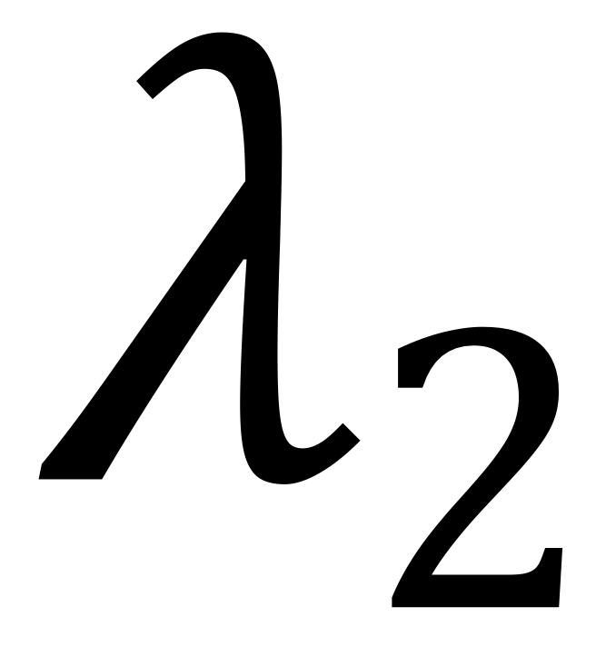
CTMC Model
4-Action a
P1
1-Off
2-On
3-Processing
( )
(1-P1)
5-Action b

Slide 7
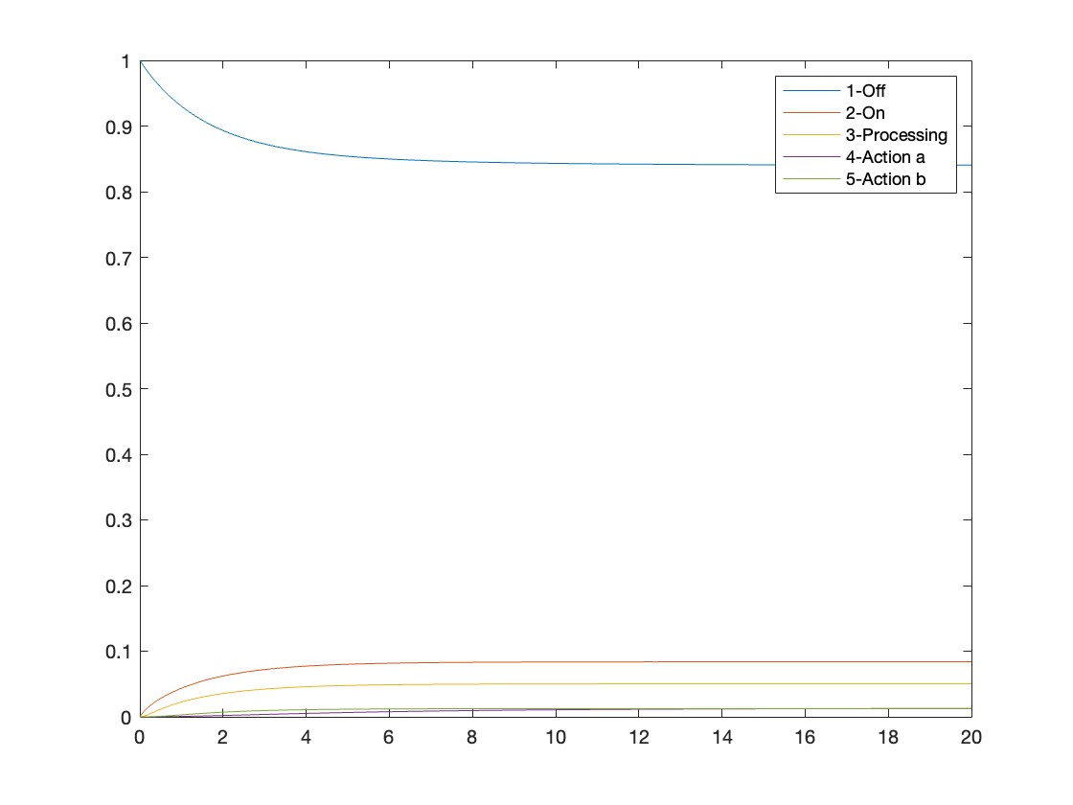
Probability of the various states for the time T = [0, 20]

Slide 8
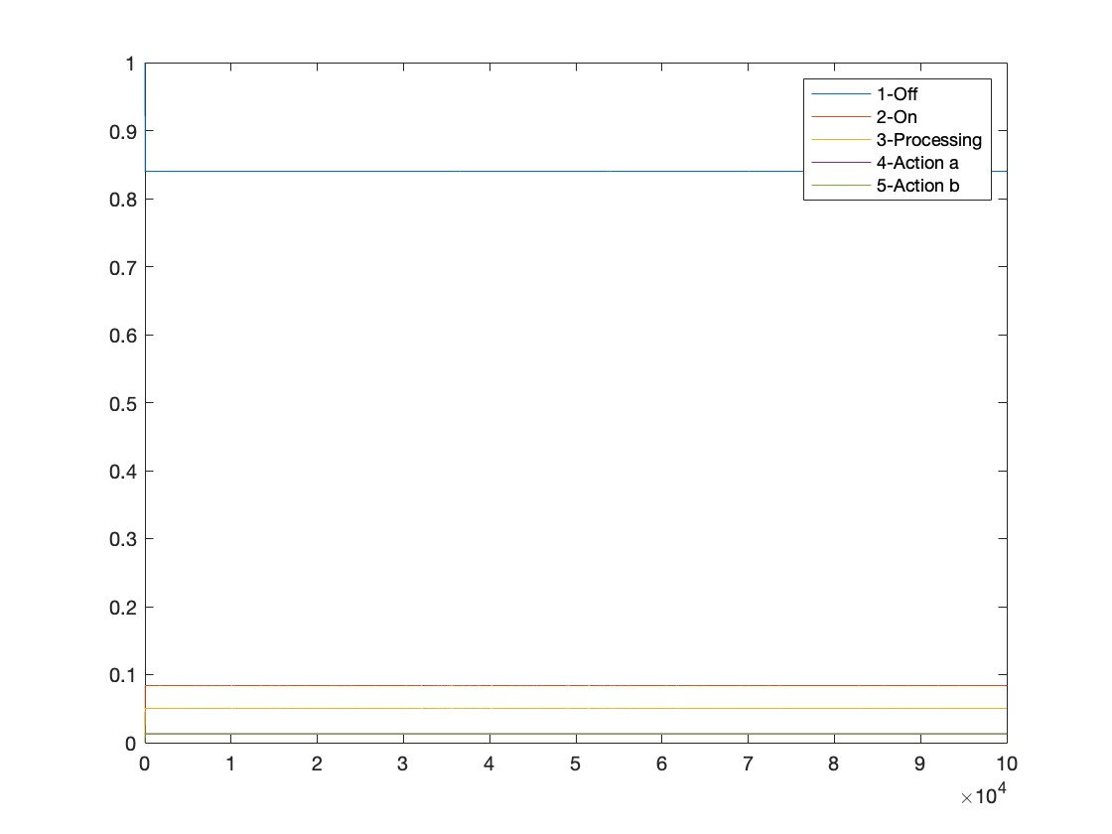
Probability of the various states for the time T = [0, 10000]

Slide 9
Result
Steady-state: pi = [0.8400, 0.0840, 0.0504, 0.0130, 0.0126]
Average energy consumption: 1.7003 mW
On frequency: 0.3360

Slide 10
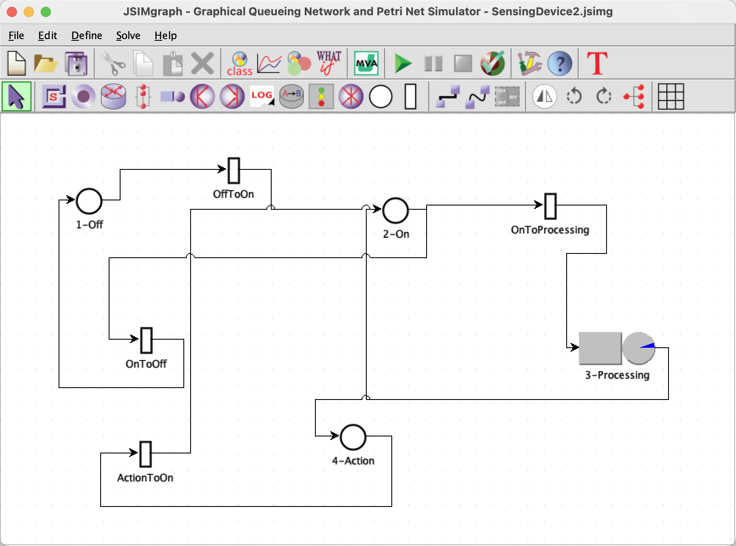
JSIMgraph

Slide 11
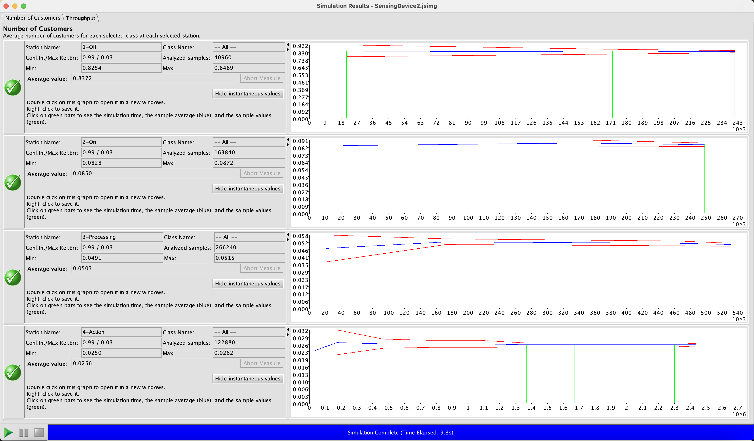
Double-Check the result of MATLAB simulation
Steady-state: 0.8372 0.0850 0.0503 0.0256

Slide 12

Average energy consumption
[0.8372,0.0850,0.0503,0.0256]
$$∙$$
[$εoff$, $εon$, $εproc$, $εact$]^{T}
= 1.7002 mW

Slide 13
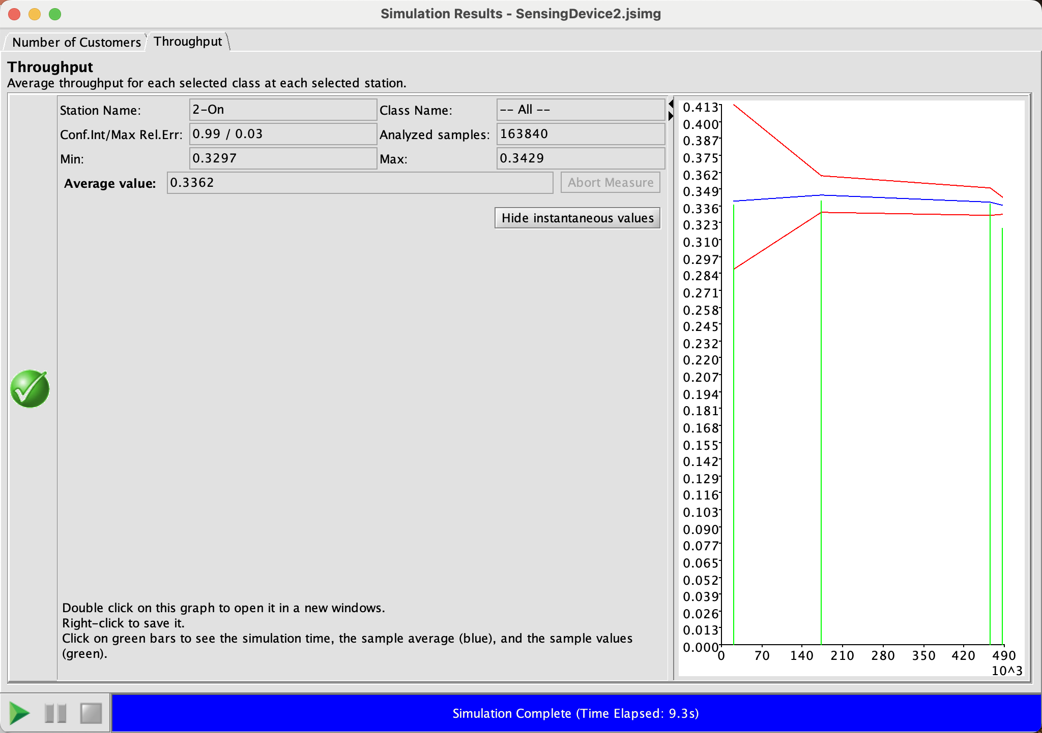
On frequency

