Slide 1










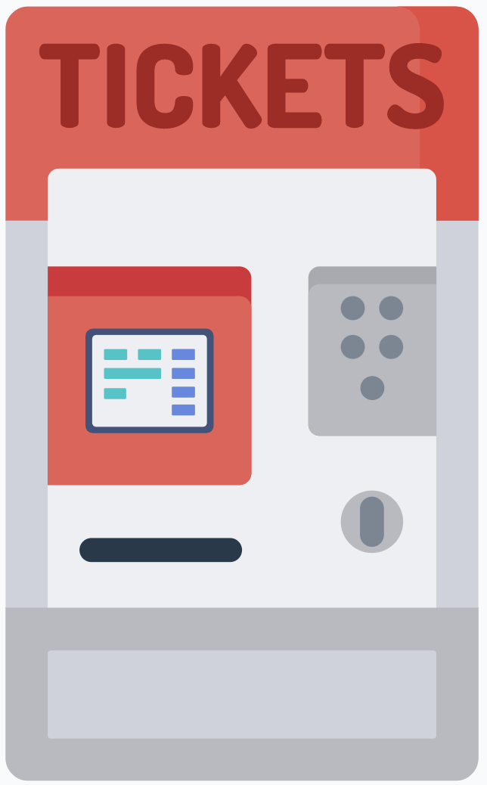

Click Customer
Mobile App
Internet
Firewall
Application Server
Firewall
DBMS and DB
Internal LAN
Manager
PC
Brick Customer
Digital Counterpart
Ticket Hand-Out Machine
Presentation Layer
Logic Application Layer
Data Access Layer

