Slide 1





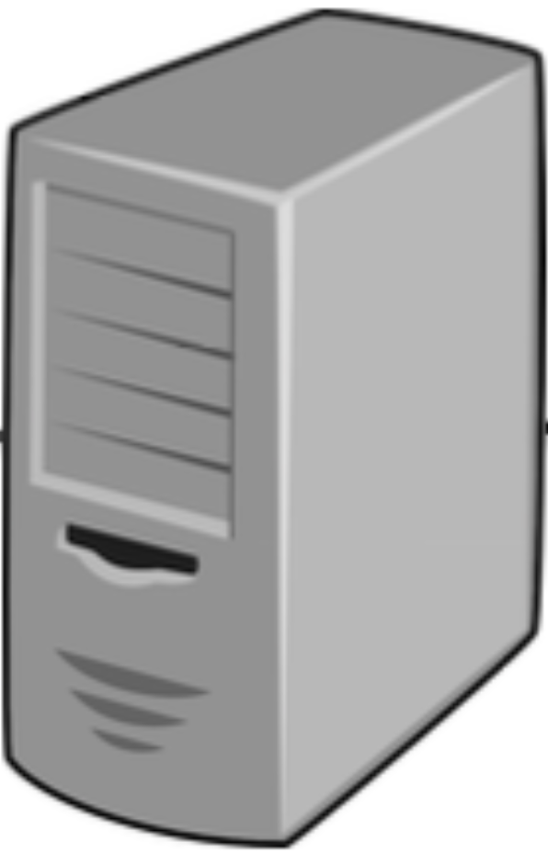
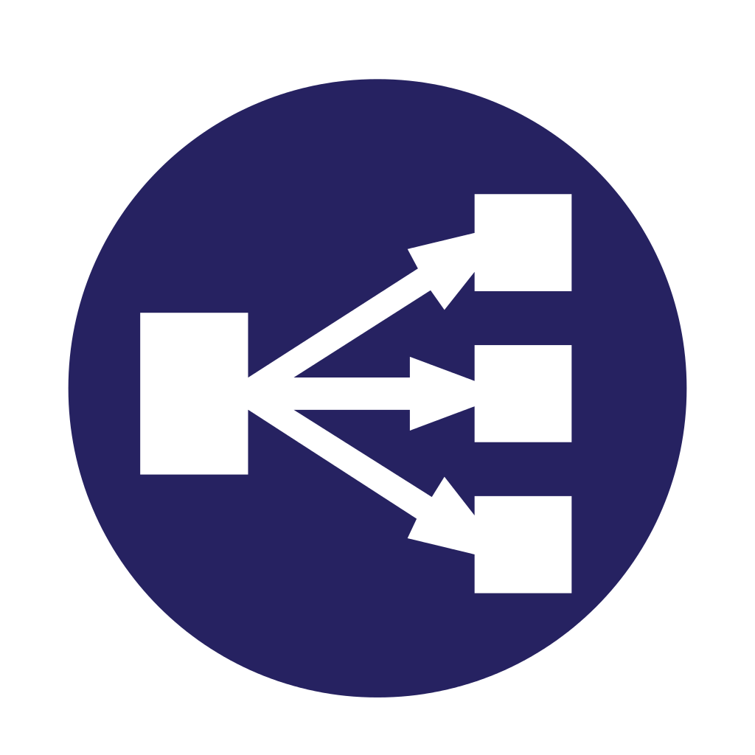



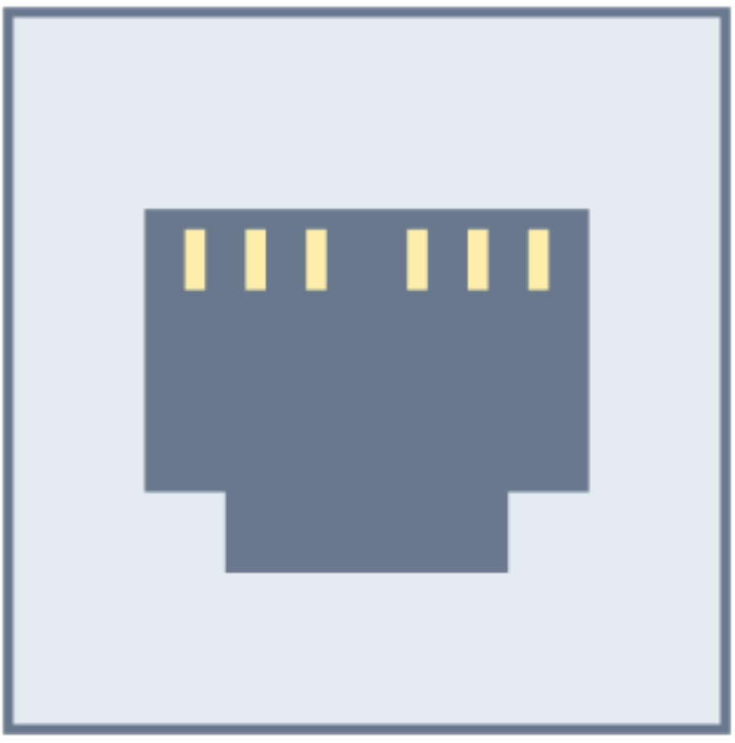
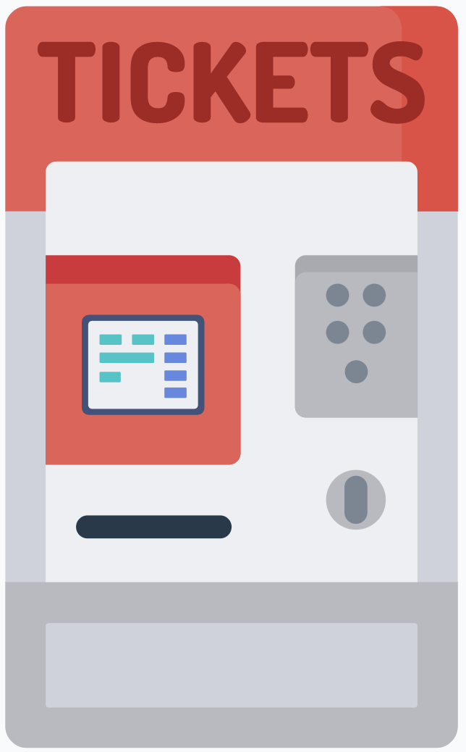
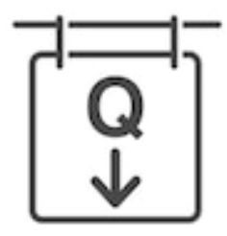

De-Militarized Zone - DMZ
Click Customer
Mobile App
Internet
Firewall
Internal LAN
Load Balancer
Application Server
Firewall
DBMS and DB
Manager
PC
Brick Customer
Digital Counterpart
QRCode Scanned Machine
Ticket Hand-Out Machine
Presentation Layer
Logic Application Layer
Data Access Layer

