Slide 1






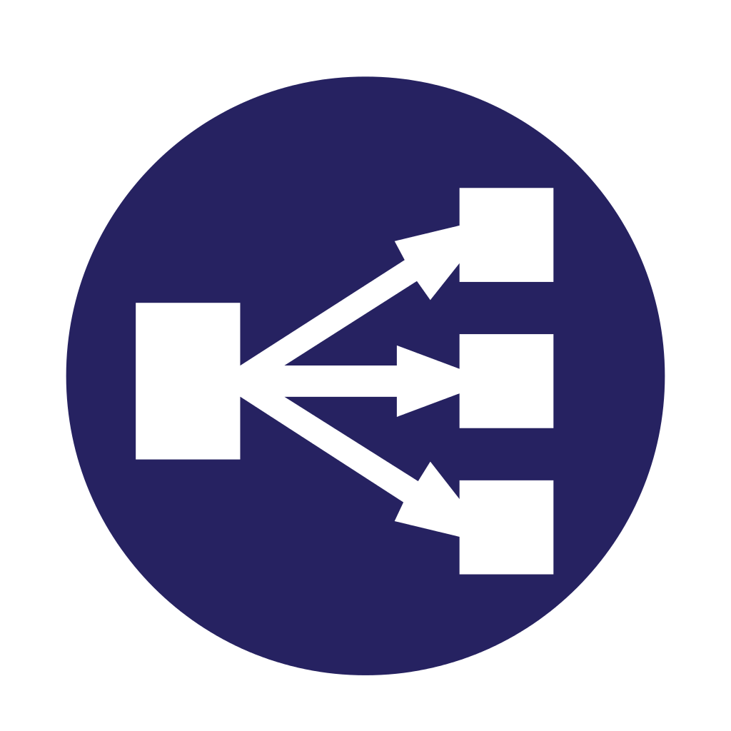




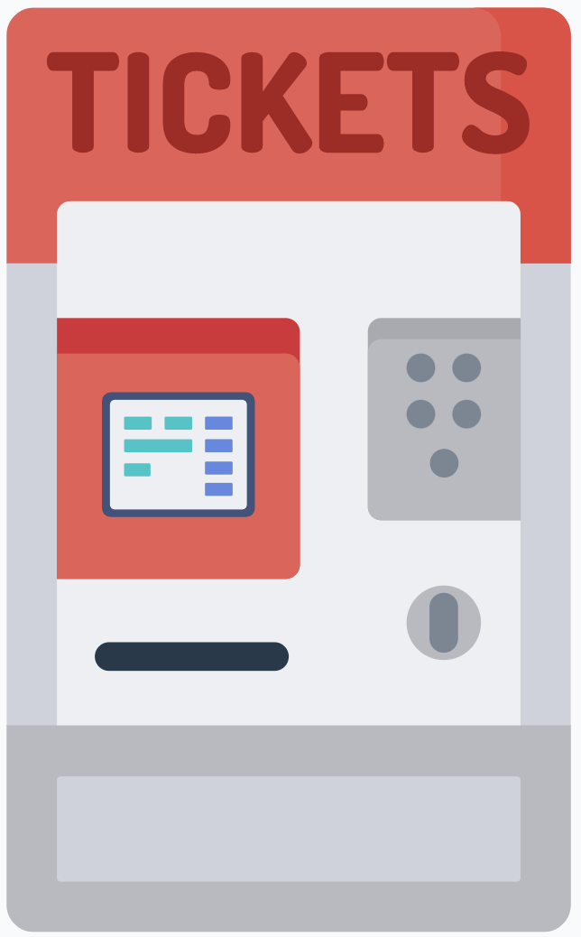

De-Militarized Zone - DMZ
Click Customer
Mobile App
Internet
Firewall
Internal LAN
Load Balancer
Application Server
Firewall
DBMS and DB
Manager
PC
Brick Customer
Digital Counterpart
Ticket Hand-Out Machine
Presentation Layer
Logic Application Layer
Data Access Layer

