Slide 1
MIDTERM PRESENTATION
Seeing the Gap
Self-perception
vs.
simulated choice
An Interactive Shopping-Platform Simulation for High School Students
Zhiyan Zhang
Research Advisor: Lawted Wu
01

Slide 2
RESEARCH QUESTION & HYPOTHESIS
Research Question & Hypothesis
Research Question: How does an interactive shopping-platform simulation affect high school students' recognition of gaps between their consumer self-perception and simulated shopping choices?
Hypothesis: After using the simulation, high school students will increase their recognition of gaps between their consumer self-perception and simulated shopping choices.
02

Slide 3
BACKGROUND
Why This Matters
High school students meet shopping pages, short videos, membership offers, game items, online reviews, and product recommendations every day.
Digital shopping pages can include countdowns, discount reminders, default add-ons, high ratings, and pop-ups.
The project studies self-understanding: students may think they are careful, while a simulated page may reveal a gap between self-perception and choice.
03

Slide 4
LITERATURE REVIEW
Literature Review
Advertising literacy
Self-report bias
Young people may understand persuasion, but this knowledge may not be used in the moment.
People's self-descriptions may not fully match their behavior in a task.
Decision-making styles
Dark patterns
Consumer judgment can be measured through multiple dimensions, not one fixed personality label.
Shopping websites can use urgency, social proof, default options, and hidden costs.
Key sources: Rozendaal et al.; De Jans et al.; Donaldson & Grant-Vallone; Sproles & Kendall; Mathur et al.
04

Slide 5
RESEARCH DESIGN / METHOD
Research Design / Method
1
2
3
4
Background questions
Self-perception test
Shopping simulation
Data comparison
Budget range, recent product categories, shopping entry points, and category price ranges.
Short five-point habit statements about budget, information checking, page details, and time pressure.
Product feed, pop-up, detail page, checkout page, reviews, default add-on, and budget reminder.
Compare self-perception answers with simulated shopping choices and mismatch patterns.
05

Slide 6
RESEARCH PLAN & CHALLENGES
Plan & Challenges
Before June 20: revise research logic, update the website, and prepare the midterm presentation.
Late June: rebuild the demo around step-by-step questions and controlled shopping pages.
Early July: test the website with a small group of high school students.
Main challenges: self-perception questions may reveal the purpose; product preference and money perception may affect choices; the page must feel realistic without copying a real brand.
Questions for advisor: whether 60 seconds per page is reasonable, and whether self-perception questions should borrow from existing scales or use daily habit wording.
06

Slide 7
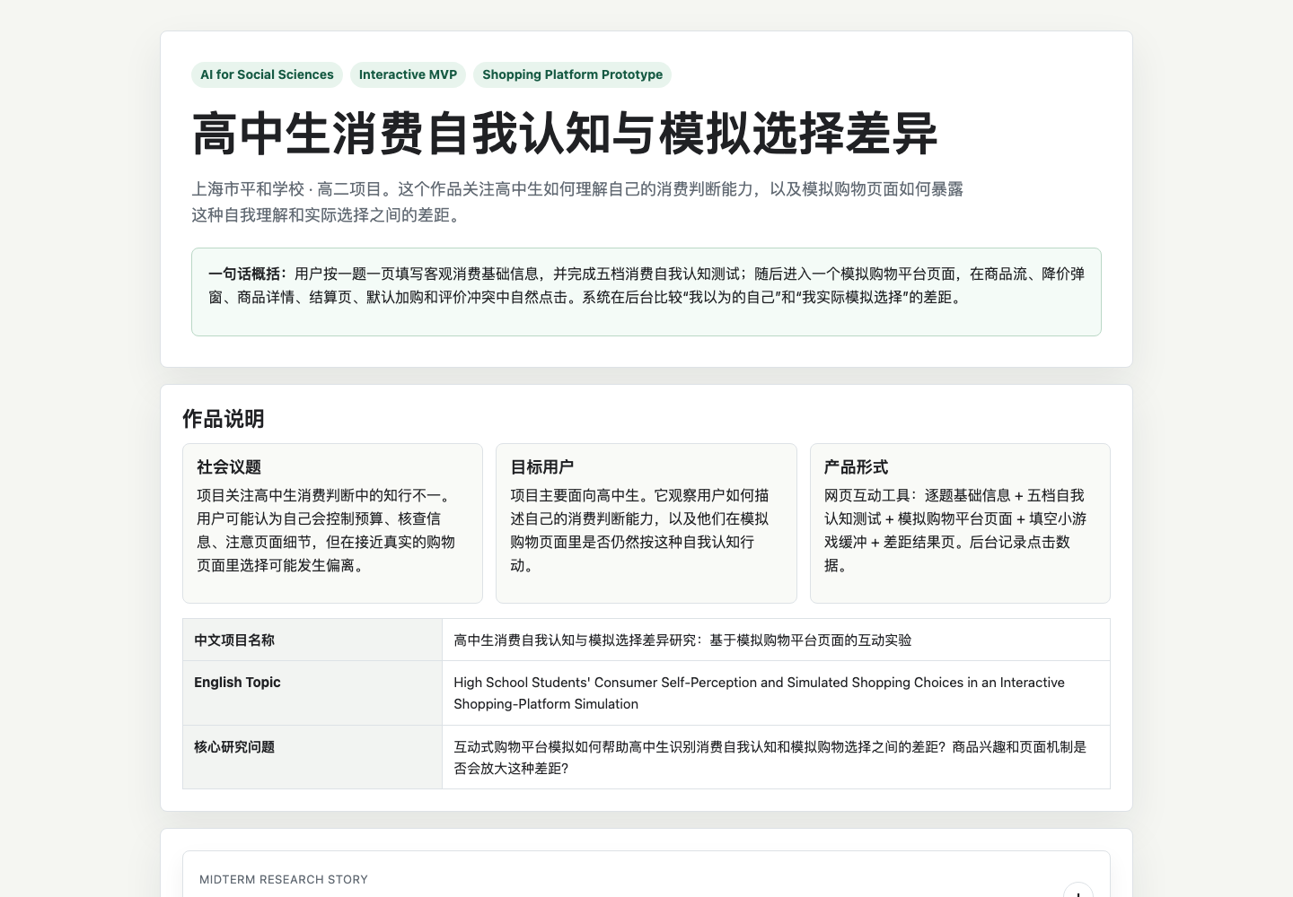
EXPECTED RESULTS — USER STUDY NOT YET RUN
Expected Results — user study not yet run
Some students may show consistency: they say they check information and then check reviews or cancel default add-ons in the simulation.
Some students may show mismatch: they say they control budget, but continue when a product matches their interest and the page shows a time-limited offer.
Product interest may be important. A recently browsed category may make students move closer to purchase.
No user study has been run yet. I will not report any numbers, charts, or conclusions at this stage.
07

Slide 8
REFERENCES
References
Braun, V., & Clarke, V. (2006). Using thematic analysis in psychology. Qualitative Research in Psychology.
Rozendaal, E., et al. (2011). Reconsidering advertising literacy as a defense against advertising effects. Media Psychology.
De Jans, S., Hudders, L., & Cauberghe, V. (2018). Adolescents' self-reported level of dispositional advertising literacy. Young Consumers.
Sproles, G. B., & Kendall, E. L. (1986). A methodology for profiling consumers' decision-making styles. Journal of Consumer Affairs.
Donaldson, S. I., & Grant-Vallone, E. J. (2002). Understanding self-report bias in organizational behavior research. Journal of Business and Psychology.
Steiner, P. M., Atzmuller, C., & Su, D. (2017). Designing valid and reliable vignette experiments for survey research.
Mathur, A., et al. (2019). Dark patterns at scale. Proceedings of the ACM on Human-Computer Interaction.
08

Slide 9
ACKNOWLEDGEMENTS
Acknowledgements
I would like to thank Research Advisor Lawted Wu for his criticism and guidance.
His feedback helped me narrow the topic, improve the research design, and make the project more realistic.
09

