Slide 1
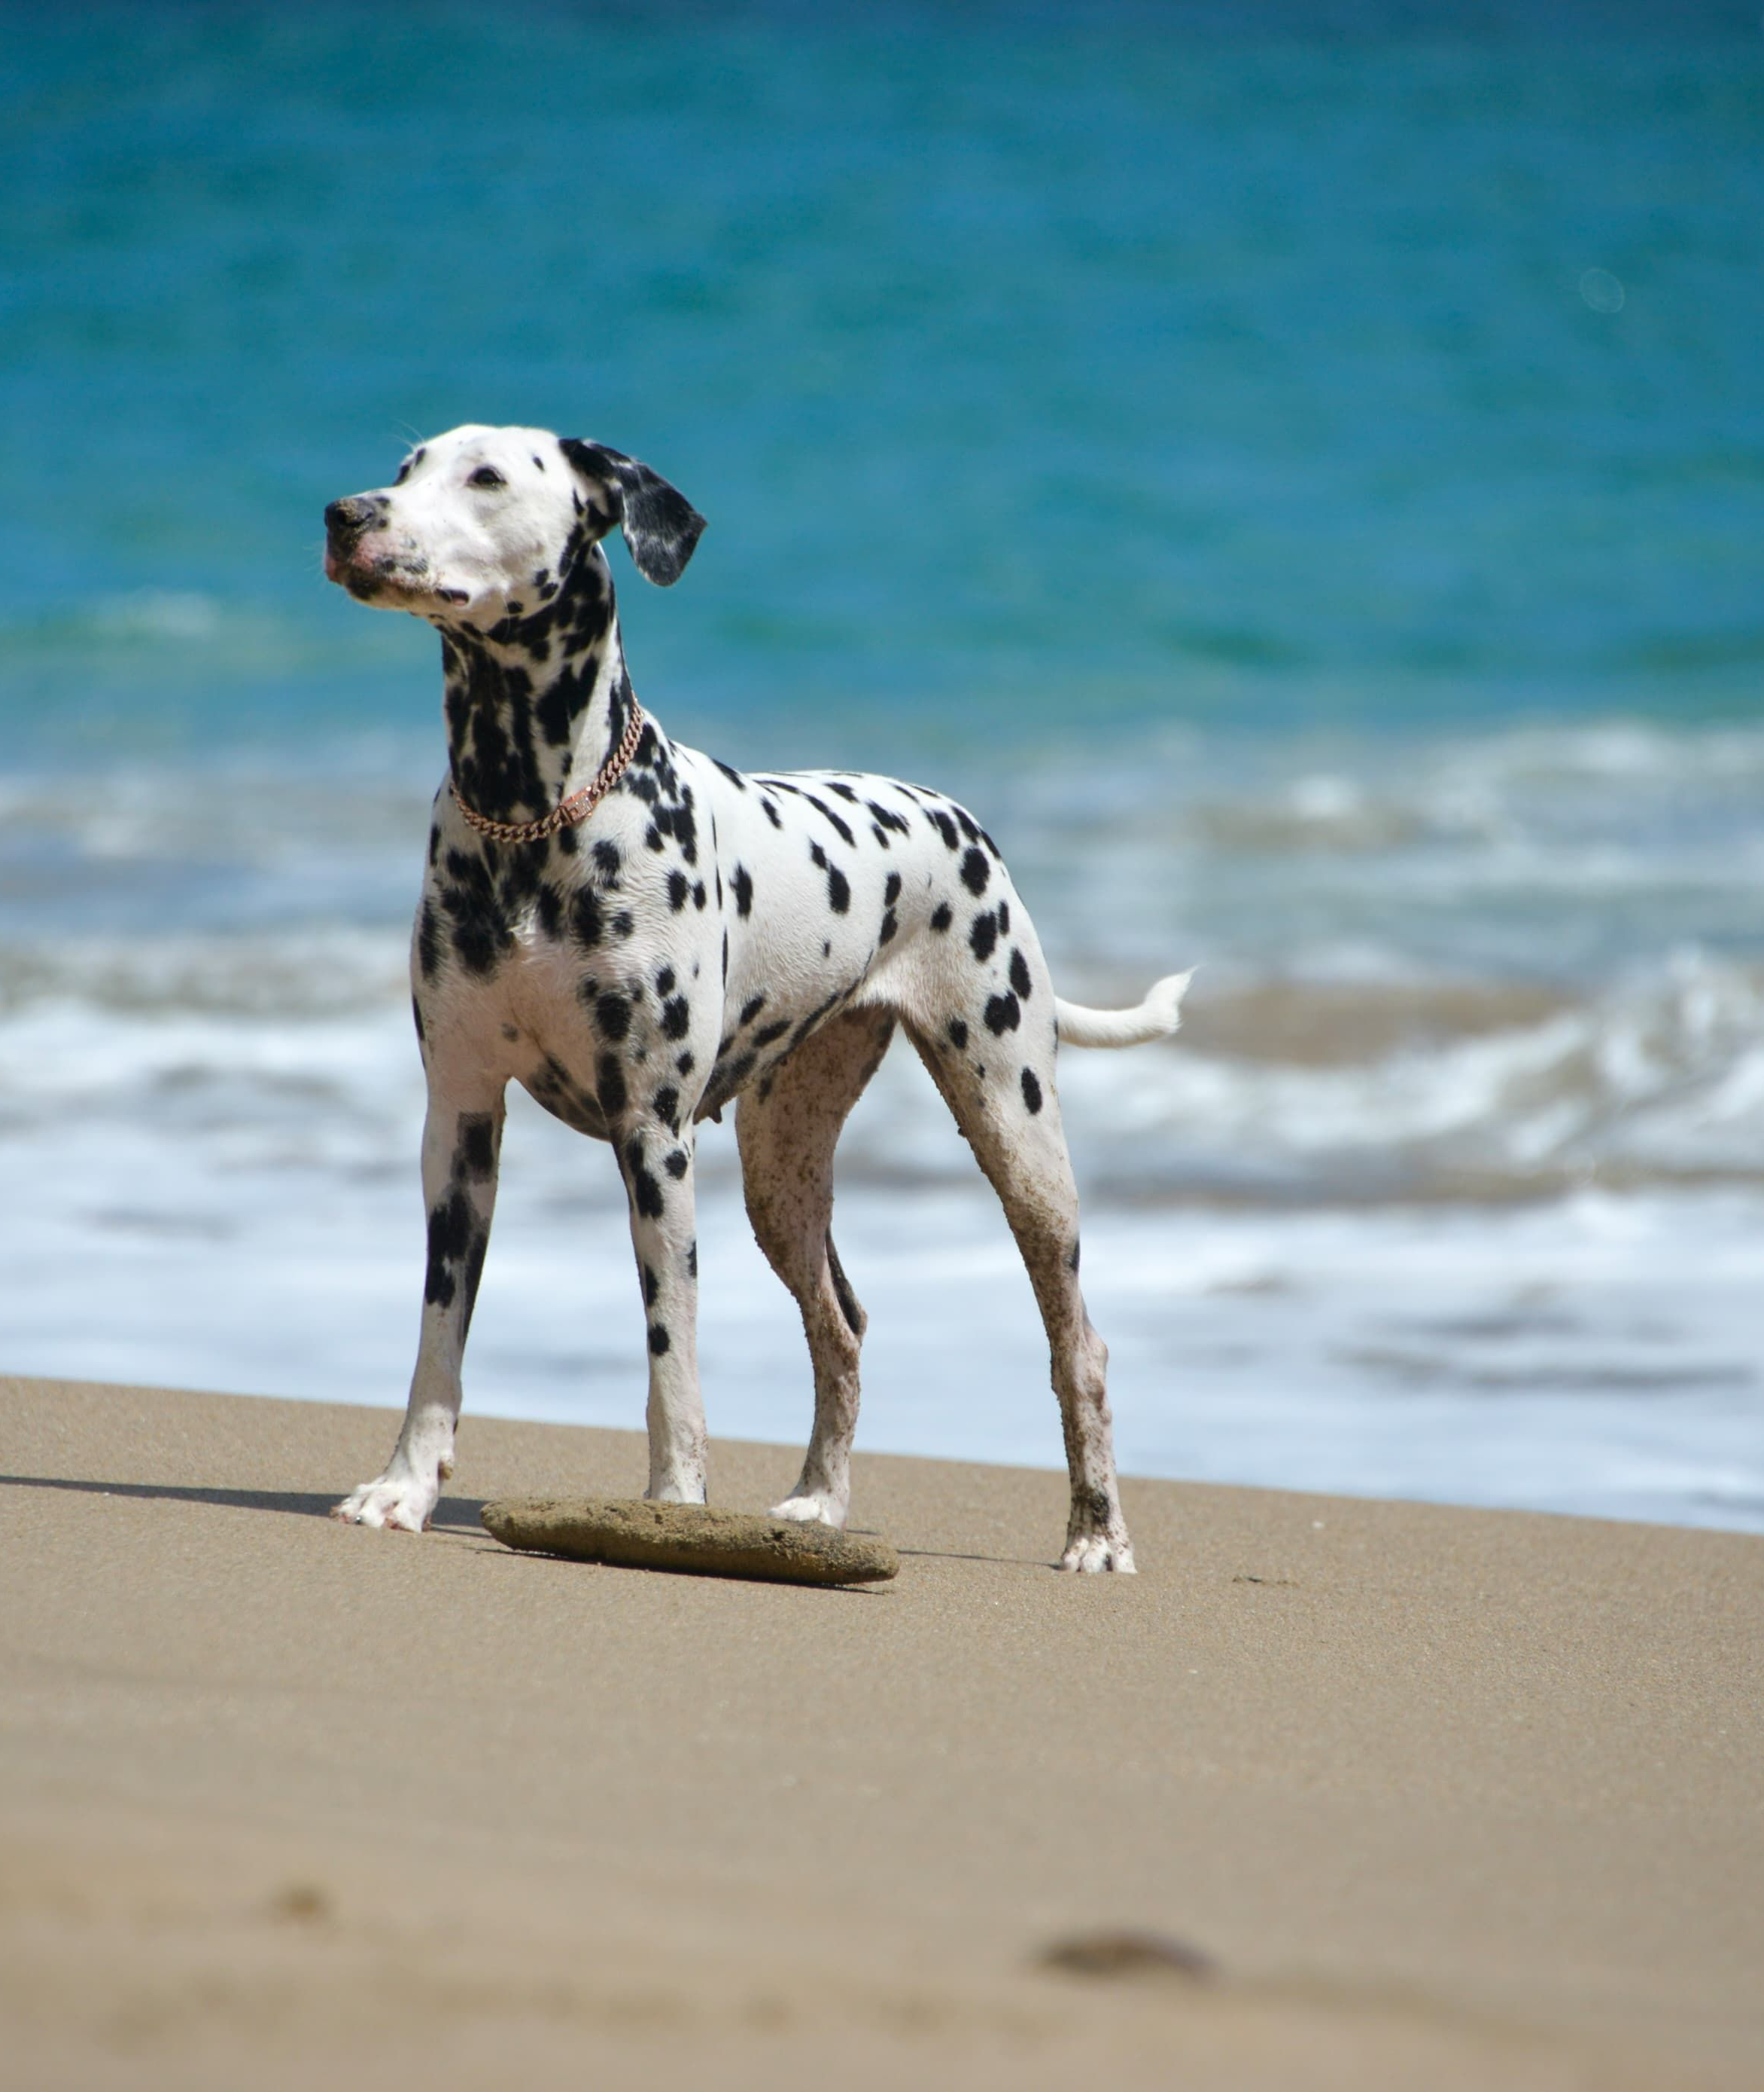
PRS PRACTICE MODULE
Skeleton-Based
Dog Behaviour
and Human-Dog
Interaction
Recognition
Recognising behaviour and interaction
from indoor video.
Group 28
Final Presentation
Notes:
Suggested duration: 10 seconds
ENGLISH
Hello, we are Group 28. Our project recognises dog behaviour and human-dog interaction from video. We will explain the system and the models, then present the evaluation before our frontend demonstration.
中文对照
大家好，我们是第28组。我们的项目从视频识别狗行为与人狗互动。接下来介绍系统、模型与评估，然后演示前端。

Slide 2
PROJECT OVERVIEW
FOR PET OWNERS
Understanding Dog Activity
Timestamped
activity results
Our system analyses video to recognise
dog behaviour and human–dog interaction.
When
It helps owners review long recordings
without watching every minute.
Start and end times
What
Dog behaviour
Human–dog interaction
Behaviour or interaction label
Walking, standing, sitting,
lying and eating / drinking.
No interaction, hand feeding,
petting and playing together.
Replay
Play the corresponding
video interval
Indoor video. One main person and one main dog.
No audio input.
Notes:
Suggested duration: 25 seconds
ENGLISH
Our project helps pet owners review long videos without watching every minute. It recognises five dog behaviours and four human-dog interaction classes. The output is a timeline showing what happened and when, with the corresponding video interval available for playback. We focus on indoor footage with one main person and one main dog, and do not use audio.
中文对照
这个项目帮助主人快速回看长视频，而不必从头到尾观看。系统识别五类狗行为和四类人狗互动，将结果整理为时间线，说明何时发生了什么，并可播放对应视频时段。当前聚焦室内场景、一个主要人物和一只主要狗，不使用音频。

Slide 3
SYSTEM WORKFLOW
One workflow from upload to review
Video input
to behaviour
timeline
Video upload
RTMDet + RTMPose
32-frame sequences
15 fps sampling
CPU inference.
Stable subject boxes
17-joint skeletons.
Joint motion
Global displacement
Detection and pose
Window classification
Results and playback
Window routing
Dog only
Person + dog
Five-class dog model
Four-class interaction model
Merged timeline and video playback
Start time End time Label Confidence
Notes:
Suggested duration: 30 seconds
ENGLISH
A video is uploaded through the mobile web application and analysed by the Python backend. We sample the video at 15 frames per second. RTMDet detects the subjects, and a bidirectional continuity rule selects stable person and dog boxes. Two RTMPose branches then extract the skeletons. The recognition models use 32-frame windows and retain both joint motion and global displacement. Dog-only windows go to the five-class behaviour model. When a person and dog are both present, the system returns one of four interaction labels. Neighbouring predictions are merged into a timeline with the relevant video intervals for playback.
中文对照
视频通过移动网页上传，由Python后端分析。视频按15 fps采样，RTMDet检测主体，双向连续性规则选择稳定的人和狗检测框，随后由两路RTMPose提取骨架。识别模型使用32帧窗口，同时保留关节运动与整体位移。只有狗的窗口进入五类行为模型；人狗同时出现时输出四类互动标签。相邻预测合并成时间线，可播放对应视频时段。
Source: Final_Report.md, Sections 2.4, 3.4, 4.2, 5.1, 6.3.

Slide 4
DATA AND EVALUATION
Datasets and Grouped Evaluation
Recognition task | Project clips | Development | Small test
Dog behaviour | 170 | 137 | 33
Human-dog interaction | 121 | 97 | 24
Group by dog, person and source video
Shared identities and source videos stay together in every split and CV fold.
Training
Training
Training
Training
Validation
Repeat five times. Combine validation predictions into OOF results.
Pose data: APT-36K 1,691 train / 374 val dog instances. Indoor evaluation: 36 frames / 28 dogs.
Notes:
Suggested duration: 30 seconds
ENGLISH
We have 170 dog-behaviour clips and 121 human-dog interaction clips. For behaviour recognition, clips are grouped by dog identity and source video. For interaction recognition, we also group by person identity. If clips share a dog, a person or an original video, they stay together in the same partition. This means the split separates identities and sources rather than randomly assigning individual clips. The same grouping rule is used in five-fold evaluation. Each development clip receives one out-of-fold prediction. The development sets contain 137 and 97 clips, with 33 and 24 clips in the supporting tests. The pose data and its separate indoor evaluation set are listed below.
中文对照
单狗行为有170段，人狗互动有121段。后续行为识别按狗身份和来源视频分组；互动识别还考虑人物身份。只要片段共享同一只狗、同一个人或同一原视频，就放在同一分区，不能随机分散单个片段。五折评估也沿用这些身份分组，每个开发样本得到一次折外预测。两个开发集分别有137与97段，辅助测试集分别有33与24段。底部另列姿态数据及独立室内评估集。
Source: Final_Report.md, Sections 2.6, 3.4, 4.2, 5.1 and 6.3.

Slide 5
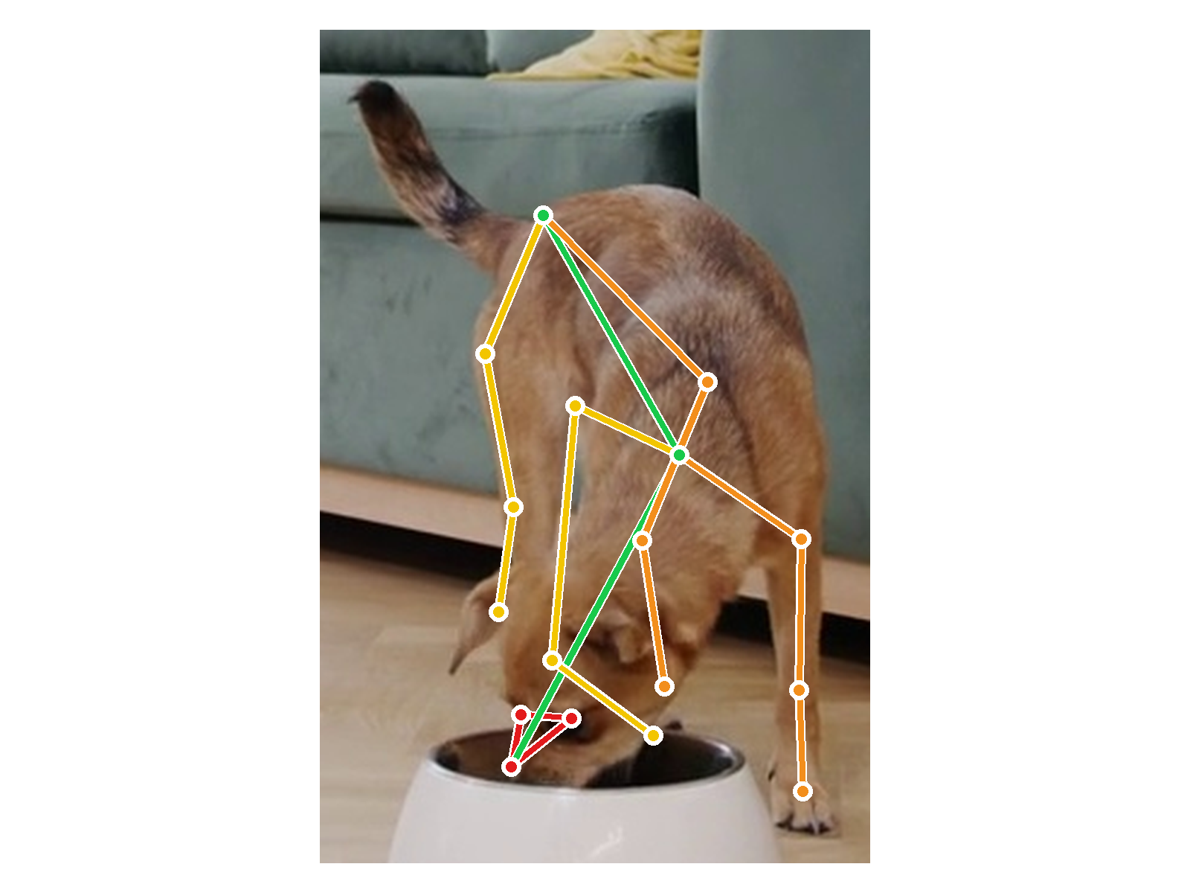
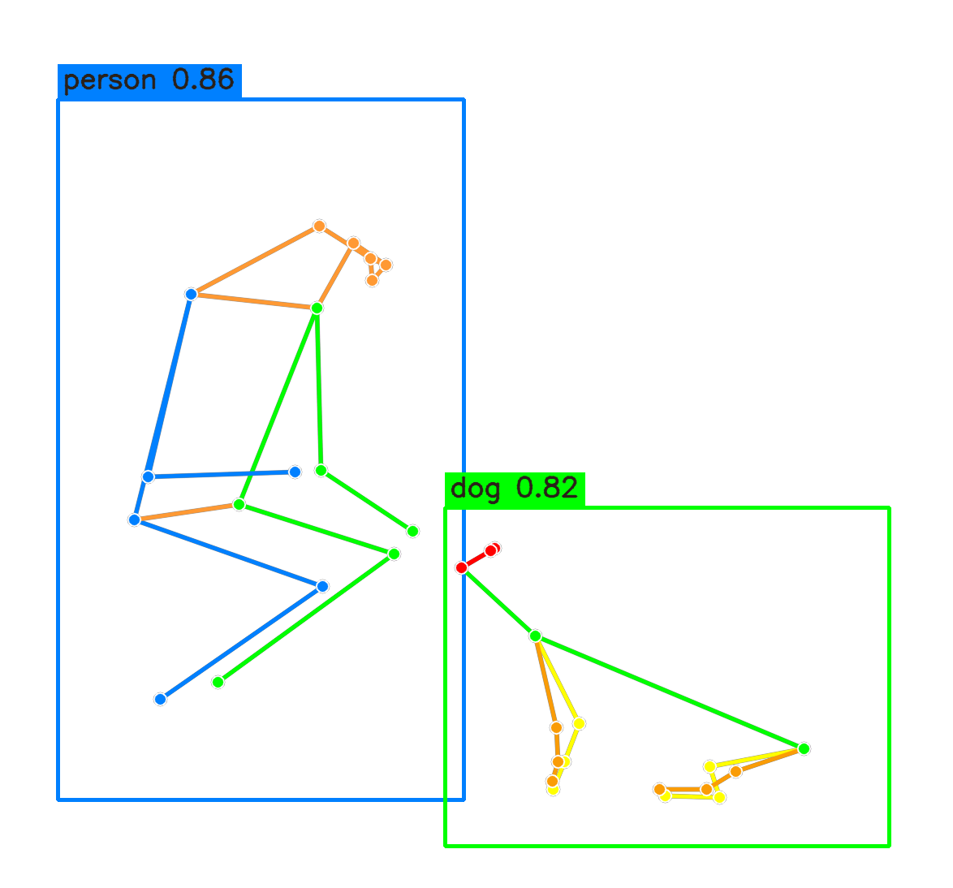
POSE EXTRACTION
Detection and Skeleton Extraction
RTMDet-m locates person and dog boxes. RTMPose-m estimates 17 joints inside each box.
Dog: AP-10K-17 pose
Person + dog: boxes and skeletons
Joint data: x, y, confidence
Recognition input: 32 frames
Original-image coordinates and detection boxes preserve global and cross-subject geometry.
Notes:
Suggested duration: 25 seconds
ENGLISH
First, RTMDet-m detects the person and dog boxes. A continuity rule keeps the selected subjects stable across frames. Then RTMPose-m estimates 17 joints inside each box: COCO joints for the person and AP-10K joints for the dog. We map all joints back into the original image and preserve their confidence scores and detection boxes. This keeps both global movement and distances between the person and dog available for recognition.
中文对照
先由RTMDet-m检测人和狗的框，连续性规则保持跨帧主体选择稳定。然后RTMPose-m在框内提取17个点，人体采用COCO布局，狗采用AP-10K布局。关键点映射回原图，同时保留置信度和检测框，供识别阶段使用整体运动以及人狗之间的距离。
Source: Final_Report.md, Sections 2.4, 3.2–3.4 and 6.3.

Slide 6
POSE QUALITY EVALUATION
Dog Pose Quality and Model Selection
36 indoor frames / 28 dogs / 547 manually labelled visible joints
Real pipeline: RTMDet boxes + RTMPose predictions. The same frames are used for P0 and P1.
Dog pose model | OKS AP | AP50 | AP75 | Mean OKS | PCK@0.1
P0: AP-10K | 67.8% | 97.0% | 76.2% | 0.827 | 85.7%
P1: + APT-36K | 69.3% | 100.0% | 75.4% | 0.831 | 86.1%
Detection quality
Model decision
Dogs located in 36 / 36 evaluation frames
Median box IoU: 0.83 (minimum: 0.63)
APT validation AP: 77.5% to 81.7%
Indoor P1–P0 mean OKS: +0.004
95% interval: −0.024 to +0.032
No clear indoor advantage from P1. Retain P0 for downstream recognition.
Visible labelled joints only. Lying/sleeping remains the weakest posture. P2 was not performed.
Notes:
Suggested duration: 45 seconds
ENGLISH
We evaluated dog-pose quality on 36 indoor frames from 28 dogs, with 547 visible joints labelled by hand. This is an evaluation of the real pipeline, using RTMDet boxes. The detector located the dog in all 36 frames, with a median box IoU of 0.83. P0 achieved 67.8 percent OKS AP and 85.7 percent PCK at 0.1. P1 was fine-tuned on APT-36K. Although it improved APT validation AP, its indoor advantage was small. The paired mean OKS change was only 0.004, and the uncertainty interval included zero. We therefore retained P0 for downstream recognition. Lying and sleeping remain the most difficult postures, and hidden joints were not scored.
中文对照
我们用来自28只狗的36帧室内图像评估狗骨架质量，人工标注了547个可见关键点。评估采用真实流程的RTMDet框。检测器在36帧中均定位到狗，框的中位IoU为0.83。P0的OKS AP为67.8%，PCK@0.1为85.7%。P1在APT-36K上微调后，APT验证AP提高，但室内优势较小。配对平均OKS变化只有0.004，区间包含零，因此下游识别保留P0。躺卧和睡眠仍是较难的姿态，遮挡关键点没有计分。
Source: Final_Report.md, Sections 2.4, 3.2–3.4 and 6.3.

Slide 7
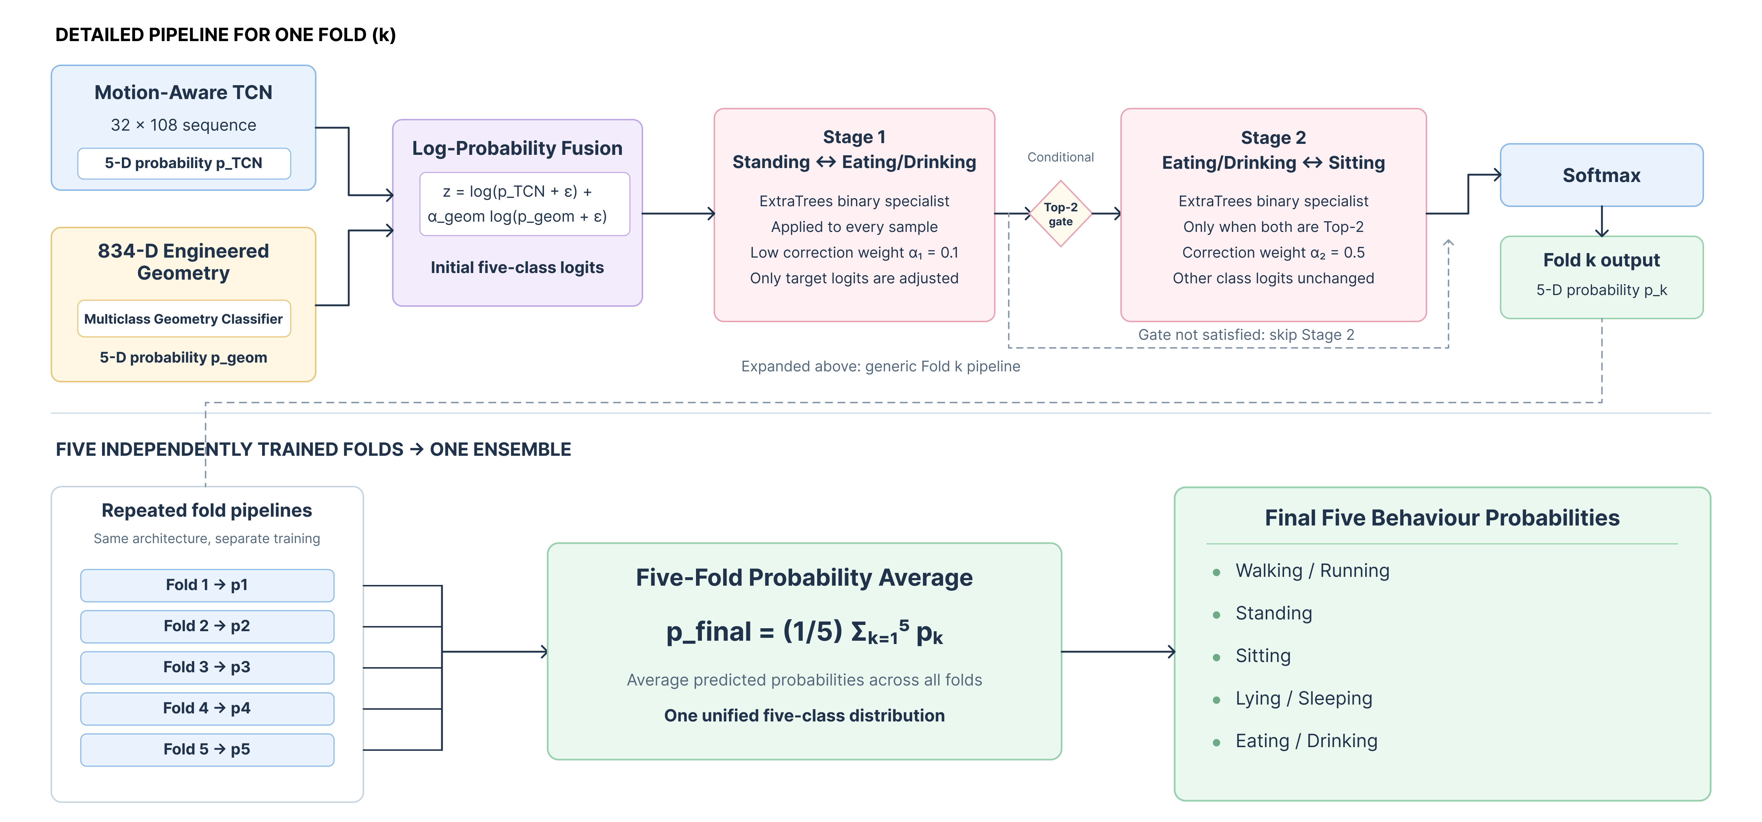
DOG BEHAVIOUR ENSEMBLE
Dog Behaviour Recognition Framework
Combining learned motion patterns with explicit geometry and motion cues.
Pairwise correction refines confusing classes. Five fold-trained models provide the final prediction.
Notes:
Suggested duration: 35 seconds
ENGLISH
For each fold, we combine the TCN and geometry probabilities in log space. Two specialists then address confusing class pairs. The first makes a low-weight adjustment between standing and eating or drinking. The second adjusts eating or drinking against sitting only when both are the top two candidates. Other class scores remain unchanged. Softmax gives the fold’s class probabilities. At inference, we average the probabilities from all five fold components to make one final prediction. In this overview, the main idea is to combine learned temporal motion patterns with explicit geometry and motion cues. Pairwise correction refines confusing classes, and five fold-trained models provide the final prediction.
中文对照
每一折先在对数空间融合TCN和几何分类器概率，再通过两个专项分类器修正容易混淆的类别。第一阶段以较低权重调整站立与进食饮水。第二阶段只在进食饮水和坐姿同时为前两位候选时校正，其他类别得分不变。Softmax得到该折概率，推理时再平均五折组件的概率，给出一个最终预测。 本页重点是结合学习到的时序运动模式与显式几何、运动特征，以成对类别校正处理易混淆类别，并平均五折训练模型的预测。
Source: Final_Report.md, Sections 2.4, 3.4, 4.2, 5.1, 6.3.

Slide 8
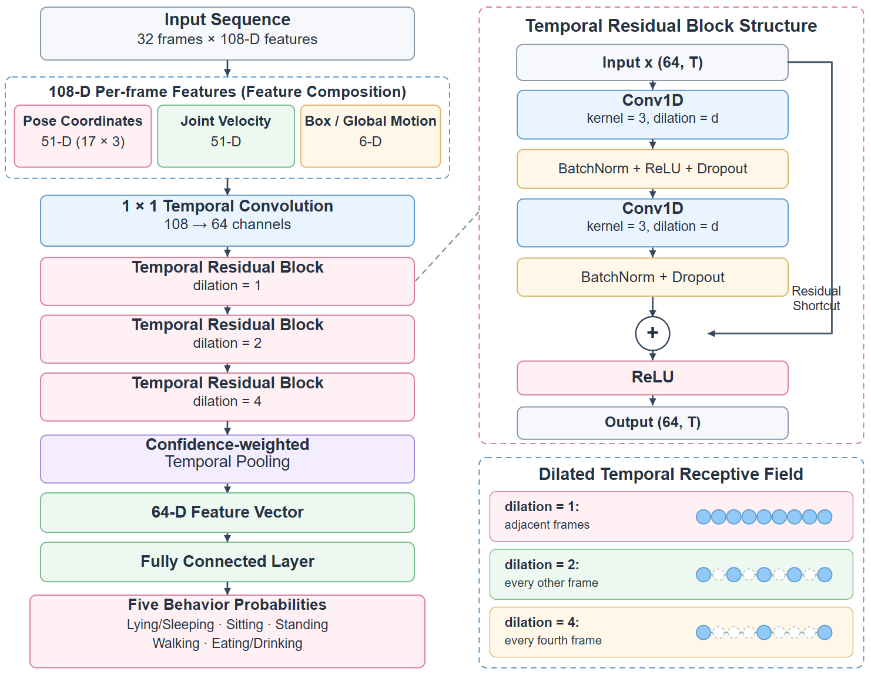
DOG BEHAVIOUR MODEL
Motion-Aware TCN for Dog Behaviour
Local motion and global movement
Joint changes capture limb movement.
Box motion preserves global displacement.
Both help separate standing from walking.
Patterns at different time scales
Dilated convolutions capture short and
longer action patterns.
Residual links help train the network.
Reliable sequence representation
Pooling gives reliable frames more weight.
The summary predicts five behaviour classes.
Notes:
Suggested duration: 45 seconds
ENGLISH
The TCN combines local motion with global movement. Joint changes describe how the legs move, while box motion preserves movement across the scene. Together, these help separate standing from walking. Dilated convolutions capture brief movements and longer action patterns. Residual connections support stable training. Finally, confidence-weighted pooling gives greater weight to reliable frames. The resulting sequence representation predicts five behaviour probabilities. The architecture on the left contains the input dimensions, so we focus here on what each design contributes.
中文对照
TCN结合局部动作和整体移动。关节点变化描述四肢如何运动，检测框运动保留狗在画面中的整体位移，两者共同帮助区分站立和行走。膨胀卷积同时捕捉短时运动和较长动作模式，残差连接帮助稳定训练。最后，置信度加权池化提高可靠帧的权重，将序列表示用于预测五类行为概率。左侧结构图已经列出输入维度，右侧重点说明设计作用。

Slide 9
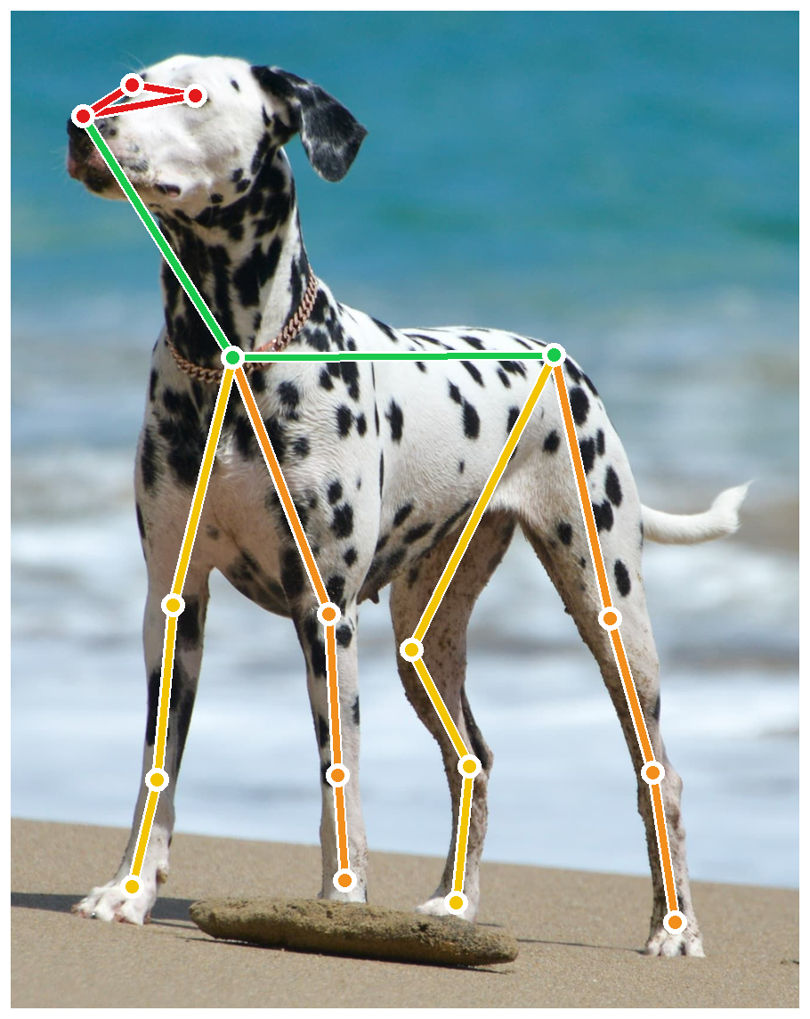
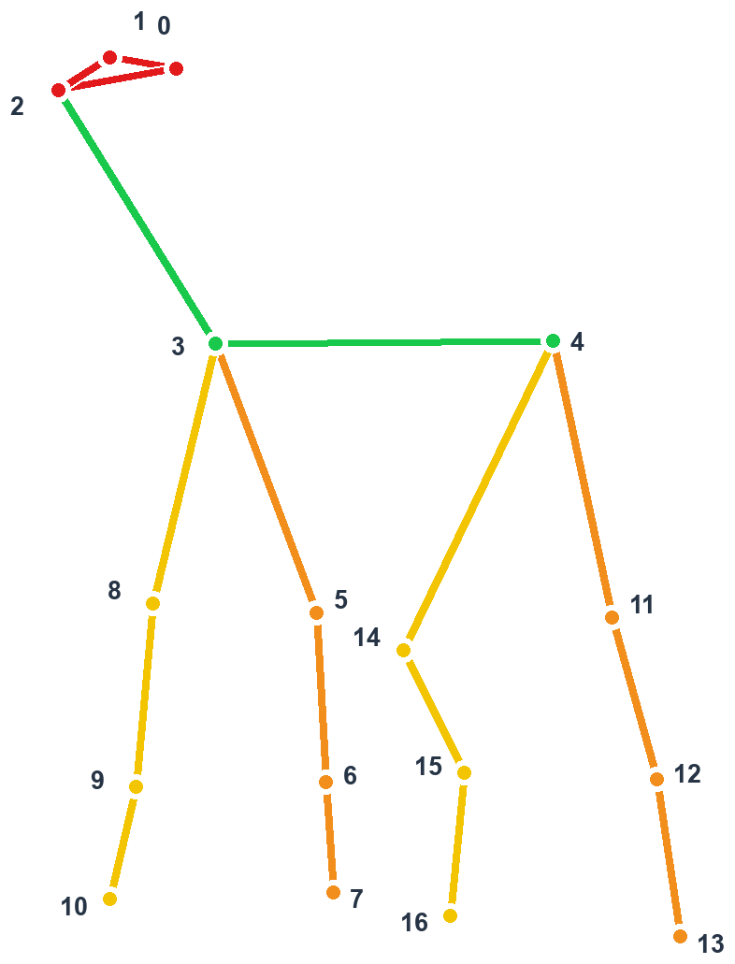
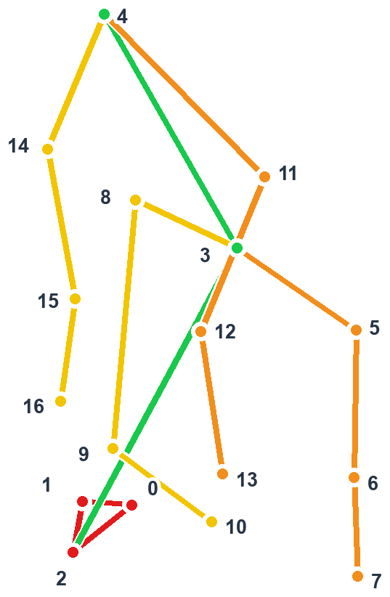
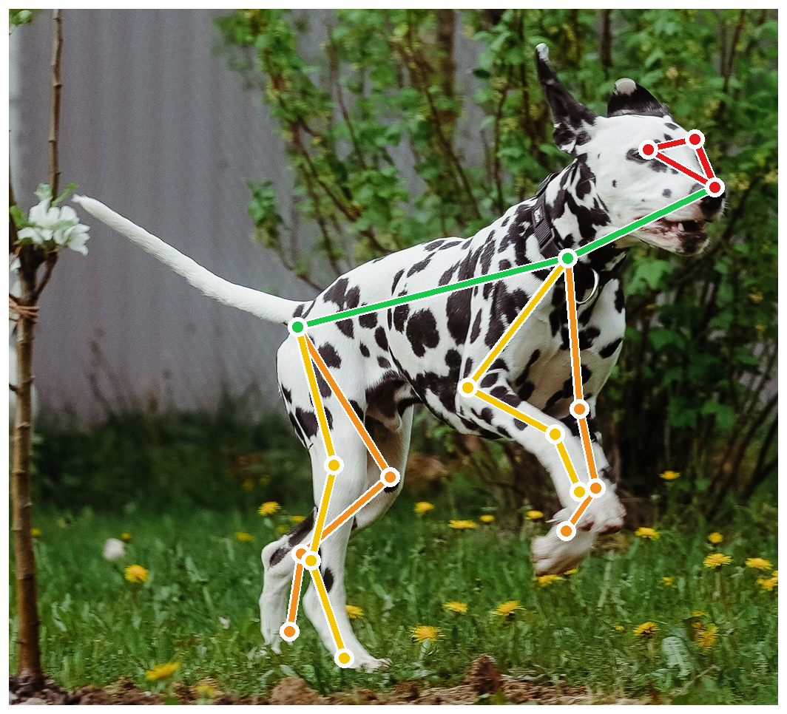
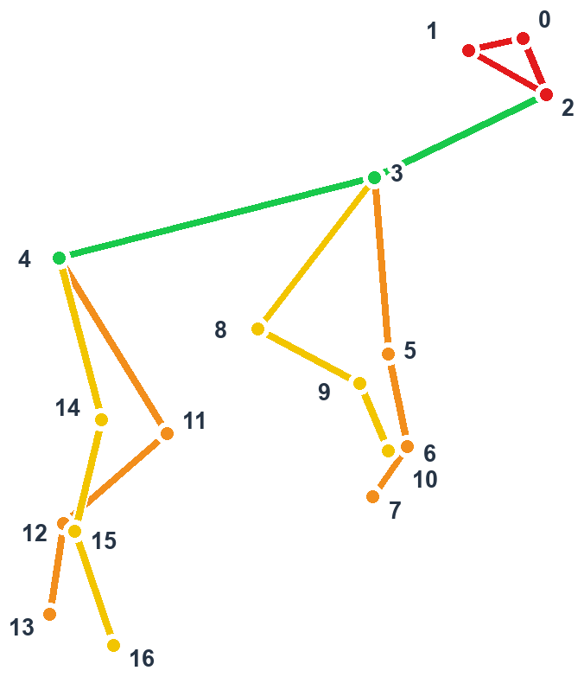
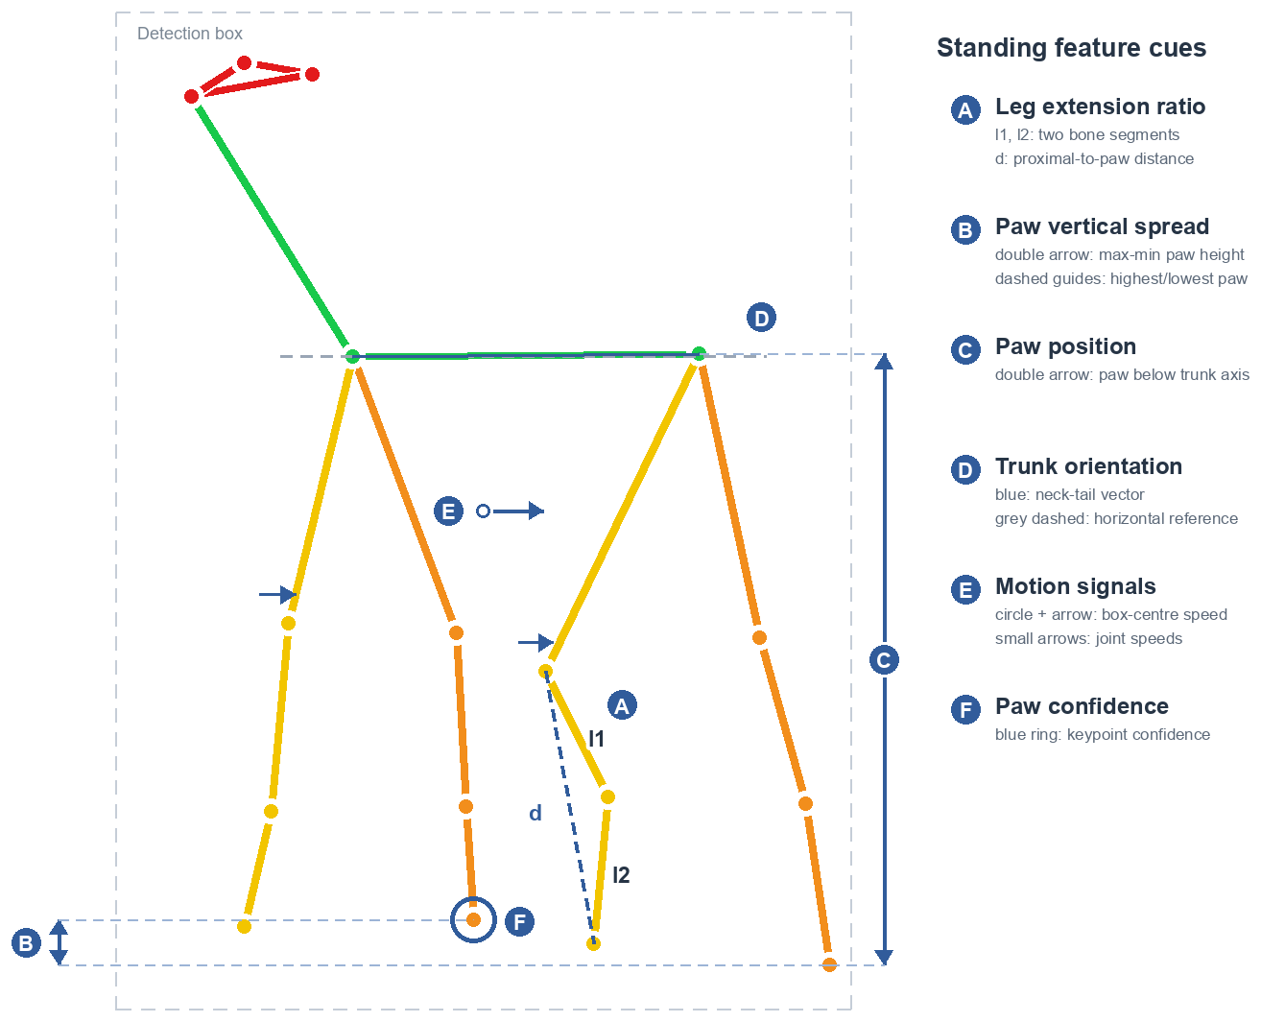
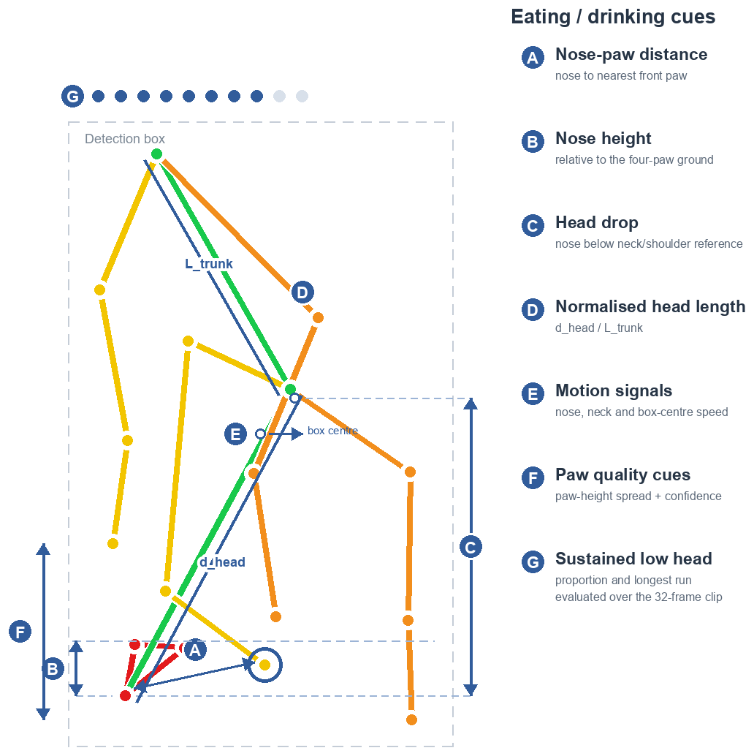
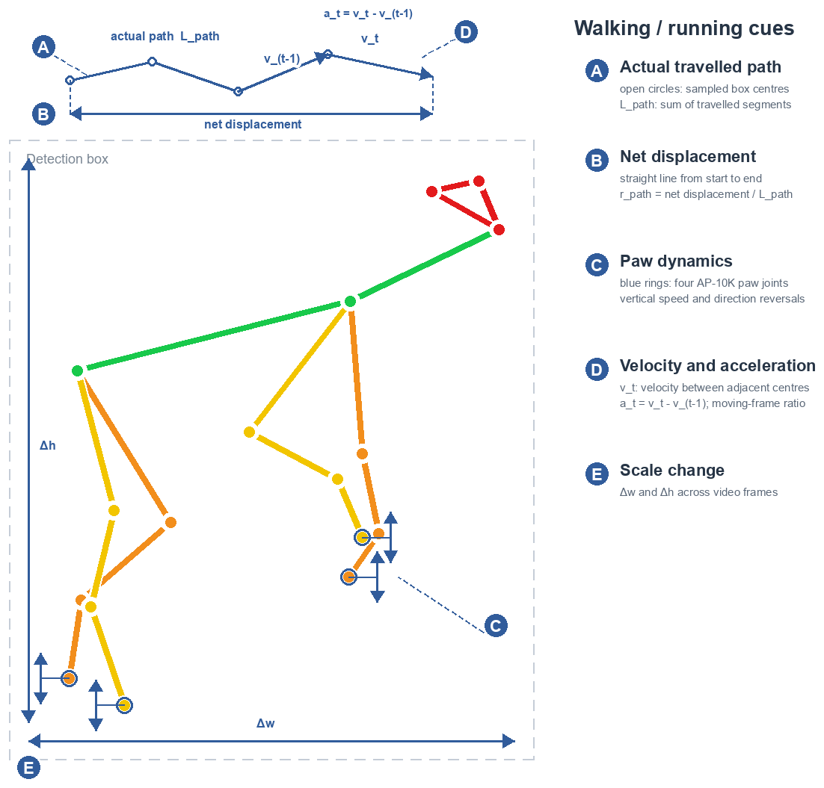
DOG BEHAVIOUR FEATURES
Engineered Skeleton Features
Standing
Eating / drinking
Walking / running
Image +
skeleton
Feature
cues
Geometry and motion signals are summarised using statistics and duration cues to form an 834-D vector.
This vector feeds the geometry classifier and complements the TCN branch.
Notes:
Suggested duration: 35 seconds
ENGLISH
The geometry branch adds explicit evidence that can be difficult to learn from our small dataset. For standing, we measure limb extension, paw support, trunk orientation and low movement. Eating or drinking uses nose height, the distance to the front paws and sustained head lowering. Walking or running uses the centre trajectory and paw dynamics. These cues come from joint geometry and changes over time. Statistical and duration summaries produce an 834-dimensional clip vector, which complements the learned temporal features. We feed the 834-dimensional vector to a clip-level geometry classifier and fuse its probabilities with the TCN.
中文对照
几何分支补充了在小数据上较难稳定学到的直接证据。站立使用肢体伸展、爪部支撑、躯干方向和低运动；进食饮水使用鼻尖高度、鼻尖到前爪的距离以及持续低头；行走跑动使用中心轨迹和爪部动态。这些线索来自关节点几何与时间变化，经过统计和持续时间汇总形成834维片段向量，与TCN学习到的时间特征互补。 834维向量输入片段级几何分类器，其类别概率再与TCN概率融合。

Slide 10
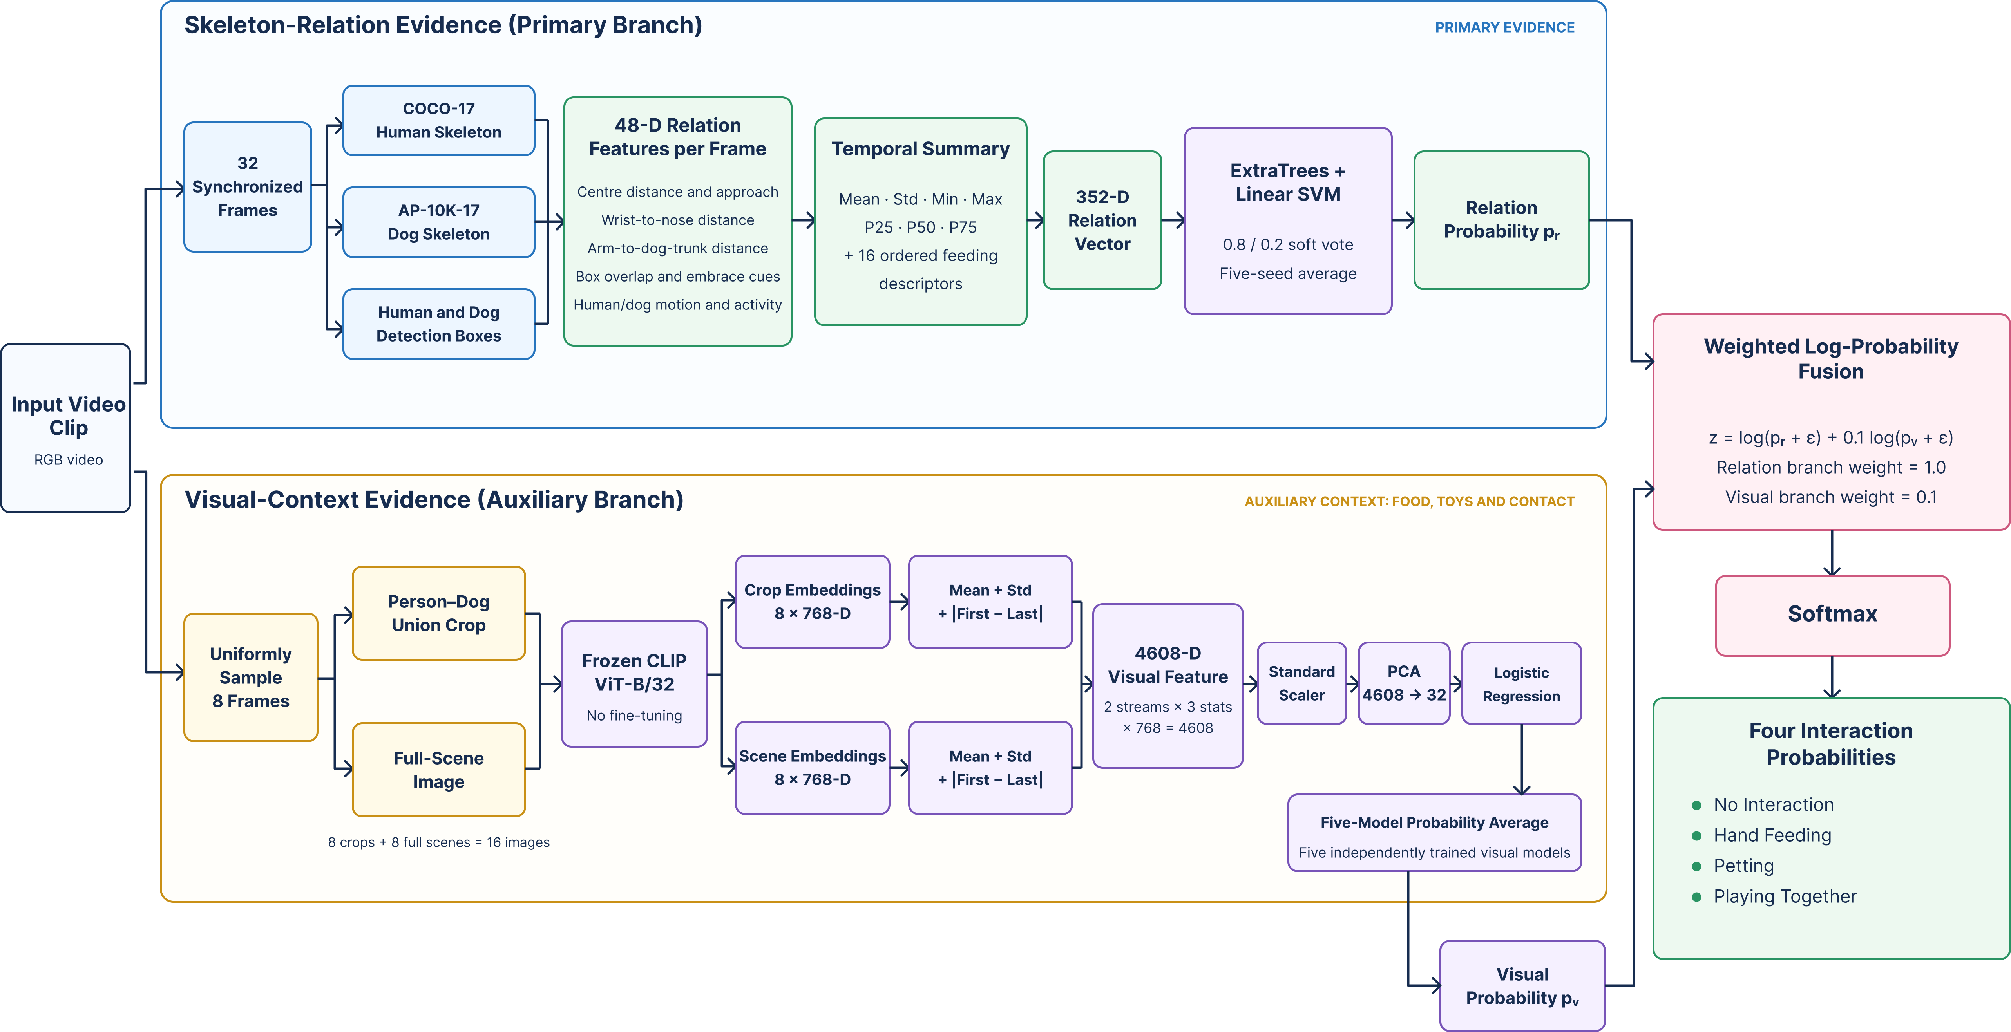
INTERACTION MODEL
Human-Dog Interaction Framework
Skeleton relations provide the main evidence. Visual context adds supporting cues.
Relations describe proximity and motion. Frozen CLIP features add appearance and scene context.
Notes:
Suggested duration: 40 seconds
ENGLISH
We summarise each relation sequence with seven statistics and add 16 ordered feeding descriptors, giving 352 features. ExtraTrees models nonlinear relations, while a linear SVM adds complementary decisions. We combine their probabilities with weights of 0.8 and 0.2, then average five random-seed models. The auxiliary branch uses frozen CLIP embeddings from eight sampled frames, including joint crops and full scenes. PCA and logistic regression turn them into visual probabilities. The final fusion gives relations weight one and visual context weight 0.1. This keeps skeleton relations as the main evidence. Skeleton relations provide the main evidence. Frozen visual features add appearance and scene context as supporting cues.
中文对照
每个关系序列经过七种统计汇总，再加入16个有序喂食描述量，共352维。ExtraTrees学习非线性关系，线性SVM提供互补判断，两者以0.8和0.2融合概率，再平均五个随机种子模型。辅助视觉分支从八个采样帧的联合裁剪和全景提取冻结CLIP特征，通过PCA和逻辑回归得到概率。最终关系权重为1，视觉权重为0.1，仍以骨架关系为主。 骨架关系提供主要证据，冻结视觉特征提供外观与场景上下文作为辅助。
Source: Final_Report.md, Sections 2.4, 3.4, 4.2, 5.1, 6.3.

Slide 11
OUR ADDED RELATION FEATURES
Human-Dog Relation Features
01
Overall geometry
Box-centre offset, distance and approach speed
02
Hand–nose proximity
Both wrists to the dog’s nose, normalised by dog size
03
Arm–trunk contact cues
Wrist, elbow and arm distance to the dog’s trunk
04
Pose and contact context
Orientation, confidence, overlap and embrace cues
05
Joint activity
Shared image coordinates
Keep the distance between subjects
after local pose normalisation.
Individual motion, relative motion and joint activity
Notes:
Suggested duration: 40 seconds
ENGLISH
Interaction needs more than two separately normalised skeletons. We keep their shared image coordinates and boxes, then add 48 relation features per frame in five groups. Overall geometry measures how far apart they are and whether they approach. Hand-to-nose features measure both wrists relative to the dog’s nose, which acts as a mouth proxy. Arm-to-trunk features measure proximity to body segments. Context adds orientation, confidence, overlap and embrace cues. Finally, activity features describe either subject moving strongly or both moving together. These are geometric cues, rather than proof of physical contact.
中文对照
互动识别不能只依赖分别归一化的两套骨架。我们保留共同原图坐标和检测框，每帧增加48维关系特征，分为五组。整体几何描述双方距离与靠近趋势；手鼻关系描述左右手腕相对鼻尖的位置，鼻尖作为嘴部代理；手臂躯干关系测量到身体骨架段的距离；上下文补充朝向、置信度、交叠与近似拥抱；运动关系描述单方大幅运动或双方共同活动。这些都是几何线索，并不等于证明发生真实接触。

Slide 12
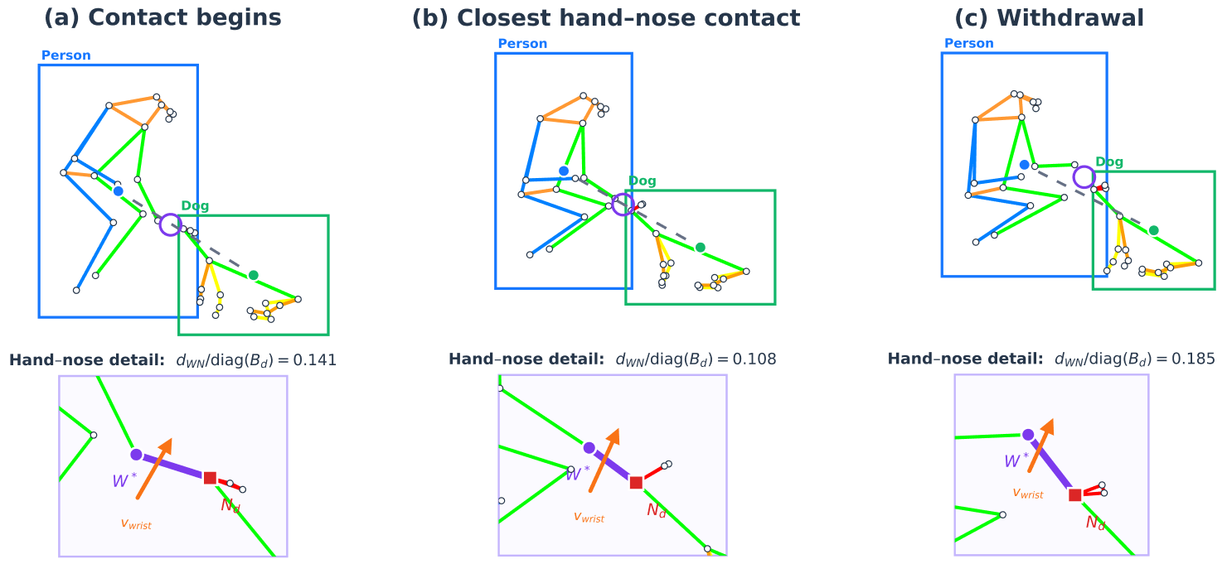
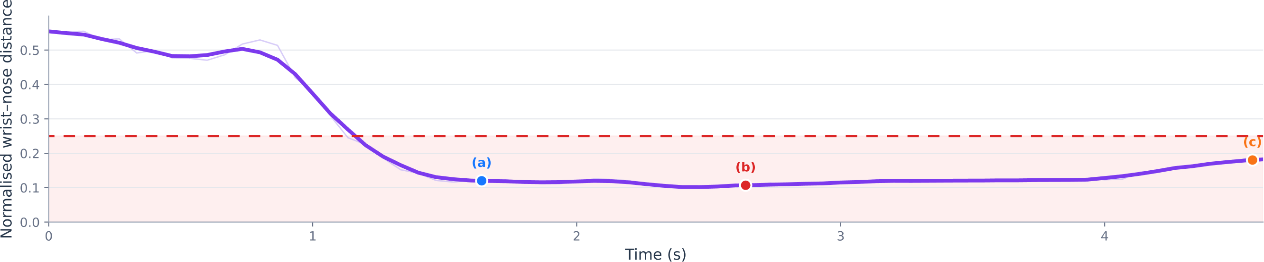
INTERACTION RELATION FEATURES
Interaction-Specific Relation Cues
Hand feeding over time
Petting
Sustained hand-to-body proximity
with small hand and arm movements.
Petting: embrace
Arm-to-trunk proximity and box overlap,
with little relative movement.
Wrist-nose distance / dog-box diagonal
Playing together
Strong centre or joint motion by
one or both subjects.
No interaction: both visible, without
feeding, petting or shared play.
Notes:
Suggested duration: 75 seconds
ENGLISH
This page compares the cues for different interaction classes. On the left, a real feeding sequence shows the hand approaching the dog’s nose, staying close, and withdrawing. We normalise wrist-to-nose distance by the dog-box diagonal. Distance alone cannot separate feeding from petting, so duration and the ordered approach-and-withdrawal pattern also matter. Petting uses sustained hand-to-body proximity with small hand and arm movements. An embrace cue combines arm-to-trunk proximity, box overlap and little relative movement. For playing together, we measure centre motion and joint motion from both subjects, retaining strong activity by either subject or by both. These cues inform the classifier rather than directly assigning labels. Embrace belongs to the petting class. No interaction means that both subjects are visible without a clear feeding, petting or shared-play event.
中文对照
这一页对比不同互动类别的关系线索。左侧真实喂食序列展示手靠近狗鼻尖、持续接近并撤回的过程，手腕到鼻尖的距离除以狗框对角线进行归一化。仅看距离不能区分喂食与抚摸，因此还加入持续时间和靠近、撤回的顺序模式。抚摸使用持续的手部靠近身体与手臂小幅运动；近似拥抱结合手臂到躯干的接近、检测框交叠与相对静止；共同玩耍结合双方中心移动和关节运动，允许任一方或双方较活跃。这些线索提供给分类器，不直接通过固定规则指定标签。 拥抱属于抚摸类。无互动指双方都在画面中，但没有明确的喂食、抚摸或共同玩耍事件。

Slide 13
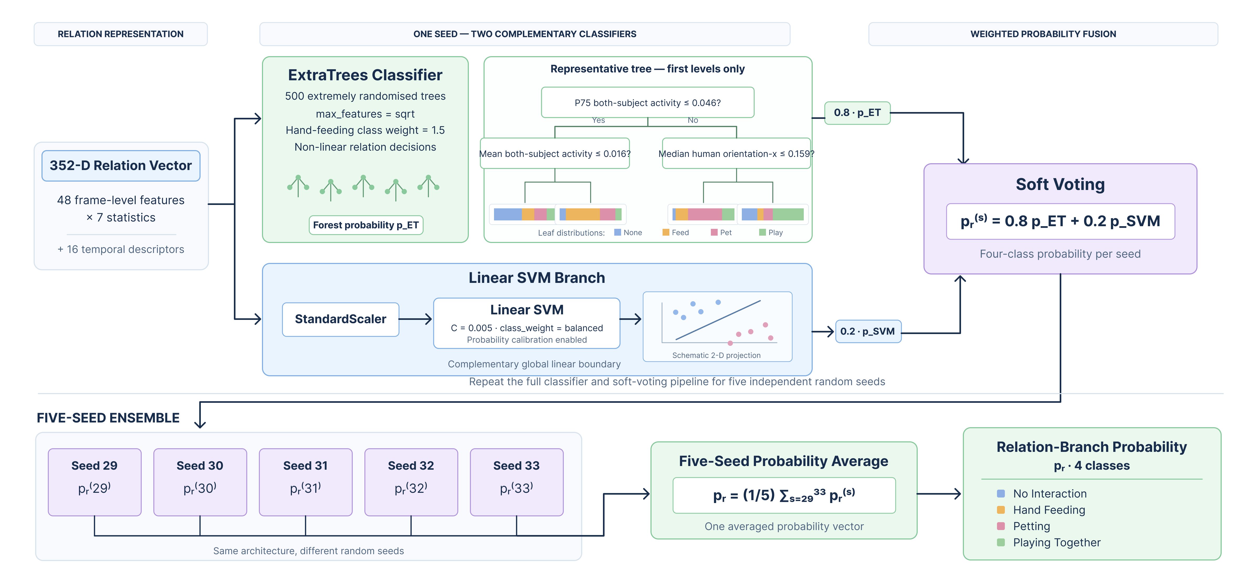
INTERACTION RELATION CLASSIFIER
Relation Classification and Fusion
Five random-seed models form the ensemble. Grouped five-fold CV evaluates the complete model.
Notes:
Suggested duration: 40 seconds
ENGLISH
After summarising the relation features, we classify the 352-dimensional vector. ExtraTrees captures nonlinear feature combinations, while a scaled linear SVM supplies a complementary boundary. Soft voting combines their probabilities with weights of 0.8 and 0.2. We repeat this with five random seeds and average the outputs to obtain the relation probability. These are five random-seed models, rather than the five validation folds. The overall interaction system then combines this relation probability with the auxiliary visual probability. The five random seeds describe inference ensembling; grouped five-fold cross-validation is the evaluation procedure.
中文对照
关系特征汇总后形成352维向量，再进行分类。ExtraTrees捕捉非线性特征组合，经过标准化的线性SVM提供互补的分类边界。软投票以0.8和0.2融合两者概率。用五个随机种子重复训练并平均输出，得到关系分支概率。这里是五个随机种子模型，不是五个验证折。完整互动系统随后将关系概率与辅助视觉概率融合。 五个随机种子描述推理时的模型集成，分组五折交叉验证则是评估流程。

Slide 14
FIVE-FOLD OOF AND SUPPORTING SMALL TEST
Dog Behaviour Evaluation
OOF confusion matrix
Five-fold OOF
Clips | Accuracy | Macro-F1
137 | 77.37% | 76.47%
Actual / predicted | Walking / running | Standing | Sitting | Lying / sleeping | Eating / drinking
Walking / running | 81.8% | 13.6% | 0.0% | 0.0% | 4.5%
Standing | 3.6% | 60.7% | 14.3% | 10.7% | 10.7%
Sitting | 0.0% | 6.7% | 90.0% | 3.3% | 0.0%
Lying / sleeping | 0.0% | 10.0% | 5.0% | 82.5% | 2.5%
Eating / drinking | 0.0% | 17.6% | 0.0% | 17.6% | 64.7%
Small test
Clips | Accuracy | Macro-F1
33 | 78.79% | 78.83%
Component gains (OOF)
Sitting recall: 90.0%. Standing and eating remain harder.
Grouped five-fold OOF is primary; the small test is supporting evidence.
0-60% omitted (axis break)
Notes:
Suggested duration: 55 seconds
ENGLISH
The dog model reaches 77.37 percent OOF accuracy and 76.47 percent Macro-F1. The matrix shows percentages within each actual class. Sitting recall is highest at 90 percent, while standing and eating or drinking remain harder. Their posture and head position can overlap. The tables put the two evaluation settings together. On 33 test clips, accuracy is 78.79 percent and Macro-F1 is 78.83 percent. Our main comparison uses grouped five-fold OOF, while the small test supports the feasibility of the system.
中文对照
单狗模型的OOF Accuracy为77.37%，Macro-F1为76.47%。矩阵显示每个真实类别内的百分比。坐姿召回率最高，为90%；站立与进食饮水仍较困难，姿态和头部位置容易重叠。右侧将两种评估放在一起，33段小测试上的Accuracy为78.79%，Macro-F1为78.83%。主要比较使用分组五折OOF，小测试补充说明系统可行性。

Slide 15
FIVE-FOLD OOF AND SUPPORTING SMALL TEST
Human-Dog Interaction Evaluation
OOF confusion matrix
Five-fold OOF
Clips | Accuracy | Macro-F1
97 | 77.32% | 76.13%
Actual / predicted | No interaction | Hand feeding | Petting | Playing together
No interaction | 96.3% | 0.0% | 3.7% | 0.0%
Hand feeding | 8.7% | 52.2% | 26.1% | 13.0%
Petting | 0.0% | 16.0% | 72.0% | 12.0%
Playing together | 0.0% | 13.6% | 0.0% | 86.4%
Small test
Clips | Accuracy | Macro-F1
24 | 83.33% | 83.30%
Component gains (OOF)
Feeding is most often confused with petting.
Grouped five-fold OOF is primary; the small test is supporting evidence.
0-60% omitted (axis break)
Notes:
Suggested duration: 55 seconds
ENGLISH
For interaction, OOF accuracy is 77.32 percent and Macro-F1 is 76.13 percent. No interaction has about 96 percent recall, and playing together has about 86 percent. Hand feeding remains the hardest class, at about 52 percent recall, mainly because it resembles petting near the head. The 24-clip test gives 83.33 percent accuracy and 83.30 percent Macro-F1. We show it beside the OOF result for comparison, while keeping the larger grouped OOF evaluation as our primary evidence.
中文对照
互动模型OOF Accuracy为77.32%，Macro-F1为76.13%。无互动召回率约96%，共同玩耍约86%。手部喂食最难，约52%，主要因为靠近头部的动作与抚摸相似。24段测试得到83.33%的Accuracy和83.30%的Macro-F1。两种评估并列展示，但仍以规模更大的分组OOF作为主要依据。

Slide 16
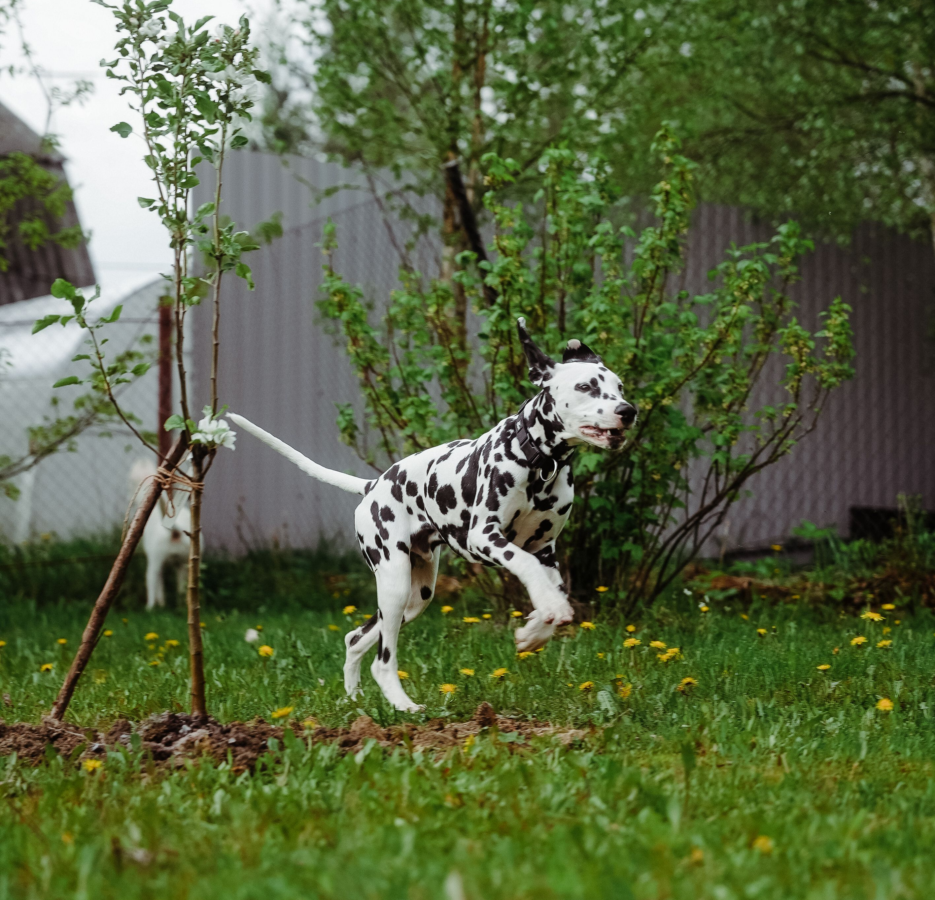
CONCLUSION
A complete video-to-timeline workflow
Upload a video.
Review its activity.
Play the relevant interval.
Frontend demonstration
Group 28
Notes:
Suggested duration: 15 seconds
ENGLISH
The complete pipeline produces a behaviour timeline from video. We will now show the frontend demonstration.
中文对照
完整流程从视频生成行为时间线，接下来演示前端。

