Slide 1
Auto-Accounting
Hands-free personal expense tracking from notifications
Xiaoyu Zhao(Zhaotiezhu2333)
Zizhen Shao(lbxy128)

Slide 2
The Problem
Manual expense tracking is tedious and incomplete
Data is fragmented across banks and payment apps
Budgeting insights arrive too late (end of month)
2

Slide 3
Our Insight
Payment notifications contain time, amount, and merchant
If we parse them reliably, we enable zero-effort bookkeeping
3

Slide 4
Solution (One-liner)
Android app listens to payment notifications, parses key fields, saves to Room,
and visualizes monthly spending — no typing required
4

Slide 5
Product Overview
Listens to Google Pay/Wallet (extensible to other apps)
Parses time, description, amount; stores locally (Room)
Monthly bar chart; export as PNG
Simple onboarding: notification & storage permissions
5

Slide 6
How It Works (Flow)
User taps Start after granting permissions
NotificationListenerService captures payment notifications
Regex-based parser extracts amount & merchant; timestamp from notification
Room DAO writes {time, description, amount} on a background thread
ChartActivity aggregates by day and renders the monthly bar chart
User exports the chart via SAF
6

Slide 7
User Journey
First launch: grant Notification Access and Storage permission
Tap Start to begin tracking
Make a purchase: entry appears automatically
Open Chart to view current month totals
Tap Export to save PNG
7

Slide 8
Tech Stack
Android (Java/Kotlin, Java 11 compatibility)
Room/SQLite, DAO time-range queries & daily aggregation
ExecutorService for background IO; Java Time (YearMonth/LocalDate)
XML layouts; Canvas drawing; Storage Access Framework (SAF)
NotificationListenerService for capture
8

Slide 9
Architecture (High-level)
notify/: GPayListenerService → parse & persist
data/db/: Table, TableDao, AppDb (Room)
data/repo/: TableWriter (single-threaded IO)
ui/: Main (permissions) → Start (tracking) → Chart (visualize/export)
Separation of capture → persist → present
9

Slide 10
Privacy & Safety
All data stays on-device (no cloud)
Reads notification content only; user can stop anytime
Exports are explicit via SAF
10

Slide 11
What We Built (Demo)
End-to-end pipeline on device
Real-time ingestion → DB → monthly chart in one tap
Exported PNG example (insert screenshot)
11

Slide 12
Limitations (Today)
Parser tuned for Google Pay/Wallet English/Chinese patterns
Basic visualization (bar chart), limited interactivity
Early UI/UX; limited customization
12

Slide 13
Roadmap
Experience & Customization
UI polish; smoother onboarding, empty states, theming
Per-transaction notes; basic editing
Budget goal with donut progress ring
Analytics & Data
Tap-to-drill-down (day, merchant)
Categories (auto/manual), weekly trends
More payment apps/banks; multi-currency; CSV export/backups
13

Slide 14
Impact & Next Steps
Frictionless capture → more complete data
Actionable monthly insights with zero manual input
Next: polish UI, budgets & drill-downs, broaden coverage
14

Slide 15
Backup
Details & references
15

Slide 16
Regex & Parsing Strategy (Examples)
Currency prefix/suffix patterns; merchant hints (at/to/with/向/给)
Fallback to app label if merchant missing
Robustness for thousand separators and decimals
16

Slide 17
Room Schema & DAO
Entity: Table { timeMillis, description, amountMinor }
DAO: queryByTimeRange(start, end), sumByDay(start, end)
Single-threaded IO via TableWriter
17

Slide 18
Permissions UX
Notification Access settings deep-link
Storage permission (legacy); SAF for export
Start button gates capture (TrackingManager)
18

Slide 19
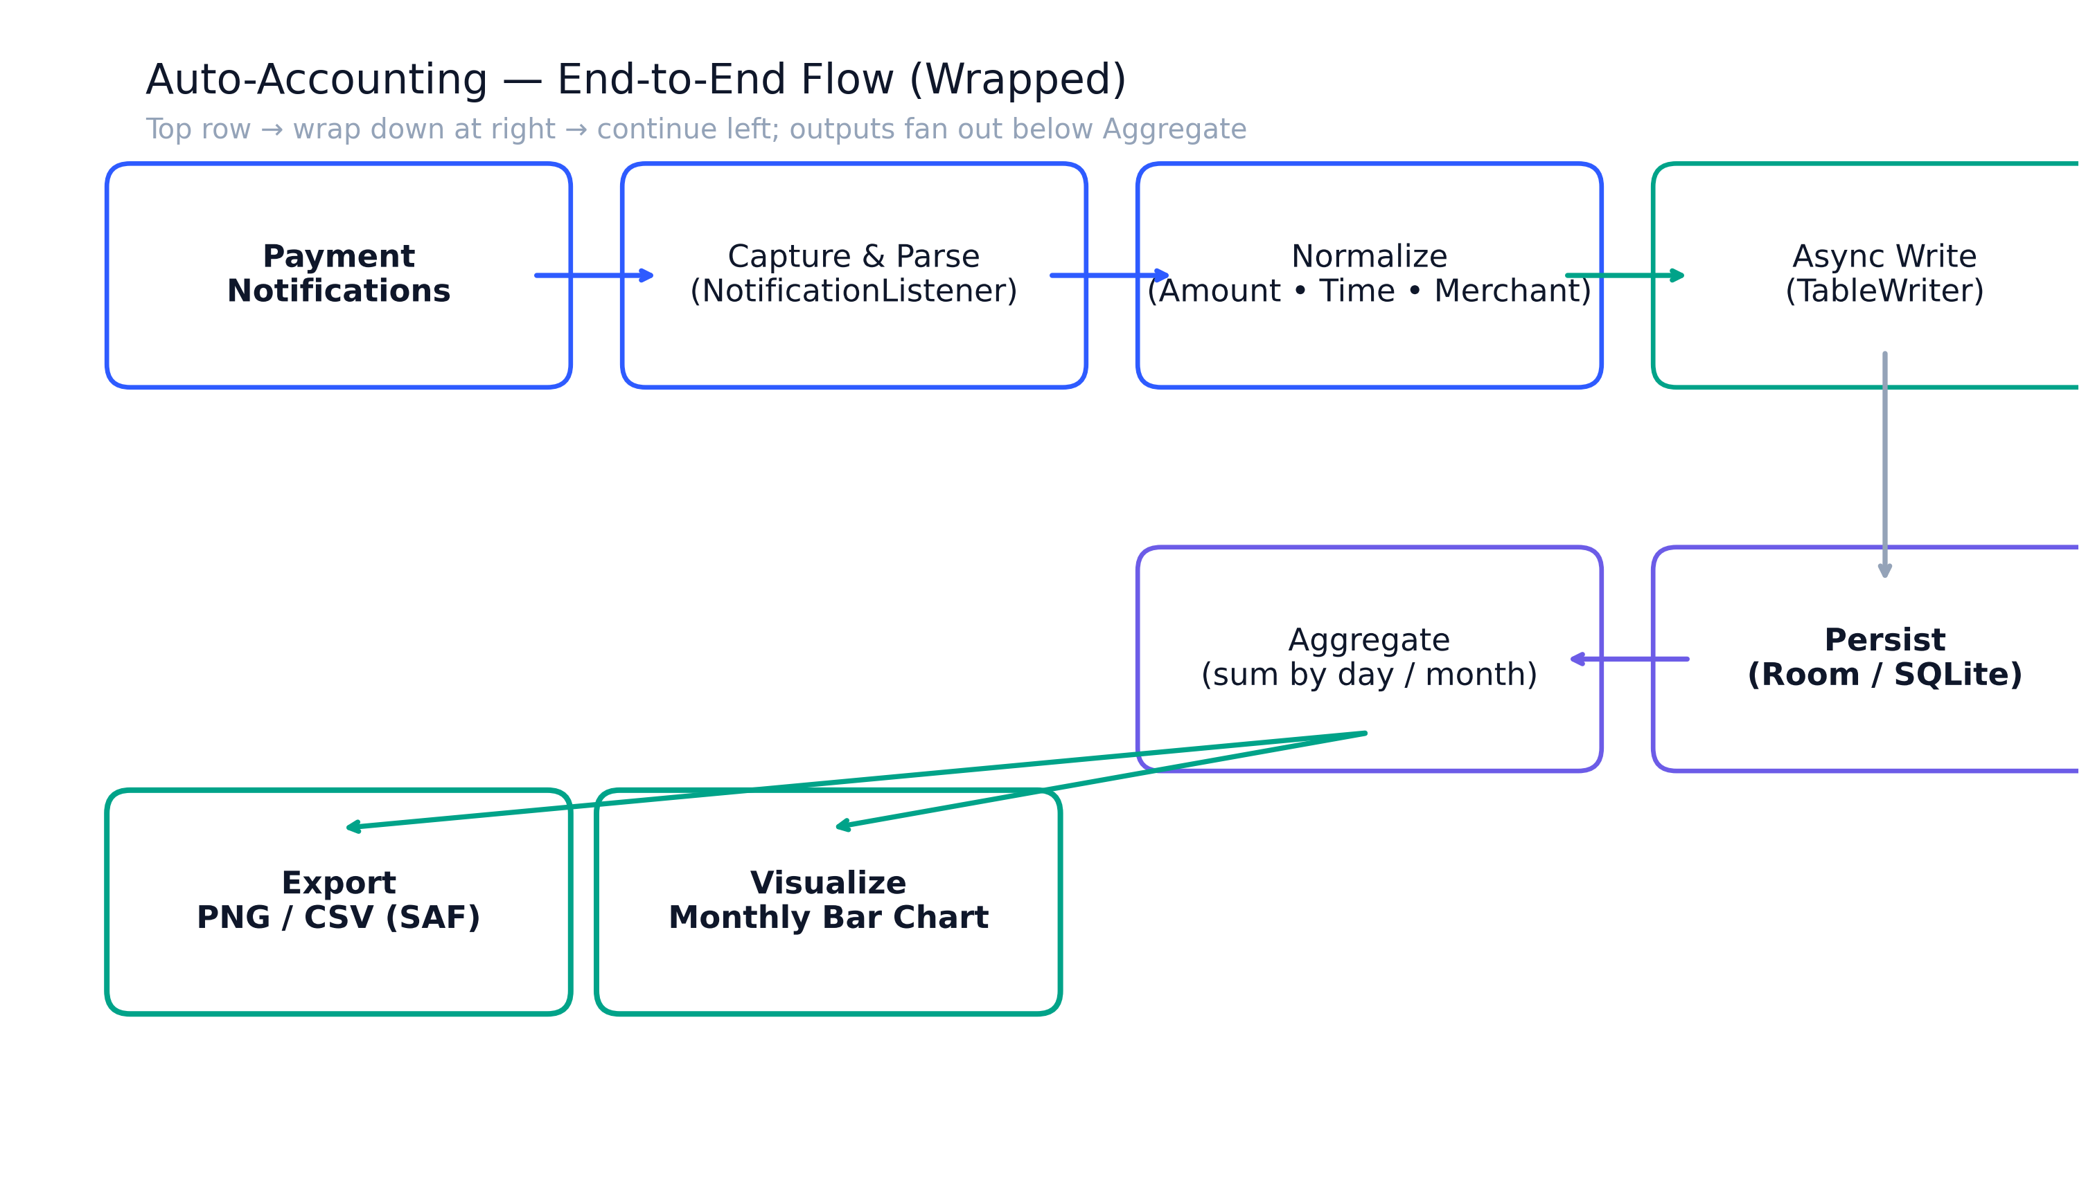
End-to-End Pipeline

Slide 20
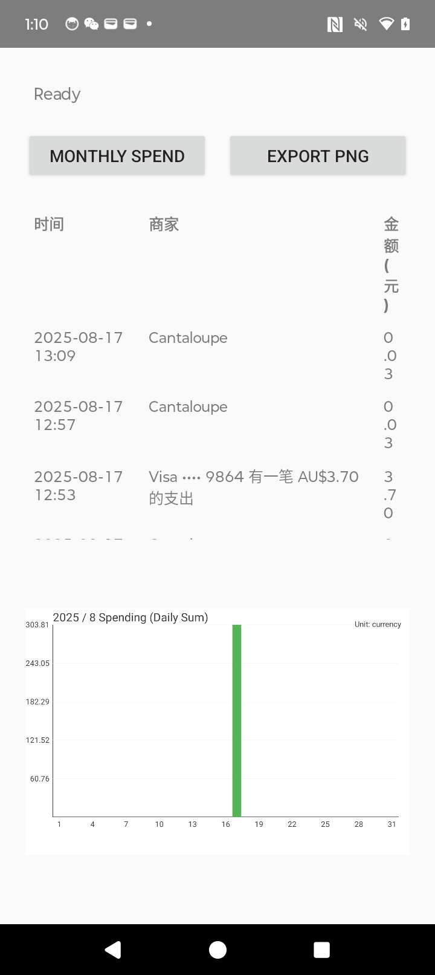
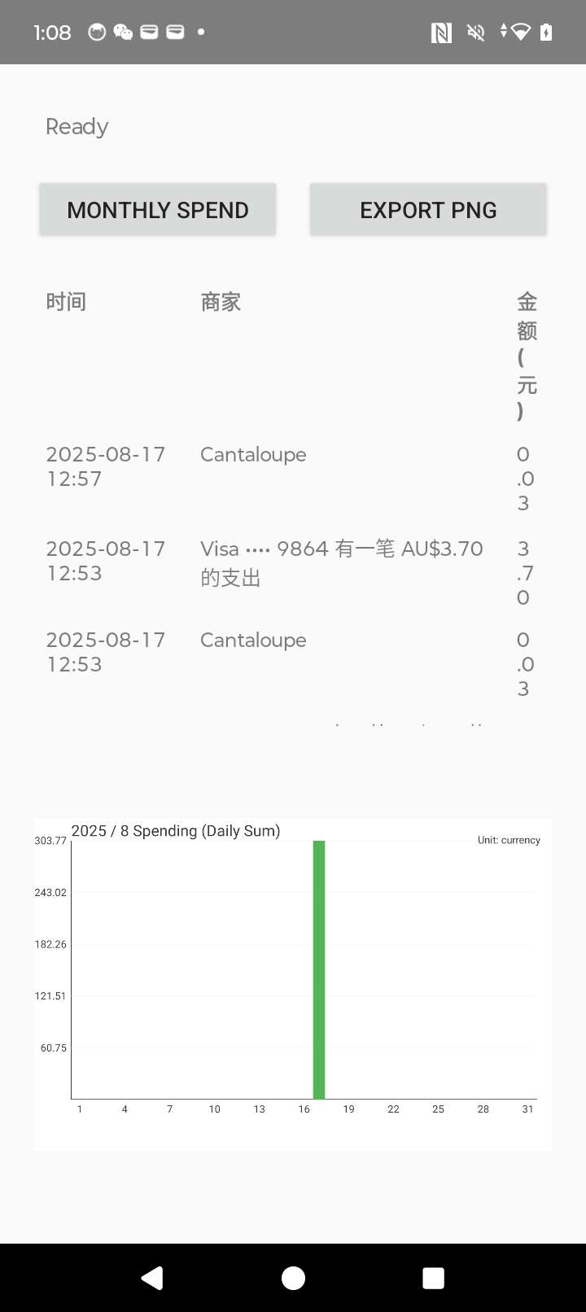
App Screenshots

Slide 21
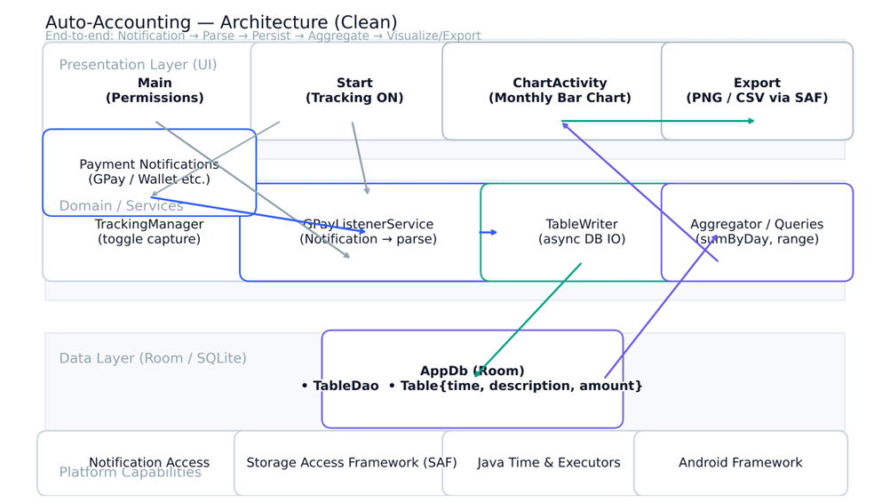
Architecture Diagram

