Slide 1
KICGPT - KICMISTRAL

Slide 2

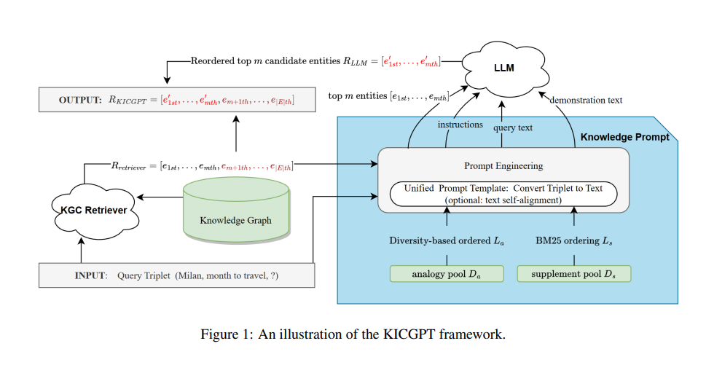
Methology:

Slide 3
Comparison &Inspiration using SMALL Test Dataset
100 samples | Mistral-7B-Instruct-v0.1 |  |  |  | Mistral-7B-Instruct-v0.1 tsa
Candidates | MRR | Hits@1 | Hits@3 | Hits@10 | MRR | Hits@1 | Hits@3 | Hits@10
10 | 0.1886 | 0.1200 | 0.2300 | 0.3200 | 0.1456 | 0.1000 | 0.1800 | 0.2300
20 | 0.1760 | 0.1300 | 0.2000 | 0.2600 | 0.1430 | 0.0900 | 0.1700 | 0.2600
30 | 0.1895 | 0.1200 | 0.2400 | 0.3100 | 0.1349 | 0.0700 | 0.2000 | 0.2300
40 | 0.1681 | 0.1200 | 0.2000 | 0.2600 | 0.1580 | 0.1200 | 0.1700 | 0.2300
50 | 0.1005 | 0.0300 | 0.1600 | 0.2000 | 0.1858 | 0.1200 | 0.2200 | 0.3000
*Use the first 100 samples from the test dataset of WN18RR // The format of outputs vary

Slide 4
GIVE UP MISTRAL 7B

Slide 5
Hyper : Candidates, tsa or not
100 samples | KICMistral 8X7B-50 |  |  |  | KICMistral 8X7B-50 tsa
Candidates | MRR | Hits@1 | Hits@3 | Hits@10 | MRR | Hits@1 | Hits@3 | Hits@10
10 | 0.3260 | 0.2400 | 0.3800 | 0.5400 | 0.3383 | 0.2300 | 0.4400 | 0.5500
20 | 0.3241 | 0.2300 | 0.3800 | 0.5300 | 0.3424 | 0.2500 | 0.3800 | 0.5400
30 | 0.3079 | 0.2000 | 0.3800 | 0.5200 | 0.3001 | 0.1900 | 0.3500 | 0.5400
40 | 0.3446 | 0.2600 | 0.4000 | 0.5100 | 0.3206 | 0.2000 | 0.4000 | 0.5700
50 | 0.3523 | 0.2500 | 0.4100 | 0.5600 | 0.3064 | 0.2000 | 0.3800 | 0.5000
*Use the first 100 samples from the test dataset of WN18RR // The format of outputs vary

Slide 6
Possible Reason
This may be because these demonstrations and aligned text are mutually supportive, which enhances the confidence of LLM to understand correct semantics, but for relations that LLM does not understand well. the aligned texts may not convey the true semantics.

Slide 7
Hyper : eff_demon_step
100 samples | KICMistral
eff_demon_step | MRR | Hits@1 | Hits@3 | Hits@10
1 | 0.3149 | 0.1900 | 0.3800 | 0.5500
2 | 0.3200 | 0.1900 | 0.4000 | 0.5700
3 | 0.3432 | 0.2200 | 0.4300 | 0.5700
4 | 0.3229 | 0.2100 | 0.4200 | 0.5600
5 | 0.3336 | 0.2300 | 0.3900 | 0.5400
6 | 0.3388 | 0.2300 | 0.3700 | 0.5600
7 | 0.3748 | 0.2600 | 0.4600 | 0.6200
8 | 0.3204 | 0.2300 | 0.3700 | 0.5100
9 | 0.3571 | 0.2400 | 0.4200 | 0.5800
10 | 0.3523 | 0.2500 | 0.4100 | 0.5600
*Use the first 100 samples from the test dataset of WN18RR // The format of outputs vary

Slide 8
eff_demon_step=7

Slide 9
Comparison based on WN18RR
 | MRR | Hits@1 | Hits@3 | Hits@10
KICGPT | 0.549 | 0.474 | 0.585 | 0.641
KICGPT tsa | 0.581 | 0.478 | 0.612 | 0.677
KICMistral 8X7B-10 | 0.2992 | 0.2176 | 0.3577 | 0.4579
KICMistral 8X7B-50 | 0.3338 | 0.2317 | 0.3950 | 0.5265

